Slide 1
BGP
v0.083

Slide 2
Statement and Acknowledgement :
This tool is deeply customized and copied by deap and sympy.
This tool is advised to personal and non-commercial use.
This tool is with GNU license and with NO WARRANTY.
Email: 986798607@qq.com
License: GNU Lesser General Public License v3.0
Cite:

Slide 3
Introduction
This tool is a symbol regression tool with dimension calculation,
which is aimed at establish expressions with physical limitation.
Features:
coefficient fitting and addition
dimension calculation
accumulative operation and free custom
characteristics feedback
high efficiency parallelism

Slide 4
Example (One example)
SymbolTree (The genetic code)
SymbolSet (Preparation set of feature and operation )
CalculatePrecision (Collection of calculation)
Functions type (Function definition and calculate rules)
Dim (Dimension definition and calculation)
Coefficient and constant (coefficient and constant definition)
Probability and control (users Probability and features bonding)
Flow
Manual
Contents

Slide 5
if __name__ == "__main__":
from sklearn.datasets import load_boston
from bgp.base import SymbolSet
from bgp.dim import dless, Dim
from bgp.flow import BaseLoop # data data = load_boston() x = data["data"] y = data["target"] c = [6, 3, 4]
# unit from sympy.physics.units import kg x_u = [kg] * 13 y_u = kg c_u = [dless, dless, dless] # Dim, the dim also could get by Dim(numpy.array([****])) directly. x, x_dim = Dim.convert_x(x, x_u, target_units=None, unit_system="SI") y, y_dim = Dim.convert_xi(y, y_u) c, c_dim = Dim.convert_x(c, c_u) # symbolset pset0 = SymbolSet() pset0.add_features(x, y, x_dim, y_dim, group=[[1, 2], [4, 5]]) pset0.add_constants(c, dim=c_dim, prob=None) pset0.add_operations(power_categories=(2, 3, 0.5), categories=("Add", "Mul", "Neg", "Abs"), self_categories=None) # run bl = BaseLoop(pset=pset0, gen=8, pop=500, hall=2, batch_size=50, n_jobs=10, re_Tree=0, store=False) result = bl.run()
print(result.items[0])
Example
Data import
Unit
(optional)
Dim
(optional)
Preparation set
add features, constants and operations.
Flow and loop
set parameters to run

Slide 6

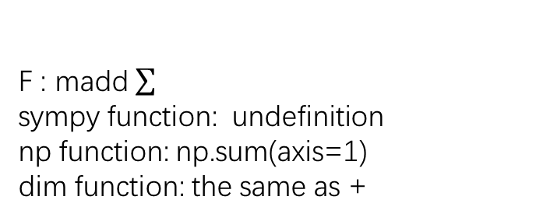
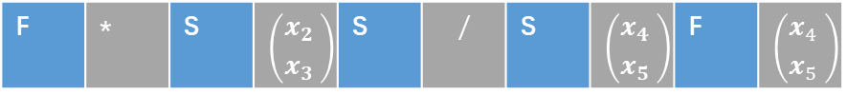
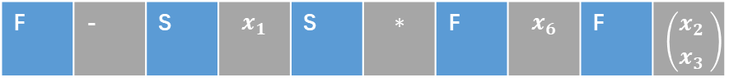


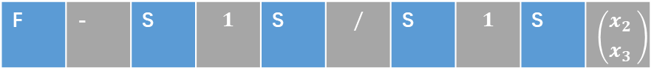
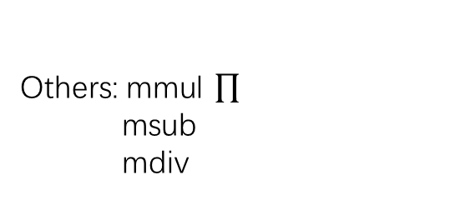
Expression and Tree Code
F | - | S | $$x_{1}$$ | S | $$∗$$ | F | $$x_{6}$$ | F | $$\left({x_{2} \atop x_{3} }\right)$$
$${x_{1}−x}_{6}∗(x_{2}+x_{3})$$
F | - | S | $$1$$ | S | $$/$$ | S | $$1$$ | S | $$\left({x_{2} \atop x_{3} }\right)$$
$$1−(\frac{1}{x_{4}}+\frac{1}{x_{5 }})$$
F | * | S | $$\left({x_{2} \atop x_{3} }\right)$$ | S | $$/$$ | S | $$\left({x_{4} \atop x_{5} }\right)$$ | F | $$\left({x_{4} \atop x_{5} }\right)$$
$$\frac{x_{2}x_{4}+x_{3}∗x_{5}}{x_{4}+x_{5}}$$
F : madd
sympy function: undefinition
np function: np.sum(axis=1)
dim function: the same as +
S : self
sympy function: lambda x:x
np function: lambda x:x
dim function: lambda x:x
Others: $\text{mmul} \prod{}$
msub
mdiv

Slide 7
Contain
Method
Attribute
SymbolTerminal
.generate(SymbolSet)
self.p_name
self.dim
self.pre_y
self.expr
Produce the Tree from symbolset
SymbolTree
(…_ExprTree)
SymbolConstant
.depart(SymbolSet)
depart the Tree to subtree
SymbolPrimitive
Symbol Tree
树状表达式
. capsule(SymbolSet)
get a short type of tree
only contain name

Slide 8
Contain
Method
Method
.add_operations
Add operations in Preparation set
.set_personal_maps
.add_accumulative_operation
Set personal preferences on features probability, by single point.
see also: preamp.set_sigle_point
Add accumulative operations in Preparation set
SymbolSet
. add_features
Add features in Preparation set
.bonding_personal_maps
. add_constants
Set personal preferences on features probability,by cut others point
see also: premap.down_other_point
Preparation set
组件合集
Add constants in Preparation set
. add_tree_to_features
Add SymbolTree in Preparation set back as a terminals,and assign a new name
. compress
Delet details for zip. Use after add all.

Slide 9
Contain
Method
Attribute
. Calculate_simple()
calulate the Tree from symbolset
Return the SymbolTree self,but resite the attribute
self.pset = pset
self.terminals = pset.terminals + pset.constants
# list of sympy.Symbol, features and constants
self.dim_x=
pset.get_values(pset.dim_ter_con)
# list of dims
self.data_x = pset.data_x # list of xi
self.dim_map = pset.dim_map
self.np_map = pset.np_map
self.y = pset.y # list of y
self.filter_warning = filter_warning
self.scoring = scoring
. Calculate_detial()
CalculatePrecision
SymbolSet
calulate the Tree from symbolset
Return the SymbolTree self,but resite the attribute
CalculatePrecision
数值计算，量纲计算
. Calculate_parallize()
calulate the Tree from symbolset
Return the
score,
dimension,
and dim_score

Slide 10
Expressions
SymbolTree
CP.Calculate
ST.generate
Each circle
CP.__init__
CalculatePrecisionSet
SymbolSet
2+ circle
（if add trees as new features）
Calculation parameters
.add_tree_to_features
Add SymbolTree in set back as a terminals, and assign a new name, value, dim
Constituent elements
Flow relationship between 3 base objects

Slide 11
Functions Type
String_name = repr(SymbolTree)
Sympy_expr = compile_(SymbolTree,…)
Func = lambdify_(Sympy_expr,…)
Y_pre = Func(x)
Y = score(Y_true,Y_pre)
Func = lambdify_(Sympy_expr,…)
Y_dim = Func(x_dim)
“func_name”
func_map
Sympy function
Calculation rules
计算规则
1.universal operation are with 3 function.
常见内置规则同时定义3个函数。
2.self operation is without sympy function, which is constructed automatedly.
自定义规则不定义 sympy function, 默认使用Sympy. Function 创建。
np_map
Numpy function
Dim_map
Dim function
SymbolTree
(…_ExprTree)
CP.Calculate
CalculatePrecision
SymbolSet

Slide 12
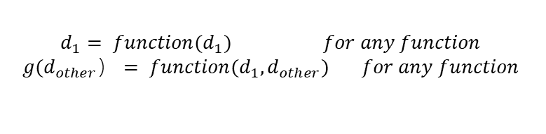
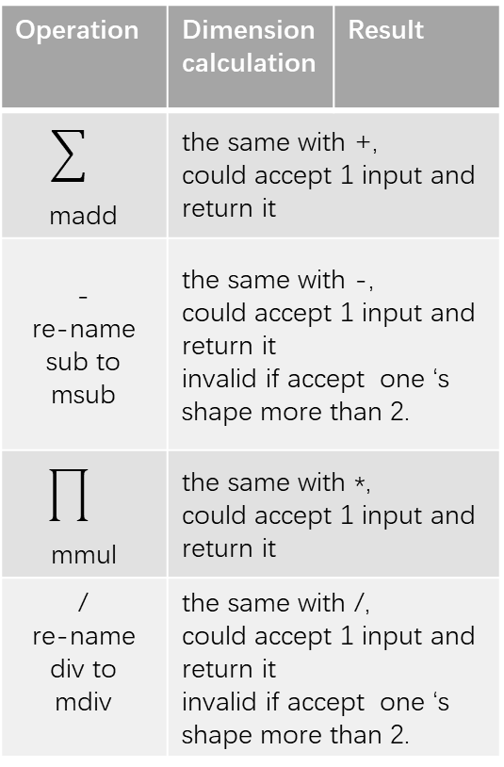
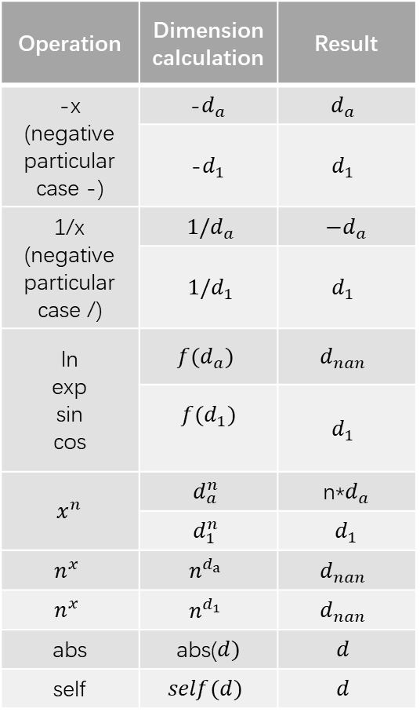
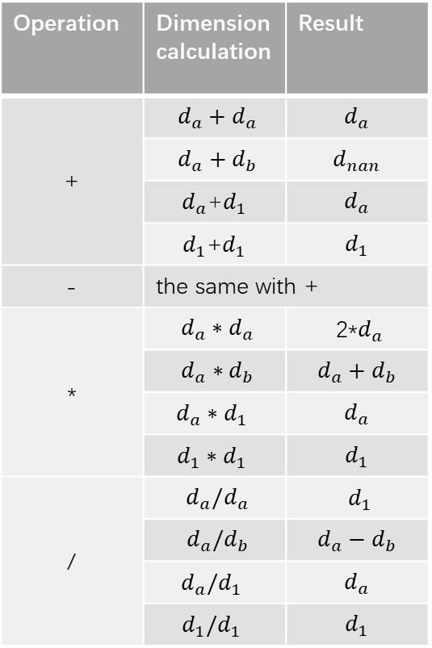
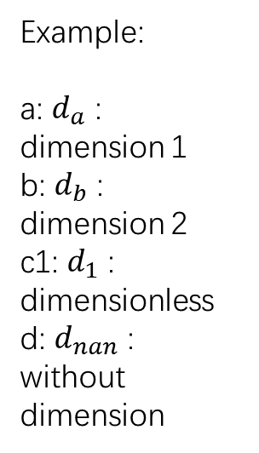
Dimension calculation
Operation | Dimension calculation | Result
-x (negative particular case -) | -$d_{a}$ | $$d_{a}$$
 | -$d_{1}$ | $$d_{1}$$
1/x (negative particular case /) | $1/d_{a}$ | $−d_{a}$
 | $1/d_{1}$ | $$d_{1}$$
ln exp sin cos | $${f(d}_{a})$$ | $$d_{nan}$$
 | $${f(d}_{1})$$ | $$d_{1}$$
$x^{n}$ | $$d_{a}^{n}$$ | n*$d_{a}$
 | $$d_{1}^{n}$$ | $$d_{1}$$
$$n^{x}$$ | $$n^{d_{a}}$$ | $$d_{nan}$$
$$n^{x}$$ | $$n^{d_{1}}$$ | $$d_{nan}$$
abs | abs($d)$ | $$d$$
self | $$self(d)$$ | $$d$$
Operation | Dimension calculation | Result
+ | $$d_{a}+d_{a}$$ | $$d_{a}$$
 | $$d_{a}+d_{b}$$ | $$d_{nan}$$
 | $d_{a}$+$d_{1}$ | $$d_{a}$$
 | $d_{1}$+$d_{1}$ | $$d_{1}$$
- | the same with +
* | $$d_{a}∗d_{a}$$ | 2*$d_{a}$
 | $$d_{a}∗d_{b}$$ | $$d_{a}+d_{b}$$
 | $$d_{a}∗d_{1}$$ | $$d_{a}$$
 | $$d_{1}∗d_{1}$$ | $$d_{1}$$
/ | $$d_{a}/d_{a}$$ | $d_{1}$
 | $$d_{a}/d_{b}$$ | $$d_{a}−d_{b}$$
 | $$d_{a}/d_{1}$$ | $$d_{a}$$
 | $$d_{1}/d_{1}$$ | $$d_{1}$$
Operation | Dimension calculation | Result
madd | the same with +, could accept 1 input and return it
- re-name sub to msub | the same with -, could accept 1 input and return it invalid if accept one ‘s shape more than 2.
mmul | the same with *, could accept 1 input and return it
/ re-name div to mdiv | the same with /, could accept 1 input and return it invalid if accept one ‘s shape more than 2.
Example:
a: $d_{a}$ : dimension 1
b: $d_{b}$ : dimension 2
c1: $d_{1}$ : dimensionless
d: $d_{nan}$ : without dimension
$$d_{1}= function(d_{1}) for any function$$
$$g(d_{other}）= function(d_{1},d_{other}) for any function$$
$$d_{nan}= function(d_{nan}) for any function$$
$$d_{nan}= function(d_{nan},d_{other}) for any function$$

Slide 13
Contain
Method
Attribute
.__xx__
operator overloading
self.unit_map = {'meter': "m", 'kilogram': "kg", 'second': "s", 'ampere': "A", 'mole': "mol", 'candela': "cd", 'kelvin': "K"}
self.unit = SI._base_units
self.dim = ['length', 'mass', 'time', 'current', 'amount_of_substance', 'luminous_intensity', 'temperature']
.isinteger
0
0
0
0
0
0
0
.is_same_base
is_same_base,such as m, m^3
Dim
.convert_to_Dim
Get scale and Dim from sympy.physics.unit
.convert_x
Dim
量纲
Get scaled x and Dim from x and sympy.physics.unit
.inverse_convert
Default is SI system, with 7 member.
Can be set as other system with less than 7,such as MKS system ('meter': "m", 'kilogram':)
Get sympy.physics.unit from Dim
.inverse_convert_x
Get scaled x and sympy.physics.unit from Dim

Slide 14
Dim obtain
Method 1: convert from sympy.physical.unit
>>>from sympy.physics.units import kg >>>y_u = kg >>>y_dim = Dim.convert_to_Dim (x_u, target_units=None, unit_system="SI")
Method 2: The dim also could get by Dim(numpy.array([****])) directly.
>>>y_dim = Dim(np.array([0,1,0,1,0,0,0]))
Others quick function:
Dim.convert_to_Dim for sigle unit 转换一个单位
Dim.convert_x for units_x and X 转换多个单位，并将换算因子放到X
Dim.convert_xi for single unit_y and y 转换一个单位，并将换算因子放到值
（用于y 或者单个xi)

Slide 15
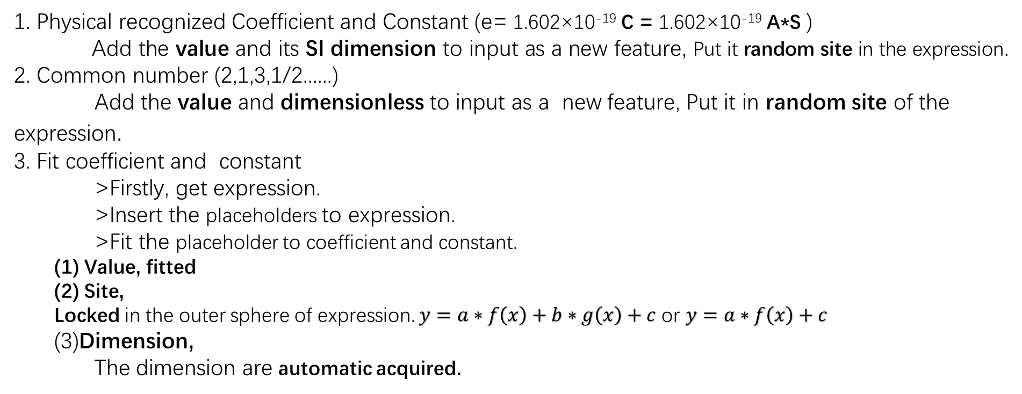
Coefficient and Constant
1. Physical recognized Coefficient and Constant (e= 1.602×10⁻¹⁹ C = 1.602×10⁻¹⁹ A*S )
Add the value and its SI dimension to input as a new feature, Put it random site in the expression.
2. Common number (2,1,3,1/2......)
Add the value and dimensionless to input as a new feature, Put it in random site of the expression.
3. Fit coefficient and constant
>Firstly, get expression.
>Insert the placeholders to expression.
>Fit the placeholder to coefficient and constant.
Value, fitted
Site,
Locked in the outer sphere of expression. $y=a∗f\left(x\right)+b∗g\left(x\right)+c$ or $y=a∗f\left(x\right)+c$
(3)Dimension,
The dimension are automatic acquired.

Slide 16
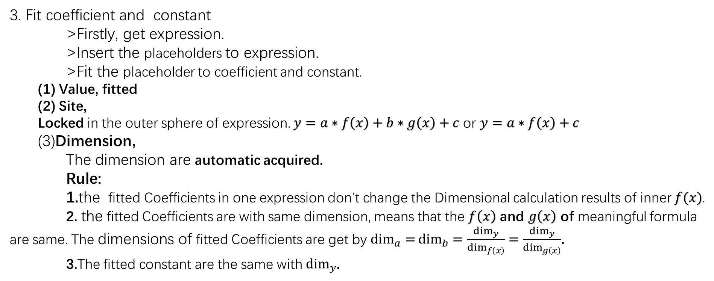
Coefficient and Constant
3. Fit coefficient and constant
>Firstly, get expression.
>Insert the placeholders to expression.
>Fit the placeholder to coefficient and constant.
Value, fitted
Site,
Locked in the outer sphere of expression. $y=a∗f\left(x\right)+b∗g\left(x\right)+c$ or $y=a∗f\left(x\right)+c$
(3)Dimension,
The dimension are automatic acquired.
Rule:
1.the fitted Coefficients in one expression don’t change the Dimensional calculation results of inner $f(x)$.
2. the fitted Coefficients are with same dimension, means that the $f\left(x\right)$ and $g\left(x\right)$ of meaningful formula are same. The dimensions of fitted Coefficients are get by $\dim_{a}{=}\dim_{b}=\frac{\dim_{y}}{\dim_{f\left(x\right)}}$ $=\frac{\dim_{y}}{\dim_{g\left(x\right)}}$.
3.The fitted constant are the same with $\dim_{y}$.

Slide 17



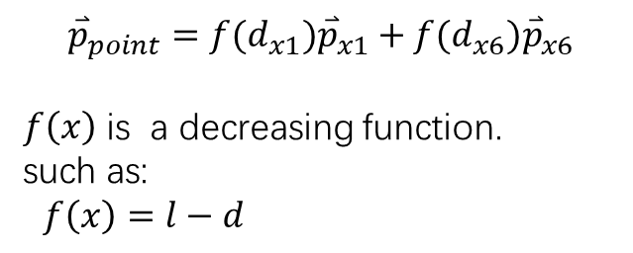

Probability and Control
. | x1 | x2 | x3 | x4 | x5 | x6 | x7
x1 | 0.01 | 0.2 | 0.4 | 0.2 | 0.3 | 0.1 | 0.3
x2 | 0.2 | … | … | … | … | … | …
x3 | 0.4 | … | … | … | … | … | …
x4 | 0.2 | … | … | … | … | … | …
x5 | 0.3 | … | … | … | .. | … | …
x6 | 0.1 | … | … | … | … | … | …
x7 | 0.3 | … | … | … | … | … | …
Example individual
probability maps are used to control the choice terminals(features and constant)
:
2D Diagonal maps is used to choice
terminals at the affect no other terminals.
:
1D probability map is used to choice terminals when there is no other terminals.
Note:
the summary of all the probability maybe not 1.
Just relative size makes sense
when relative proportion is 1, the two features is bonding forcedly.
$$l$$
F | - | S | $$x_{1}$$ | S | $$∗$$ | F | $$x_{6}$$ | F | ?
$$d_{x6}$$
$$d_{x1}$$
2 D Diagonal matrix (probability map)
the ? would consider the presented x1,x6
$${\overset{⃑}{p}}_{point}={f(d_{x1})\overset{⃑}{p}}_{x1}+f({d_{x6})\overset{⃑}{p}}_{x6}$$
$f\left(x\right)$ is a decreasing function.
such as:
$f\left(x\right)=l−d$
x1 | x2 | x3 | x4 | x5 | x6 | x7
0.3 | 0.2 | 0.4 | 0.2 | 0.3 | 0.1 | 0.3
1 D probability map

Slide 18
Contain
Method
Method
get_indexes_value
. down_other_point
get the values list of one index
decrease the value of others and increase target point
update
update values by individuals
PreMap
(np.ndarray)
. set_sigle_point
set the single couple point but don’t change others.
get_one_node_value
get the probability values list of one point of individual
weight by distance to the point
2 D Diagonal matrix (probability map)
probability of choice
at others already existed
. set_ratio_point
set the ratio on value of point
get_nodes_value
get the probability values list of a few points of individual
weight by distance to the point
. set_ratio
prob
set the ratio of summary value on point
get_ind_value
1 D probability map
probability of single choice
get the probability values of individual
average weighted

Slide 19
inner key flow
Flow details
preprocessing
+-*/ ln, ……
flow
Dim
.convert_x
SymbolSet
(CalculatePrecisionSet)
Population
(SymbolTree)
X, y, c, X_dim,
y_dim, c_dim
Add as new features
Refresh SymbolSet
X, y, c,
x_unit, y_unit,
c_unit
Calculation
(CalculatePrecisionSet)
Select
(kbest)
Elite Selection
(kdimbest)
Decompose
Crossover and mutate
Next generation

Slide 20
inner key flow
Flow Partition
preprocessing
+-*/ ln, ……
flow
Dim
.convert_x
SymbolSet
(CalculatePrecisionSet)
Population
(SymbolTree)
X, y, c, X_dim,
y_dim, c_dim
Add as new features
Refresh SymbolSet
X, y, c,
x_unit, y_unit,
c_unit
Calculation
(CalculatePrecisionSet)
1
Select
(kbest)
Prepration set
Elite Selection
(kdimbest)
Decompose
Preprocessing
Crossover and mutate
Next generation
2
BaseLoop

Slide 21
Probability of Flow details
refresh and auto-learning
SymbolSet
(CalculatePrecisionSet)
Population
(SymbolTree)
generate uniform prob(1D,2D)
and Artificial preference setting
Add as new features
to SymbolSet
Calculation
(CalculatePrecisionSet)
Select
(kbest)
Elite Selection
(kdimbest)
Decompose
Crossover and mutate
auto-learning and refresh prob 2D
Next generation
using

Slide 22
1
Prepration set parameter and method
parameter | Type | Doc | Chinese
.add_operations .add_accumulative_operation
power_categories=None, | list of int | power function | 添加幂函数，指数
categories | list of str | function | 常见函数
self_categories=None, | list of list of 5 member | self definition | 自定义函数 (详情见文档)
power_categories_prob="balance", | int,str | probility of power categories | 添加幂函数出现概率
categories_prob="balance", | int,str | probility of categories | 常见函数函数出现概率
special_prob=None | dict | specific probility of categories | 指定某函数出现概率

Slide 23
1
Prepration set parameter and method
parameter | Type | Doc | Chinese
add_features add_constants
x | np.ndarray 2D | feature values | 特征值
y | np.ndarray | target value | 目标值
x_dim | list of Dim | feature dimensions | 特征量纲 若为1，默认全部无量纲
y_dim | Dim | target dimensions | 目标量纲 若为1，默认无量纲
prob | None, list of float the same size wih x.shape[1] | 1D sigle choice probability | 单特征出现概率
group | list of list | group features index | 特征分组，强制绑定在一起计算
feature_name | None, list of float the same size wih x.shape[1 | feature name | 初始特征名字，若用，仅用于展示
bonding_personal_maps set_personal_maps
sv | list of 3 member’s list | set value of interaction map such as [[3,4,0.5],[5,6,0.03]] | 定制特征互影响概率

Slide 24
2
Flow loop parameter
Parameter | Type | Doc | Chinese
pset | SymbolSet | the feature x and traget y and others should have been added. | 已经添加好特征常数，运算符的准备序列
pop | int | number of population | 遗传种群大小
gen | int | generation | 遗传代数
mutate_prob | float [0,1) | probability of mutate | 变异概率
mate_prob | float [0,1) | probability of mate(crossover) | 交叉概率
initial_max | int | max initial size of expression | 初始个体(表达式)尺寸上限
max_value | int | max size of expression | 个体(表达式)尺寸上限
hall | int >=1 | number of HallOfFame(elite) to maintain | 精英个数
re_hall | None, int>=2 | number of HallOfFame to add to next generation. | 回馈精英个数
re_Tree | int | number of new features to add to next generation. | 每次循环，个体作为新特征个数
personal_map | bool or “auto” | "auto" is using premap and with auto refresh the premap with individual True is just using constant premap False is just use the prob of terminals | 是否使用互影响概率（2D），以及是否自动更新

Slide 25
2
Flow loop parameter
Parameter | Type | Doc | Chinese
scoring | list of Callbale | default is [sklearn.metrics.r2_score], scores to evaluate the (y_true, y_calculate) | 评分列表，若使用多评分，请保证这些评分可以加权平均
score_pen | tuple of float | >0 : max problem, best is positive, worse -np.inf <0 : min problem, best is negative, worse np.inf if multiply score method, the scores must be turn to same dimension in preprocessing or weight by score_pen. Because the all the selection are stand on the mean(w_i*score_i). default (1,) | 最大值问题为（1，） 最小值问题为（-1，） 多评分问题（0.6，0.4）加权平均
add_coef | bool | add coef in expression or not. | 是否添加系数项
inter_add | bool | add intercept in expression or not. | 是否添加截距项
inner_add:bool | bool | add coef to inner expression or not. | 系数项可否到公式内部
cal_dim | bool | the dim calculation | 是否计算量纲
dim_type | Dim or None or list of Dim | "coef": af(x)+b. a,b have dimension, f(x) is not dnan. "integer": in af(x)+b. f(x) is interger dimension. [Dim1,Dim2]: f(x) in list. Dim: f(x) ~= Dim. (see fuzzy) Dim: f(x) == Dim. None: f(x) == pset.y_dim | 目标量纲
fuzzy | bool | choose the dim with same base with dim_type, such as m,m^2,m^3. | 放宽量纲限制到 同底量纲
more
strict

Slide 26
2
Flow loop parameter
Parameter | Type | Doc | Chinese
stats: | dict | details of logbook to show. default is stats = {“fitness_dim_is_target“: ("mean",), "dim_is_traget": ("sum",)} | 记录统计（详情见文档） 此记录与精英记录hall独立。可以查看更多信息，精英hall只对最好个体保存。 两者对应结果，即打印结果和输出结果可能为不同信息。
verbose | bool | print verbose logbook or not | 动态打印记录统计
tq | bool | print progress bar or not | 进度条
store | bool,or str of path | store | 默认存储当前文件夹下。 若为字符串，请保证字符串为路径
filter_warning | bool | filter_warning | 是否过滤警告
n_jobs | int default 1, advise 6 | paralyze number | 并行参数
batch_size | int, default 40, depend of machine | batch_size to calcalation | 分批大小
random_state: | None,int | np.random seed | 随机种子

