Slide 1
Cardiovascular Risk Prediction
CAPSTONE PROJECT
Presented By:
Ashok Bolisetty – NRI Institute of Technology

Slide 2
OUTLINE
Problem Statement
Proposed System/Solution
System Development Approach
Algorithm & Deployment
Result
Conclusion
Future Scope
References

Slide 3
Problem Statement
Example: The dataset is from an ongoing cardiovascular study on residents of the town of Framingham, Massachusetts. The classification goal is to predict whether the patient has a 10-year risk of future coronary heart disease (CHD). The dataset provides the patients’ information. It includes over 4,000 records and 15 attributes. Each attribute is a potential risk factor. There are both demographic, behavioral, and medical risk factors.

Slide 4
Proposed Solution
The proposed system aims to address the challenge of predicting the required you can develop a robust and reliable cardiovascular risk prediction model that can assist healthcare professionals in identifying individuals at higher risk of cardiovascular disease and guide preventive interventions and treatment strategies. The solution will consist of the following components:
Data Collection:
Gather data from reliable sources such as health institutions, research databases, or publicly available datasets like NHANES (National Health and Nutrition Examination Survey).
Collect information on demographics (age, gender), lifestyle factors (smoking status, physical activity), medical history (diabetes status, hypertension), and clinical measurements (blood pressure, cholesterol levels).
Data Preprocessing:
Clean the dataset by handling missing values, outliers, and inconsistencies.Normalize numerical features to a standard scale
Encode categorical variables (e.g., gender, smoking status) using one-hot encoding or label encoding.
Feature Engineering:
Extract additional features such as body mass index (BMI), calculated from height and weight measurements.
Create derived features like blood pressure categories (e.g., normal, prehypertension, hypertension).
Exploratory Data Analysis (EDA):
Visualize distributions of key features and their relationships with the target variable (CVD risk).
Explore correlations between variables to identify potential predictors of CVD risk.
Model Selection:
Choose suitable machine learning algorithms for classification, considering factors like interpretability, scalability, and performance.
Experiment with algorithms such as logistic regression, decision trees, random forests, gradient boosting machines (GBM), or neural networks.

Slide 5
System Approach
The "System Approach" section outlines the overall strategy and methodology for developing and implementing the a cardiovascular risk prediction project involves considering the interconnected elements of the healthcare system, data infrastructure, model development, deployment, and impact assessment. Here's a suggested structure for this section:
Understanding the Healthcare System:
Data Infrastructure
Model Development
Deployment and Integration
Impact Assessment

Slide 6
Algorithm & Deployment
In the Algorithm section, describe the machine learning algorithm chosen for cardiovascular risk prediction mode. Here's an example structure for this section:
Logistic Regression:
Suitable for binary classification tasks like predicting cardiovascular risk.
Provides interpretable results and works well with linearly separable data.
Helps identify the influence of different risk factors on the outcome.
Random Forest:
Ensemble learning method that can handle non-linear relationships and interactions between features.
Robust to overfitting and noisy data.
Provides feature importance measures to identify key predictors of cardiovascular risk.
Gradient Boosting Machine (GBM):
Builds an ensemble of weak learners sequentially, focusing on areas where the previous models performed poorly.
Often provides superior performance compared to other algorithms.
Requires tuning of hyperparameters but can deliver highly accurate predictions.
Neural Networks:
Deep learning models capable of learning complex patterns from data.
Suitable for large datasets with high-dimensional features.
May require substantial computational resources and hyperparameter tuning.

Slide 7
Result
When reporting results, it's important to provide a comprehensive analysis of the model's performance, including performance metrics, interpretation of results, limitations, and areas for future improvement. This ensures transparency and facilitates informed decision-making by stakeholders in the healthcare domain.

Slide 8
Conclusion
The development and deployment of a cardiovascular risk prediction model represent a significant step towards proactive healthcare management and personalized intervention strategies. Through the systematic approach outlined, encompassing algorithm selection, deployment considerations, and expected results, we can derive valuable insights into predicting individuals' risk of cardiovascular disease.

Slide 9
Future scope
The future scope for cardiovascular risk prediction models lies in advancing towards more personalized, precise, and equitable healthcare solutions. By embracing interdisciplinary collaboration, technological innovation, and ethical stewardship, we can harness the full potential of predictive analytics to prevent and manage cardiovascular disease effectively.

Slide 10
References
These references cover a range of topics including cardiovascular risk prediction models, machine learning applications in healthcare, predictive analytics, and ethical considerations in AI adoption in medicine. They should provide a solid foundation for further exploration and research in this field.

Slide 11
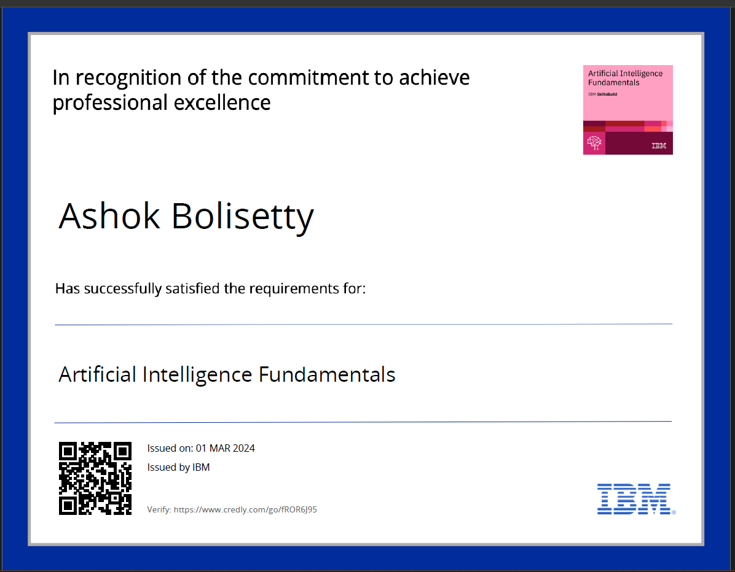
course certificate 1

Slide 12
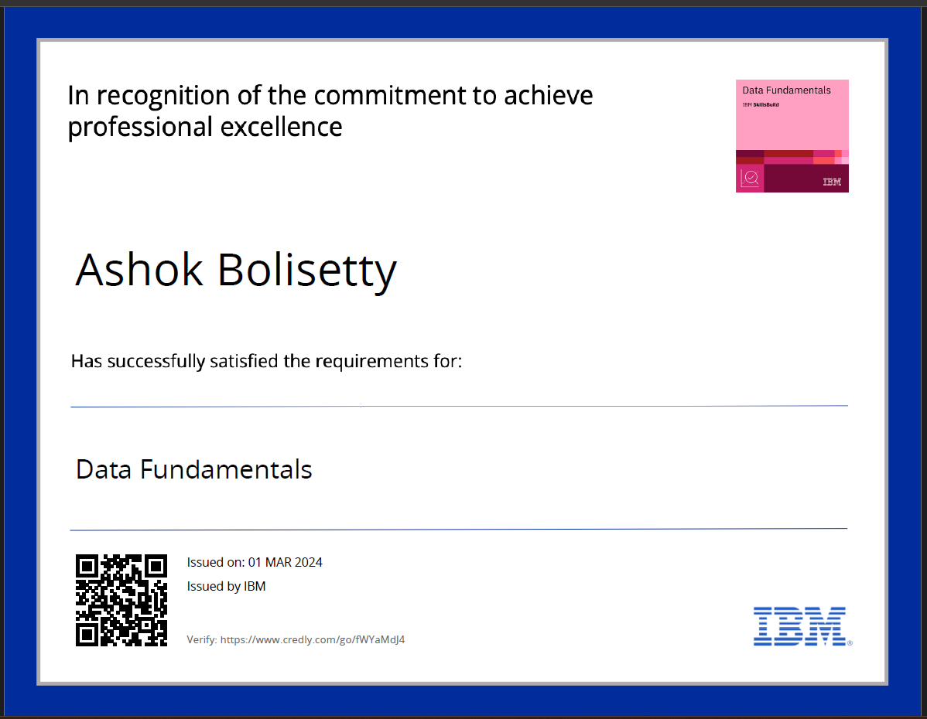
course certificate 2

Slide 13
THANK YOU

