Slide 1

Less code,
More logic.
Genero Overview

Slide 2
The business problem Be responsive to change
‘It is not the
strongest
of the species that survives
nor the
the most intelligent,
but the one most
responsive to change’
Charles Darwin
The Origin of Species, 1859

Slide 3
Setup
Four Js Products
BDS (Business Development Suite)
Compiler/Runtime
Windows Front End (wtk)
Web Front End (html client)
Java Front End
X11
Ascii
Web Services extension
Genero BDL (Genero Business Development Language)
Compiler/Runtime
GDC (Genero Desktop Client)
WEB
GDCAX (Genero Desktop Client ActiveX)
GWC (Genero Web Client)
GST (Genero Studio)
GWS (Genero Web Services)
GRW (Genero Report Writer)

Slide 4
Setup
Prefix of products
Example
fjs-fgl-2.11.03-build1169.8-w32vc71
Fjs= Four Js
Fgl= Tipo de Producto
X.XX= Version del Prducto
.&X= numero de parche
W32vc71= plataforma
.exe= windows run= Unix/Linux
Product type
Fgl=Compiler/Runtime
Gas=Genero Application Server
Gdc=Genero Desktop Client
Gdcax=Genero Desktop Client ActiveX
GWS=Genero Web Services
GRE=Genero Report Engine
GRD=Genero Report Designer
Platform
W32vc60=Windows 32 bits soporte con Visual C 6.0
W32vc71=Windows 32 bits soporte con Visual C 7.0
A640433= Aix 64 bits version 4.3.3

Slide 5
Setup
Installation
We suggest to have first a directory structure
$HOME/fourjs/{PRODUCT}/{VERSION}/{CLIENT}
Example
$HOME/fourjs/genero/211/dev o bien $HOME/fourjs/genero/211/rt
$HOME/fourjs/genero/211/gdcax
$HOME/fourjs/genero/211/gas
$HOME/fourjs/genero/211/gdc
How to install
Unix
. ./package.run –i (depends of the shell)
Windows
Executable file (.exe)
Important: It is mandatory to install first the compiler/runtime, then you will be able to install the other products

Slide 6
Setup
Licensing
Licenses types
BDS
FAB#XXXXXXXX [X]
Genero
TAB#XXXXXXXX [X]
Installation procedure
During the product installation the main program is called to apply this procedure
License Number
License Key
The program generates another number called Installation Number
You need to sent to your support center or by web those numbers and immediatly we will generate a fourth number called Installation Key that will complete the licensing
To complete the licensing
fglWrt –k [installation key]
To verify the status of the license
fglWrt –a see
Maintenance key, available from version 2.20
fglWrt –m [maintenance key]

Slide 7
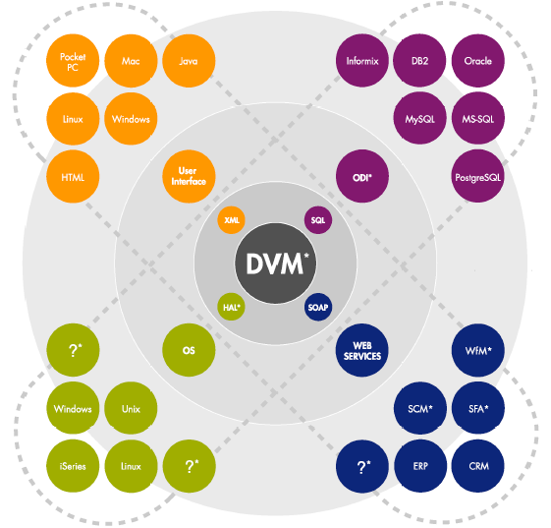
Cross-Platform Arquitecture

Slide 8
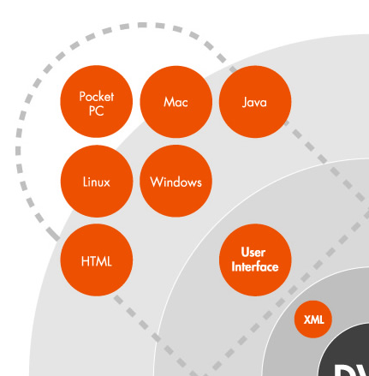
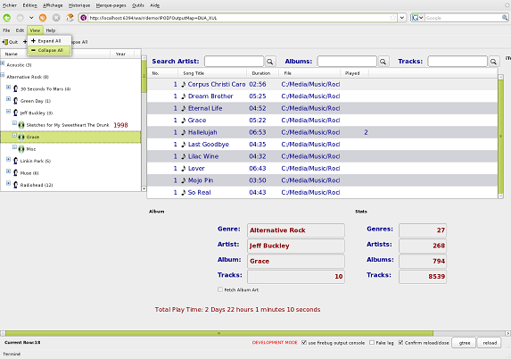
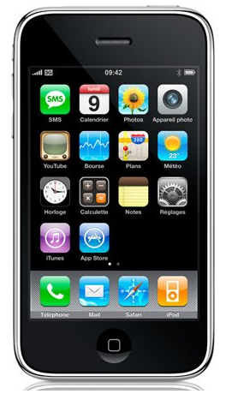
Flexible deployment Integrate with existing IT landscape
Desktop model
Mobile
MAC
OSX
ASCII
Windows
Linux
SaaS model
HTML/
AJAX
Abstract User
Interface
XML
Mobile model

Slide 9
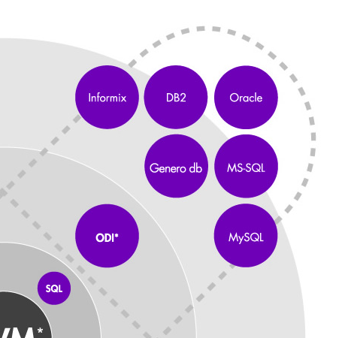
Flexible deployment Database agnostic
Open Database Interface
Multi-vendor
Embedded SQL
Switch rapidly
Sybase

Slide 10
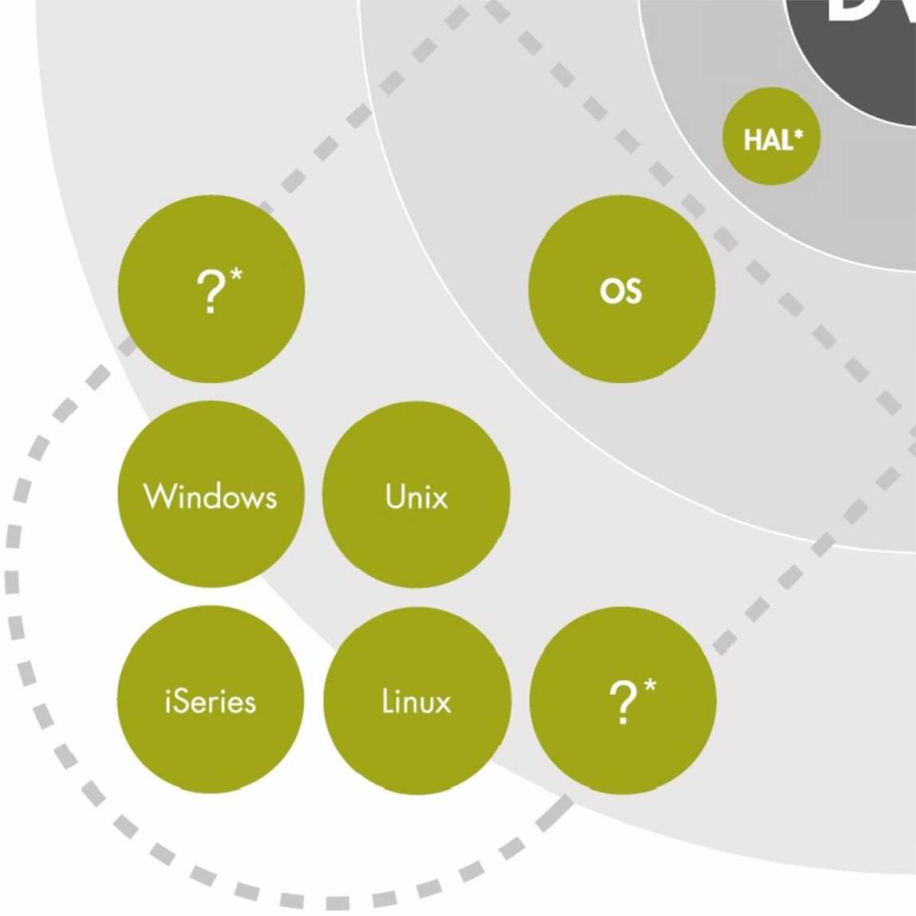
Flexible deployment Operating system agnostic
One binary fits all
Compile once
Deploy anywhere
Reduce life cycle costs

Slide 11
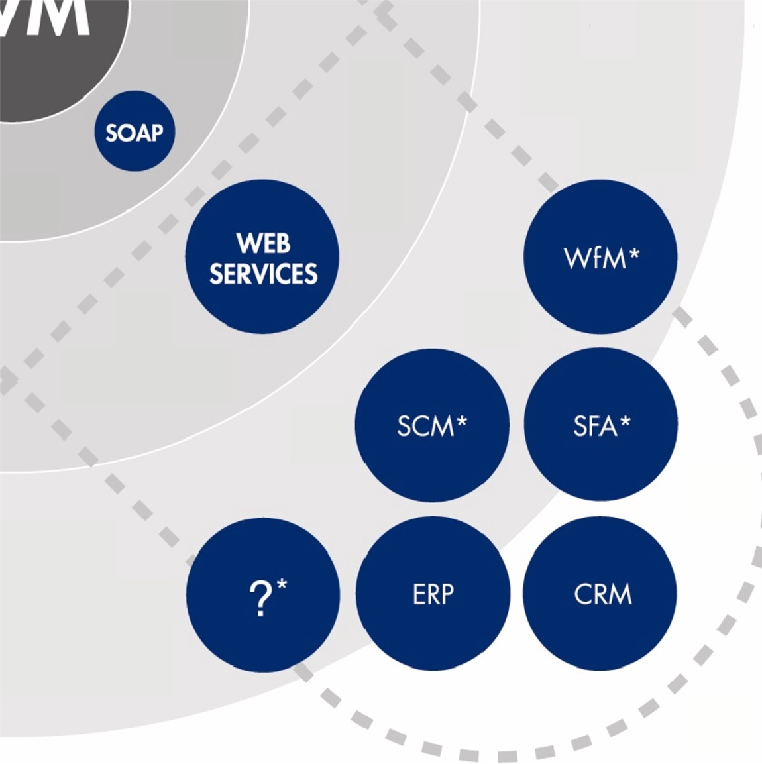
Scalable performance Autonomous services connect via Web services
SOA Integration
Scales to ‘000s of concurrent users on a single server

Slide 12
Arquitecture
GDC (SSH Tunnel)
GDC, GJC
Firewall
Firewall
Application Server
Firewall
Web Server
PDA´s or Cellular Phone
Browsers: GWC or GDCAX (ActiveX)
GDC (Windows, Mac, X11, ActiveX), ASCII, GJC (Java)
Database Servers

Slide 13
Arquitecture concepts
Dynamic Virtual Machine – DVM
Application/Runtime server, automatically manages and optimizes communication between clients and runtime system
Runtime System
Part of the DVM where the Business Logic and Design Logic are processed
Abstract User Interface – AUI
XML based logical model of the user interface, which can be rendered at runtime to specific platforms
Dynamic User Interface – DUI
The DOM tree model of the AUI that can be modified at runtime
Open Database Interface – ODI
Optional part of the DVM, provide concurrent access to a broad range of databases

Slide 14
The Language
The Language
Genero BDL is a high-level, fourth generation language with an open, readable syntax encouraging an individual or group programming style. You write your program logic in text files, or program source modules, which are compiled and linked into programs that can be executed by the Runtime system
Displaying Data to the User
Entering and Changing Data
Searching the Database (Querying)
Responding to User Actions

Slide 15
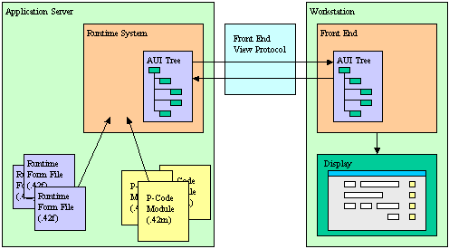
The User Interface
What happens when a user executes a Genero BDL application? The Genero Runtime System creates the Abstract User Interface tree, and the Genero Front End makes this abstract tree visible on the Front End Client, such as the Genero Desktop Client or Genero Web Client.

Slide 16
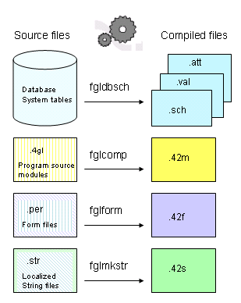
Compiling a Genero BDL Application
Compiling
Your Genero BDL program can consist of a single source code module, but generally you will have multiple modules, form specification files, and perhaps localized string files. Database schema files are also required if you have defined data types and variables in an existing database column or table using the DEFINE ... LIKE statement
The tools that Genero uses to compile the various application files, the file extensions of the source code, and the corresponding compiled files, are listed below

Slide 17
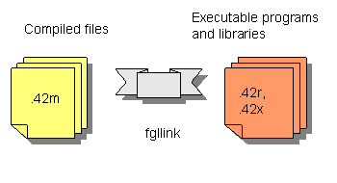
Compiling a Genero BDL Application
The Genero BDL source code compiler generates hardware-independent pseudo-machine code (P-code).
This code is not directly executable by the operating system or GUI, but can be interpreted by the Genero BDL runner (usually named fglrun).
The compiled P-code modules are binary.
The files are not printable or editable as text.
The compiled source code modules can be linked into a program executed by the Runtime System, or into a library that can be linked into other programs.

Slide 18
Compiling a Genero BDL Application
Compiling and Building Applications from the command-line
Tool fglcomp: Module compiler
This tool compiles a program source module (extension .4gl) into a pseudo-code version. The compiled module has an extension of .42m. If the compilation fails, a text file flagging the errors is created. The error file has an extension of .err.
If your program consists of more than one module, the modules must be linked together prior to execution.
Tool fgllink: Module linker
This tool assembles multiple p-code modules compiled with fglcomp into a single .42r program or a .42x library.
Example
fglcomp <modulename>.4gl
Example of running the program:
fglrun <modulename>.42m …
Example of creating a program:
fgllink -o <programname>.42r <module1name>.42m <module2name>.42m ...
Example of running the program:
fglrun <programname>.42r
Example of creating a library that can be linked into other programs:
fgllink -o <libraryname>.42x <module1name>.42m <module2name>.42m ...

Slide 19
Compiling a Genero BDL Application
Tool fgl2p: Program compiler
This tool is provided to create programs or libraries in one command line. It uses the fglcomp and the fgllink tools to compile and link modules together. If compilation of any of the modules fails, the file <modulename>.err is created.
Note: Windows or Unix-based makefiles may be used as well, to automate the process of compiling and linking programs
Example of creating a program:
fgl2p -o <programname>.42r <module1name>.4gl <module2name>.4gl ...
Example of creating a library:
fgl2p -o <libraryname>.42x <module1name>.42m <module2name>.42m ...

Slide 20



Q&A

Slide 21
Thank you

