Slide 1

Less code,
More logic.
Product Overview
Genero Studio

Slide 2













Overview Business application modeling
Edit code
DB Meta schema
Design Forms
Create Reports
Debug apps
Manage Projects
Files &Dirs
Team work (SCM)
Diff
App Generator
SOA & WS
Profiler
Help

Slide 3
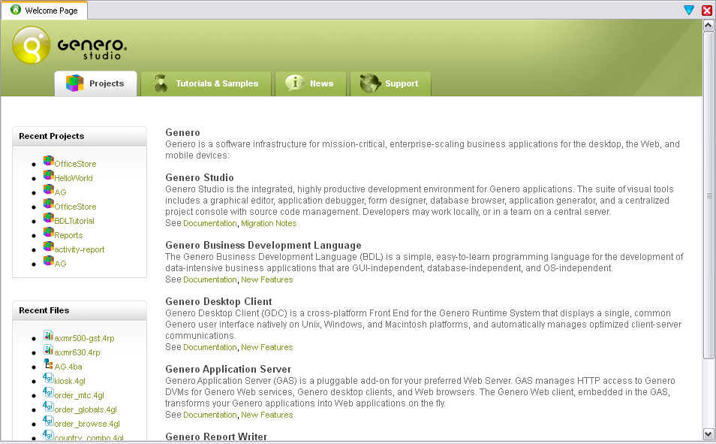
Welcome Page
Recent files & projects
Tutorials
Samples
RSS feeds

Slide 4
Project manager
Defines how applications and libraries are built
Define dependencies
Add schemas for automatic versioning
Easy rebuilds, debug, execution
Custom operations on files types (MIME)
Simplifies team development
Integrated source code management

Slide 5
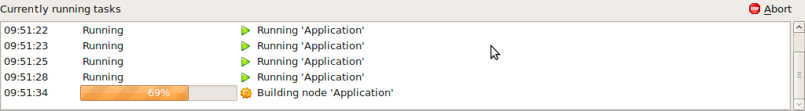
Project manager
Multicore builds
Command line builds
Run multiple applications
Internal project database provides:
TODO, BUG lists extracted from source code
Functionsearch
Navigation to symbol definitions
Task manager

Slide 6
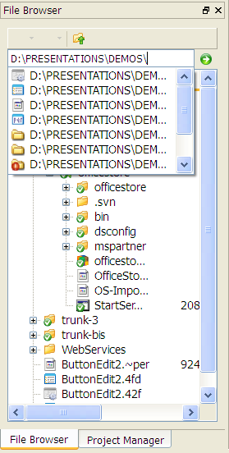
File Browser
Back/forward navigation
Path completion
Files & folders in same view
Integrated source code management

Slide 7

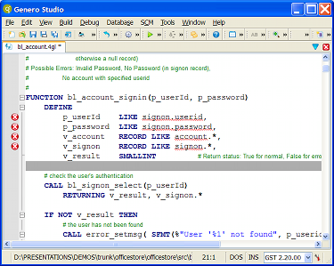
Code editor
Language aware
Genero BDL
code completion
auto-closes strings, brackets,
parentheses
auto-trims white spaces
real-time syntax &
semantic checking
custom appearance
font, style, color
word wrap
set debug breakpoints
fast, memory efficient

Slide 8
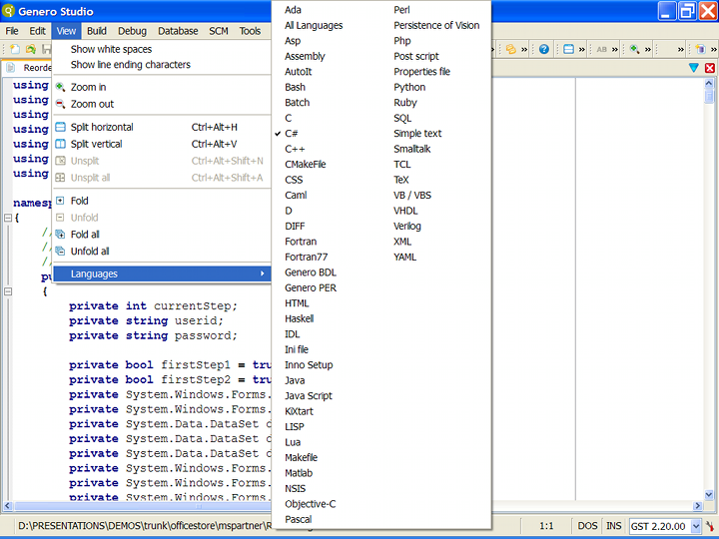
Code editor
Language aware
60 languages
Syntax highlighting
auto-closes strings, brackets,
parentheses
auto-trims white spaces

Slide 9
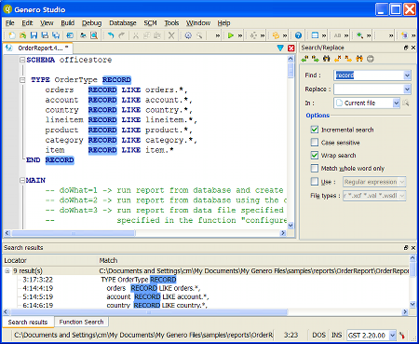
Code editor
Powerful search& replace
Smart search
source code,
screen forms,
project libraries
Results appear in docking views

Slide 10
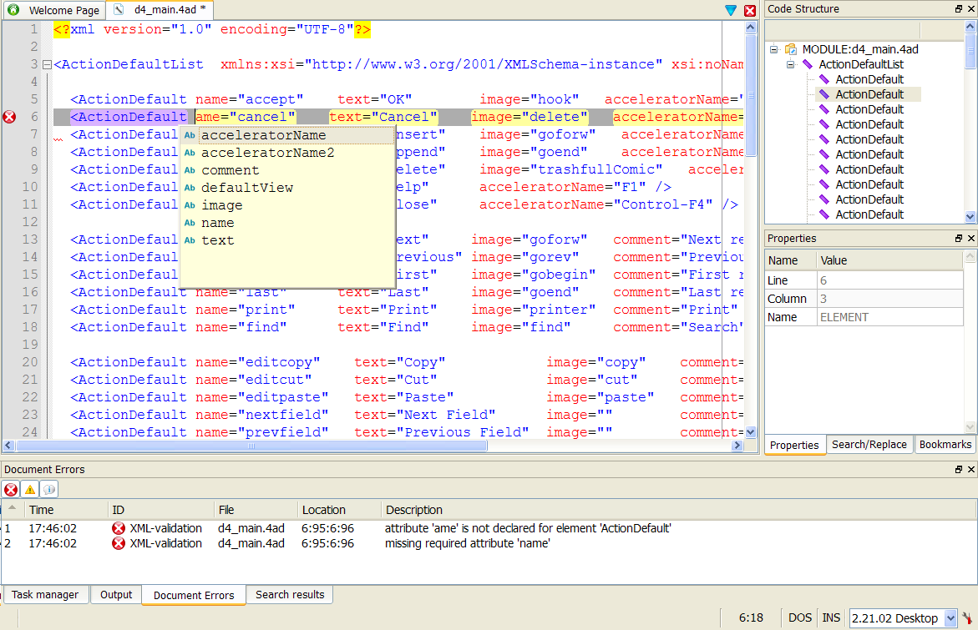
Code editor – XML smart editor

Slide 11
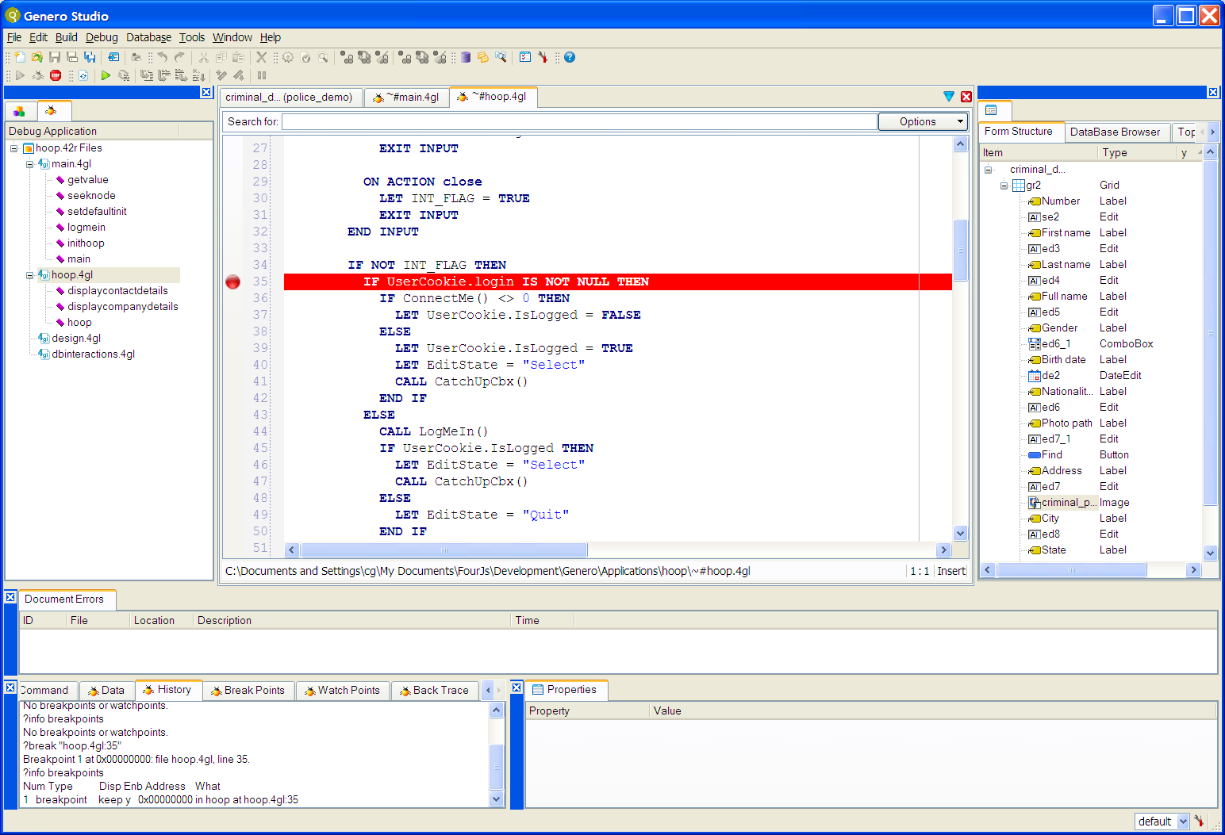
Debugger

Slide 12
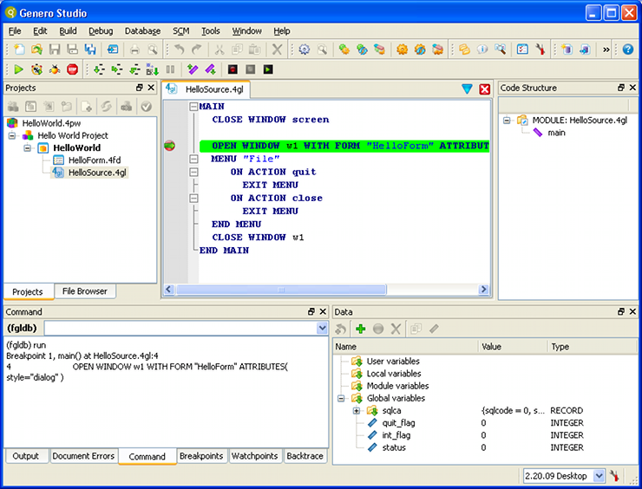
Debugger
Local & remote debug
Desktop & Web applications debug
Start, stop, interrupt
break points
watch points
conditional expressions
Debug source directly
read-only copy of source
stack back-trace, up/down navigation
variable editing
modified variables flagged
Create debug scripts

Slide 13
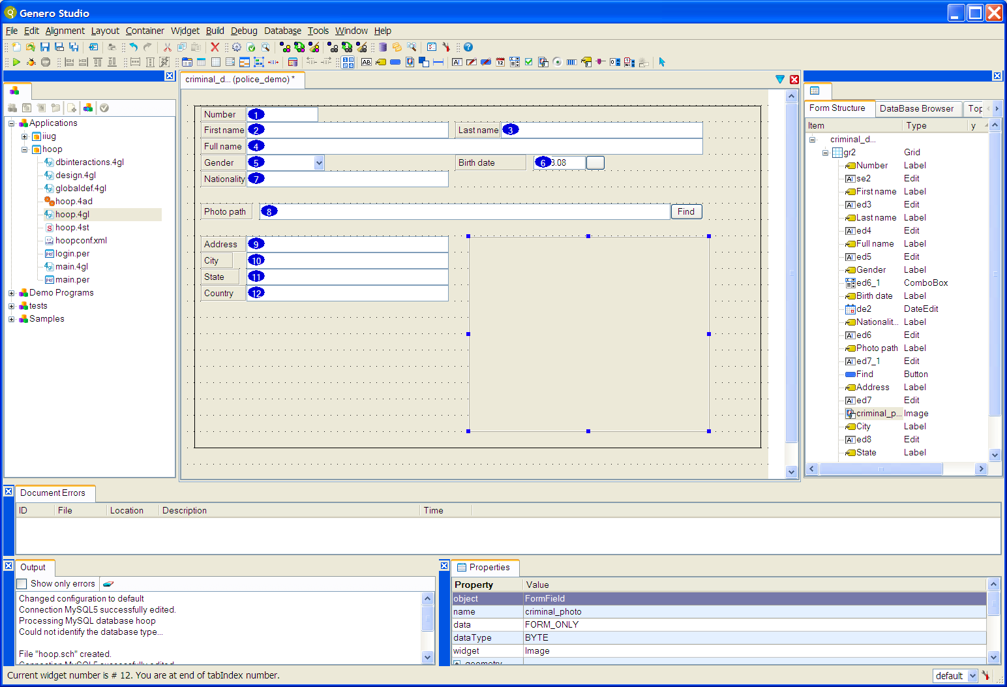
Form designer

Slide 14
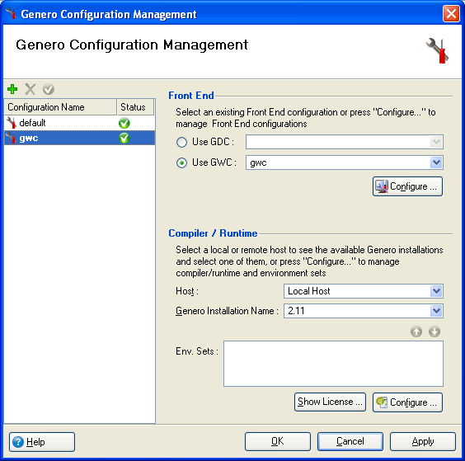
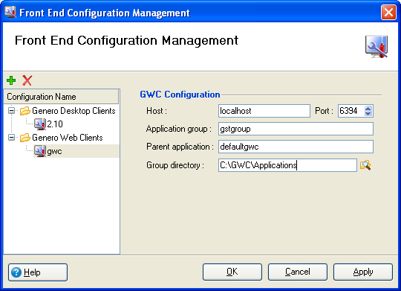
Form designer
Client independent GUI
Flip between
Windows
Mac OSX
Linux
Web 2.0

Slide 15
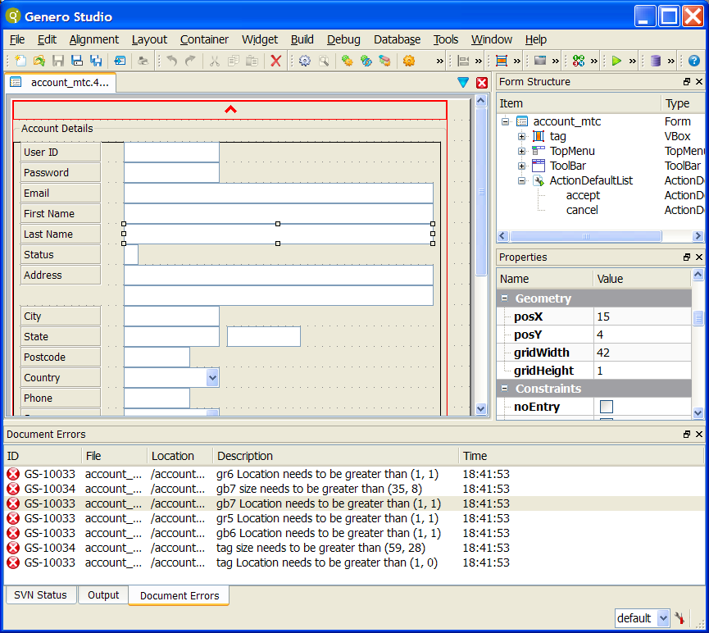
Form designer
Auto validation:
Errors, tips
Structure view
Hierarchy of objects
TopMenu
Toolbar
Action defaults
Screen records

Slide 16
Form designer
HBOX/VBOX containers
Drag’n’ drop withinview
Multiple selection
Search/replace widgets properties
in forms

Slide 17
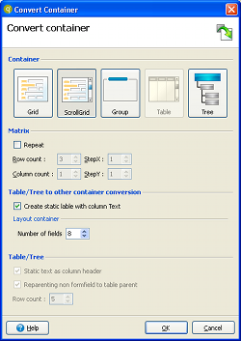
Form designer
Convert
Fields into
table columns
matrices
and vice versa
container types between
tables,
grids,
trees,
scrollgrids

Slide 18
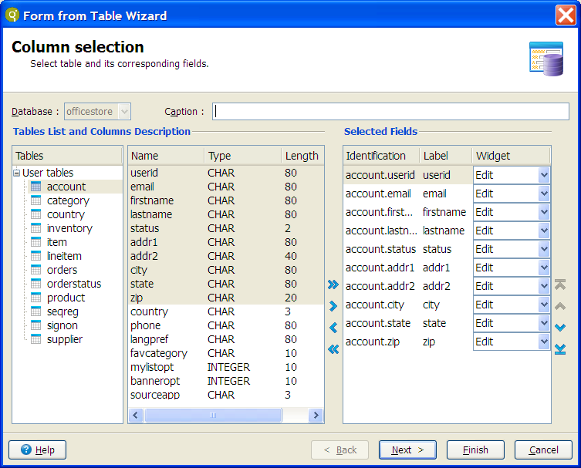
Form designer
Uses metaschema
Avoids tedious repetition
through use of defaults

Slide 19
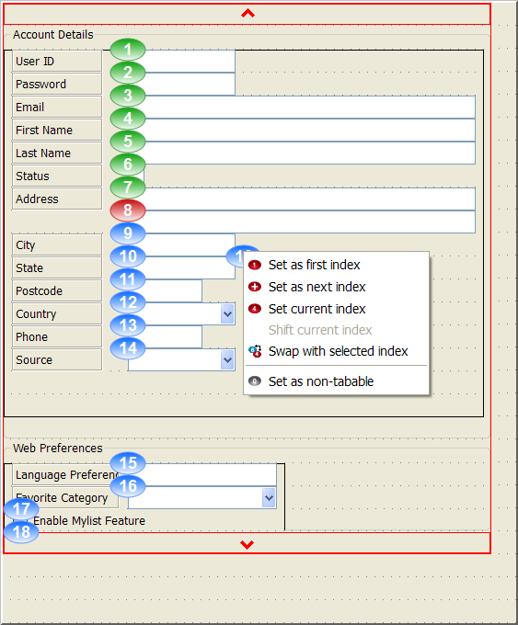
Form designer
Tab index editing

Slide 20

Teamwork
Subversion (SVN) source code control system
Supports most CVS features
Directories, renames, and file meta-data are versioned
Commits are truly atomic
Revision numbers are per-commit, not per-file
Log messages are attached to the revision, not stored redundantly as in CVS.
Natively client/server, layered library design
Apache network server option, with WebDAV/DeltaVprotocol
Client/server protocol sends bi-directional diffs
Repository mirroring

Slide 21
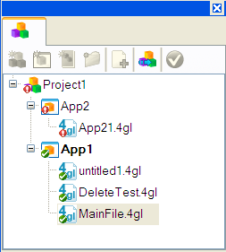
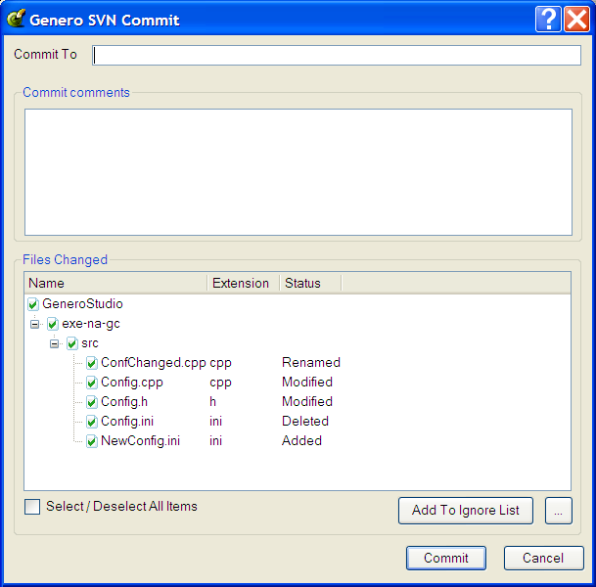
Teamwork
Subversion integration
directory operations
project manager - file status
checkout, commit, update…
add, remove files
Background execution for long tasks
Eg: large checkouts

Slide 22
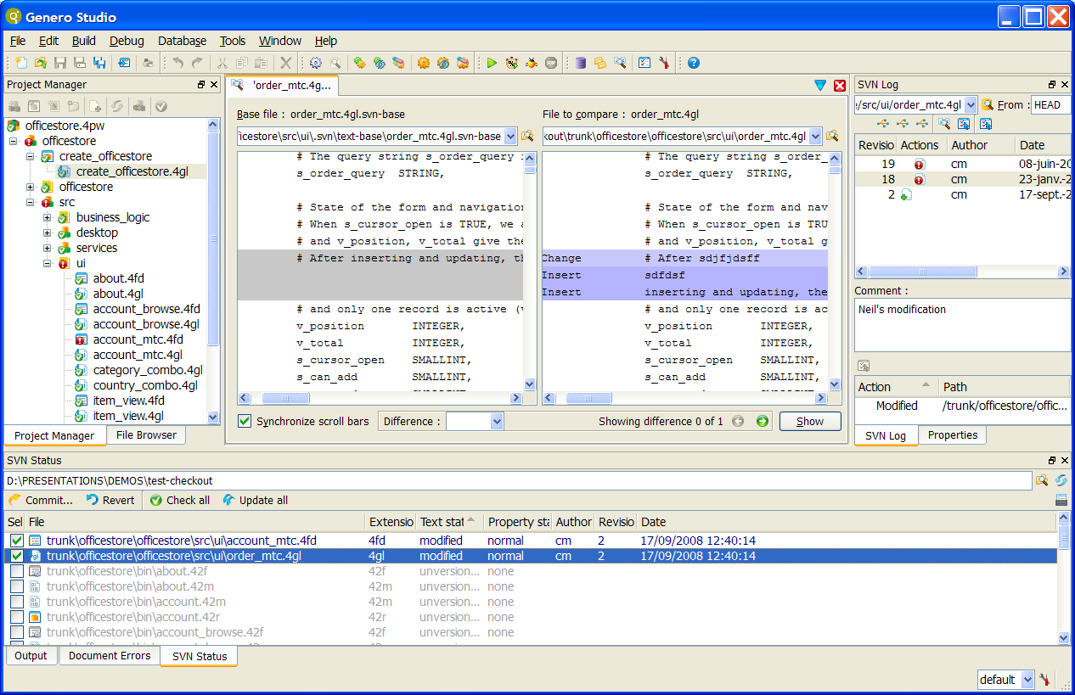
Teamwork
Unique SVN console

Slide 23
Teamwork
Dockingviews
Status & log views simultaneously
diff, open files
Full Subversion
copy, merge
bug tracking
Repository Browser
view – avoid checkout
log, copy, import, open…

Slide 24
Teamwork
Improved server-side security management
SSH connectivity for Studio server
each user connects via own login
rights granted according to credentials
uses operating system security

Slide 25
Business Application Lifecycle
Model driven approach
Design user interface and define code generation options
Generate code & insert custom code
Application design (create business application diagram)
Create database schema (import or design)
Create forms, services, reports
Running Application

Slide 26






Business Application Lifecycle
Model driven approach
Application design
TIGHTLY COUPLED DIAGRAMS & SOURCE CODE
MODIFY APPLICATION
MODIFY / ADD NEW PROGRAMS, SERVICES & FORMS
MODIFY DATABASE SCHEMA
REGENERATE & SYNCHRONIZE CODE
Create database, forms, services, reports
Running Application
Design UI and generation options
Generate code & insert custom code

Slide 27

Business Application Lifecycle
Model driven approach
Application design
DESIGN
Create database, forms, services, reports
PROTOTYPE
Running Application
Design UI and generation options
IMPLEMENT
Generate code & insert custom code
MAINTAIN

Slide 28
Business Application Modeling
Role of the diagrams
Business Application Diagram:
Defines applications
Defines the main form for each application
Defines the forms accessed from another form
Managed forms
Defines the Screen Records
Associates a Query with each Screen Record
Defines the dependency between Screen Records (Master/detail)
Defines Code Generation Options
Meta Schema
Centralaizes information about DB fields (to avoid duplication)
- Widgets, Validation, PK/FK relations…

Slide 29
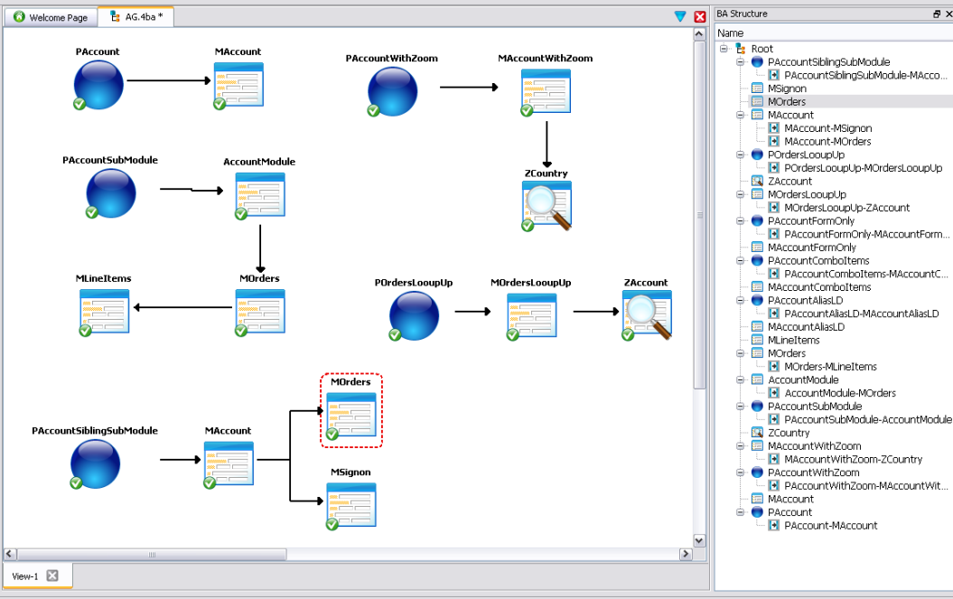
Business Application Modeling
Business Application Diagram
Applications
Managed Forms
Zooms
Modules
Relations

Slide 30
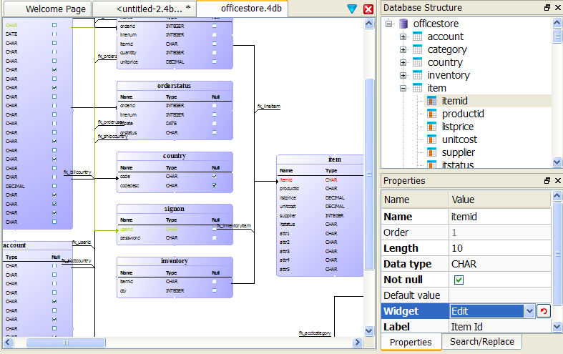
Business Application Modeling
Database Diagram

Slide 31
Business Application Modeling
Meta schema
Improves developer productivity
Central repository
Extract tables, columns & relations from schema
Centralize application attributes to avoid redundencies
Field labels
Widgets
Constraints…

Slide 32
Business Application Modeling
Meta schema
Create, import, synchronize
database schema
tables, fields, types, primary & foreign keys, indexes,
converts to Genero types
SERIALs, INTEGER, DATE…
Enrich
database schema
«First name» for «order_fname»
set default widgets
add relations (PK/FK) not present in database schema
custom properties
Generation of database scripts (DCL)

Slide 33
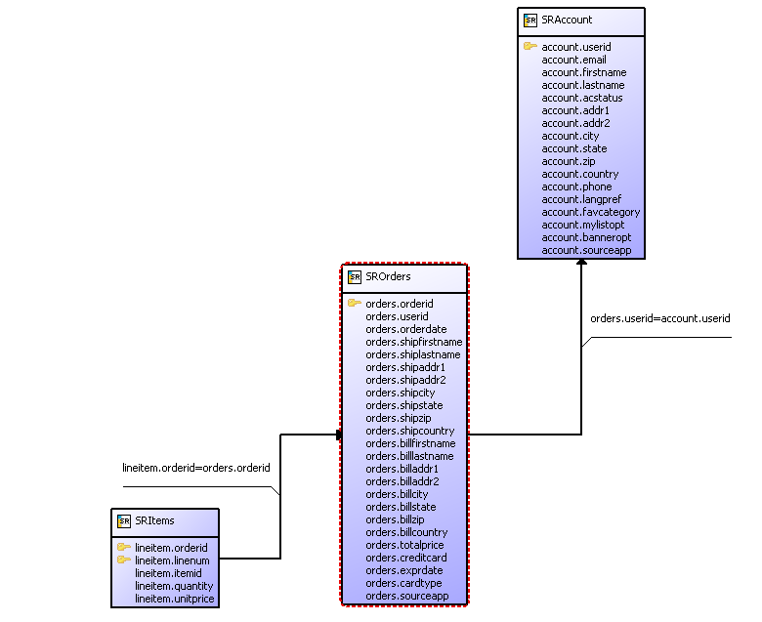
Business Application Modeling
Managed Forms Diagrams

Slide 34
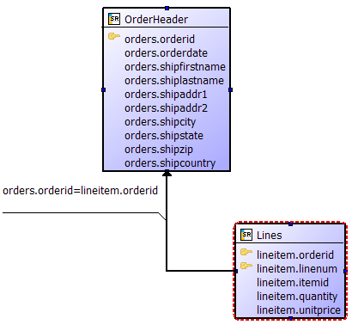
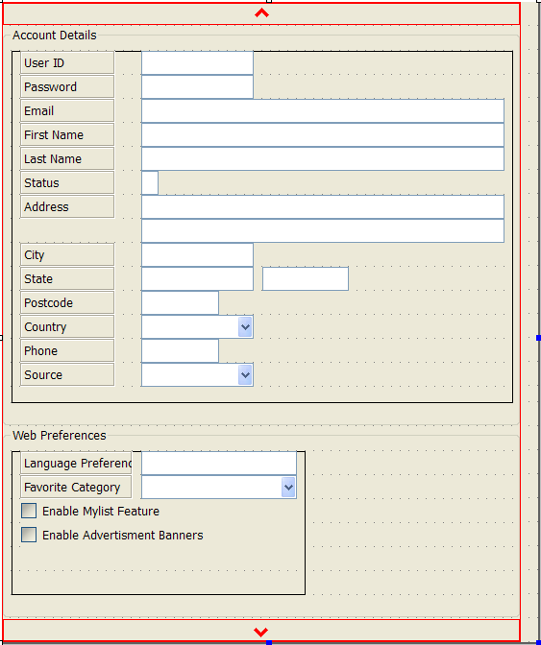
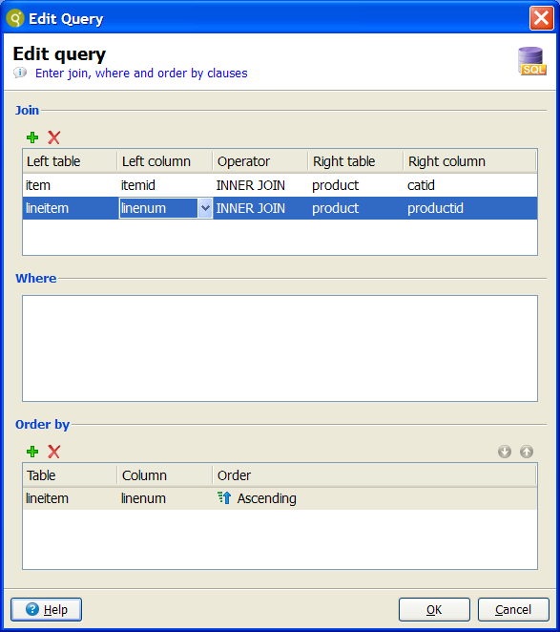
Business Application Modeling
Managed Forms (Zoom or Module) contain:
Query attached to the screen record
Relationship between screen records (Master/Detail)
Screen record
Form
Query

Slide 35
Code Generation
Concepts
Template driven code generation
Templates define code skeleton and style
Code is generated based on configuration
Generated code can be customized
<BLOCK>, <POINT> sections are untouched by re-generation
User-defined templates

Slide 36



Code Generation
Pass 1: Gathering data
From Business Application Diagram
From Managed Forms
From Meta Schema
Form User source code
A.4px
1.4mf
.4gl

Slide 37


Code Generation
Pass 2: Code generation
Template file defines the code to generate
Template
TCL
.4gl

Slide 38
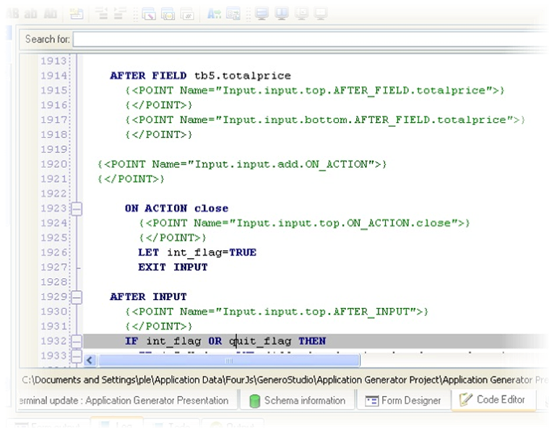
Code Generation

Slide 39
Code Generation – default templates
Database driven application design
Functions
Detailed or list views
Lookup fields
Master/details forms with multiple details
Automatic search lists (Zooms)
Common actions
INSERT/UPDATE/DELETE managed by template
Query By Example

Slide 40


Code Generation – default templates
Two types of managed forms:
Zoom: to Select a value
Module: to Insert / Update / Delete / Browser / QBE

Slide 41
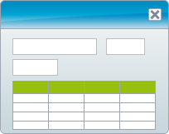
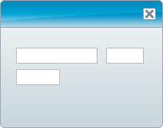
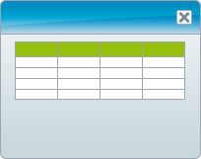
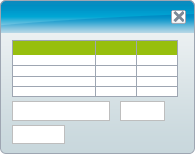
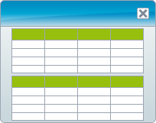

Code Generation – default templates
Types of formshandled
Detailedview / listviewtoggle
Master and Detail
Detailed
List
List / Detailed
Master and Detail
Detailed
List

Slide 42
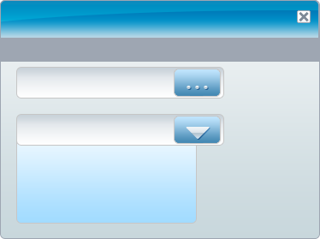

Code Generation – default templates
Lookups, comboboxes, zooms, details
File View Detail1 Detail2 Window ?
Detail 1
Zoom for field 1
lookup as combo box

Slide 43
Application Generator - customization
Design Diagrams are customizable
Business Application Diagram
Items which appear on the diagram and actions
Dynamic properties for each item
Meta Schema
Dynamic properties for Table, Columns, PK, FK
Forms
Dynamic properties for Records, Fields, Relations
Detail 1
Zoom for field 1

Slide 44
Application Generator - customization
Database driven application design
Data entry
Diagrams (BA, Meta Schema, Form Diagram)
XML files (using XSD)
Any format
Code Generator
TCL Generator by default
Can be replaced by a generator of your choice:
- XSLT, perl, python
- Genero BDL…
Template driven code style and skeleton generation
Change settings and regenerate skeleton
Customized code is untouched by re-generation
Possibility to write your own templates
Define relationship (foreign key)
Generation options
QUERY, INSERT, UPDATE, DELETE, LIST_DETAIL…
Detail 1
Zoom for field 1

Slide 45
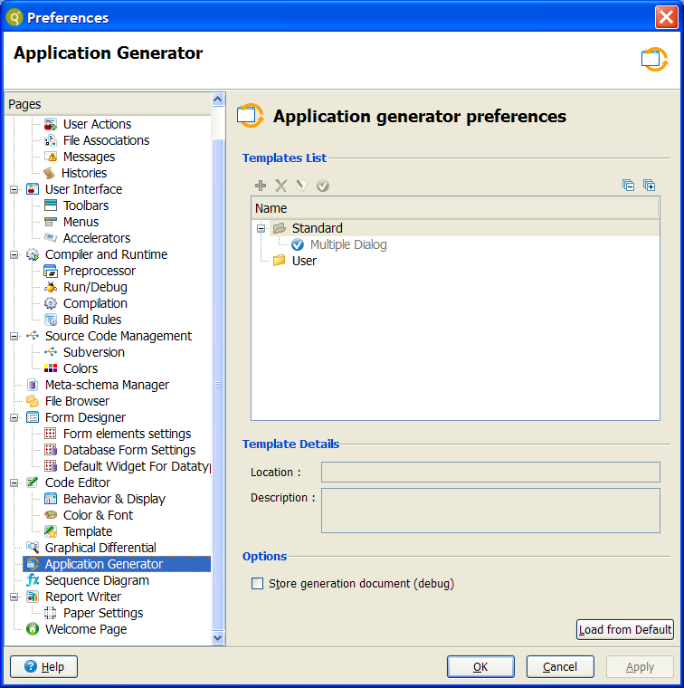
Application Generator - customization
Behavior depends upon
Preferences
Build rules
Detail 1
Zoom for field 1

Slide 46
Code Analyzer
Goal
Understand global application structure
Hints on creating module, package, library structure
Source code analysis
Graphic representation
Package, library, module dependencies as component diagrams
Sequence diagrams
Code documentation (>2.30)
Navigate between diagrams and code

Slide 47
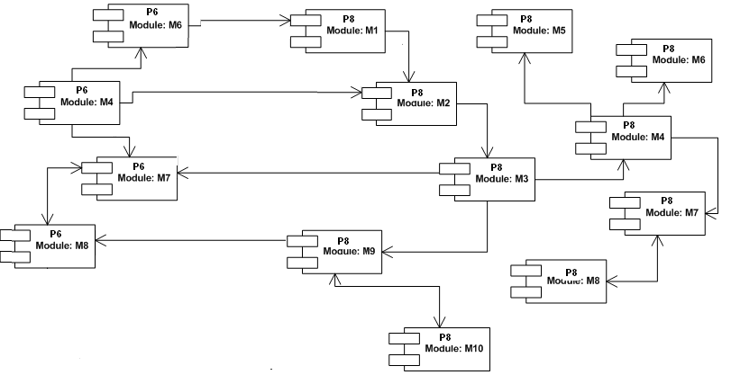
Code Analyzer
Component Diagram:
Packages (project, library, application)
Modules (.4gl file)

Slide 48
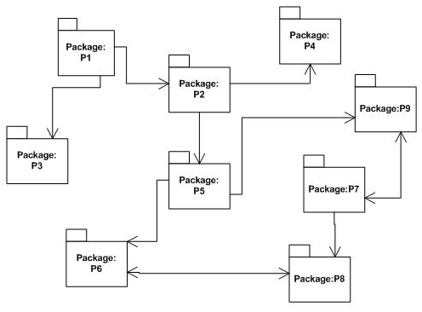
Code Analyzer
Component Diagram:
Packages (project, library, application)
Modules (.4gl file)

Slide 49
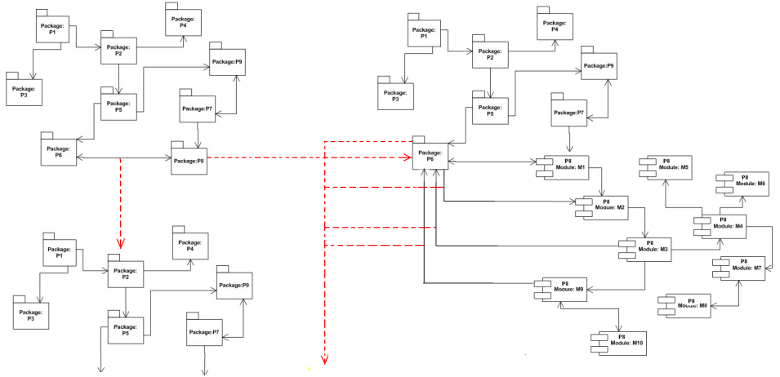

Code Analyzer
Component Diagram:
Open diagram form Project Manager / File Browser
Navigate inside diagram

Slide 50
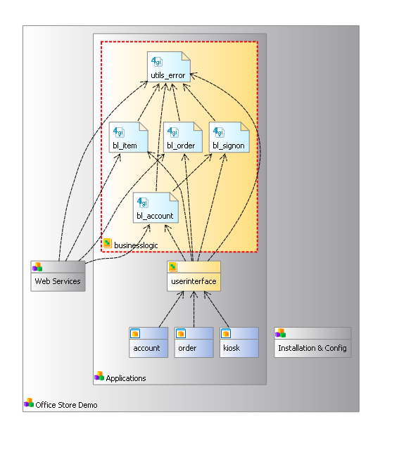
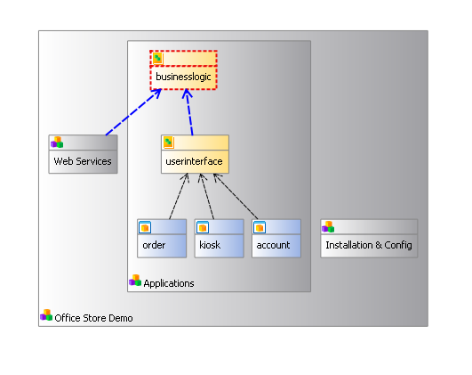
Code Analyzer
Component Diagram

Slide 51
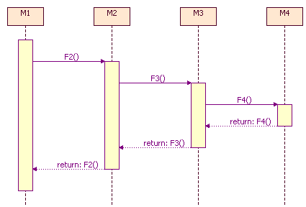
Code Analyzer
Sequence Diagram
Function call sequence for a function
Example: Function F1() of module M1.

Slide 52
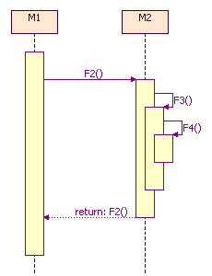
Code Analyzer
SequenceDiagram
Inner module function calls
Example: f2() calls f3() and f4(). All 3 functions are defined in M2.

Slide 53
Code Analyzer
Sequence Diagram
Open diagrams from
Code Editor
Component Diagram function links
Navigation inside the diagram
Click on a function to see its sequence diagram
Show / hide functions or modules
Explicit filtering
Call level to display

Slide 54
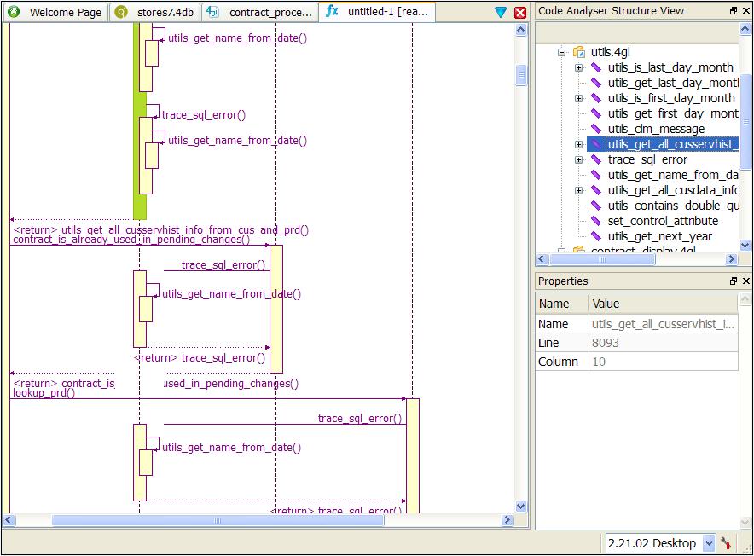
Code Analyzer
Sequence Diagram

Slide 55
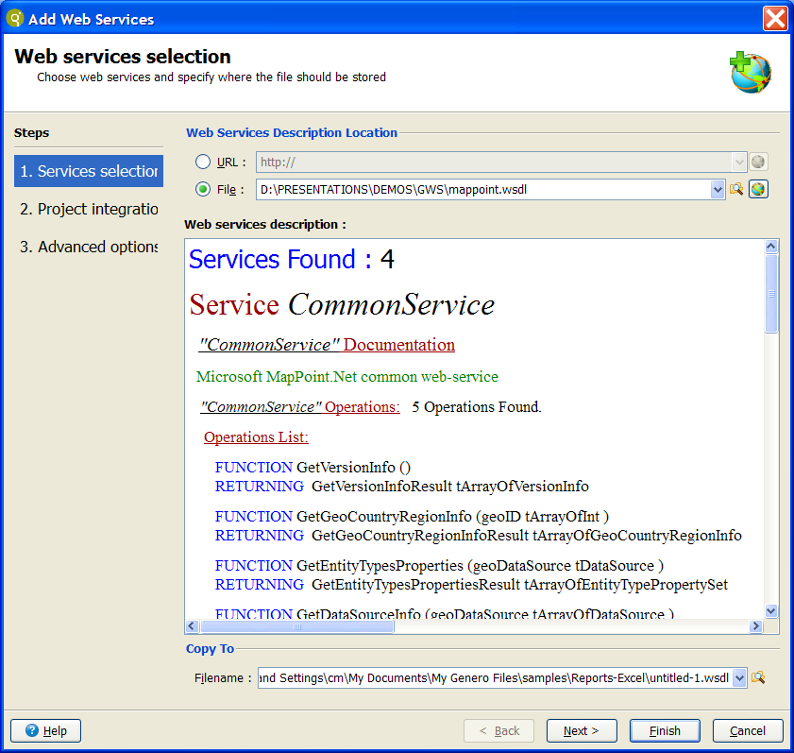
Web Services Wizard

Slide 56

Web services
Web Services
Consume services from URL
Use services in projects
Generate server skeleton from WSDL
Generate WSDL from code

Slide 57



Q&A

Slide 58
Thank you

