Slide 1

Genero Desktop Client Overview

Slide 2

Genero Desktop Client (GDC)
The Genero Desktop Client is a Graphical Front End to the Genero Runtime System.
To run a Genero application with the GDC, it must be installed and running on the client.
Based on QT libraries provided under Windows, Unix and Mac.
GDC supports connections to the Runtime System using telnet, rlogin or ssh (1 or 2).
GDC can be installed on the client manually OR automatically using GDCAX.

Slide 3
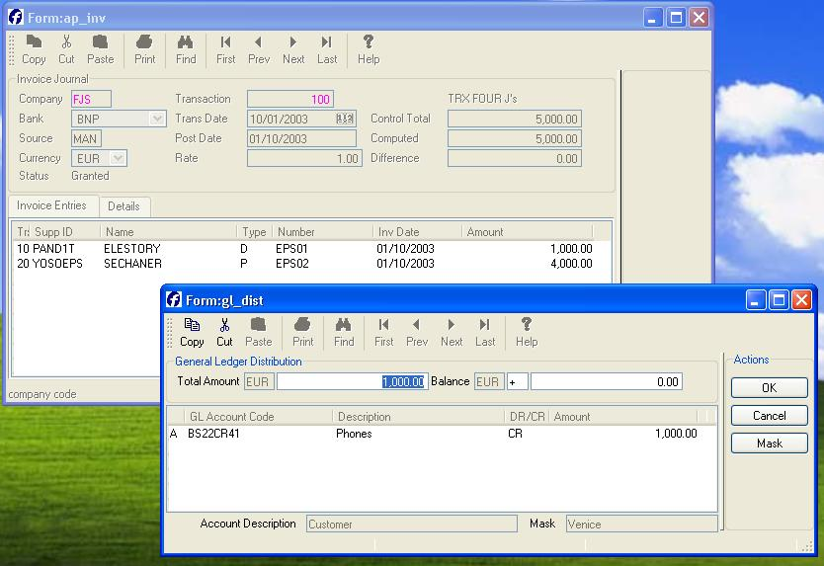
Genero Desktop Client (GDC)
Screenshot on Windows :

Slide 4
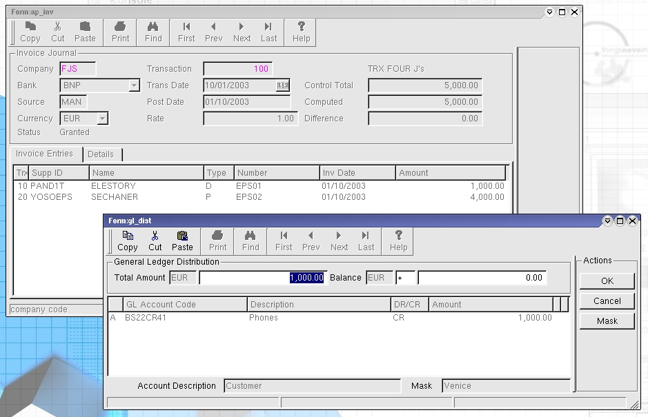
Genero Desktop Client (GDC)
Screenshot on Linux :

Slide 5
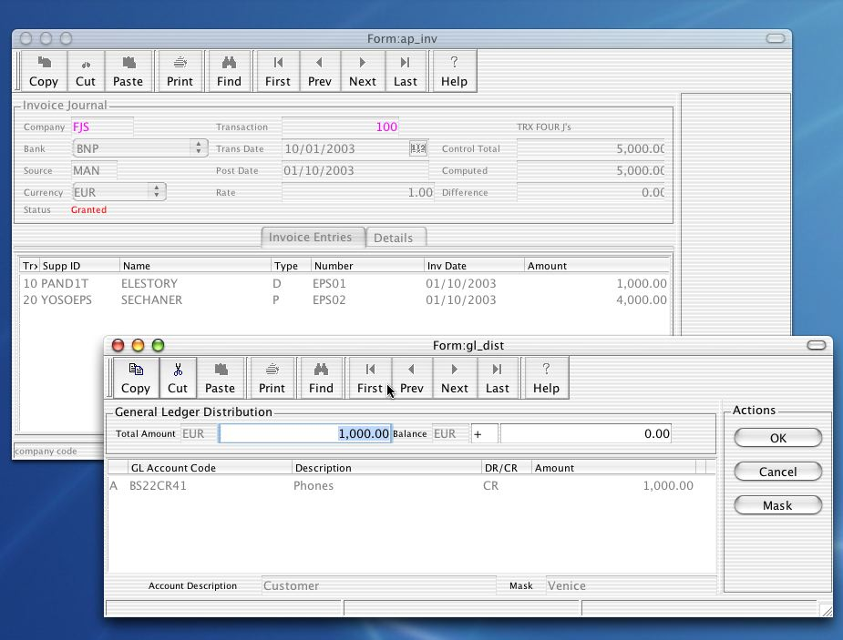
Genero Desktop Client (GDC)
Screenshot on Mac OS X :

Slide 6
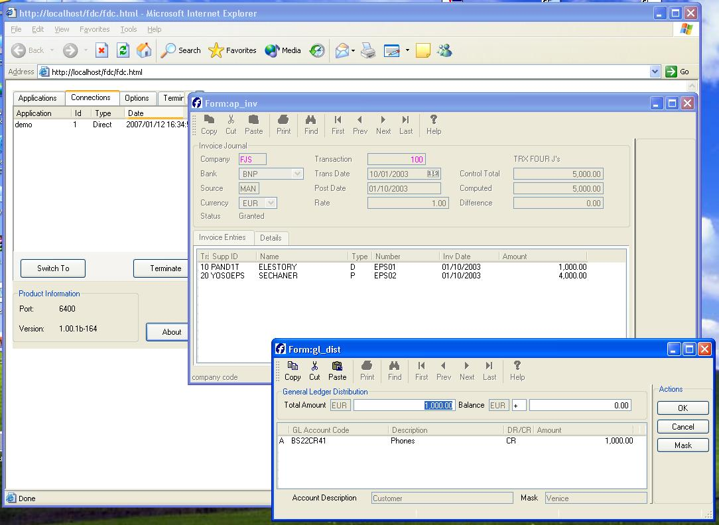
Genero Desktop Client (GDC)
Screenshot of GDCAX:

Slide 7
Genero Desktop Client (GDC)
Installation:
GDC installation files are:
fjs-gdc-XXX-windows.exe OR fjs-gdcax-XXX-windows.exe for Windows
fjs-gdc-XXX-lnxlc22.run OR fjs-gdcax-XXX-lnxlc22.run for Linux
Install GDC on the client in the directory you have chosen. For the GDCAX, do the same but in the DocRoot directory of your Web Server

Slide 8
GDC Flags
Information
-h |  |  | Display the About Box
Network / System
-p | --port | new_port | GDC will listen on the new_port port
-n | --new |  | Starts a new instance of GDC
-D |  |  | Starts GDC in Debug Mode (Debug tree and Debug Console are active)
-A | --Authentication | Security level | Sets GDC’s security level regarding Runtime System’s connexion.
-R | -RCPd |  | Start automatically built-in RCP deamon (Windows only)

Slide 9
GDC Flags
Start Application
-S | --Start | Shortcut_name | Starts GDC with options defined in the specified shortcut
-s | --startDirect |  | Starts GDC and checks options –U –H –T –P and –C
-U | --User | User_Name | Only with –s or –S option. Specifies the user name
-H | --Host | Host_Name | Only with –s or –S option. Specifies the host name
-P | --Password | Password | Only with –s or –S option. Specifies the password name
-C | --Cmd | Command_Line | Only with –s or –S option. Specifies the command line lanched at connexion.

Slide 10
GDC Flags
Start Application
-T | --Type | Connexion_Type | Only with –s option. Defines which protocol will be used. Default value is SSH
Start GDC
-a | --admin |  | Starts GDC in Admin mode
-M | --Minimized |  | Starts GDC minimized
-X | --close |  | Closes GDC when no more application or teminals are running

Slide 11
GDC Flags
Flags usage example:
gdc -S demo -X -M
Starts GDC minimized and starts the connexion defined in the "demo" shortcut
gdc -s -T SSH2 -U john -H doe –C "@FGL;export FGLSERVER;cd demo; fglrun demo" -X -M
Starts GDC minimized, then connects to the machine "doe" as "john" using SSH2 protocol. Once connected, it runs the command line "FGLSERVER=<ip>:<port>;export FGLSERVER;cd demo;fglrun demo.

Slide 12
User Mode & Admin Mode
By default, GDC starts in user mode
By adding –a or –admin, GDC starts in administration mode.
To create shortcuts or modify options, GDC needs to be started in administration mode.

Slide 13
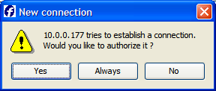
Security Levels
A argument
By default, GDC accepts all incoming connections on the listened port.
Security Level 1: -A 1
GDC requests an acknowledgement when a connection is coming in. The connection can be accepted once (Yes), accepted steadily (Always) or rejected (No).
Security Level 2 & 3: -A 2 & -A 3
When GDC starts, it generates a random key. Once it connects to an application server, this key is set into _FGLEID environment variable. When the Runtime System connects to the GDC, it sends this key back.
If the key differs, with security level 2, a popup windows asks the user to accept or deny the connection. With security level 3, the connection is simply denied.

Slide 14
Shortcuts
Within the Shortcut Wizard "Command Line" section, you can use these tags:
@FGL | FGLSERVER=<IP Address>:<serv num>
@FGLNT | set FGLSERVER=<IP Address>:<serv num>&&set FGLGUI=1
@FGLCSH | setenv FGLSERVER "<IP Address>:<serv num>";setenv FGLGUI 1
@FGLKSH | FGLSERVER="<IP Address>:<serv num>";export FGLSERVER; FGLGUI=1; export FGLGUI
@SRVNUM | <GDC listening port - 6400 (The second part of FGLSERVER)>
@PORT | <GDC listening port>
@USR | <Client current user name>
@USER | <User name on the remote system>
@IP | <IP address of the client computer>
@COMPUTER | <Machine host name>
@E_SRV | export FGLSERVER
@4GLSRVVER | <GDC version>

Slide 15
GDC & Application Graphical Aspect
While using an application, some graphical settings are stored by GDC.
Windows: Settings are stored into the registry under \HKEY_CURRENT_USER\Software\Four J's Development Tools\GDC
Unix and MacOS: An internal system is used to store data.

Slide 16
GDC & Application Graphical Aspect
Stores Settings:
Position of the upper left corner of the top-level window
State of the top-level window (Maximized, …)
StartMenu section width if the StartMenu is defined as a tree
Table width
Initial number of rows of a table when displayed at first time
Number of columns of a table when the window is closed
Number of rows of a table when the window is closed
Column and the direction used to sort the table
Width of each columns
Number of columns and their apparition order
Text linked to these columns and its visible attribute
Height and width of textedit fields

Slide 17
Local Actions
GDC allows the user to perform some local actions.
Local actions means that no interaction with the Runtime System is needed or that the Runtime System did not define them.
A local action may send events or information to the Runtime System.

Slide 18
Local Actions
Name | ShortCut | Definition
editcopy | Ctrl-c | Copies the selected text into the clipboard
editcut | Ctrl-x | Moves the selected text into the clipboard
editpast | Ctrl-v | Pastes the content of the clipboard into the current field
nextfield | Tab | Moves the focus to the next field
prevfield | Shift-Tab | Moves the focus to the previous field
firstrow | Home | Moves the focus to the first row
prevpage | Page Up | Moves one page back
prevrow | Key Up | Moves one row back
nextrow | Key Down | Moves one row forward
nextpage | Page Down | Moves one page forward
lastrow | End | Moves the focus to the last row
interrupt |  | Sends interrupt to the DVM

Slide 19
Summary
In summary:
The GDC is the Genero Desktop Client, the graphical front end to the Genero Runtime System
GDC is a common interface for running Genero applications under Windows, Mac, and X11 desktops
GDCAX can be used to install and run GDC from a browser
You can create shortcuts to connect to servers and run applications
You can set up and play back log files

Slide 20



Q&A

Slide 21
Thank you

