Slide 1

Forms in Genero
^{Genero Interface Programming}

Slide 2
Forms in Genero - Reminder
Text based source file using specific syntax
.per suffix
Defines an application screen
Includes Form Items (screen elements)
Compiled into .42f files with fglform
fglform <options> <filename>.per

Slide 3
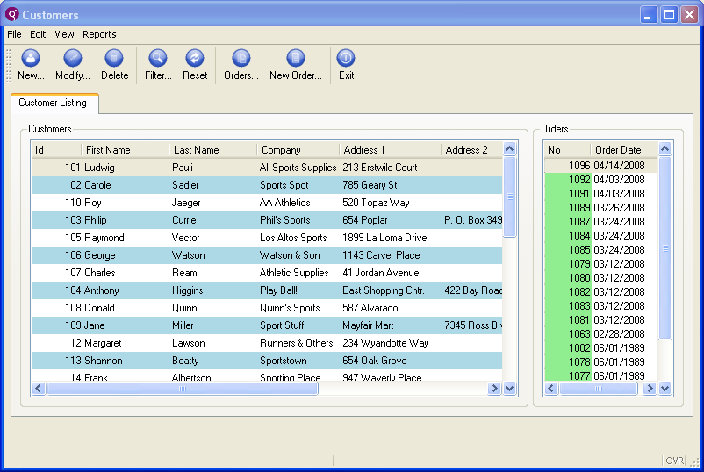
Example Genero Form
Top menu
Tool bar
Folders
Grouped fields
Tables/Arrays
Status bar

Slide 4
Elements of a Genero Form
Container – a formatted screen region or a container for other containers (Grid, Folder, Table, groupboxes, etc.)
FormField– an area where users can view and edit data
Widget – a user-friendly form item for an underlying FormField (Edit, ComboBox, RadioGroup, etc. )
Action View – a form item that can trigger a program action (Button, Topmenu item, Toolbar icon, etc.)
Label – a text area that displays descriptive information

Slide 5
.42f example
schema gift
layout (text = "Merchants")
vbox
grid
{
Merchant Help
}
end --grid
table
{
id Merchant Name
[a0 ][f000 ]
[a0 ][f000 ]
[a0 ][f000 ]
[a0 ][f000 ]
[a0 ][f000 ]
}
end --table
end --vbox
end --layout
tables
merchant
attributes
a0 = merchant.merchant_id;
f000 = merchant.merchant_name;
end
instructions
screen record
sa_merchant[5](merchant_id,
merchant_name)
<?xml version='1.0'?>
<Form name="merchant" text="Merchants" width="34" height="6">
<VBox>
<Grid width="20" height="1">
<Label text="Merchant Help" width="13" posY="0" posX="7" />
</Grid>
<Table height="5" pageSize="5" tabName="sa_merchant">
<TableColumn text="id" colName="merchant_id" sqlType="CHAR(3)" fieldId="0" sqlTabName="merchant">
<Edit width="3" />
</TableColumn>
<TableColumn text="Merchant Name" colName="merchant_name" sqlType="CHAR(20)" fieldId="1" sqlTabName="merchant">
<Edit width="20" />
</TableColumn>
</Table>
</VBox>
<RecordView tabName="merchant">
<Link colName="merchant_id" fieldIdRef="0" />
<Link colName="merchant_name" fieldIdRef="1" />
</RecordView>
</Form>

Slide 6
The SCHEMA Section
SCHEMA Section
Defines the database schema on which the form is based.
Not required
Replace the old DATABASE section
DATABASE section is still compatible.
Syntax:
SCHEMA ( database[@dbserver] | string | FORMONLY )
Notes:
Database section is still compatible but nobody knows for how long, it is quite easy to change it with sed commands so do postpone this work too long.

Slide 7
The ACTION DEFULTS Section
ACTION DEFAULTS Section
Defines default attributes of local action view for the form elements.
Actions and Action Defaults will be discussed in module 4
Syntax:
ACTION DEFAULTS
ACTION action_identifier ( action_attribute [,…] )
[…]
END
Notes:
Database section is still compatible but nobody knows for how long, it is quite easy to change it with sed commands so do postpone this work too long.

Slide 8
The LAYOUT Section
LAYOUT Section
The LAYOUT section defines the abstract layout of the elements of the form.
This section is a tree of layout nodes, used to define graphical elements. Your form must have either a LAYOUT section or the deprecated SCREEN section.
Syntax:
LAYOUT [ ( attribute [ = value ] [,…] ) ] root-layout-container […]
[END]
Notes:
Attributes for the LAYOUT section are TEXT, TAG, STYLE, VERSION, SPACING, WINDOWSTYLE.

Slide 9
Layout Containers
Layout Containers
Containers are blocks holding other containers or defining a formatted screen region.
They are nested to create the visual layout of the form area of the user interface.
Valid containers are:
HBOX container
VBOX container
GROUP container
FOLDER container
PAGE container
GRID container
SCROLLGRID container
TABLE container
TREEVIEW container

Slide 10
Layout Containers Examples
LAYOUT Example - .per
LAYOUT ( text = "Customer Orders" )
VBOX
GROUP ( text = "Customer Details" )
GRID
{
Name: [f001 ]
Phone: [f002 ]
Address: [f003 ]
}
END --GRID
END --GROUP
TABLE
{
OrdNo Date Ship date Weight
[c01 |c02 |c03 |c04 ]
[c01 |c02 |c03 |c04 ]
[c01 |c02 |c03 |c04 ]
}
END --TABLE
END --VBOX
END --LAYOUT
Notes:
Discussion questions:
What container is the grid within?
Is the table container within the same container as the grid container?
Is there a container within a container?
We'll take a look at each of the containers in the next few pages.

Slide 11
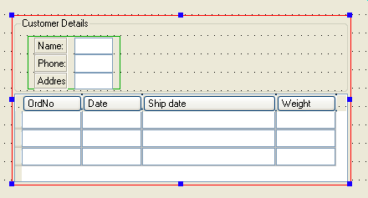
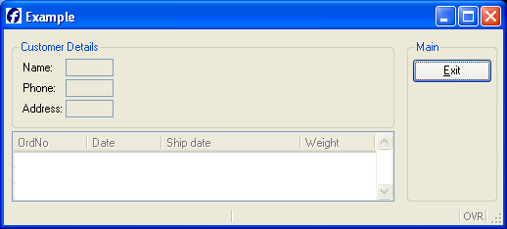
Layout Containers Examples
LAYOUT Example – Form Designer
VBox
Group Box
Grid
Table
Notes:
Discussion questions:
What container is the grid within?
Is the table container within the same container as the grid container?
Is there a container within a container?
We'll take a look at each of the containers in the next few pages.

Slide 12
Attributes
Containers have a set of supported attributes that can be applied in the .per definition for presentation and behavior.
Example:
GROUP (text = "Customer Details", HIDDEN)
The documentation lists the valid attributes for each container, and includes an Attributes List.
Notes:
Syntax for VBOX and HBOX are the same.
Valid attributes are:
TAG = "string" Defines a tag for this element to identify a form item with a specific string.
HIDDEN When used, indicates that the container will be invisible by default.

Slide 13


VBOX and HBOX
VBOX
Stands for Vertical Box
Displays the elements defined within the container vertically from top to bottom.
HBOX
Stands for Horizontal Box
Displays the elements defined within the container horizontally from left to right.
Syntax:
VBOX [ ( attribute [ = value ] ) ] layout-container [...] END
Notes:
Syntax for VBOX and HBOX are the same.
Valid attributes are:
TAG = "string" Defines a tag for this element to identify a form item with a specific string.
HIDDEN When used, indicates that the container will be invisible by default.

Slide 14
GROUP Containers
A GROUP container can be used to display a titled box (usually called groupbox)
around contained elements.
Syntax:
GROUP [ ( attribute [ = value ] ) ] layout-container [...]
END
Where layout-container can be:
VBOX, HBOX, GROUP, FOLDER, GRID, TABLE

Slide 15
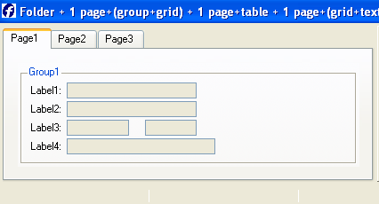
FOLDER and PAGE Containers
A FOLDER container can be used to display PAGE containers as folder tabs.
Syntax:
FOLDER [ ( attribute [ = value ] ) ] PAGE layout-container [...] END [...] END
Where layout-container can be:
VBOX, HBOX, GROUP, FOLDER, GRID, TABLE
PAGE containers can include other containers such as GROUP and GRID

Slide 16
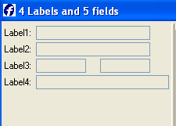
GRID Containers
The GRID container declares a formatted text block, encased in braces “{…}”, defining the dimensions and the relative positions of the logical elements of a screen. Form fields are normally defined here.
Syntax:
GRID [ ( attribute [ = value ] ) ] { { text | item-tag | layout-tag } [...] }
END

Slide 17
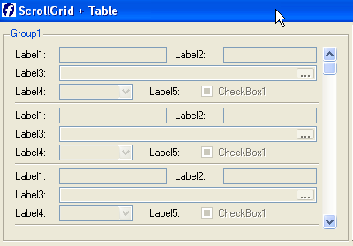
SCROLLGRID Containers
SCROLLGRID is similar to the GRID container, except that you can repeat the screen elements on several "record rows" in order to design a multiple-record view, which will appear with a scrollbar.
Syntax:
SCROLLGRID [ ( attribute [ = value ] ) ] { row-template [...] } END
where row-template is a text block containing:
{ text | item-tag | h-line } [...]

Slide 18
SCROLLGRID Containers
The TABLE container defines the presentation of a list of records.
The first line of a table-area can be text defining the column titles.
The second line must be field item tags that define the columns receiving data.
Syntax:
TABLE [ ( attribute [ = value ] ) ] { [ title [...] ]
[identifier [|...] ] }
END

Slide 19
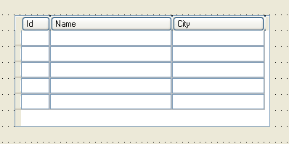
TABLE Example
Text-Based
LAYOUT
TABLE
{
Id Name City
[f01 |f02 |f03 ]
[f01 |f02 |f03 ]
[f01 |f02 |f03 ]
[f01 |f02 |f03 ]
}
END
END
Form Designer
Notes:
Column titles could be defined in the ATTRIBUTES section:
EDIT f01 = customer.id, TITLE="Id";

Slide 20
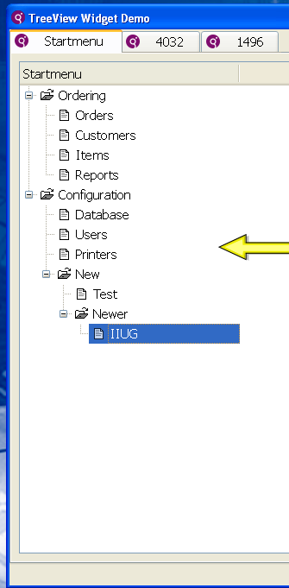
Tree Container
Predefined actions expand and collapse allow trapping of user selections. In code, can add/delete selected portion of tree dynamically.

Slide 21
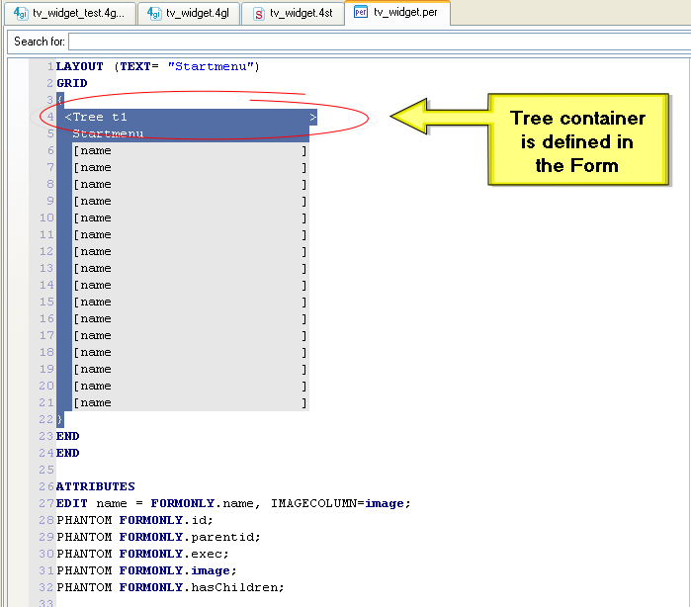
Tree Container

Slide 22
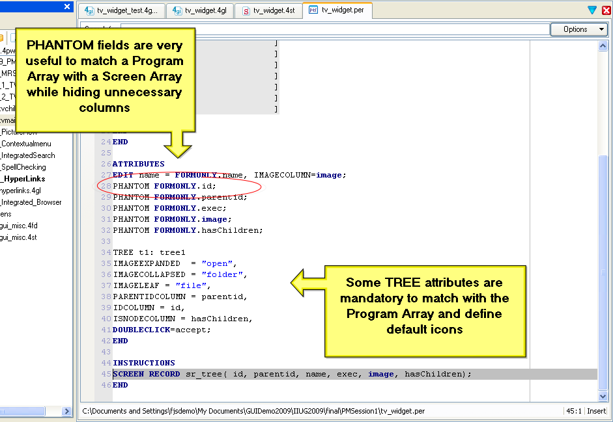

Slide 23
Form Elements
FIELD
EDIT
BUTTON
BUTTONEDIT
CANVAS
COMBOBOX
CHECKBOX
DATEEDIT
GROUP
IMAGE
LABEL
PROGRESSBAR
RADIOGROUP
SCROLLGRID
SLIDER
SPINEDIT
TABLE
TEXTEDIT
TIMEEDIT
Notes:
All of the form element types are covered in detail in the Genero Documentation, in the Form Specification Files – Attributes section.

Slide 24
Form Elements
Text Based form definition file
LAYOUT ( text = "Customer orders" )
VBOX
GROUP ( text = "Customer details" )
GRID
{
Name: [f001 ]
Phone: [f002 ]
Address: [f003 ]
}
END --GRID
END --GROUP
TABLE
{
OrdNo Date Ship date Weight
[c01 |c02 |c03 |c04 ]
[c01 |c02 |c03 |c04 ]
[c01 |c02 |c03 |c04 ]
}
END --TABLE
END --VBOX
END --LAYOUT
Text labels
Form Fields
Pipe symbol used to make items appear next to each other

Slide 25
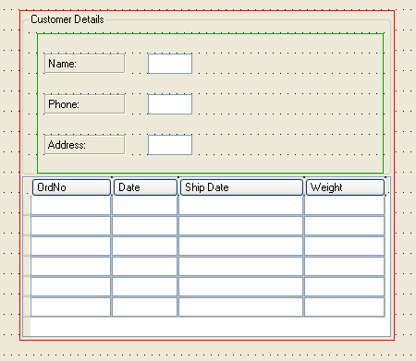
Form Elements
Form Designer definition file
Text labels
Form Fields
Table
Container

Slide 26

Edit
A EDIT item is a common line-edit field.
Syntax:
EDIT item-tag = field-name[,attribute-list];
Notes:
Attributes:
AUTONEXT, CENTURY, COLOR, COLOR WHERE, COMMENT, DEFAULT, DISPLAY LIKE, DOWNSHIFT, HIDDEN, FONTPITCH, FORMAT, INCLUDE, INVISIBLE, JUSTIFY, KEY,
The form field can be a
NOT NULL, NOENTRY, PICTURE, PROGRAM, REQUIRED, REVERSE, SAMPLE, STYLE, SCROLL, SIZEPOLICY, TAG, TABINDEX, UPSHIFT, VALIDATE LIKE, VERIFY.
Table Column only: UNSORTABLE, UNSIZABLE, UNHIDABLE, UNMOVABLE, TITLE.

Slide 27

Button
A BUTTON is an action view, not associated with database columns and therefore using the static notation.
Example:
BUTTON btn1 : help, TEXT="Click me",
IMAGE="question“ ;
Notes:
Note: Use lower-case action identifiers to ensure proper binding to other elements (toolbars and topmenus, for example).
Attributes:
COMMENT, HIDDEN, IMAGE, SIZEPOLICY, STYLE, TAG, TEXT

Slide 28

Button Edit
A BUTTONEDIT defines a line-edit with a push-button that can trigger an action.
Example:
BUTTONEDIT f001 = customer.state,REQUIRED,
IMAGE="smiley",
ACTION=zoom;
Notes:
Attributes:
ACTION, AUTONEXT, CENTURY, COLOR, COLOR WHERE, COMMENT, DEFAULT, DISPLAY LIKE, DOWNSHIFT, HIDDEN, FORMAT, FONTPITCH, IMAGE, INCLUDE, INVISIBLE, JUSTIFY, KEY, NOT NULL, NOENTRY, PICTURE, SAMPLE, SCROLL, SIZEPOLICY, STYLE, REQUIRED, TAG, TABINDEX, TITLE, UPSHIFT, VALIDATE LIKE, VERIFY.
Table Column only: UNSORTABLE, UNSIZABLE, UNHIDABLE, UNMOVABLE.

Slide 29
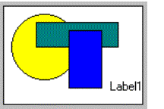
Canvas
A CANVAS item defines an area in which you can draw shapes.
Example:
CANVAS cvs1 : canvasarea1;
Notes:
Attributes:
COMMENT, HIDDEN, TAG.
In programs, you draw canvas shapes by creating Canvas nodes in the Abstract User Interface tree with the DOM API utilities.

Slide 30
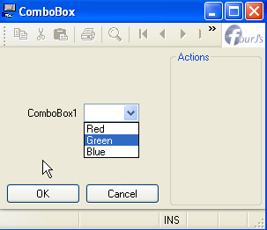
Combo Box
The COMBOBOX item type defines a line-edit with a drop-down list of values.
Example
COMBOBOX f1 = customer.colorCombo,
ITEMS = ((1,'Red'),
(2,'Green'), (3,'Blue));
Notes:
You can associate real values with display values in the Combo Box. In this example, if the user chooses Green, the value of 2 is sent to the program.
Attributes:
COLOR, COMMENT, DEFAULT, DOWNSHIFT, FONTPITCH, HIDDEN, KEY, INITIALIZER, ITEMS, NOT NULL, NOENTRY, QUERYEDITABLE, REQUIRED, SAMPLE, SIZEPOLICY, STYLE, UPSHIFT, TAG, TABINDEX, TITLE
Table Column only: UNSORTABLE, UNSIZABLE, UNHIDABLE, UNMOVABLE.
Later in the class you will learn how to dynamically populate a COMBOBOX control with data from a database.

Slide 31
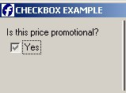
Checkbox
A CHECKBOX defines a boolean entry with a box and a text label.
Example:
CheckBox check1= formonly.check1,
valueChecked=“Y”,
valueUnchecked=“N”,
text=“Yes”
Notes:
The box shows a check sign when the form field contains the value defined in the VALUECHECKED attribute (for example: 'Y'), and shows no check sign if the field value equals the value defined by the VALUEUNCHECKED attribute (for example: 'N'). The TEXT attribute defines the label to be displayed near the check box.
Other Attributes:
COMMENT, DEFAULT, FONTPITCH, HIDDEN, KEY, NOT NULL, NOENTRY, REQUIRED, SIZEPOLICY, STYLE, TAG, TABINDEX, TEXT, TITLE
Table Column only: UNSORTABLE, UNSIZABLE, UNHIDABLE, UNMOVABLE.

Slide 32
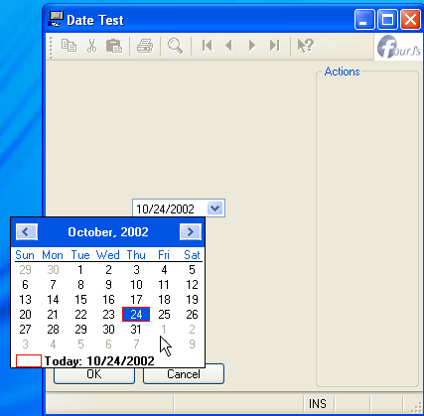
DateEdit
DateEdit defines a line edit box with a button that opens a calendar window.
Example:
DateEdit calendar = formonly.calendar;
Notes:
The keyboard commands for use with DateEdit are:
ALT-UP or ALT-DOWN : Open the calendar when you are in the field
TAB : Switch between day/month/year
ARROW KEYS : change the value of the day/month/year
ALT-UP or ALT-DOWN or ENTER : validate your choice and close the calendar
ESCAPE : annull the changes and close the calendar.
Attributes:
CENTURY, COLOR, COLOR WHERE, COMMENT, DEFAULT, FONTPITCH, FORMAT, HIDDEN, INCLUDE, JUSTIFY, KEY, NOT NULL, NOENTRY, REQUIRED, SAMPLE, SIZEPOLICY, STYLE, TAG, TABINDEX, TITLE.
Table Column only: UNSORTABLE, UNSIZABLE, UNHIDABLE, UNMOVABLE.

Slide 33
Image
An IMAGE item defines an area in which you can display an image from a pixel-map file.
Form Field Images – for images that change often.
IMAGE f01 = contact.picture,
HEIGHT=400 PIXELS,
WIDTH=200 PIXELS,
STRETCH=BOTH;
Static Images – for images that do not change.
IMAGE f01 : logo, IMAGE="fjs.gif",
STRETCH=BOTH;
Notes:
Attributes:
COLOR, COLOR WHERE, COMMENT, AUTOSCALE, HIDDEN, SIZEPOLICY, WIDTH, HEIGHT, STYLE, STRETCH, TAG.
Static Image only: IMAGE
Table Column only: UNSORTABLE, UNSIZABLE, UNHIDABLE, UNMOVABLE, TITLE.

Slide 34
Labels
The LABEL form item defines a simple text area to display read-only data. There are two types, and each has unique syntax:
Form Field Labels - for labels that have a value that changes often, such as data retrieved from a database.
LABEL custid = customer.customer_id;
Static Labels - for labels that have a value that does not change.
LABEL lab1 : copyright,
TEXT = "2003 ABC COMPANY";
Notes:
Attributes:
COLOR, HIDDEN, FONTPITCH, JUSTIFY, SIZEPOLICY, STYLE, TAG, TITLE
Form Field Label only: COLOR WHERE, FORMAT, SAMPLE.
Table Column only: UNSORTABLE, UNSIZABLE, UNHIDABLE, UNMOVABLE.
Static Label only: TEXT.
Why use static labels?
Unable to fit in form layout
Provides a unique identifier in the DOM tree
Label text could be a string for localization (see the Genero documentation for information about Localised Strings)

Slide 35

Progress Bar
Example:
PROGRESSBAR r1 = FORMONLY.r1 TYPE INTEGER,
VALUEMIN=0, VALUEMAX=100;
The Progress Bar item type defines a horizontal bar with a progress indicator.
Notes:
The VALUEMIN and VALUEMAX attributes define the lower and upper integer limit of the progress information. Any value outside this range will not be displayed.
Other Attributes:
HIDDEN, STYLE, TAG, TITLE
Table Column only: UNSORTABLE, UNSIZABLE, UNHIDABLE, UNMOVABLE.

Slide 36
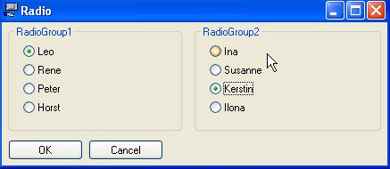
Radio Button
A RADIOGROUP defines a set of radio buttons.
Example:
RadioGroup r1 = formonly.r1,
items=((0,"Leo"),(1,"Rene"),
(2,"Peter"),(3,"Horst"));
RadioGroup r2 = formonly.r2 ,
items=((0,"Ina"),(1,"Susanne"),
(2,"Kerstin"),(3,"Ilona"));
Notes:
Each button is associated with a value defined in the ITEMS attribute. The label associated with each value will be used as the radio button text.
Attributes:
COMMENT, DEFAULT, FONTPITCH, HIDDEN, ITEMS, KEY, NOT NULL, NOENTRY, ORIENTATION, REQUIRED, SIZEPOLICY, STYLE, TAG, TABINDEX, TITLE
Table Column only: UNSORTABLE, UNSIZABLE, UNHIDABLE, UNMOVABLE.
To get a horizontal radiogroup, set the ORIENTATION attribute to HORIZONTAL:
RADIOGROUP r1 = formonly.r1, ORIENTATION=HORIZONTAL, ITEMS=( … );

Slide 37

Slider
The SLIDER item type defines a horizontal or vertical slider.
Example:
SLIDER f01 = workstate.duration,
VALUEMIN=0, VALUEMAX=5,
STEP=1;
Notes:
Attributes:
COLOR, COLOR WHERE, COMMENT, DEFAULT, HIDDEN, ORIENTATION, SIZEPOLICY, STEP, STYLE, TABINDEX, TAG, VALUEMIN, VALUEMAX.
Table Column only: UNSORTABLE, UNSIZABLE, UNHIDABLE, UNMOVABLE, TITLE.

Slide 38
Spin Edit
The SPINEDIT item type defines a spin box widget, also called a spin button.
Example:
SPINEDIT f01 = command.nbitems, STEP=5;
Notes:
Attributes:
COLOR, COLOR WHERE, COMMENT, DEFAULT, FONTPITCH, HIDDEN, NOT NULL, NOENTRY, REQUIRED, SIZEPOLICY, STEP, STYLE, TABINDEX, TAG.
Table Column only: UNSORTABLE, UNSIZABLE, UNHIDABLE, UNMOVABLE, TITLE.

Slide 39
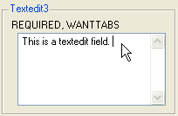
Text Edit
The TEXTEDIT form item type defines a multi-line edit form field.
Example:
TEXTEDIT f1 = customer.comments,STRETCH=BOTH,WANTTABS;
New textEdit style options include integrated search
and spell checking.
Notes:
See new 2.20 style examples in the Styles chapter.
By default, when the focus is in a TEXTEDIT field, the TAB key moves to the next field while the RETURN key adds a NewLine (ASCII 10) character in the text.
To control the user input when pressing TAB and RETURN keys, you can specify the WANTTABS and WANTNORETURNS attributes:
WANTTABS - The TAB key is consumed by the TEXTEDIT field, and a TAB character is added to the text.
WANTNORETURNS - The RETURN key is not consumed by the TEXTEDIT field, and the dialog is validated.
You can use the SCROLLBARS attribute to define vertical and/or horizontal scrollbars for the TEXTEDIT form field. By default, this attribute is set to VERTICAL for TEXTEDIT fields.
The STRETCH attribute can be used to force the TEXTEDIT field to stretch when the parent container is resized. Values can be NONE, X, Y or BOTH.
Other attributes:
COLOR, COMMENT, DEFAULT, DOWNSHIFT, HIDDEN, FONTPITCH, KEY, NOT NULL, NOENTRY, REQUIRED, SAMPLE, SIZEPOLICY, STYLE, TAG, TABINDEX, TITLE, UPSHIFT
Table Column only: UNSORTABLE, UNSIZABLE, UNHIDABLE, UNMOVABLE.

Slide 40

Time Edit
The TIMEEDIT item type defines a time editor widget.
Example:
TIMEEDIT f01 = command.deliverytime;
Notes:
Attributes:
COLOR, COLOR WHERE, COMMENT, DEFAULT, FONTPITCH, HIDDEN, NOT NULL, NOENTRY, REQUIRED, SIZEPOLICY, STYLE, TABINDEX, TAG.
Table Column only: UNSORTABLE, UNSIZABLE, UNHIDABLE, UNMOVABLE, TITLE.

Slide 41
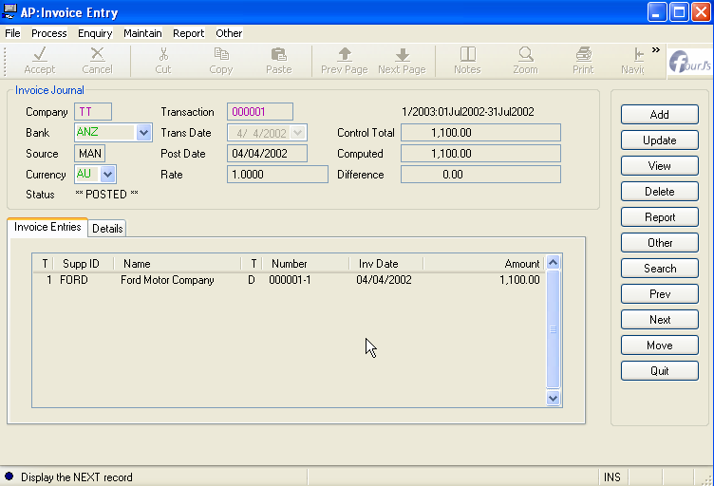
TOPMENU and TOOLBAR Sections
Topmenus and Toolbars are views for actions that can trigger events in your code.
Top menu
Toolbar
Notes:
You can create Topmenus and Toolbars in the TOPMENU and TOOLBAR sections of the form definition file, or you can write a separate XML file and load it into your program. Both techniques are covered in an upcoming module.

Slide 42
Summary
A form definition file (either .per or .4fd) is used to design the form area of a Genero program.
The definition file is translated into an XML document and loaded into the AUI at runtime. (A .42f file.)
The LAYOUT section in the .per file manages the layout of the form.
Form items are used within GRID, SCROLLGRID and TABLE containers to provide fields for static and database-driven values.
Containers and form items have specific attributes.
TopMenus and Toolbars can be defined.
The Action Defaults can be used to centralize the definition of attributes for the form action views.

Slide 43



Q&A

Slide 44
Thank you

