Slide 1

Menus, TopMenus, ToolBars and StartMenus
^{Genero Interface Programming}

Slide 2
Genero Menus
Menu items are action views tied to the actions defined by the current interactive statement, which can be MENU, INPUT, INPUT ARRAY, DISPLAY ARRAY or CONSTRUCT.
When a user selects a Menu item, the program receives an action event corresponding to the program trigger the item is bound to.
A Menu item is disabled automatically if the corresponding action is not available (for example, when a ring menu option is hidden).
Since Menus are part of the Abstract User Interface, you can manipulate them dynamically at runtime.

Slide 3

Menus
By default, Menu buttons are generated in the application window for the actions listed in the MENU statement of your program code.
The menu buttons display in a specific area of the window, depending on the client software.
MENU
ON ACTION find CALL query_cust() ON ACTION next CALL fetch_cust(1) ON ACTION previous CALL fetch_cust(-1) ON ACTION quit EXIT MENU
END MENU

Slide 4
Menus
Attributes List
Attribute | Type | Description
style | STRING | Defines the presentation style of the ring menu. Values can be 'default, 'dialog' or 'popup'.
comment | STRING | Defines the message to be shown when the menu is displayed with 'dialog' style
image | STRING | Defines the icon to be shown when the menu is displayed with 'dialog' style.
Example:
MENU ATTRIBUTE (STYLE="dialog", COMMENT=“Delete?")
ON ACTION …
Notes:
Menu.dialog is a style defined in the default.4st.

Slide 5
Menus
Some considerations:
You cannot define new styles for a MENU.
An ON IDLE idle-seconds clause defines a set of instructions that must be executed after idle-seconds of inactivity.
You can define a window Style to change the menu panel position or make it disappear.
MENU is a set of actions; you can define different kinds of views for actions.

Slide 6
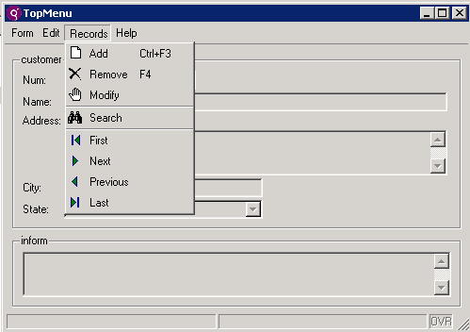
Top Menus
A Top Menu is a view for actions, presented as a typical pull-down menu with options that can trigger events.
Menu options are bound to the actions specified in the program by ON ACTION clauses.
The Top Menu items (buttons) are enabled in accordance with the actions defined by the current interactive statement in your program.

Slide 7
Defining Top Menus
A Top Menu can be defined in a form’s TOPMENU section; the menu will be available for the specific form only.
A Top Menu can also be defined in a .4tm file and loaded with ui.interface.loadTopMenu() or ui.Form.loadTopMenu()
Using a .4tm file allows for reuse of the Top Menu in different forms.

Slide 8
Top Menus: Defined in a Form
TOPMENU Section
The TOPMENU section defines a pull-down menu with options that are bound to actions.
Syntax:
TOPMENU GROUP group-identifier ( group-attribute [,...]
{ command | group
| separator
} [...]
END
[END]
Where command and separator are:
COMMAND command-identifier ( command-attribute [,...] )
SEPARATOR separator-identifier ( separator-attribute [,...] )
Notes:
Don’t confuse TOPMENU with STARTMENU. TOPMENU is like a toolbar that corresponds to application ACTIONS. STARTMENU is used to launch other applications.

Slide 9
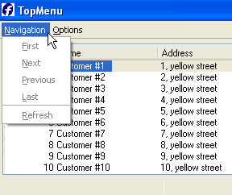
TOPMENU in the Form Example
TOPMENU
GROUP navi (text="Navigation")
COMMAND first (text="First")
COMMAND next (text="Next")
COMMAND previous (text="Previous")
COMMAND last (text="Last")
SEPARATOR
COMMAND refresh (text="Refresh")
END
GROUP options (text="Options")
COMMAND accept (text="Select",image="ok")
COMMAND cancel (text="Cancel",image="cancel")
END
END
Notes:
The TOPMENU section is provided to define a pull-down menu in a form. You build a tree of GROUP elements to design the pull-down menu. A GROUP can contain COMMAND, SEPARATOR or GROUP children.
GROUP defines a new group of pull down menu options
COMMAND defines a pull down menu option that triggers an action
SEPARATOR keyword that indicates separation of menu options
A COMMAND defines a pull-down menu option that triggers an action when it is selected. For example, if you define a TopMenu option as "COMMAND first", it can be controlled by an "ON ACTION first" clause in an interactive instruction.

Slide 10
Top Menus: Defined in a .4tm
Example:
<TopMenu>
<TopMenuGroup text="Form">
<TopMenuCommand name="help" text="Help" image="quest" />
<TopMenuCommand name="quit" text="Quit">
</TopMenuGroup>
<TopMenuGroup text="Records">
<TopMenuCommand name="append" text="Add" image="add" />
<TopMenuCommand name="delete" text="Remove" image="delete"/>
<TopMenuCommand name="update" text="Modify" image="change"/>
<TopMenuSeparator/>
<TopMenuCommand name="search" text="Query" image="find" />
</TopMenuGroup>
</TopMenu>

Slide 11
.4tm Syntax
Syntax:
<TopMenu [ topmenu-attribute="value" [...] ] > group [...] </TopMenu>
Where group is:
<TopMenuGroup group-attribute="value" [...]> { <TopMenuSeparator/> | <TopMenuCommand command-attribute="value" [...] /> | group } [...] </TopMenuGroup>

Slide 12
Top Menu Attributes
Node | Attribute | Type | Description
TopMenuGroup | tag | STRING | Identifies the node
TopMenuGroup | text | STRING | Defines the text to be displayed in the pull-down menu group
TopMenuGroup | comment | STRING | Defines the message to be shown for this element
TopMenuGroup | image | STRING | Defines the icon to be used in the pull-down menu group
TopMenuGroup | hidden | INTEGER | Indicates if the group is hidden
Notes:
There is also a TopMenu Separator that can be used to create a separation between groups.
Images cannot be displayed for the first level of TopMenuGroup elements.

Slide 13
Top Menu Attributes
Node | Attribute | Type | Description
TopMenuCommand | name | STRING | Defines the action corresponding to the topmenu command
TopMenuCommand | tag | STRING | Identifies the node
TopMenuCommand | text | STRING | Defines the text to be displayed in the pull-down menu option
TopMenuCommand | comment | STRING | Defines the message to be shown for this element
TopMenuCommand | image | STRING | Defines the icon to be used in the pull-down menu option
TopMenuCommand | hidden | INTEGER | Indicates if the command is hidden
TopMenuCommand | acceleratorName | STRING | Shortcut key that can trigger the action

Slide 14
Top Menu Attributes
Node | Attribute | Type | Description
TopMenuSeparator | tag | STRING | Identifies the node
TopMenuSeparator | hidden | INTEGER | Indicates if the separator is hidden

Slide 15
Loading Top Menus
Use the ui.Interface loadTopMenu() object method to load a default Top Menu from an XML file.
Use the ui.Form loadTopMenu() object method to load a specific Top Menu for a form from an XML file.
CALL ui.Interface.loadTopMenu("mytopmenus")
DEFINE
myForm ui.form
...
CALL myForm.loadTopMenu("mytopmenus")
Notes:
ui.Interface.loadTopMenu method loads a top menu available in the whole application.
ui.Form.loadTopMenu method loads a top menu available for the selected form only.

Slide 16
Loading a Top Menu Example
This example loads the TopMenu in the form initializer function that is called.
CALL ui.Form.setDefaultInitializer("topmenu_from_xml")
OPEN WINDOW w_topmenu WITH FORM "topmenu_xml"
ATTRIBUTE ( TEXT="TopMenu from xml" )
...
FUNCTION topmenu_from_xml(fn)
DEFINE
fn ui.Form
...
CALL fn.loadTopMenu("mytopmenu")
...
END FUNCTION
"mytopmenu" is a file with an extension .4tm located in the DBPATH

Slide 17
Top Menus
Some considerations:
You can define an XML file to create your TopMenu.
The DOM tag names are case-sensitive; Topmenu is different from TopMenu.
A TopMenu is part of a form definition (the TopMenu node must be created under the Form node).
A TopMenu command is bound to an action node of the current interactive instruction if its name attribute corresponds to an action node name.
Notes:
To avoid errors, write action names in lowercase.

Slide 18

Toolbars
A Toolbar is a view providing buttons that can trigger events in an interactive instruction.
The Toolbar items (buttons) are enabled in accordance with the actions defined by the current interactive instruction.

Slide 19
Toolbars
A Toolbar can be defined in a form’s TOOLBAR section; the toolbar will be available for the specific form only.
A Toolbar can also be defined in a .4tb file and loaded with ui.interface.loadToolBar() or ui.Form.loadToolBar()
Using a .4tb file allows for reuse of the Toolbar in different forms.

Slide 20
Toolbar defined ia a .per
TOOLBAR
ITEM find
ITEM previous
ITEM next
SEPARATOR
ITEM close (TEXT="Quit", IMAGE="exit")
END
Notes:
The TOOLBAR section in the form definition file has the following syntax:
TOOLBAR [toolbar-identifier] [ ( toolbar-attribute [,...] ) ]
{ ITEM item-identifier [ ( item-attribute [,...] ) ]
| SEPARATOR [separator-identifier] [ ( item-attribute [,...] ) ]
}
[...]
END

Slide 21
Defining Toolbars in XM.
In an XML file (standard.4tb):
<ToolBar>
<ToolBarItem name="f5" text="List" image="list" />
<ToolBarSeparator/>
<ToolBarItem name="Query" text="Query" image="search" />
<ToolBarItem name="Add" text="Append" image="add" />
<ToolBarItem name="Delete" text="Delete" image="delete" />
<ToolBarItem name="Modify" text="Modify" image="change" />
<ToolBarSeparator/>
<ToolBarItem name="f1" text="Help" image="list" />
<ToolBarSeparator/>
<ToolBarItem name="Quit" text="Quit" image="quit" />
</ToolBar>
Notes:
Syntax:
<ToolBar [ toolbar-attribute="value" [...] ] > { <ToolBarSeparator/> | <ToolBarItem toolbaritem-attribute="value" [...] /> } [...] </ToolBar>

Slide 22
Toolbar Attributes
Node | Attribute | Type | Description
ToolBar | tag | STRING | User-defined attribute to identify the node
ToolBar | name | STRING | Identifies the toolbar
ToolBar | buttonTextHidden | INTEGER | Defines if the text of toolbar buttons must appear by default

Slide 23
Toolbar Attributes
Node | Attribute | Type | Description
ToolBarItem | Name | STRING | Defines the action corresponding to the toolbar button.
ToolBarItem | tag | STRING | User-defined attribute to identify the node
ToolBarItem | Text | STRING | Defines the text to be displayed in the toolbar button.
ToolBarItem | Comment | STRING | Defines the message to be shown as tooltip when the user selects a toolbar button.
ToolBarItem | Image | STRING | Defines the icon to be used in the toolbar button.
ToolBarItem | hidden | INTEGER | Indicates if the item is hidden

Slide 24
Toolbar Attributes
Node | Attribute | Type | Description
ToolBarSeparator | tag | STRING | User-defined attribute to identify the node
ToolbarSeparator | hidden | INTEGER | Indicates if the separator is hidden

Slide 25
Load Toolbars Example
You can use the utility method provided by the Interface built-in class:
Or you can use the utility method provided by the Form built-in class:
CALL ui.Interface.loadToolbar("standard")
DEFINE myform ui.form
…
CALL myform.loadToolbar("standard")
Notes:
In the examples, standard is a file with an extension .4tb located in the DBPATH.

Slide 26
Toolbars
Some considerations:
The DOM tag names are case-sensitive; Toolbar is different from ToolBar.
When binding to an action, make sure that you are using the right value in the name attribute.
When binding to a key, make sure the name attribute value is in lowercase ("f5").
Make sure the image file is accessible to the Genero Client.
The images directory defined in the GDC
A URL accessible to the GDC

Slide 27
Start Menus
A Start Menu defines a tree of commands that start programs on the application server where the runtime system executes.
A program can only have one Start Menu.
The Start Menu window should use the style 'main'.
We recommend that you create a specific BDL program dedicated for running the Start Menu. This program must create (or load) a Start Menu and then perform an interactive instruction (eg. DISPLAY ARRAY or a MENU in the SCREEN window)

Slide 28
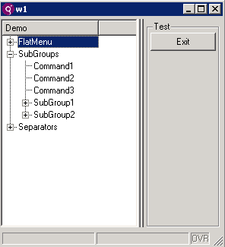
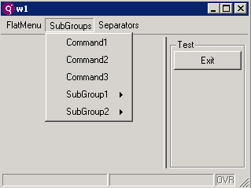
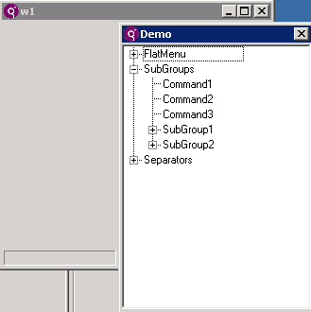
Start Menus
Menu, Tree and Poptree styles:

Slide 29
Start Menus
Example:
<StartMenu text="Example1">
<StartMenuGroup text="FlatMenu">
<StartMenuCommand text="Command1" exec="fglrun hello Command1" />
</StartMenuGroup>
<StartMenuGroup text="SubGroups">
<StartMenuCommand text="Command1" exec="fglrun hello Command1" />
<StartMenuGroup text="SubGroup1">
<StartMenuCommand text="Command21" exec="fglrun hello Command21"/>
</StartMenuGroup>
<StartMenuGroup text="SubGroup2">
<StartMenuCommand text="Command31" exec="fglrun hello Command31"/>
</StartMenuGroup>
</StartMenuGroup>
<StartMenuGroup text="Separators">
<StartMenuCommand text="Command1" exec="fglrun hello Command1" />
<StartMenuSeparator/>
<StartMenuCommand text="Command2" exec="fglrun hello Command3" />
</StartMenuGroup>
</StartMenu>

Slide 30
Start Menus
Syntax:
<StartMenu [ startmenu-attribute="value" [...] ] > startmenu-group [...] </StartMenu>
where startmenu-group is:
<StartMenuGroup group-attribute="value" [...]> { <StartMenuSeparator/> | <StartMenuCommand command-attribute="value" [...] /> | group } [...] </StartMenuGroup>

Slide 31
Start Menu Attributes
Node | Attribute | Type | Description
StartMenu | text | STRING | Defines the text to be displayed as title.
StartMenuGroup | text | STRING | Defines the text to be displayed for this group.
StartMenuGroup | image | STRING | Defines the icon to be used for this group.
StartMenuGroup | disabled | INTEGER | Indicates if the group is disabled (grayed out, cannot be selected.)
StartMenuCommand | exec | STRING | Defines the command to be executed when the user selects this command.
StartMenuCommand | text | STRING | Defines the text to be displayed for this command.
StartMenuCommand | Image | STRING | Defines the icon to be used for this command.
StartMenuCommand | disabled | INTEGER | Indicates if the group is disabled (grayed out, cannot be selected.)
Notes:
Note:You can add an attribute Name for all these nodes, of type STRING, to identify the startMenu item, but it is not required.
There is also a startMenuSeparator available.

Slide 32
Load Start Menu Example
You can also use the utility method provided by the Interface built-in class.
CALL ui.Interface.loadStartMenu("app_menu")
"app_menu" is a file with an extension .4sm located in the DBPATH.

Slide 33
Start Menus
Some considerations:
You can define an XML file to create your StartMenu.
The DOM tag names are case sensitive; Startmenu is different from StartMenu.
You can apply different styles for a Start Menu: Menu | tree | poptree (see Window Style attributes).
Since the Start Menu is part of the Abstract User Interface, you can manipulate it at runtime.

Slide 34
StatusBar
New window style attribute for StatusBar layout specification.
You can now set statusBarType attribute in the 4st style file for Windows in order to control the display of status bars.
Values of statusBarType can be:
none = No statusbar
default = The default status bar, same as panels2
panels1 = 1 panel, 1:comment/error/message
panels2 = 2 panels, 1:comment, 2:error/message
panels3 = 2 panels, 1:error/message, 2:comment
lines1 = 2 lines, 1:comment, 2:error/message
lines2 = 2 lines, 1:comment/message, 2:error

Slide 35
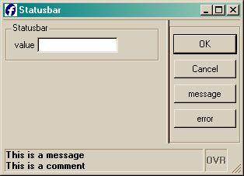
StatusBar
<Style name="Window.statusbar">
<StyleAttribute name="windowType“ value="normal" />
<StyleAttribute name="statusBarType" value="lines2" />
</Style>

Slide 36
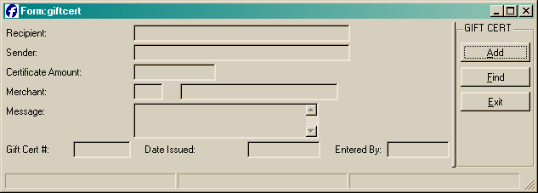
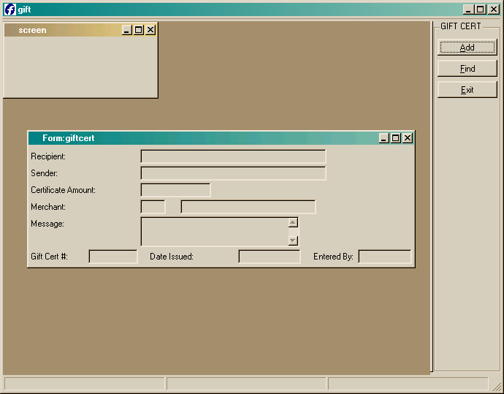
Multiple Document Interface
SDI
MDI (WCI)

Slide 37
Multiple Document Interface
Some considerations:
In BDL, a Multiple Document Interface is also referred to as WCI: Window Container Interface.
A Window Container Interface (WCI) makes sense when the application programs have a main window that is the root for other windows opened temporarily (typically, modal windows to pick a record in a list).
WCI configuration is done dynamically at the beginning of programs, by using the ui.Interface built-in class.
The WCI container program is a separate BDL program of a special type, in which the default SCREEN window is used as an MDI container.

Slide 38
Multiple Document Interface
The WCI container program must indicate that its type is special (setType method), and must identify itself (setName method):
MAIN
CALL ui.Interface.setName("parent1")
CALL ui.Interface.setType("container")
CALL ui.Interface.setText("SoftStore Manager")
CALL ui.Interface.loadStartMenu("mystartmenu")
…
WCI children programs must attach to a parent container by giving the name of the container program:
MAIN
CALL ui.Interface.setName("custapp")
CALL ui.Interface.setType("child")
CALL ui.Interface.setText("Customers")
CALL ui.Interface.setContainer("parent1")
…

Slide 39
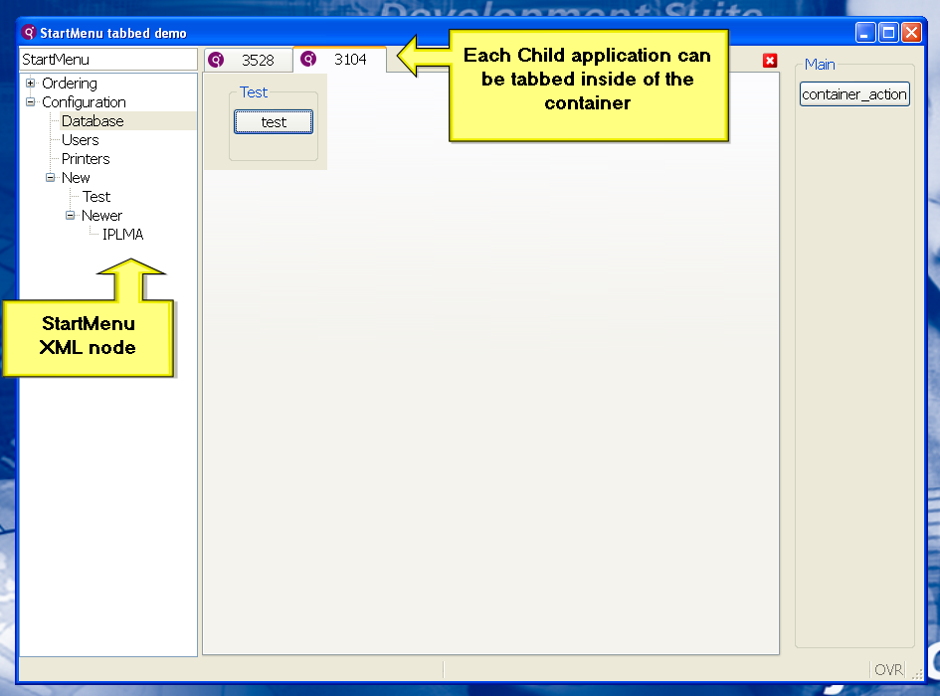
Multiple Document Interface
Start Menus launch programs. Those programs can be run in a Window Container Interface. All child programs open and are contained by a parent window. 2.20 introduces the tabs as an MDI style.
Methods used:
ui.interface.setType(parent|child)
ui.interface.setContainer()
Window Style:
<StyleAttribute name = “tabbedContainer” value = “yes”/>

Slide 40
Multiple Document Interface
To conclude :
The only style applied is Window.main.
The Toolbar is unique for the container however the StartMenu and TopMenu are not.
If a child program is started, but the parent container is not, the client shows a system error message and the program stops with a runtime error.
If a container program is started twice, the client shows a system error message and the program is stopped with a runtime error.
When the parent container program is stopped, other applications are stopped automatically.

Slide 41



Q&A

Slide 42
Thank you

