Slide 1

Giving Users Choices:
Actions
^{Genero Interface Programming}

Slide 2
What are actions?
Actions, triggered by interactive elements in the GUI (such as buttons), are events transmitted to the runtime system for interpretation.
Action Views (in GUI)
can produce
Action Events (in DOM)
that will execute the code of the corresponding
Action Handler (in code)

Slide 3
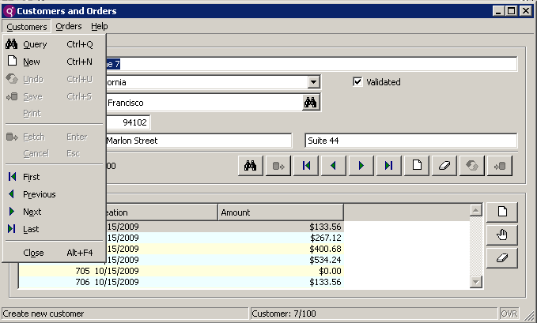
Action Views, Events and Handlers
Action Views
Action Events
Action Handlers
INPUT ARRAY
…
ON ACTION cust_append
CALL w()
…
MENU
…
ON ACTION cust_append
CALL x()
…
cust_append
INPUT
…
ON ACTION cust_append
CALL y()
…
DISPLAY ARRAY
…
ON ACTION cust_append
CALL z()
…

Slide 4
The ON ACTION Statement
The ON ACTION statement can be used within interactive dialog statements MENU, CONSTRUCT, INPUT, INPUT ARRAY, DISPLAY ARRAY and DIALOG to issue a series of instructions. The actions are automatically enabled and disabled based on the current interactive instruction.
The INFIELD clause allows you to trigger an action only when a field has focus.
Example:
ON ACTION print
CALL print()
CALL print_msg()
ON ACTION zoom INFIELD customer_city
CALL lookup()

Slide 5
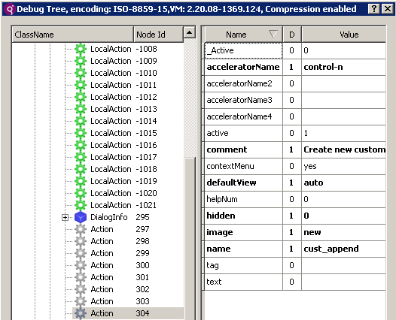

Action Binding
Action Views
Action Events
Action Handlers

Slide 6
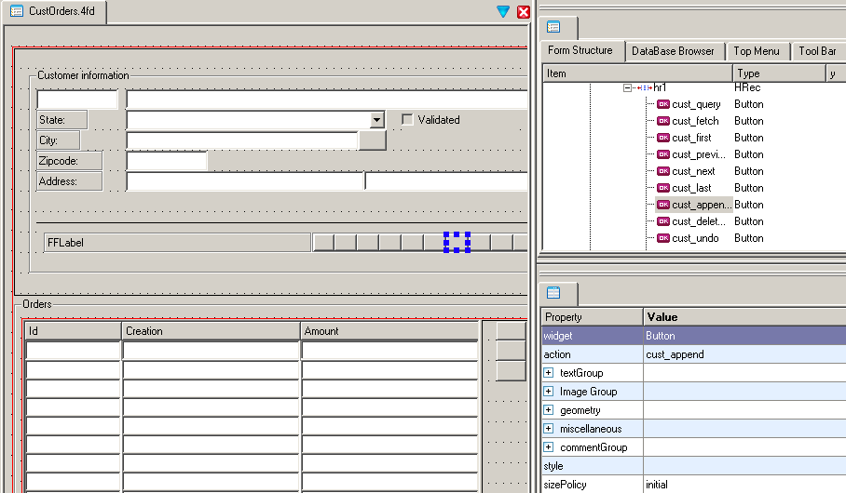
The Name Attribute

Slide 7
Triggering Actions
Actions can be triggered by:
Buttons in the action frame
ToolBar button
TopMenu option
Button on form
Keyboard shortcuts tied to the action:
Examples: Ctrl-p to print or F1 for help

Slide 8
Using Predefined Actions
Some actions are predefined and implement a particular behavior automatically.
Predefined Action | Definition | Examples
Automatic actions | Actions that are automatically created and handled by the runtime system. | accept cancel close insert
Special actions | Actions with a special usage. | interrupt dialogtouched
Local actions | Actions that are handled on the front-end only. | editcopy editpaste

Slide 9
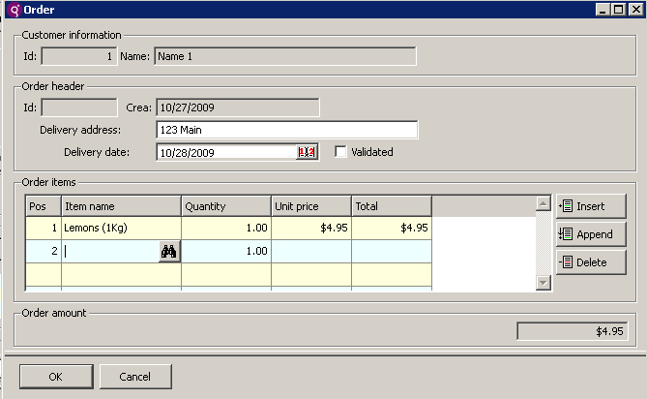
Predefined Actions Example
For example, the accept action validates input and leaves the dialog, the cancel action leaves the dialog without validation and the insert action inserts a new row in an INPUT ARRAY dialog.

Slide 10
Overriding predefined actions
You can add an action handler for a predefined action and override the default behavior.
MENU
…
ON ACTION cust_append
CALL cust_append()
…
ON ACTION close
EXIT MENU
END MENU

Slide 11
Enabling and Disabling Actions
...
BEFORE INPUT
CALL DIALOG.setActionActive("zoom",TRUE)
...

Slide 12
Summary
Actions are events transmitted to the runtime system for interpretation.
Actions are triggered by action views in the GUI (such as buttons).
The ON ACTION statement in the code handles the action when triggered.
Action views are bound to action handlers with the ‘name’ attribute.
Some actions have been predefined for you, such as close.
Actions can be programmatically enabled, disabled and hidden with simple ui.Dialog methods.

Slide 13



Q&A

Slide 14
Thank you

