Slide 1

Using Arrays
^{Genero Interface Programming}

Slide 2
What is an Array?
array_a
101
102
103
104
105
array_r
array_a[3]
101|Bob|Joy
102|Lisa|Lumpe
103|Joe|Madras
104|Rosa|Rodriguez
105|Jerry|Daley
array_r[3].store_num
Notes:
An array is a series of objects all of which are the same size and type. Each object in an array is called an array element. You could have an array defined as any supported data types or record, but not another array.
For example you might have an array of integers or an array of characters or, commonly in Genero, an array of records from a database table.
Array elements can be accessed via an index and are continuous from a logical point of view. So, as above, to identify an element in the array, you reference the logical element number. For a record, you reference the element number and the column in the record.

Slide 3
Visualizing an Array
3 element vector
3 x 3 x 3
27 element cube
3 x 3
9 element matrix
Notes:
Arrays can have one, two, or three dimensions.
One way to visualize an array is to think of the popular puzzle Rubik’s cube. A single row or column would be a one dimensional array, one face of the cube a 2 dimensional array and the cube itself a 3 dimensional array.
Each cell in the cube represents an element in the array if a given type.
One dimensional, called a vector, here has 3 elements
2 dimensional, called a matrix, is represented as a single row and column has 9 elements
3 dimensional, the whole cube has 3x3x3 or 27 elements

Slide 4
Using an Array
Genero Program
Database
Database Connection
Cursor
Result Set
DECLARE CURSOR, FOREACH instruction to fill array with data
Program Array
User Interface
Window/Form
DISPLAY ARRAY instruction
Or
INPUT ARRAY instruction
Table/Tree container
Notes:
In Genero, your program establishes a connection with a database and as you learned in the Using cursors video, you can set up a cursor to manage a result set of rows.
Data from the result set can then be used to fill the array with data.
Your program array data is then displayed to your screen array – either a table container or a tree-view container. Depending on whether you have begun a DISPLAY ARRAY or INPUT ARRAY instruction, the container will allow the user to browse and/or modify the data shown.
Let’s look at defining the program array.

Slide 5
Defining the Array
DEFINE store_arr[5] ARRAY OF
RECORD
store_num LIKE customer.store_num,
store_name LIKE customer.store_name,
phone LIKE customer.phone
END RECORD
Static
Explicitly sized, all elements initialized.
Array out of bounds errors.
Maximum size is 65535.
DEFINE store_arr DYNAMIC ARRAY OF
RECORD
store_num LIKE customer.store_num,
store_name LIKE customer.store_name,
phone LIKE customer.phone
END RECORD
Dynamic
Variable size, no theoretical size limit.
Elements allocated automatically as instructed,
for example when you fill the array with data from a result set.
Notes:
There are two ways to define a program array. The legacy way is to define it as static object with a set number of elements. A static array is:
Static Array:
Explicitly sized for all dimensions
All elements are initialized – this can use a lot of memory
Maximum size is 65535
A better and recommended way of defining an array is Dynamically:
DYNAMIC ARRAY:
Variable size
Elements allocated automatically as instructed, for example when you fill the array with data from a result set.
No theoretical size limit

Slide 6
Loading the Array
FUNCTION get_all()
DECLARE store_cur CURSOR FOR
SELECT store_num, store_name, phone FROM customer
CALL store_arr.clear()
FOREACH store_cur INTO storerec.*
CALL store_arr.appendElement()
LET store_arr[store_arr.getLength()].* = storerec.*
END FOREACH
DISPLAY ARRAY store_arr TO tb2.*
END FUNCTION
-- initialized to NULL
-- appended element filled with current store_rec.* data
store_arr
store_arr[1].*
701|Dan’s Sports|555-212-0889
702|Judy’s Garage|555-209-0009
703|Amazon.com|555-333-1242
store_arr[2].*
store_arr[3].*
Notes:
To fill the array with data, typically from a result set, you’ll use a FOREACH loop.
In this code, the appendElement method appends a new element to the dynamic array.
Next, the last fetched record is assigned to the newly created element at the end of the array. All members of the record are copied respectively to the members of the new array element.
This continues until the result set is exhausted, then the cursor is closed and the FOREACH loop is ended.

Slide 7
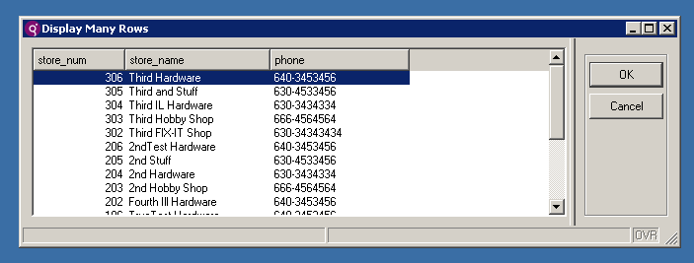
DISPLAY ARRAY – Browse the list
FUNCTION get_all()
DECLARE store_cur CURSOR FOR
SELECT store_num, store_name, phone FROM customer
CALL store_arr.clear()
FOREACH store_cur INTO storerec.*
CALL store_arr.appendElement()
LET store_arr[store_arr.getLength()].* = storerec.*
END FOREACH
DISPLAY ARRAY store_arr TO tb2.*
END FUNCTION
-- map the array to the form container tb2
Notes:
The DISPLAY ARRAY dialog allows you to let users browse a list of records using an array as the data buffer.

Slide 8
DISPLAY ARRAY – Paged Mode
Genero Program
Database
Database Connection
DECLARE, OPEN cursor
SCROLL Cursor
Result Set
DYNAMIC Array (holds one page)
User Interface
Window/Form
DISPLAY ARRAY
ON FILL BUFFER
FETCH more pages into dynamic array
Table/Tree container
Notes:
You can choose to display the data in full list mode or in paged mode.
Full list mode – with full list mode (the default) all the data you want to display is copied into the screen array. The user has access to all the data whether or not they look at all of it. This mode should be used for short and static lists of rows.
Paged mode allows you to provide the user with rows of data dynamically, a page at a time and allows you to fetch fresh data from the database.

Slide 9
DISPLAY ARRAY – Paged Mode
You can choose to display the data in full list mode or in paged mode.
Full list mode – with full list mode (the default) all the data you want to display is copied into the screen array. The user has access to all the data whether or not they look at all of it. This mode should be used for short and static lists of rows.
Paged mode allows you to provide the user with rows of data dynamically, a page at a time and allows you to fetch fresh data from the database.
Notes:
You can choose to display the data in full list mode or in paged mode.
Full list mode – with full list mode (the default) all the data you want to display is copied into the screen array. The user has access to all the data whether or not they look at all of it. This mode should be used for short and static lists of rows.
Paged mode allows you to provide the user with rows of data dynamically, a page at a time and allows you to fetch fresh data from the database.

Slide 10
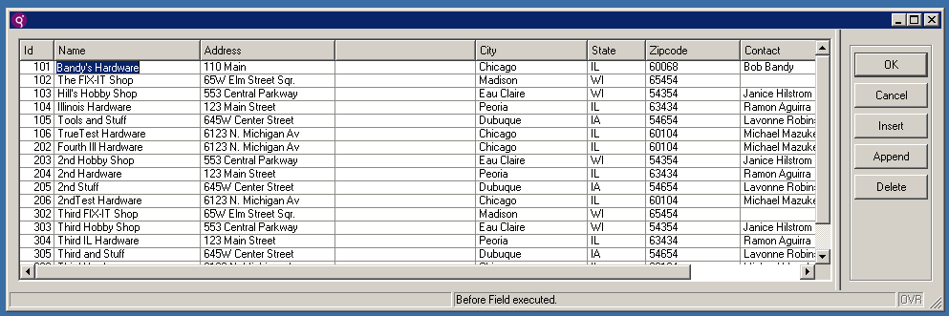
INPUT ARRAY – Modify the list
INPUT ARRAY allows the user to edit or delete existing rows, insert new rows, and move inside the list of records.
Upon confirmation, the changes are added to the database with standard SQL statements (INSERT/UPDATE/DELETE)
Notes:
The INPUT ARRAY dialog supports data entry into a screen array and stores the entered data in a program array.

Slide 11
Methods for Arrays
Name | Description
appendElement( ) | Adds a new element at the end of a dynamic array. This method has no effect on a static array.
clear( ) | Removes all elements in a dynamic array. Sets all elements to NULL in a static array.
deleteElement( INTEGER ) | Removes an element at the given position. In a static or dynamic array, the elements after the given position are moved up. In a dynamic array, the number of elements is decremented by 1.
getLength( ) RETURNING INTEGER | Returns the length of a one-dimensional array.
insertElement( INTEGER ) | Inserts a new element at the given position. In a static or dynamic array, the elements after the given position are moved down. In a dynamic array, the number of elements is incremented by 1.

Slide 12



Q&A

Slide 13
Thank you

