Slide 1

Applying Styles
^{Genero Interface Programming}

Slide 2
Presentation Styles
Presentation Styles are provided to centralize attributes related to the appearance of user interface elements.
Elements in the AUI that reference a Style attribute will automatically get the attribute values defined in that style.
Elements in the AUI that don’t reference a style will use the global default style.
Presentation styles are defined in a unique file with the extension .4st. Genero provides a default style file:
$FGLDIR/lib/default.4st
You can create your own style file to replace default.4st.

Slide 3
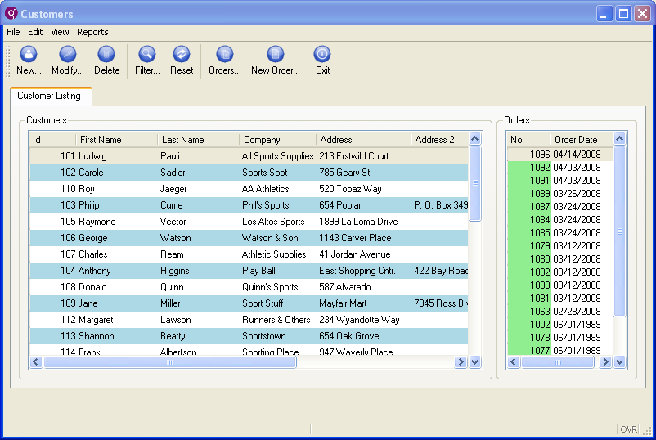
Styles Applied to Objects
Window has style applied to not include Menu Panel.
Two tables, each with a different style applied.

Slide 4
Presentation Styles File
Example (mystyles.4st):
<StyleList>
<Style name="Window">
<StyleAttribute name="windowType" value="normal" />
</Style>
<Style name="Window.dialog">
<StyleAttribute name="windowType" value="modal" />
</Style>
<Style name="Window.naked">
<StyleAttribute name="windowType" value="modal" />
<StyleAttribute name="sizable" value="yes" />
<StyleAttribute name="border" value="tool" />
<StyleAttribute name="actionPanelPosition" value="none" />
<StyleAttribute name="ringMenuPosition" value="none" />
</Style>
<Style name="Window.main">
<StyleAttribute name="windowType" value="normal" />
<StyleAttribute name="startMenuPosition" value="menu" />
</Style>
<Style name="Window.newstyle">
<StyleAttribute name="windowType" value="normal" />
<StyleAttribute name="ringMenuPosition" value="bottom" />
</Style>
</StyleList>

Slide 5
Presentation Styles File
Styles can be defined at several levels
*
Global; applied automatically to all elements
element-type
Global; applied automatically to the named element type (Window, Edit, Combobox, …)
.any-name
Specific; applied to any element types that have the Style attribute set to this Style name.
element-type.any-name
Specific; applied only to elements of the given type that have the Style attribute set to this Style name.

Slide 6
Presentation Styles File
<StyleList>
<Style name="Window">
<StyleAttribute name="windowType" value="normal" />
<StyleAttribute name="sizable" value="yes" />
<StyleAttribute name="actionPanelPosition" value="bottom" />
<StyleAttribute name="ringMenuPosition" value="none" />
</Style>
<Style name="Window.required">
<StyleAttribute name="windowType" value="modal" />
<StyleAttribute name="sizable" value="no" />
<StyleAttribute name=actionPanelPosition" value="none" />
</Style>
<Style name="Label">
<StyleAttribute name="fontFamily" value="sans-serif" />
<StyleAttribute name="fontSize" value="x-large" />
</Style>
<Style name=“TextEdit.intsearch">
<StyleAttribute name=“integratedSearch" value=“yes" />
<StyleAttribute name=“wrapPolicy" value=“atWordBoundary" />
</Style>
<Style name=".urgent">
<StyleAttribute name="backgroundColor" value="red" />
<StyleAttribute name="fontSize" value="xx-large" />
</Style>
</StyleList>
Notes:
The style Window will be applied to all windows and forms.
The style Window.required can only be applied to windows. It will be applied only if specified in the code.
The style Label will be applied to all labels.
The style TextEdit.intSearch will be applied to all TextEdit widgets with the intSearch style applied.
The style urgent can be applied to every objects. It will be applied only if specified in the code. You can only use common style attributes for such style definitions.

Slide 7
Presentation Styles File
Styles in BDL
…
OPEN WINDOW w1 WITH FORM "login"
ATTRIBUTE (STYLE = "required")
…
Styles in form files
…
LAYOUT ( STYLE = "required" )
…
ATTRIBUTES
EDIT f001 = customer.confcall, style="urgent";
…
Notes:
To set the urgent style, you do not write the dot. The dot character is to define the link between the element and the style name.
Writing .urgent is the same as writing *.urgent. * means all elements.

Slide 8
Presentation Styles File
Pseudo selectors can be used to add special effects to an object, depending on its state or position.
focus object has the focus
query object is in construct mode
active object is active
inactive object is inactive
display object is in a display array
input object is in an input array, input or construct
odd object is on an odd row in a table
even object is on an even row in a table
Notes:
The Pseudo selector is added to the style name, preceded by a colon.
<Style name="Edit:focus">
<Style name=".important:focus">
<Style name="Edit.important:focus">
Pseudo selectors can also be combined:
<Style name="Table:even:focus">

Slide 9
Presentation Styles File
<StyleList>
<Style name="Edit:focus">
<StyleAttribute name="backgroundImage"
value="http://www.4js.com/pics/hereami.jpg" />
</Style>
<Style name="Table:odd">
<StyleAttribute name="backgroundColor" value="lightBlue" />
</Style>
<Style name="Table:even">
<StyleAttribute name="backgroundColor" value="lightGray" />
</Style>
<Style name="*:active">
<StyleAttribute name="backgroundColor" value="white" />
</Style>
</StyleList>

Slide 10
Window Styles in default.4st
Dialog: for typical modal windows like winmessage or winquestion
Naked: No Menu, no Action Buttons
Main: Start Application Window; ideal to display a StartMenu
Viewer: No Menu, no Action Buttons, only the cross button on upper right corner
If you don’t specify a STYLE, the default style defined as ‘Window’ is used.
Notes:
See the Presentation Styles section in the documentation for the full definitions list for creating custom window styles.

Slide 11
Using Styles
Use the attribute STYLE to specify the style to be applied.
Example (using a Window style):
…
OPEN WINDOW w1 WITH FORM “start_form”
ATTRIBUTE (STYLE = “main”)
…
Notes:
The value set for the attribute STYLE can also be a variable.
LET StyleName = "main"
OPEN WINDOW w1 WITH FORM "start_form"
ATTRIBUTE (STYLE = StyleName)
The style can also be specified in the LAYOUT section of the form. For example,
in start_form.per LAYOUT (STYLE=“main") would have the same effect.

Slide 12
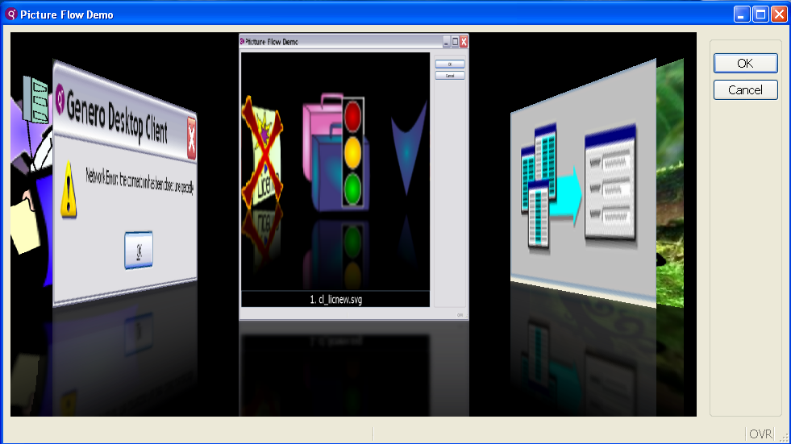
Style Example: Table as PictureFow
A program array is filled with image paths and displayed using standard DISPLAY ARRAY instruction.
Table container has special style applied:
<StyleAttribute name= “tableType” value=“pictureflow”/>

Slide 13
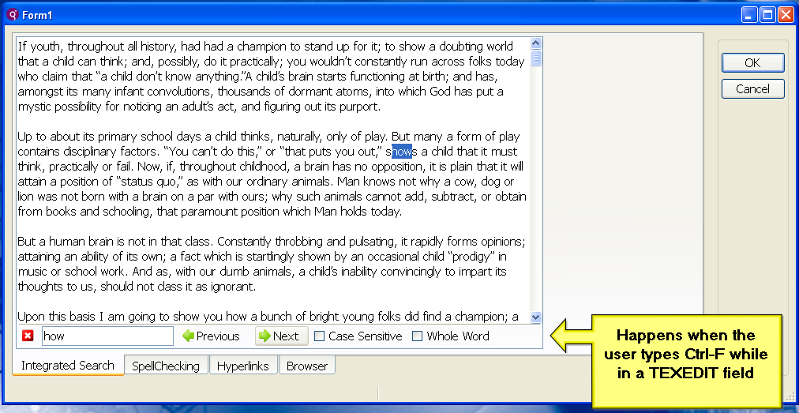
TextEdit with Integrated Search
textEdit with special style:
<StyleAttribute name=“integratedSearch” value = “yes”/>
Also note page container with special style:
<StyleAttribute name=“position” value = “bottom”/>

Slide 14
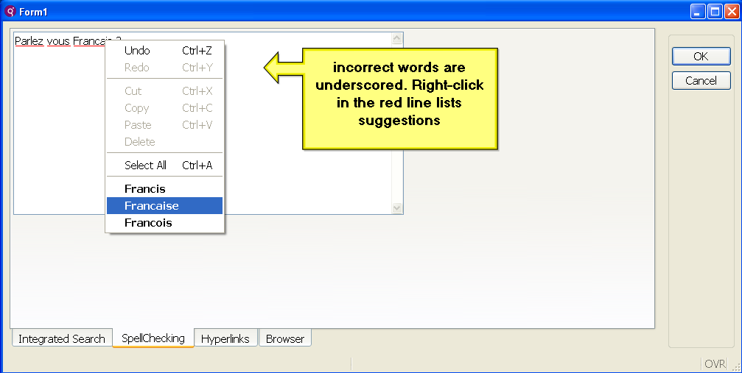
TextEdit with Spell Checking
textEdit with special style:
<StyleAttribute name=“spellCheck” value = “en_US.aff|en_US.dic”/>
Notes:
Dictionary files must be loaded on client.

Slide 15
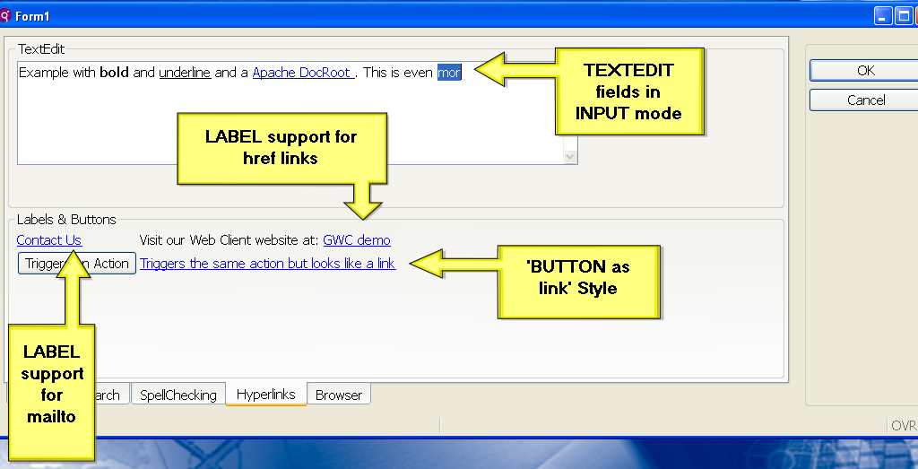
Hyperlinks and Widgets

Slide 16
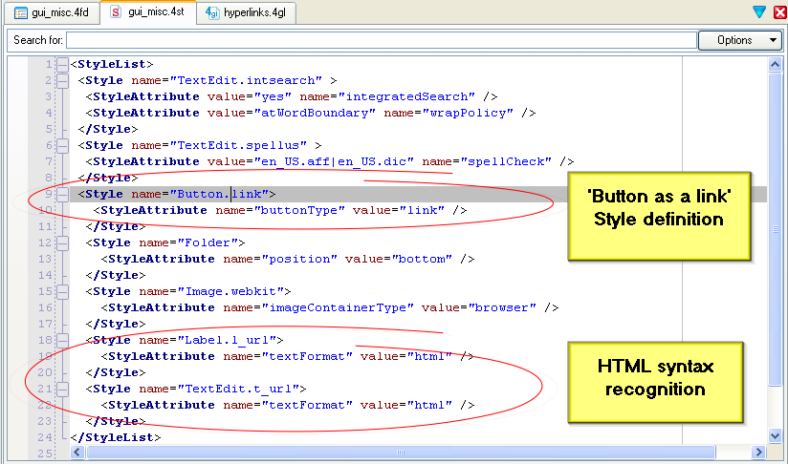
Hyperlinks and Widgets

Slide 17
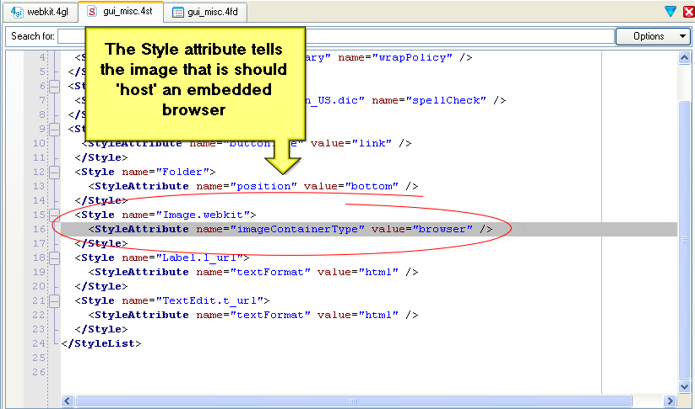
Image Widget as Browser

Slide 18
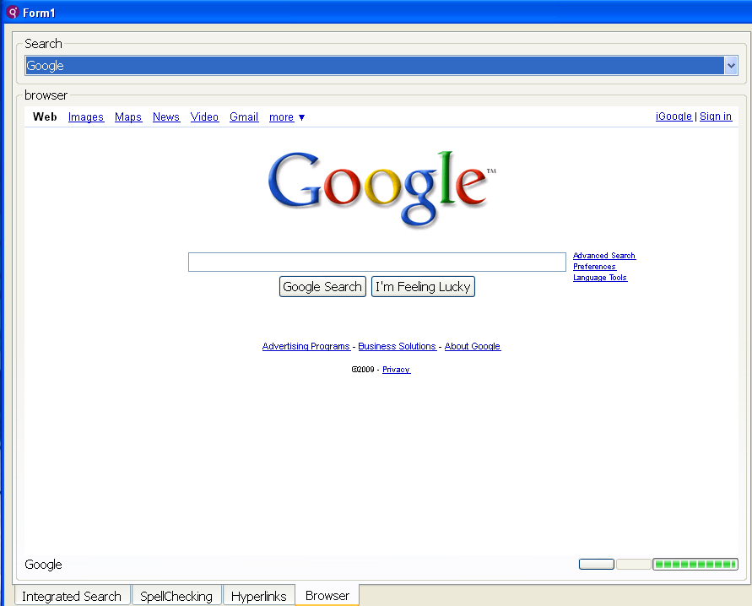
Image Widget as Browser
Some limitations:
Currently no plug-in support (Flash, Acrobat) so no multimedia.

Slide 19
StatusBar
You can set the statusBarType attribute in the .4st style file for windows to control the display of status bars.
Values of statusBarType can be:
none = No statusbar
default = The default status bar, same as panels2
panels1 = 1 panel, 1:comment/error/message
panels2 = 2 panels, 1:comment, 2:error/message
panels3 = 2 panels, 1:error/message, 2:comment
lines1 = 2 lines, 1:comment, 2:error/message
lines2 = 2 lines, 1:comment/message, 2:error

Slide 20
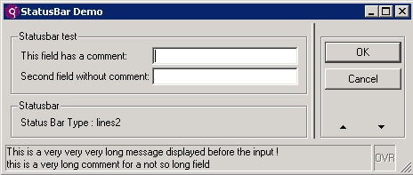
StatusBar
Example:
<Style name="Window.statusbar">
<StyleAttribute name="windowType“ value="normal" />
<StyleAttribute name="statusBarType" value="lines2" />
</Style>

Slide 21
Using Your Own Presentation Styles
Call the following method in your program to use your style file instead of $FGLDIR/lib/default.4st:
Style files have an extension .4st
Style files are searched for in the DBPATH
Use one of your styles in the application:
CALL ui.Interface.loadStyles(“mystyles")
…
OPEN WINDOW w1 WITH FORM “order_form"
ATTRIBUTE (STYLE = “newstyle")
…

Slide 22
Setting a Style Dynamically
Two methods in the ui.Form class:
setElementStyle()
setFieldStyle()
MAIN
DEFINE w ui.Window,
f ui.Form,
custid INTEGER,
custname CHAR(10)
OPEN WINDOW w1 WITH FORM "customer"
LET w = ui.Window.getCurrent()
LET f = w.getForm()
INPUT BY NAME custid, custname
ON ACTION changeLabel
CALL f.setElementStyle(“Label”,”required”)
END INPUT
END MAIN

Slide 23



Q&A

Slide 24
Thank you

