Slide 1

Implementing Multiple Row Selection
^{Learning Genero BDL}

Slide 2
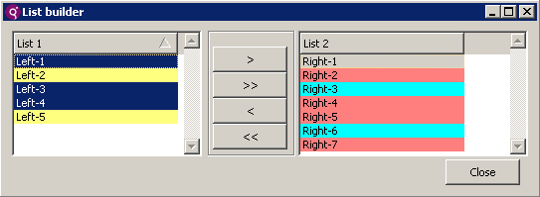
Multiple Row Selection (MRS)
The DISPLAY ARRAY sub-dialog allows multi-row selection.
Users can select multiple rows using standard selection keys such as control-click and shift-click.
Notes:
Read text.
Example here shows two DYNAMIC ARRAYS and the DISPLAY ARRAY statements are sub-dialogs of a DIALOG statement so that they are both
active at the same time. The user can select one, many, or all rows from the tables and move them back and forth.

Slide 3
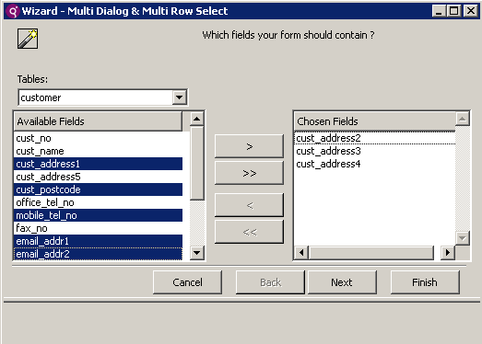
Selected Row vs. Current Row
No selected rows. 1 “current” row.
5 rows flagged as “selected”. 1 “current” row.
Notes:
When you use multi-row selection, you must distinguish between two concepts: row selection and current row. In GUI mode, a selected row usually has a blue background, while the current row has a dotted focus rectangle. The current row may not be selected, or a selected row may not be the current row.

Slide 4
setSelectionMode()
DIALOG.setSelectionMode() indicates if the named screen array in the DISPLAY ARRAY is to use Multiple Selection.
CALL DIALOG.setSelectionMode(“left-array",1)
CALL DIALOG.setSelectionMode(“right-array”,1)
Notes:
There are 3 DIALOG methods to assist you in implementing MRS.
Read Text.
In this example both display arrays are being set to accept multiple selections.

Slide 5
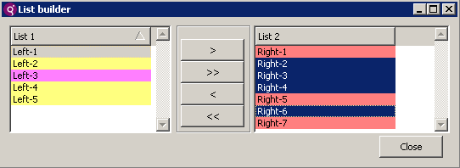
isRowSelected()
DIALOG.isRowSelected() queries to see if a row’s selection flag has been set.
FOR ra = 1 TO arra.getLength()
IF d.isRowSelected(sa, ra) THEN
CALL d.appendRow(sb) -- if row selected, append to other array
LET rb = d.getArrayLength(sb) -- let rb = newly appended row
LET arrb[rb].name = arra[ra].name -- set the text of new row
LET attb[rb].color = atta[ra].color -- preserve color of new row
CALL d.deleteRow(sa, ra) -- delete the row from source array
LET ra = ra - 1 -- subtract counter in source array, row deleted
END IF
END FOR
Notes:
Read text.
This code shows the isRowselected() method used within a FOR LOOP to check each row in the array. As each row is checked, if it is a selected row, the row is appended to the other array and is deleted from the source array. You can use two loops, one to append to the array and one to delete from the source array or you can use one loop as shown here, but note that you have to reduce the counter variable.

Slide 6
setSelectionRange()
DIALOG.setSelectionRange() programmatically changes selection flags for a range of rows.
ON ACTION select_all_rows
CALL DIALOG.setSelectionRange("sr", 1, -1, 1)
ON ACTION unselect_all_rows
CALL DIALOG.setSelectionRange("sr", 1, -1, 0)
Beginning and ending index. -1 indicates end of list.
Notes:
Read text.
In these examples, all rows are either selected or unselected. To select all rows, beginning to end, use 1 and -1, but you could also supply values such as begin at 5 and end at 10 or pass an integer variable to this method for the start and end values.
Let’s take a look at the full code for this example.

Slide 7



Q&A

Slide 8
Thank you

