Slide 1

Working with Tree Containers
^{Learning Genero BDL}

Slide 2
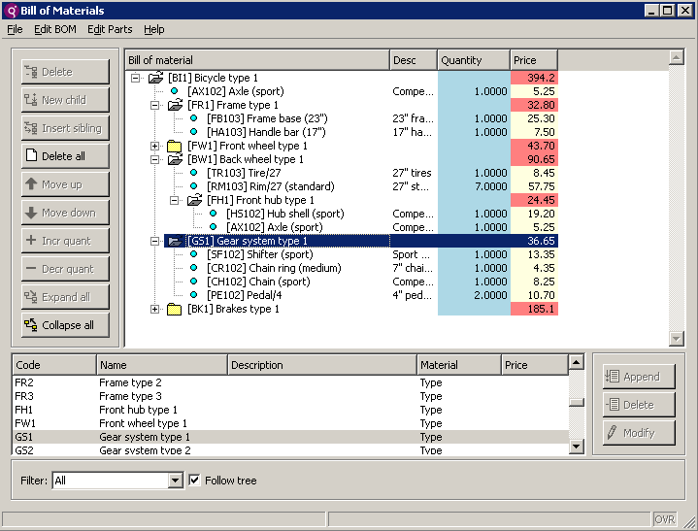
What is a Tree Container?
Tree containers are like table containers, but the first columns are used to display a tree of nodes.
Tree
Table
Notes:
Read text.
Just like a table container, GUI tree-views can be implemented with Genero by using a DISPLAY ARRAY instruction with a screen-array bound to a TREE container
The tree container has specific tree-view attributes.
Let’s take a look at a simple example that has a tree container defined in the form and the code that dynamically fills the array based on the user expanding and collapsing nodes in the tree.

Slide 3
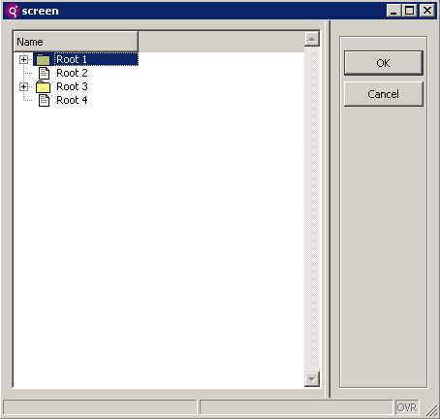
Basic Steps
Define tree container in form.
Define array to hold tree data.
Fill the program array with rows.
Display the program array to the screen array (TREE)either statically or dynamically.
Tree

Slide 4
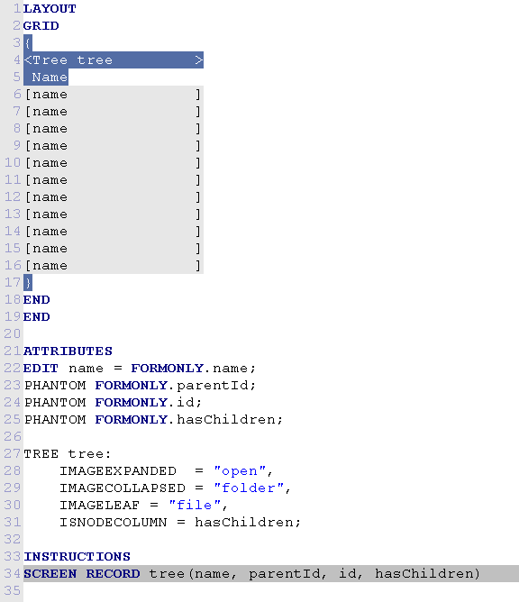
1. Define Tree Container in Form
Tree container defined with at least one EDIT column.
PHANTOM (v. 2.20) field type allows you to map screen record to program array without having to show all columns. PHANTOMS are used, but don’t appear to the user.
Images used for nodes can be defined.

Slide 5
2. Define Array to Hold Tree Data
DEFINE tree DYNAMIC ARRAY OF RECORD
NAME STRING,
parentId STRING,
id STRING,
hasChildren BOOLEAN
END RECORD
The name, pid, id members are mandatory. These hold the node text, icon, parent and current node identifiers that define the structure of the tree.

Slide 6
3. & 4. Fill and Display the Array
Standard fill of array with data (FOREACH and/or insertelement(), appendelement())
Standard DISPLAY ARRAY of array to screen record (TREE).
DISPLAY ARRAY bomlist TO tvsr.*

Slide 7



Q&A

Slide 8
Thank you

