Slide 1

Implementing Drag and Drop
^{Learning Genero BDL}

Slide 2
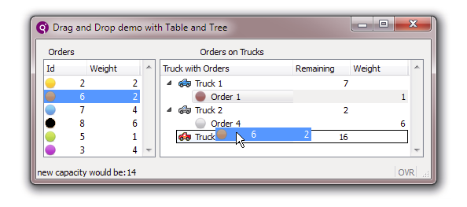
Drag and Drop
Drag and Drop is a new feature in BDL 2.30. It allows the user to select an item from one list and drag it with the mouse to another place in the list or to a different list.
There are several ways you can implement drag and drop in your programs.

Slide 3
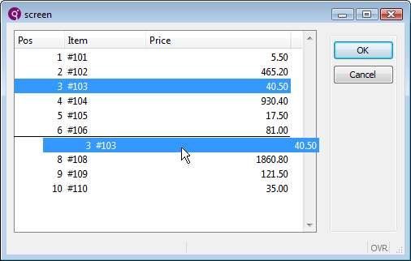
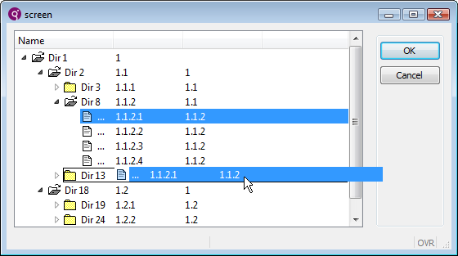
1. Drag and Drop in a List (table or tree)
The user can select one (or many) rows from a list, drag to a new position in the list, and drop into a new position.
Example 1: Using a table container.
Example 2: Using a tree-view container.

Slide 4
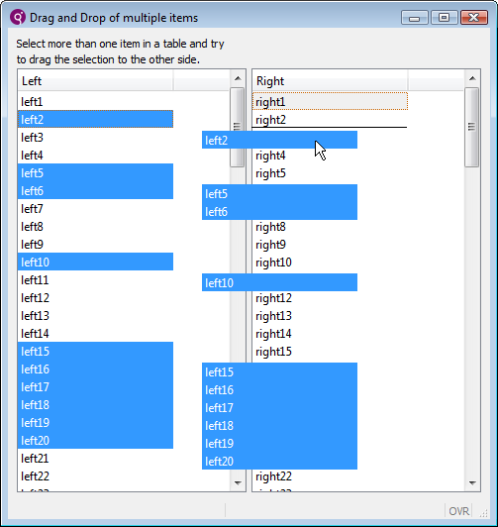
2. Drag and Drop Between Lists
The user can select one (or many) rows from one list, drag to a new position in a different list, and drop into a new position.
Example 2: Using one table and one tree-view container.
Example 1: Using two table containers.

Slide 5
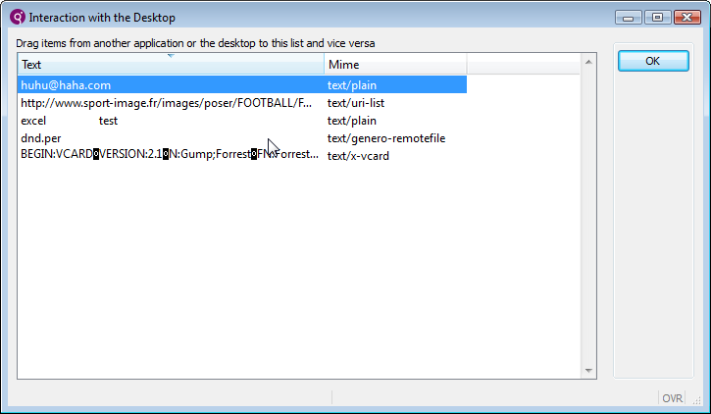
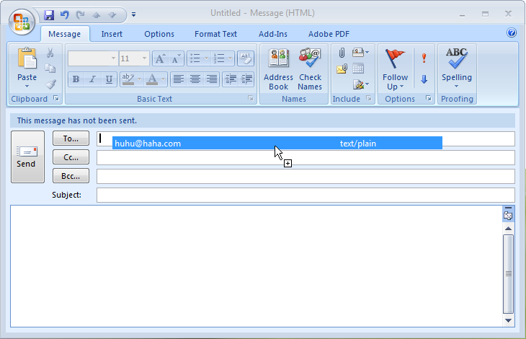
3. Drag and Drop Between Genero and Genero or Other Programs
The user can select some data from a Genero program, drag to a compatible desktop program, and drop into position.
Genero program/table container.
Microsoft Outlook mail program.

Slide 6
Steps to Implement Drag and Drop
Define a DragDrop object. (ui.DragDrop) which is the object being dragged.
Define table or tree view containers on form.
Define DISPLAY ARRAY dialog(s).
Define drag and drop interaction blocks:
ON DRAG_START
ON DRAG_FINISHED
ON DRAG_ENTER
ON DRAG_OVER
ON DROP
In conjunction with methods from new ui.DragDrop class.

Slide 7
Interaction Blocks Overview
Interaction Block
ON DRAG_START
ON DRAG_ENTER
ON DRAG_OVER
ON DROP
ON DRAG_FINISHED

Slide 8
A Simple List
DISPLAY ARRAY arr TO sr.* ATTRIBUTES(UNBUFFERED)
ON DRAG_START(dnd)
CALL dnd.setOperation("move")
ON DROP(dnd)
CALL dnd.dropInternal()
END DISPLAY

Slide 9
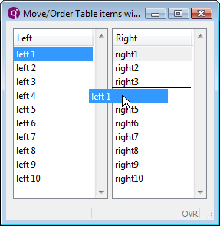
Between Two Lists
DISPLAY ARRAY arr_left TO sr_left.*
ON DRAG_START(dnd)
LET drag_source = S_LEFT
LET drag_index = arr_curr()
LET drag_value = arr_left[drag_index]
ON DRAG_FINISHED(dnd)
INITIALIZE drag_source TO NULL
ON DRAG_ENTER(dnd)
IF drag_source IS NULL THEN
CALL dnd.setOperation(NULL)
END IF
ON DROP (dnd)
IF drag_source == S_LEFT THEN
CALL dnd.dropInternal()
ELSE
LET drop_index = dnd.getLocationRow()
CALL DIALOG.insertRow(S_LEFT, drop_index)
CALL DIALOG.setCurrentRow(S_LEFT, drop_index)
LET arr_left[drop_index] = drag_value
CALL DIALOG.deleteRow(S_RIGHT, drag_index)
END IF
END DISPLAY
S_LEFT
S_RIGHT
This block is triggered when an object is dropped. In this example, the ON DROP from the S_RIGHT DISPLAY ARRAY will execute, not this one.

Slide 10
Between Two Lists
DISPLAY ARRAY arr_left TO sr_left.*
ON DRAG_START(dnd)
LET drag_source = S_LEFT
LET drag_index = arr_curr()
LET drag_value = arr_left[drag_index]
ON DRAG_FINISHED(dnd)
INITIALIZE drag_source TO NULL
ON DRAG_ENTER(dnd)
IF drag_source IS NULL THEN
CALL dnd.setOperation(NULL)
…
DISPLAY ARRAY arr_right TO sr_right.*
ON DRAG_START(dnd)
LET drag_source = S_RIGHT
LET drag_index = arr_curr()
LET drag_value = arr_right[drag_index]
ON DRAG_FINISHED(dnd)
INITIALIZE drag_source TO NULL
ON DRAG_ENTER(dnd)
IF drag_source IS NULL THEN
CALL dnd.setOperation(NULL)
END IF
ON DROP(dnd)
IF drag_source == S_RIGHT THEN
CALL dnd.dropInternal()
ELSE
LET drop_index = dnd.getLocationRow()
CALL DIALOG.insertRow(S_RIGHT, drop_index)
CALL DIALOG.setCurrentRow(S_RIGHT, drop_index)
LET arr_right[drop_index] = drag_value
CALL DIALOG.deleteRow(S_LEFT, drag_index)
END IF
END DISPLAY

Slide 11
ON DRAG_START
ON DRAG_START (dndObject) is executed when the user has begun the drag operation.
Typically used to specify if the default drag operation is a “copy” or a “move”, or an option for the user to toggle.
If the dragged object can be dropped outside the Genero program, the MIME type is typically set in this block.

Slide 12
ON DRAG_ENTER
ON DRAG_ENTER (dndObject) is executed when an ON_DROP is defined and the mouse cursor enters the visual boundaries of the drop target dialog.
Not required, but allows for the prevention of unauthorized MIME types being dropped in target.
ON DRAG_ENTER (dnd)
IF dnd.selectMimeType("text/plain") THEN
CALL dnd.setOperation("copy")
CALL dnd.setFeedback("all")
ELSE
CALL dnd.setOperation(NULL) -- denies drop
END IF

Slide 13
ON DRAG_OVER
ON DRAG_OVER(dndObject)
When ON DROP is defined, the ON DRAG_OVER block will be executed after ON DRAG_ENTER, when the mouse cursor is moving over the drop target, or when the Drag & Drop operation has changed (toggling copy/move).
ON DRAG_OVER will be called only once per row, even if the mouse cursor moves over the row.

Slide 14
Order of Execution
1
ON DRAG_START
ON DRAG_ENTER (if ON_DROP is defined)
ON DRAG_OVER
Possibly ON_DROP and ON DRAG_FINISHED (User completes drop.)
Or just ON_DRAG FINISHED (User decides not to drop or tries to drop in invalid place.)
2
3

Slide 15
Example 4gl – Use XML datastream
MAIN
DEFINE xmlfile, reportfile, device STRING
DEFINE preview BOOLEAN
DEFINE result INTEGER
DEFINE grw_handler om.SaxDocumentHandler
LET xmlfile="testfile.xml"
LET reportfile="rpt1.4rp"
LET device="SVG"
LET preview=TRUE
IF fgl_report_loadCurrentSettings(reportfile) THEN
CALL fgl_report_selectDevice(device)
CALL fgl_report_selectPreview(preview)
LET grw_handler = fgl_report_commitCurrentSettings()
LET result = fgl_report_runReportFromProcessLevelDataFile(grw_handler,xmlfile)
ELSE
EXIT PROGRAM
END IF
END MAIN

Slide 16



Q&A

Slide 17
Thank you

