Slide 1
Increase Store Profit Margin Researcher – Britton Blaize Olle

Slide 2
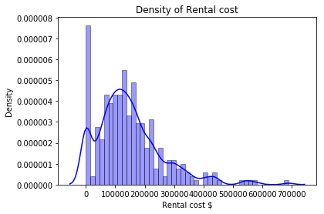
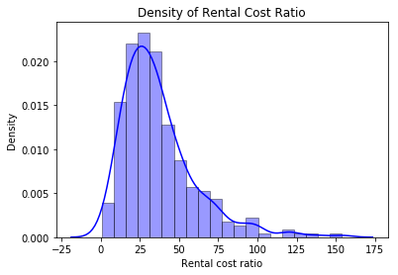
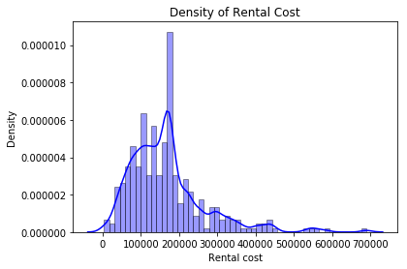
Apples to Apples Comparison There are both owned and leased locations. This creates an apples-to-oranges comparison. To create an apples to apples comparison we imputed rental cost for each owned location.
Before Adjustments
Ratio Distribution
After Adjustments
High density at zero as owned properties all have zero rental cost
Ratio distribution is similar to the distribution of the rented properties rented cost
Density increased around the mean. Owned property rental cost should have a central tendency

Slide 3
Major Factors
Location
State groupings showed significant performance differences between states
Need further data, some states were more heavily represented than others
Further analysis on geographical location is a must
TX appears to be the best state to open new location based on profit margin performance.
Number of Products
Key driver of performance
Could be related to size of store
Clear and obvious trend
Contrary to Costco findings
# of Products
Profit Margin

Slide 4
Next Steps
Additional data
Test findings
Create optimization model
Location square footage
City/Town
Population demographics
Local vs regional promotions
Number of employees
Findings suggested that the more products the better the profit margin performance. Would like to test this assumption and test the predictive power of certain variables.
Build a optimization model to provide stores with an appropriate number of products to have in the store to maximize profit margin.

Slide 5

Thank you!
Any questions?
Email: blaizeolle@outlook.com
Phone: (970)688-1777

