Slide 1
Oil Production Forecasting & Economic Evaluation
Decline Curve Analysis (Arps)
• Volve Field
Prepared by: Bolleddu Praveen Prakash 22JE0264

Slide 2
Theory
Introduce the project:
Petroleum production declines naturally over time. Forecasting oil recovery and evaluating economics is crucial for investment decisions.

Slide 3
Oil wells show declining production trends due to reservoir depletion.
Companies need reliable tools to forecast future production and assess profitability before committing capital.
Decline Curve Analysis (DCA) provides a simple, engineering-based forecasting method.
Coupled with economic models (NPV, IRR, Payback), it helps evaluate project viability

Slide 4
Workflow
Data Acquisition Collect real field production data (Volve dataset).
Data Cleaning Remove nulls, convert units (Sm³ → bbl).
Decline Curve Analysis (DCA) Fit Arps model to observed rates.
Forecasting Project rates to economic limit.
Economic Evaluation Apply CAPEX, OPEX, oil price, discount rate.
Sensitivity Analysis Vary price, cost, and discount assumptions.
Visualization Use Power BI for interactive dashboards.

Slide 5
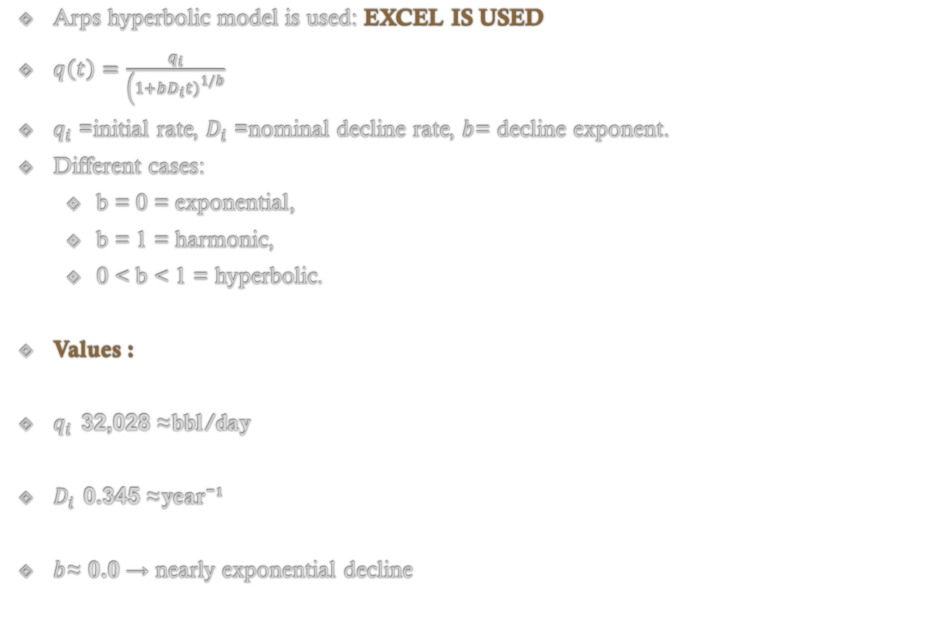
Decline Curve Analysis
Arps hyperbolic model is used: EXCEL IS USED
$q\left(t\right)=\frac{q_{i}}{\left(1+bD_{i}t{\left.)\right.}^{1/b}\right.}$
$q_{i}$= initial rate, $D_{i}$= nominal decline rate, $b$= decline exponent.
Different cases:
b = 0 = exponential,
b = 1 = harmonic,
0 < b < 1 = hyperbolic.
Values :
$q_{i}$≈ 32,028 bbl/day
$D_{i}$≈ 0.345 year⁻¹
$b$≈ 0.0 → nearly exponential decline

Slide 6
Result
Theory: From Python File
Production forecast extended until economic limit = 50 bbl/day.
Cumulative production = EUR (Estimated Ultimate Recovery).
Values:
Forecast horizon: 18.75 years
EUR: 33.9 million bbl

Slide 7
ECONOMICS
Values (base case): Assumption Base
CAPEX: $100M
OPEX: $10/bbl + $1M/year fixed
Oil Price: $70/bbl
Discount Rate: 10%
Results: Excel File Attached
NPV: ≈ $1.49 Billion
IRR: ≈ 20,774%
Payback: 0.08 years (1 month)
PI: 15.9
Breakeven Oil Price: ≈ $14.1/bbl

Slide 8
Graphs Result
Integrated data + results into an interactive dashboard.
Slicers allow dynamic testing of oil price, OPEX, discount rate.
Visuals: decline curve, cumulative production, KPIs, tornado chart. POWER BI used

Slide 9
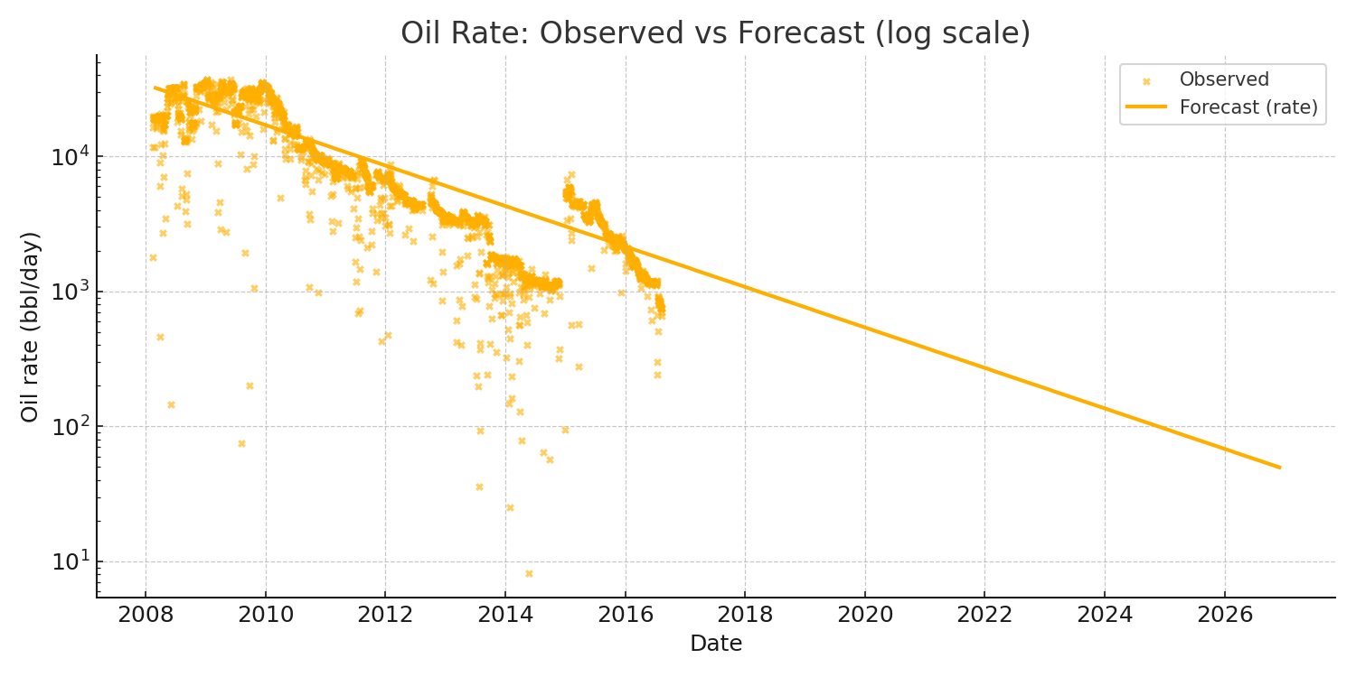
Oil Rate: Observed vs Forecast (log scale)
Observed points (cleaned) and Arps forecast. Units: bbl/day

Slide 10
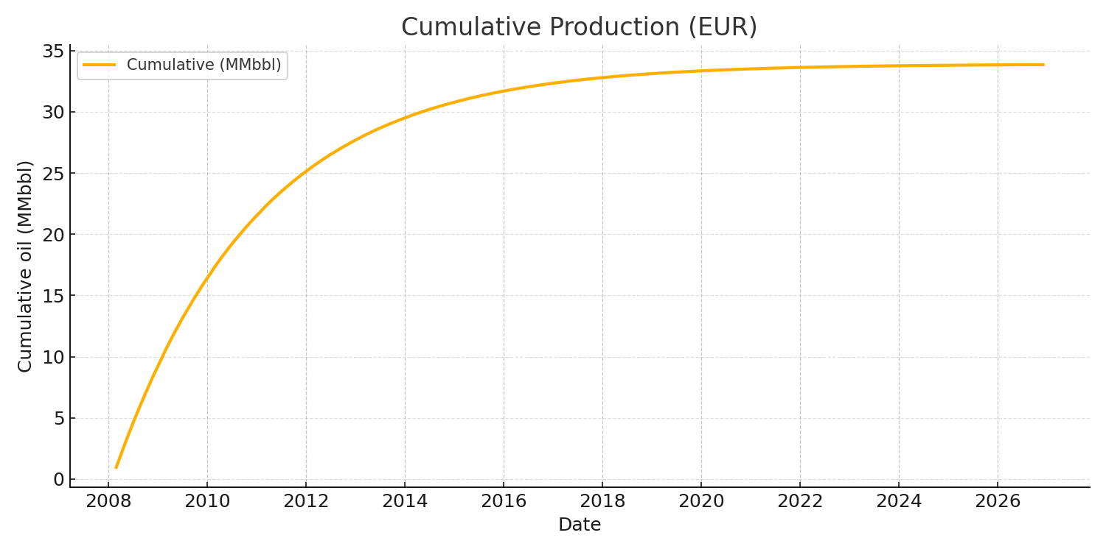
Cumulative Production (EUR)
Cumulative production in MMbbl

Slide 11
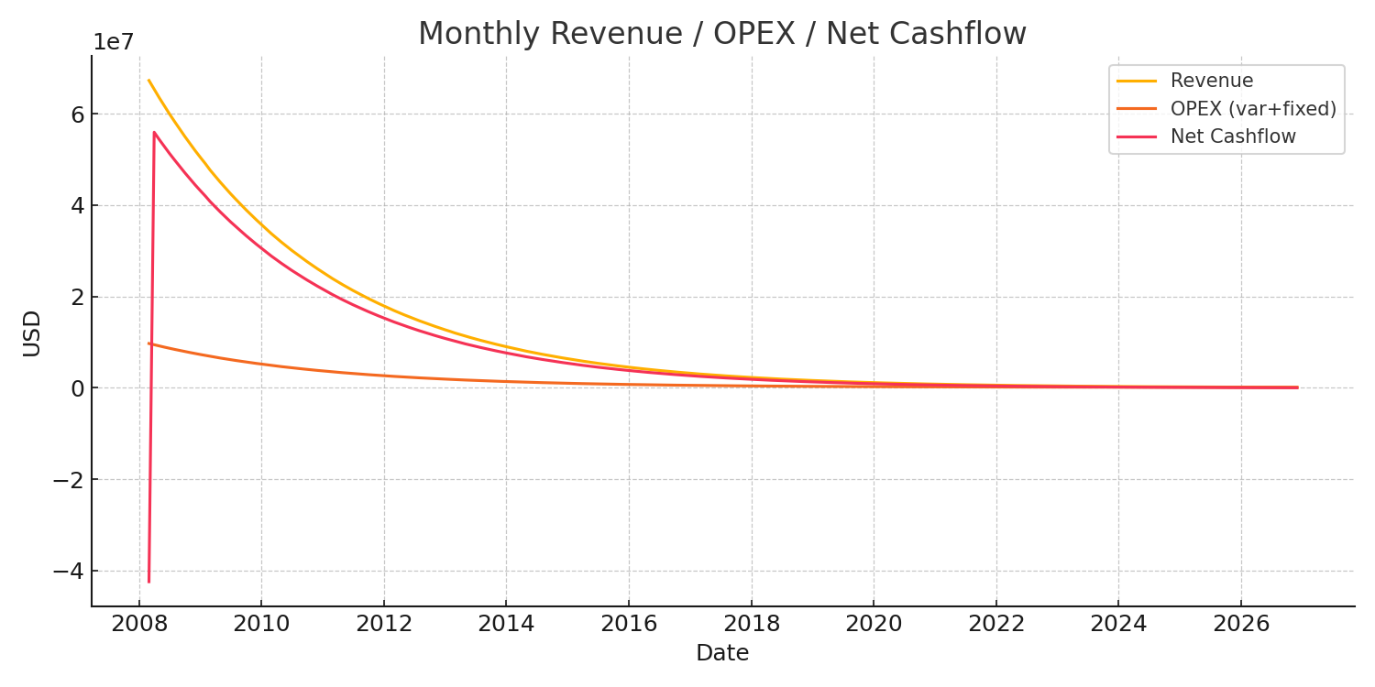
Monthly Cashflows
Revenue, OPEX and Net Cashflow (monthly)

Slide 12
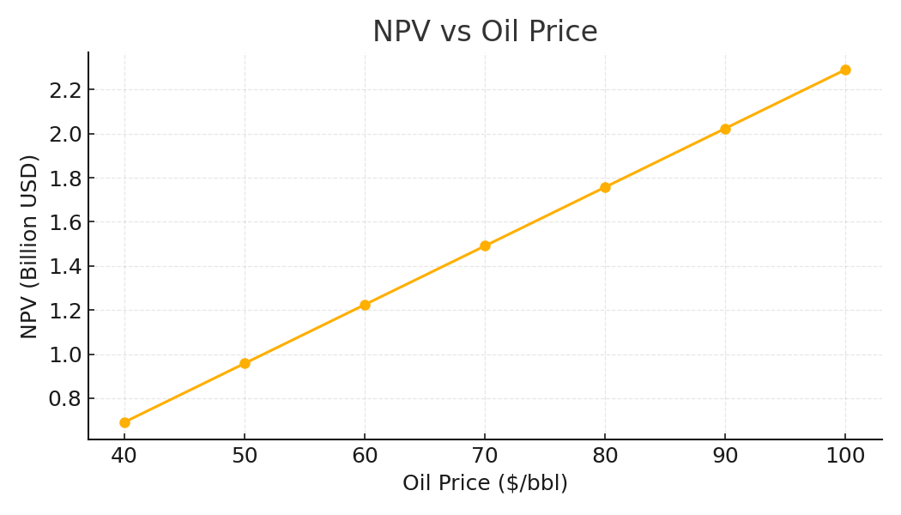
Sensitivity: NPV vs Oil Price

Slide 13
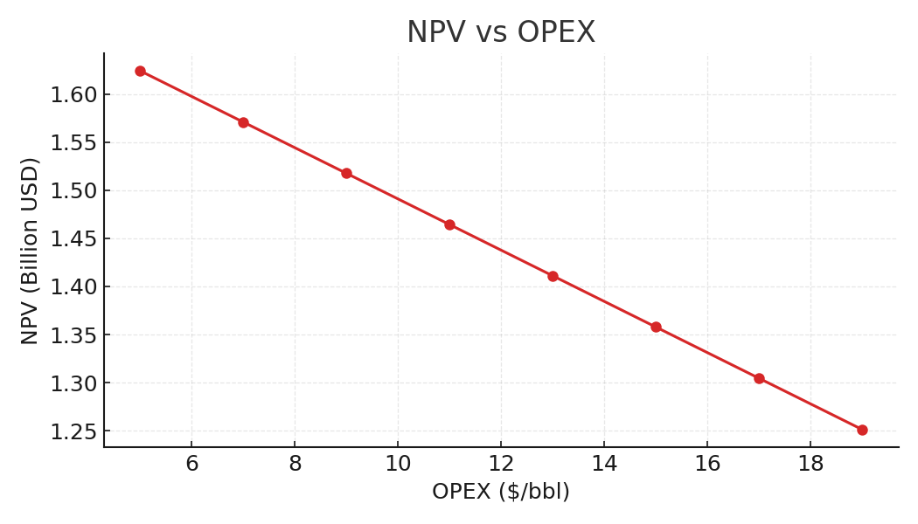
Sensitivity: NPV vs OPEX

Slide 14
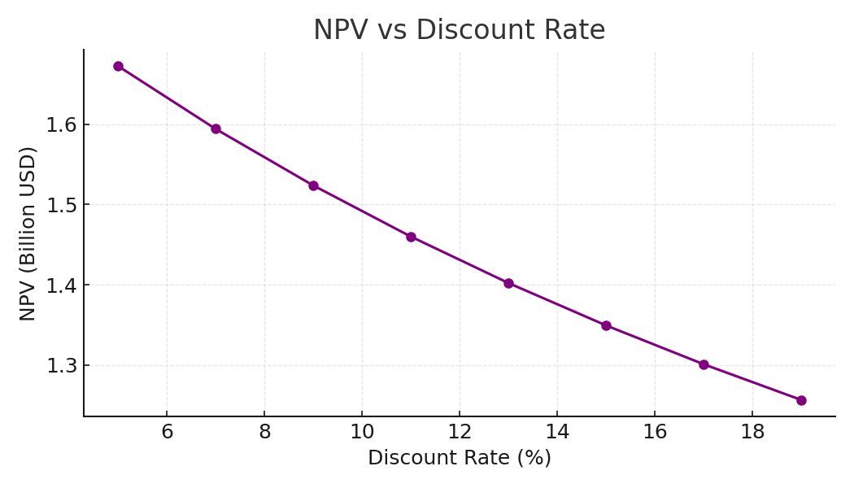
Sensitivity: NPV vs Discount Rate

Slide 15
CONCLUSION
Integrated Reservoir Engineering (Decline Curve Analysis) with Petroleum Economics (NPV, IRR, Payback, PI).
Used real Volve field data for oil production forecasting.
Estimated EUR ≈ 33.9 million bbl with economic horizon ~18.75 years.
Base-case economics show NPV ≈ $1.49 Billion, Payback ≈ 1 month, Breakeven Oil Price ≈ $14.1/bbl.
Sensitivity analysis proves project is most impacted by oil price fluctuations.
Developed an interactive Power BI dashboard for scenario testing and decision support.

Slide 16
References
Data → Volve dataset.
Formulas/Books → Arps (1945), Craft & Hawkins (1991), Economides (2012).
Papers → Fetkovich (1980), Ilk et al. (2008).
Tools → Python, Power BI, Excel.

