Slide 1
CMR Technical Campus
UGC (AUTONOMOUS)
Accredited by NAAC with A Grade
Approved by AICTE, New Delhi and Affiliated to JNTU, Hyderabad
Department of Computer Science and Engineering
A Mini Project
on Drug Recommendation System based on Sentiment Analysis of Drug Reviews using Machine Learning
Under the Guidance of
TABEEN FATIMA
(Assistant Professor)
Presented by
Shrigiri Divya (207R1A05B4)
Bollepally Lahari (207R1A0567)
M.Sri Harsha (207R1A0592)

Slide 2
CONTENTS
Abstract
Existing System
Disadvantages of existing system
Proposed System
Advantages of proposed system
Hardware and software requirements
Novelty of project
Architecture
Modules
UML Diagrams
Sample Code
Results
Conclusion
Future Scope
References
GitHub Link

Slide 3
ABSTRACT
A Drug Recommendation system is a system that analyzes drug reviews to determine the sentiment of the reviewer towards the drug and recommend the best drugs based on sentiment analysis.
Since many studies show that number of people die due to the medical errors caused by medical practitioners , who prescribe medicine based on their experiences.
The unavailability caused a lot individuals to start taking medication independently without appropriate consultation.
This system provide a drug recommendation system for doctors which can be used by them while prescribing medicines.

Slide 4
EXISTING SYSTEM
There are several existing systems that use sentiment analysis and machine learning to recommend drugs based on reviews.
These systems analyze the sentiment of the reviews and use that information to recommend drugs that are most likely to be effective for the patient's specific needs.
This system uses a combination of machine learning algorithms and natural language processing techniques to analyze drug reviews and extract important features such as drug effectiveness, side effects, and dosage.
The system also takes into account the patient's medical history ,symptoms ,age and gender to provide personalized drug recommendations.

Slide 5
DISADVANTAGES OF EXISTING SYSTEM
Biased Reviews
Limited Data Availability
Security and Privacy Concerns
Limited Scope
It Provides Information about one disease

Slide 6
PROPOSED SYSTEM
This is a customary system that proposes an item to the user, dependent on their advantage and necessity.
Medicine is offered on a specific condition dependent on patient reviews using sentiment analysis and feature engineering.
Sentiment analysis is a progression of strategies, methods, and tools for distinguishing and extracting emotional data, such as opinion and attitudes.
This system predicts the reviews based upon sentiment analysis of the patient who have already used that particular drug previously.

Slide 7
ADVANTAGES OF PROPOSED SYSTEM
Suggests the quality Medication
Improves the quality of rapid patient care
Increase the efficiency of medical treatment

Slide 8
HARDWARE REQUIREMENTS
System : i3 or above
Ram : 4 GB
Hard Disk : 40 GB

Slide 9
SOFTWARE REQUIREMENTS
Operating system : Windows8 or Above.
Coding Language : python

Slide 10
NOVELTY OF PROJECT
Drug recommendation system based on Sentiment Analysis of Drug Reviews using Machine Learning presents several novel aspects that distinguish it from previous research:
Integration of sentiment analysis and machine learning
Application of machine learning in healthcare
Potential for improving patient outcomes
Focus on the use of patient-generated data

Slide 11
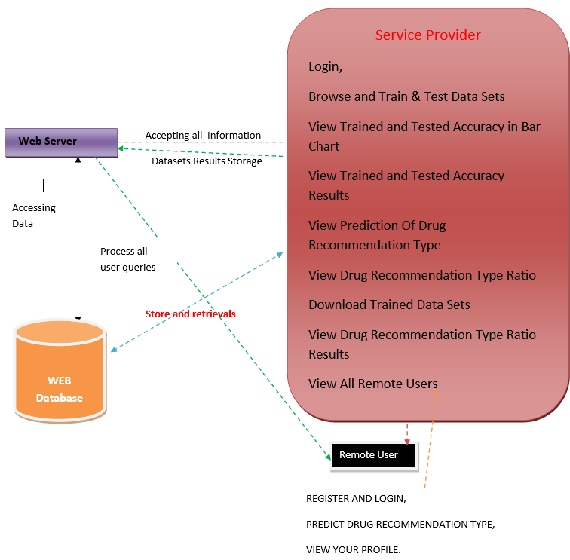
Architecture

Slide 12
MODULES
Service Provider
In this module, the Service Provider has to login by using valid user name and password. After login is successful he can do some operations.
View and Authorize Users
In this module, the admin can view the list of users who all registered.
Remote User
In this module, there are n numbers of users are present. User should register before doing any operations. Once user registers, their details will be stored to the database.

Slide 13
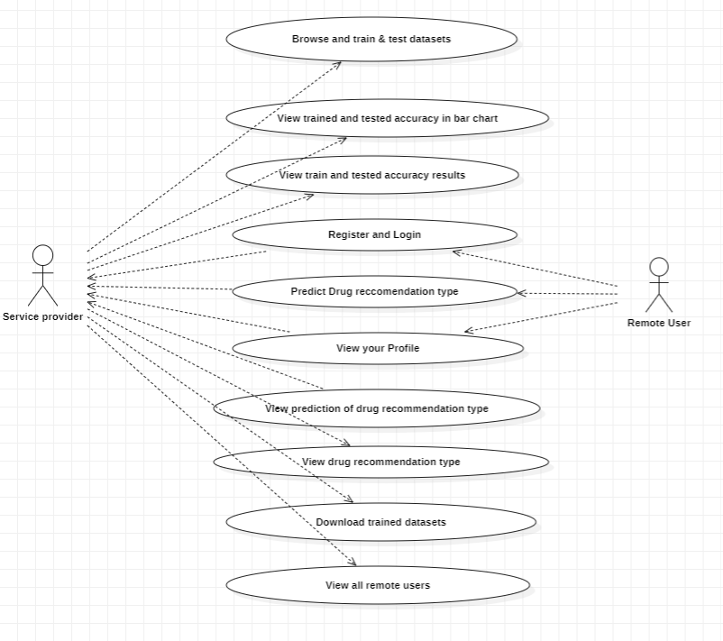
USECASE DIAGRAM

Slide 14
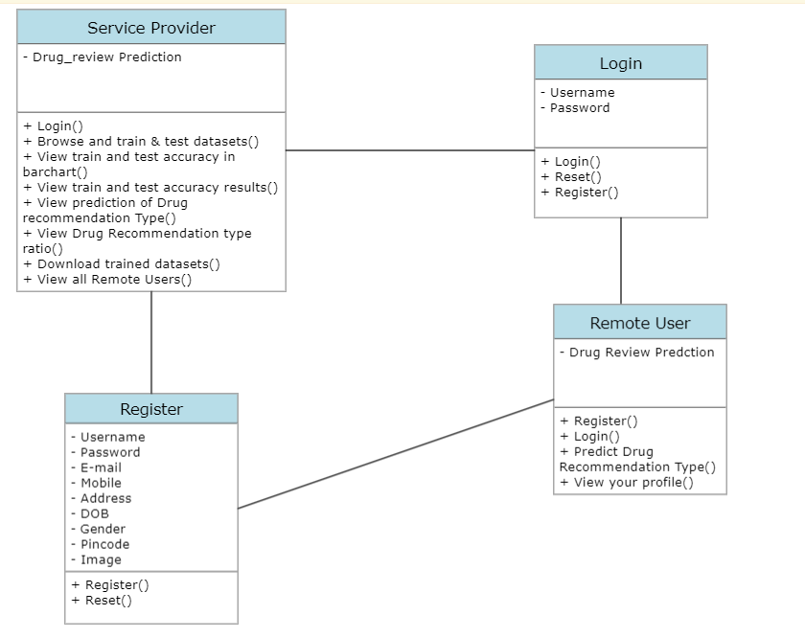
CLASS DIAGRAM

Slide 15
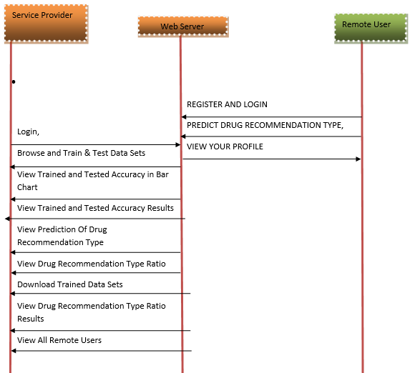
SEQUENCE DIAGRAM

Slide 16
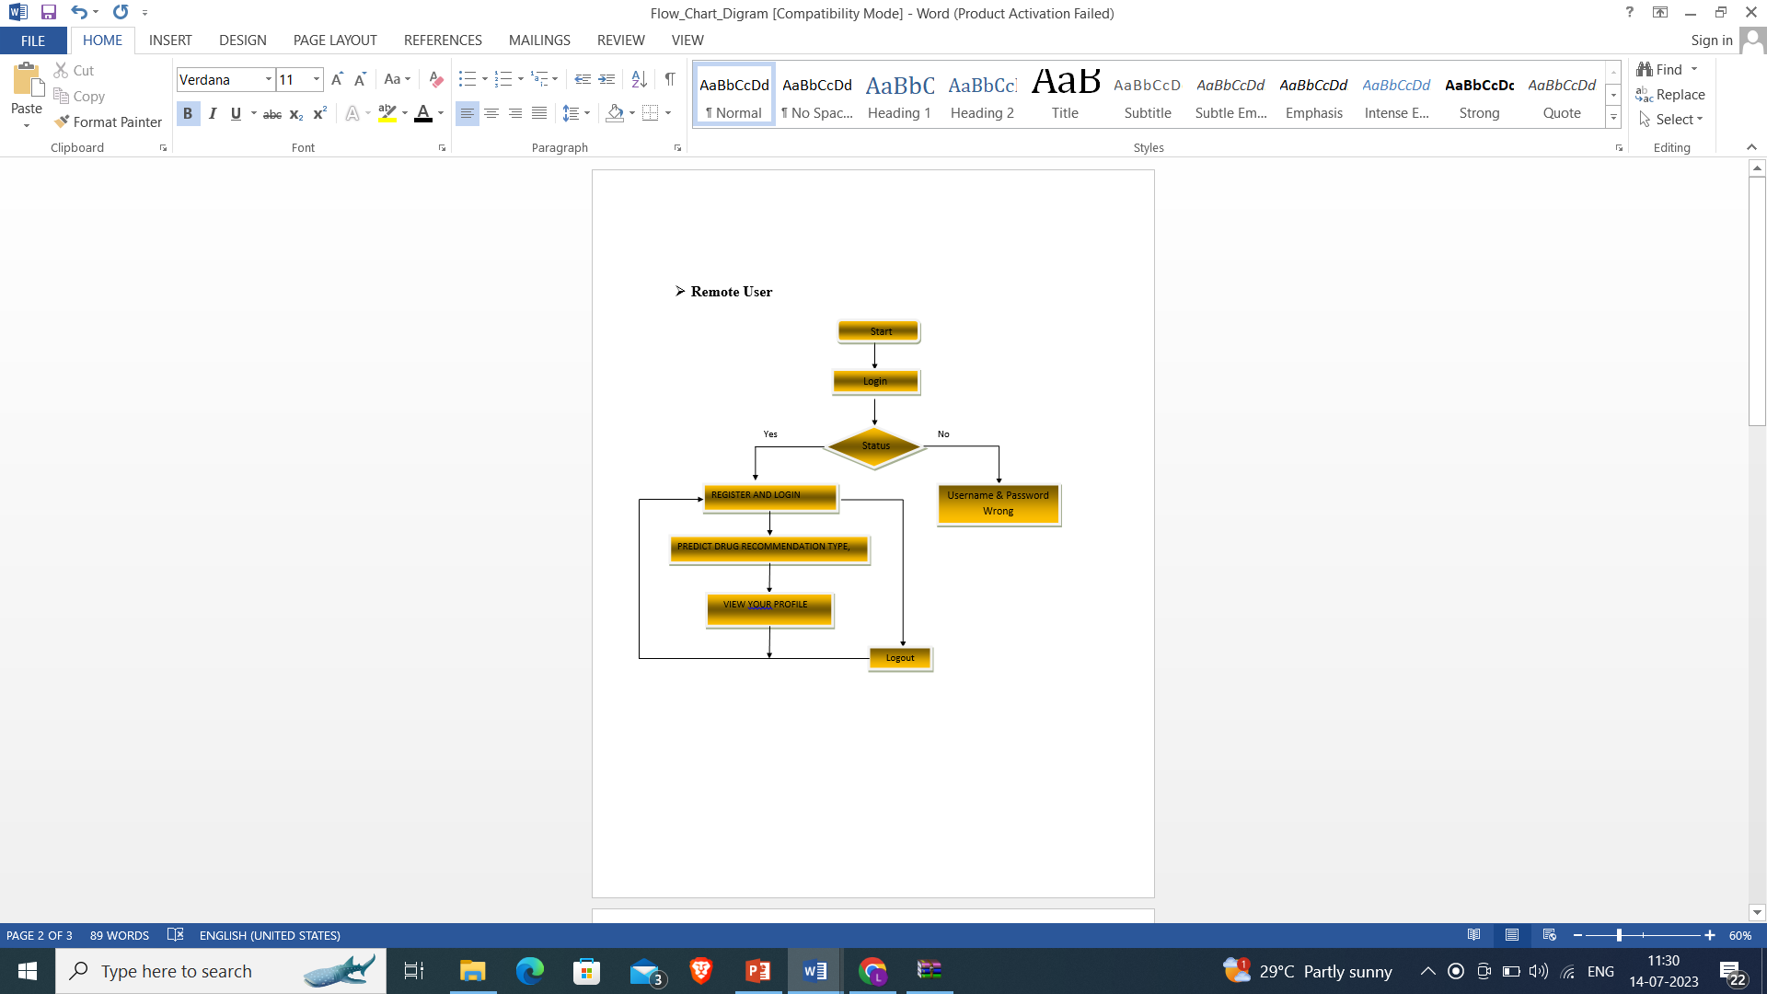
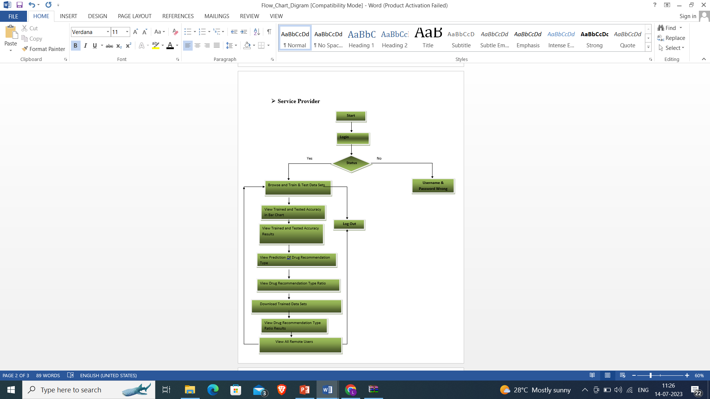
ACTIVITY DIAGRAM

Slide 17
SAMPLE CODE
import os
import sys
def main():
os.environ.setdefault('DJANGO_SETTINGS_MODULE', 'drug_recommendation_system.settings')
try:
from django.core.management import execute from_command_line
except ImportError as exc:
raise ImportError(
"Couldn't import Django. Are you sure it's installed and "
"available on your PYTHONPATH environment variable? Did you "
"forget to activate a virtual environment?"
) from exc
execute_from_command_line(sys.argv)
if __name__ == '__main__':
main()

Slide 18
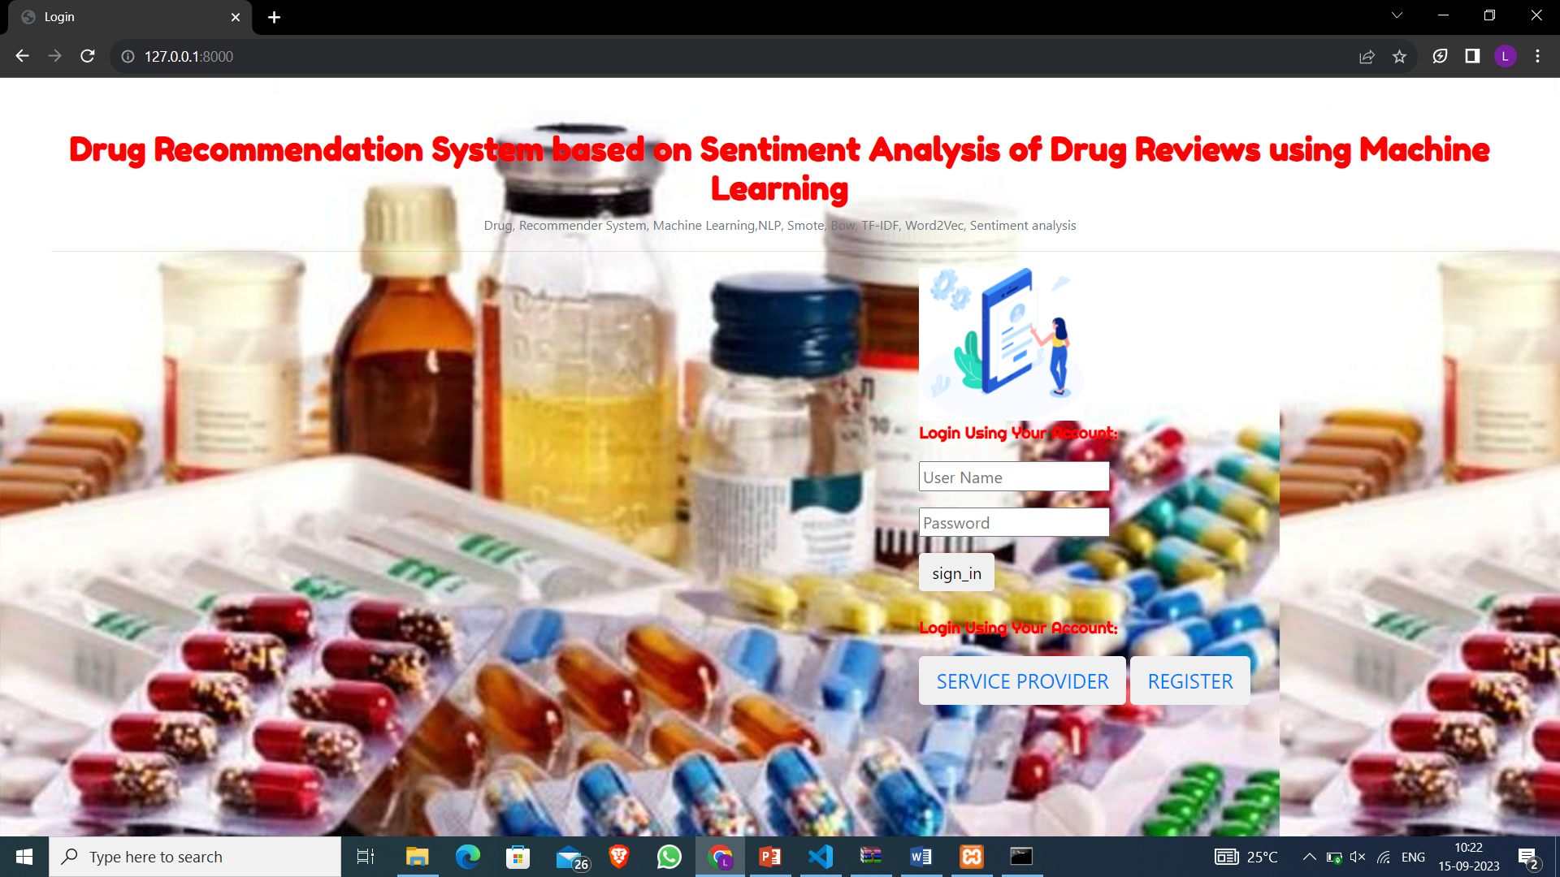
RESULTS

Slide 19
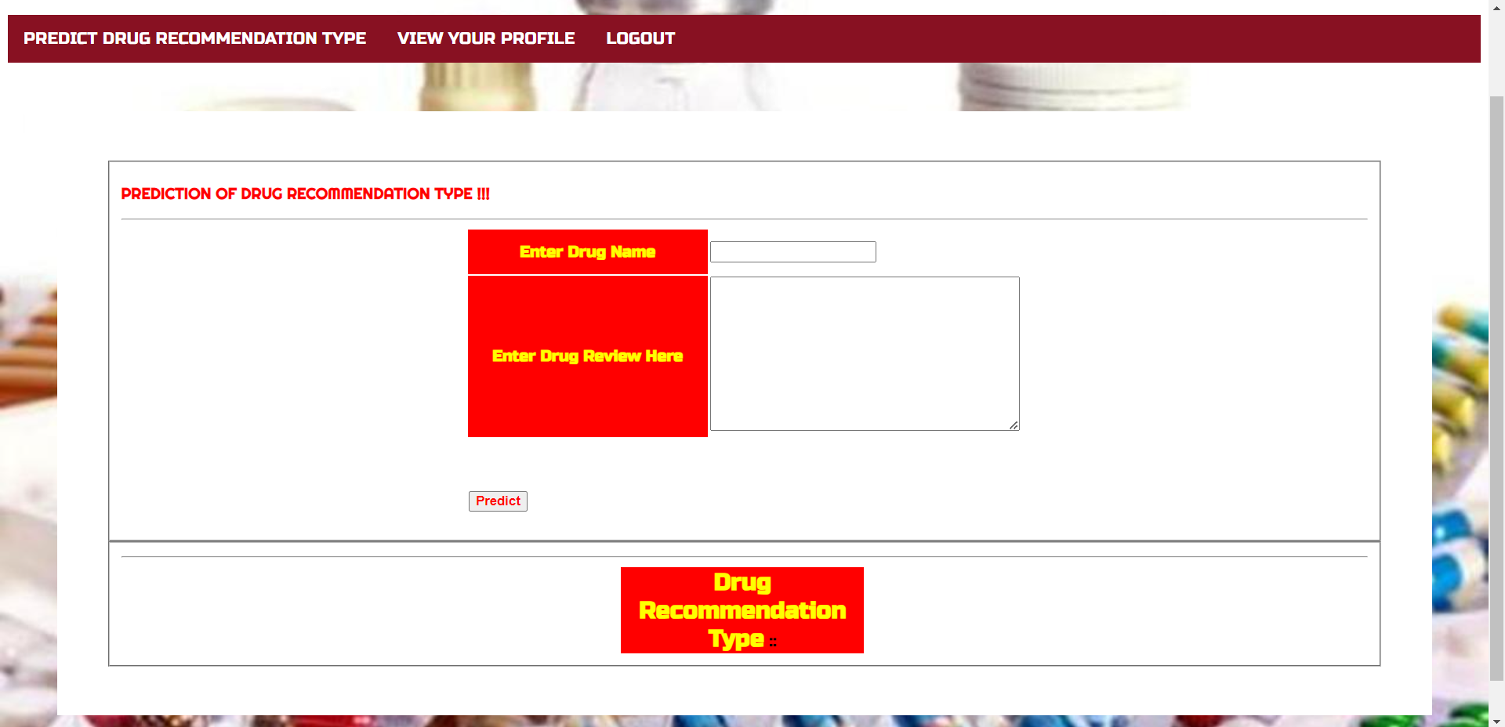

Slide 20
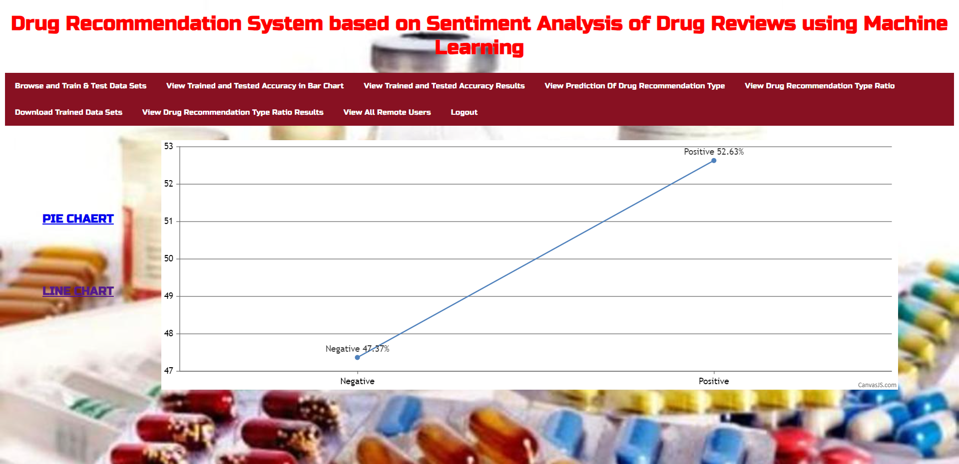

Slide 21
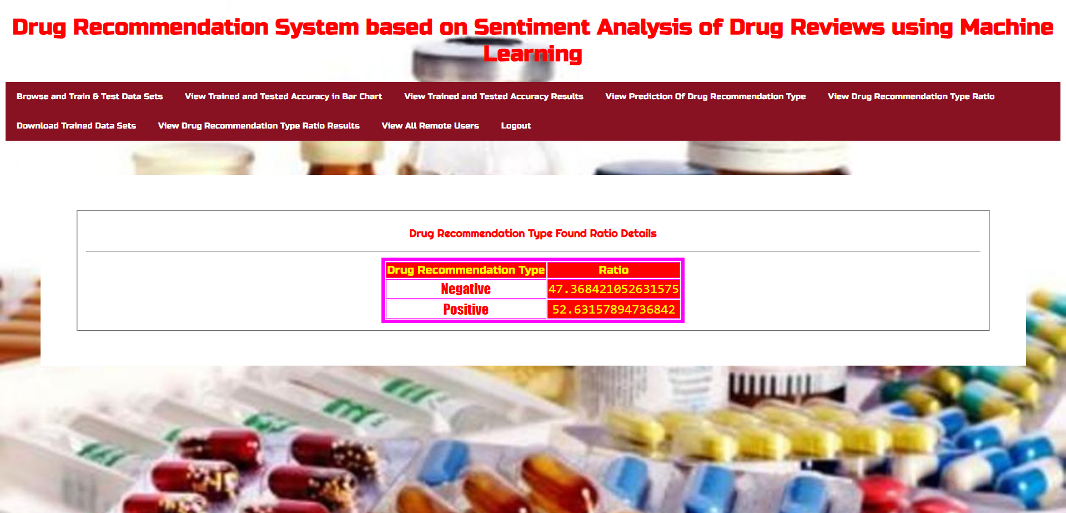

Slide 22
CONCLUSION
It can be concluded that the drug recommendation system developed using sentiment analysis of drug reviews and machine learning has the potential to be a useful tool in assisting healthcare providers in making informed decisions about drug prescriptions.
By analyzing the sentiment of drug reviews, the system can identify positive and negative experiences with certain medications, which can help healthcare providers make more personalized and effective drug recommendations.
Overall, the development of a drug recommendation system based on sentiment analysis of drug reviews using machine learning is a promising approach that can enhance the quality of healthcare provided to patients.

Slide 23
FUTURE SCOPE
Personalized Recommendations
Real time Updates
Data Privacy and Security
Clinical Trails and Research
Global Expansion

Slide 24
REFERENCES
Telemedicine, https://www.mohfw.gov.in/pdf/Telemedicine.pdf
Wittich CM, Burkle CM, Lanier WL. Medication errors: an overview
for clinicians. Mayo Clin Proc. 2014 Aug;89(8):1116-25.
CHEN, M. R., & WANG, H. F. (2013). The reason and prevention of
hospital medication errors. Practical Journal of Clinical Medicine, 4.
Drug Review Dataset, https://archive.ics.uci.edu/ml/datasets/Drug%
2BReview%2BDataset%2B%2528Drugs.com%2529#
Fox, Susannah, and Maeve Duggan. ”Health online 2013. 2013.” URL:
http://pewinternet.org/Reports/2013/Health-online.aspx
Fox, Susannah & Duggan, Maeve. (2012). Health Online 2013. Pew
Research Internet Project Report.

Slide 25
GitHub Link
https://github.com/bollepallylahari/DrugRecommendtion

Slide 26
THANK YOU

