Slide 1
SELF-HELP APP
GROUP-1

Slide 2
TECHNOLOGY STACK
Front End: Angular
ORM: Hibernate
Source Control: git
Backend: Springboot
Database: MySQL

Slide 3
DATABASE DESIGN
1

Slide 4
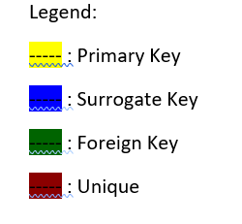
DATABASE DESIGN
Patient
Attributes: PatientID, Username, Password, DoctorID (Doctor), SectionsCompleted, EmailVerified, Name, Age, Sex, Email, Address, DOB, Marital Status and other relevant information..
Specialist
Attributes: SpecID, Username, Password, Name, Email.

Slide 5
DATABASE DESIGN
Doctor
Attributes: DoctorID, Username, Password, Name, Email, SpecialistID (Specialist), RoomCode.
Admin
Attributes: AdminID, Username, Password, Name, Email.

Slide 6
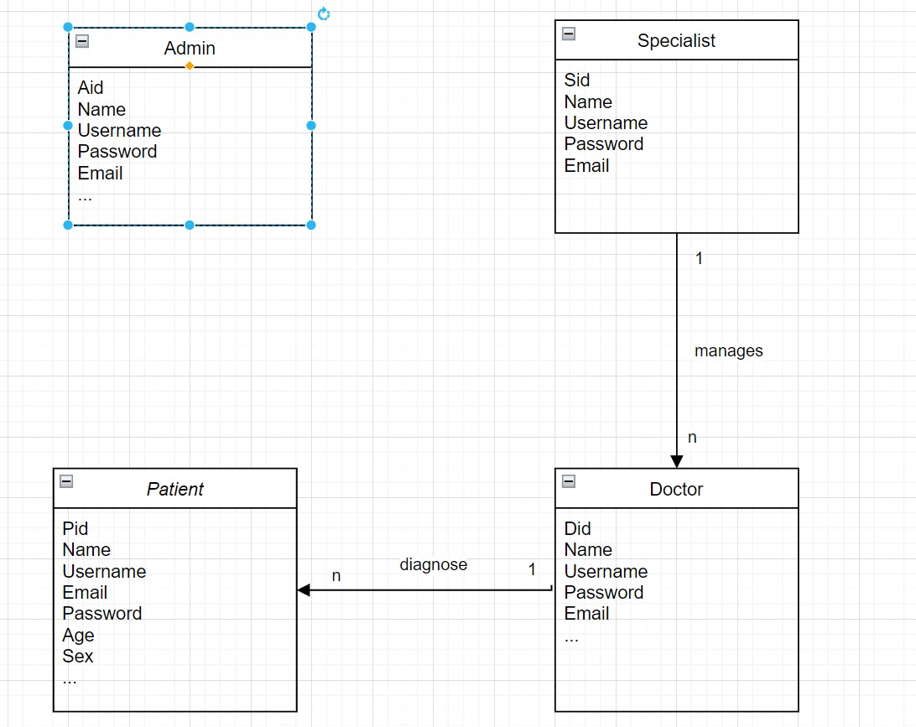
CLASS DIAGRAM

Slide 7
API DESIGN
2

Slide 8
PATIENT’S API CALLS
/login(POST): Allows the user (Patient, Doctor, Admin or Specialist) to login to the application.
/register(POST): Allows registration of only Patients.
/findExistingEmail/{email}(GET): Checks if the email is already in database.
/findExistingUName/{username}(GET): Checks if the username is already in database.

Slide 9
PATIENT’S API CALLS
{username}/progress/{section}(GET): Updates the Section wise progress of the patient through the material.
/updateProfile(POST): User can update its own profile. However, some details can’t be updated by the user such as medical records.
/forgotPassword(POST): User can update its password after authentication.
/logout(POST): Logs the user out and clears any relevant session variables.

Slide 10
DOCTOR’S API CALLS
/progress/{username}(POST): Doctors can check the Progress of a particular use.
/generateRoomCode/{username}(POST): Generates the room code of a Doctor.
/joinRoom(POST): Joins any existing room of a doctor.
/progress/{username}(POST): Doctors can check the Progress of a particular user.

Slide 11
DOCTOR’S API CALLS
/remSections/{username}/{sectionList}(POST): Removes access of the sections from a particular user.
/addSections/{username}/{sectionList}(POST): Removes access of the sections from a particular user.

Slide 12
ADMIN’S API CALLS
/editPatient/{username}(POST): Edits all the data of the Patient.
/delPatient/{username}(POST): Deletes a Patient.
/editDoc/{username}(POST): Edits the data of a Doctor.
/delDoc/{username}(POST): Deletes a Doctor.
/registerSpec(POST): Register a new Specialist.
/editSpec/{username}(POST): Edits the details of a Specialist.
/delSpec/{username}(POST): Deletes a Specialist.

Slide 13
SEQUENCE DIAGRAMS
3

Slide 14
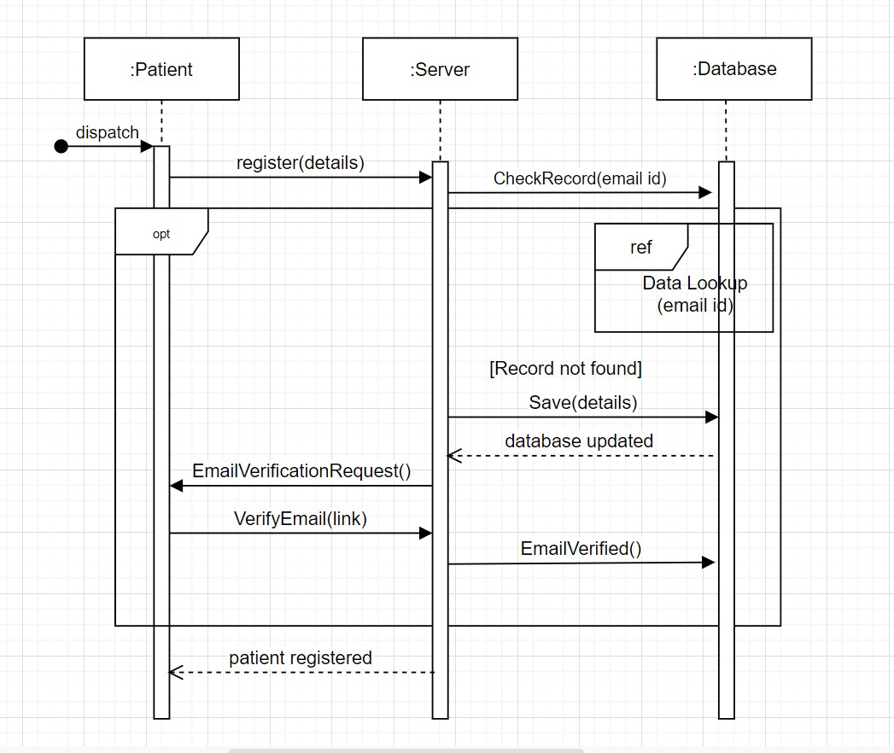
PATIENT REGISTER

Slide 15
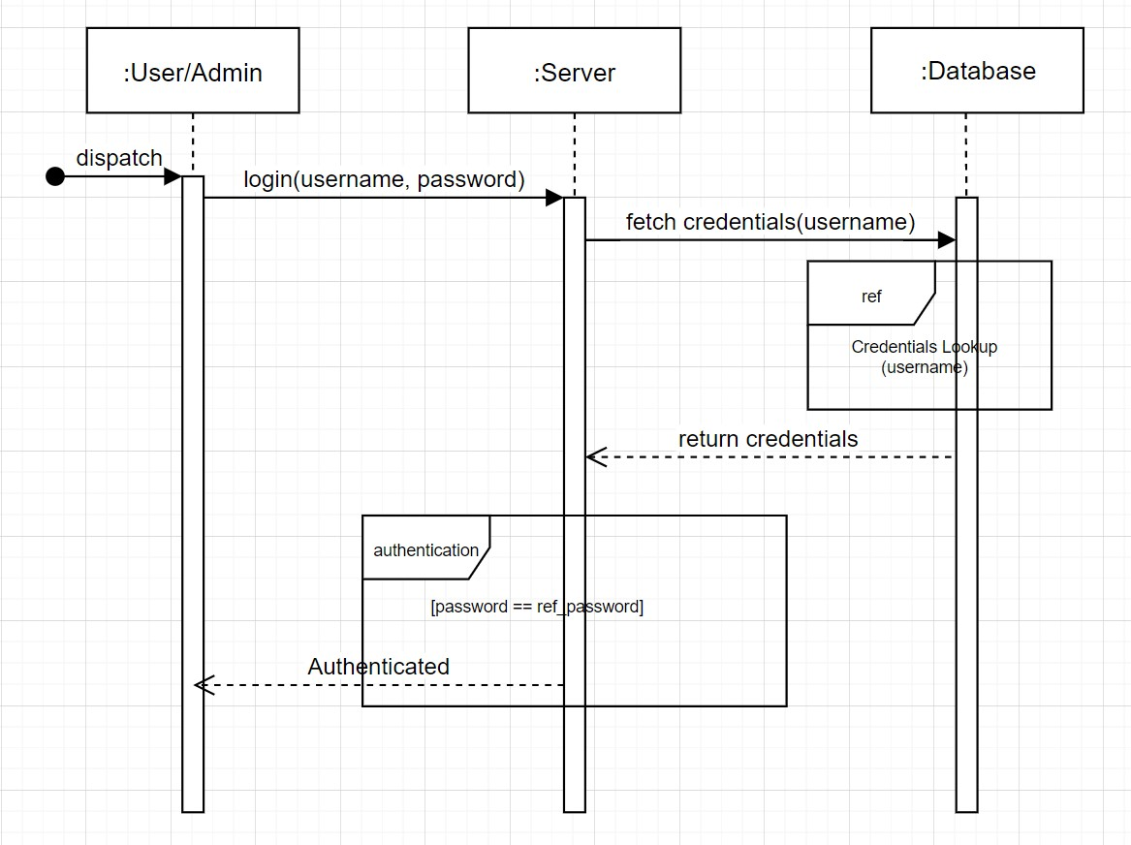
USER LOGIN

Slide 16
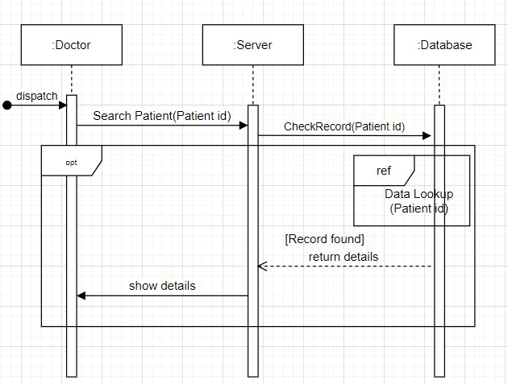
DOCTOR SEARCH

Slide 17
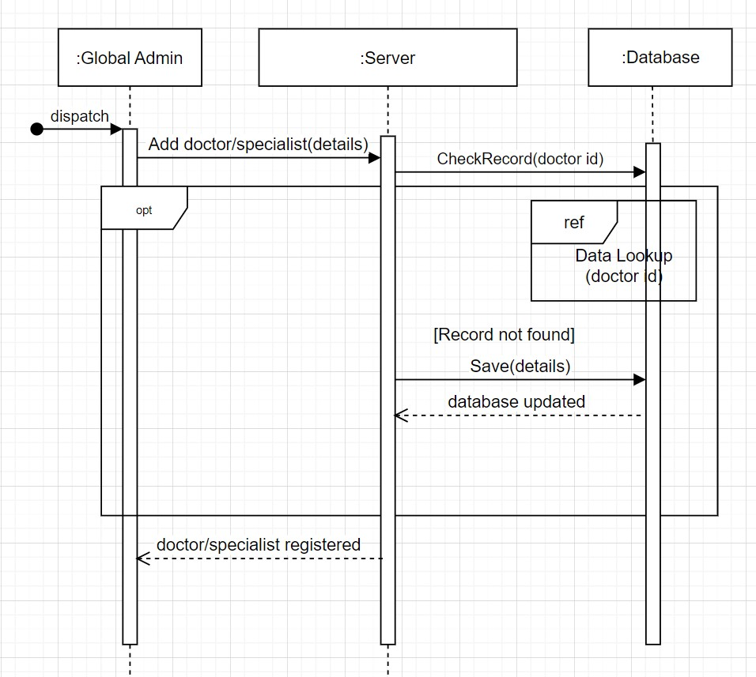
ADD DOCTOR/SPECIALIST-ADMIN

Slide 18
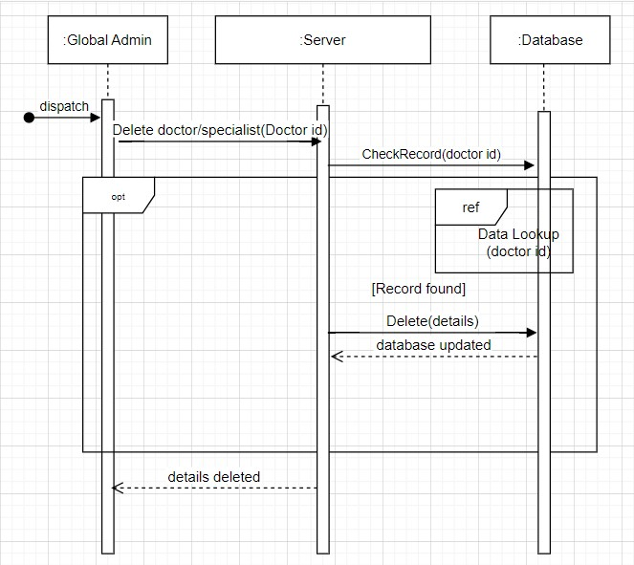
DELETE DOCTOR/SPECIALIST-ADMIN

Slide 19
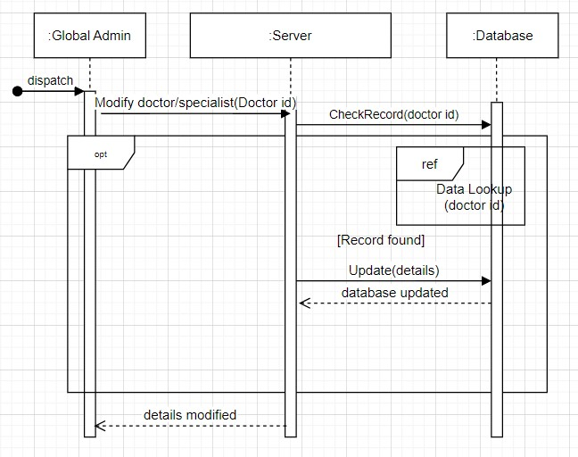
MODIFY DOCTOR/SPECIALIST-ADMIN

Slide 20
THANKS!

