Slide 1
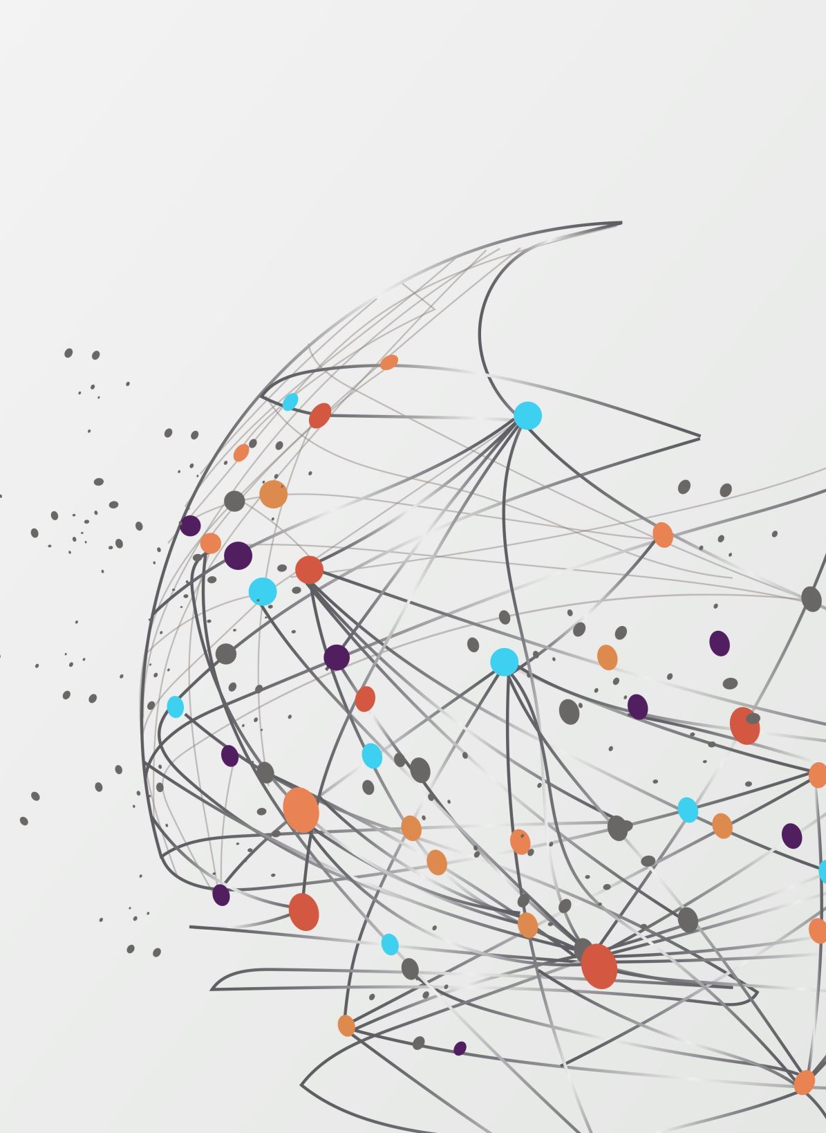
Walking Mechanism
Mechatronics System Design
Ashwini, Harshit, Shreya, Shreyas

Slide 2
Introduction
Developing a functional walking mechanism utilizing robotic design principles and simulation techniques taught in the course.
Objective : To design, analyze, and build a planar walking mechanism capable of stable locomotion using principles
of linkage design and servo control.

Slide 3
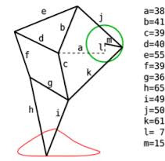
Design Selection : Theo Jansen Mechanism
Stability: Offers exceptional stability, resulting in minimal vertical wobbling of the body during movement compared to other walking designs.
Unique Kinematic Motion: Its distinctive motion pattern mimics natural walking, providing a fascinating study in biomechanics.
Historical Significance: The design has historical importance, as it was developed by artist Theo Jansen, blending art and engineering in innovative ways.
Simplicity in Design: Its simple mechanical structure allows for easier fabrication and assembly.
Notes:
Vertical Stability:
Theo Jansen: Its unique linkage design ensures a more stable and level body motion, resulting in less vertical oscillation.
Klann Mechanism: While effective, the Klann mechanism can exhibit greater vertical motion, potentially leading to instability and awkward gait patterns.
Complexity of Design:
Theo Jansen: Features a relatively simple and elegant design that is easier to fabricate and understand, making it more accessible for educational purposes.
Klann Mechanism: Involves more intricate linkages, which complicate the assembly and may require more precise tolerances in fabrication.
Foot Trajectory:
Theo Jansen: Produces a more natural and continuous foot trajectory, leading to smoother and more efficient walking.
Klann Mechanism: The foot motion can be more jerky and less fluid, which might not replicate natural walking as effectively.
Aesthetic Appeal:
Theo Jansen: The visually striking design offers both artistic and mechanical intrigue, which enhances its appeal for projects that combine art and engineering.
Klann Mechanism: While functional, it lacks the same level of aesthetic engagement as the Theo Jansen mechanism.
Historical and Educational Context:
Theo Jansen: Provides rich historical and contextual significance due to its relationship with art and engineering, making it a compelling choice for educational exploration.
Other Mechanisms (e.g., Trot-based): They may not offer the same level of interdisciplinary connections, focusing more strictly on mechanical properties without the artistic narrative.

Slide 4
Analytical Model Development
Forward Kinematics
Mathematical Modelling
Key Parameters : Link lengths, Joint angles , Distances in the configuration of the mechanism
Notes:
“We define the crank rotation θ and, using the known link-length ratios (R, A, B, C, D, E, G), write vector-closure equations for each kinematic loop to solve for all intermediate joint angles as functions of θ.”
“By summing the link-vectors ℓk[cos⁡ϕk,sin⁡ϕk]\ell_k[\cos\phi_k, \sin\phi_k] around each loop and enforcing zero net displacement, we obtain closed-form or numerical solutions for the orientations φₖ(θ).”
“Finally, chaining these vectors yields the foot point position E(θ)=(Ex(θ), Ey(θ))E(θ) = \bigl(E_x(θ),\,E_y(θ)\bigr), giving the complete forward-kinematics model of the leg.”
Mathematical Modeling:
Development of equations relevant to the movement of the mechanism, including relationships between the joint coordinates and overall position.
Key Params point
a set of length ratios that together produce:
A nearly straight, horizontal foot trajectory during ground contact
A smooth, lifting and swinging return path
Good clearance and stability

Slide 5
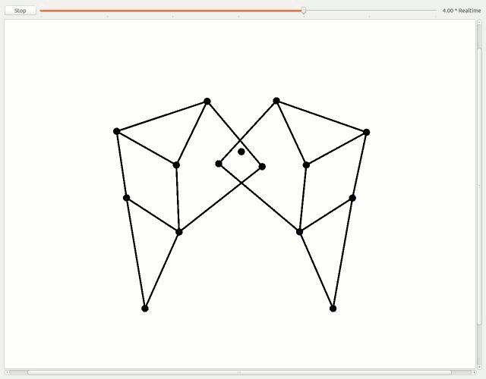
Simulation of the Foot Trajectory

Slide 6
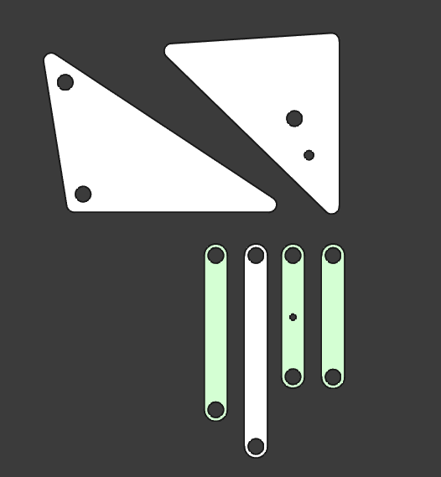
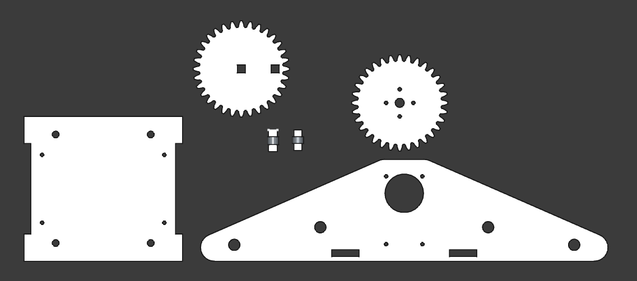
Design Component Overview

Slide 7
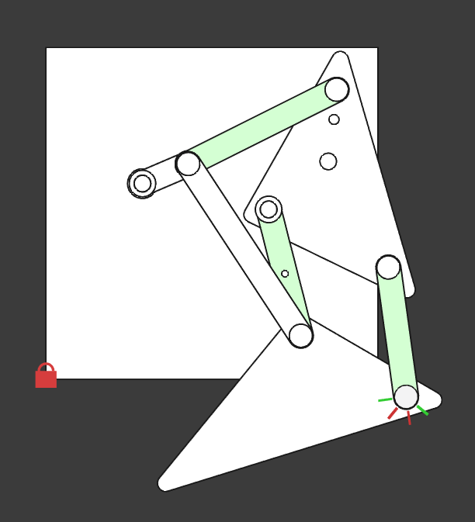
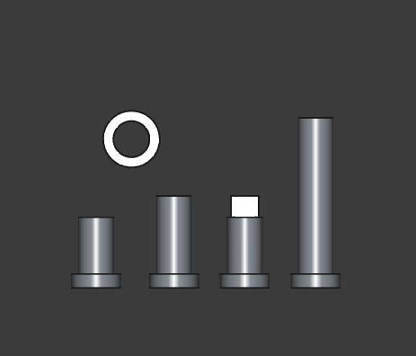
Design Component Overview

Slide 8
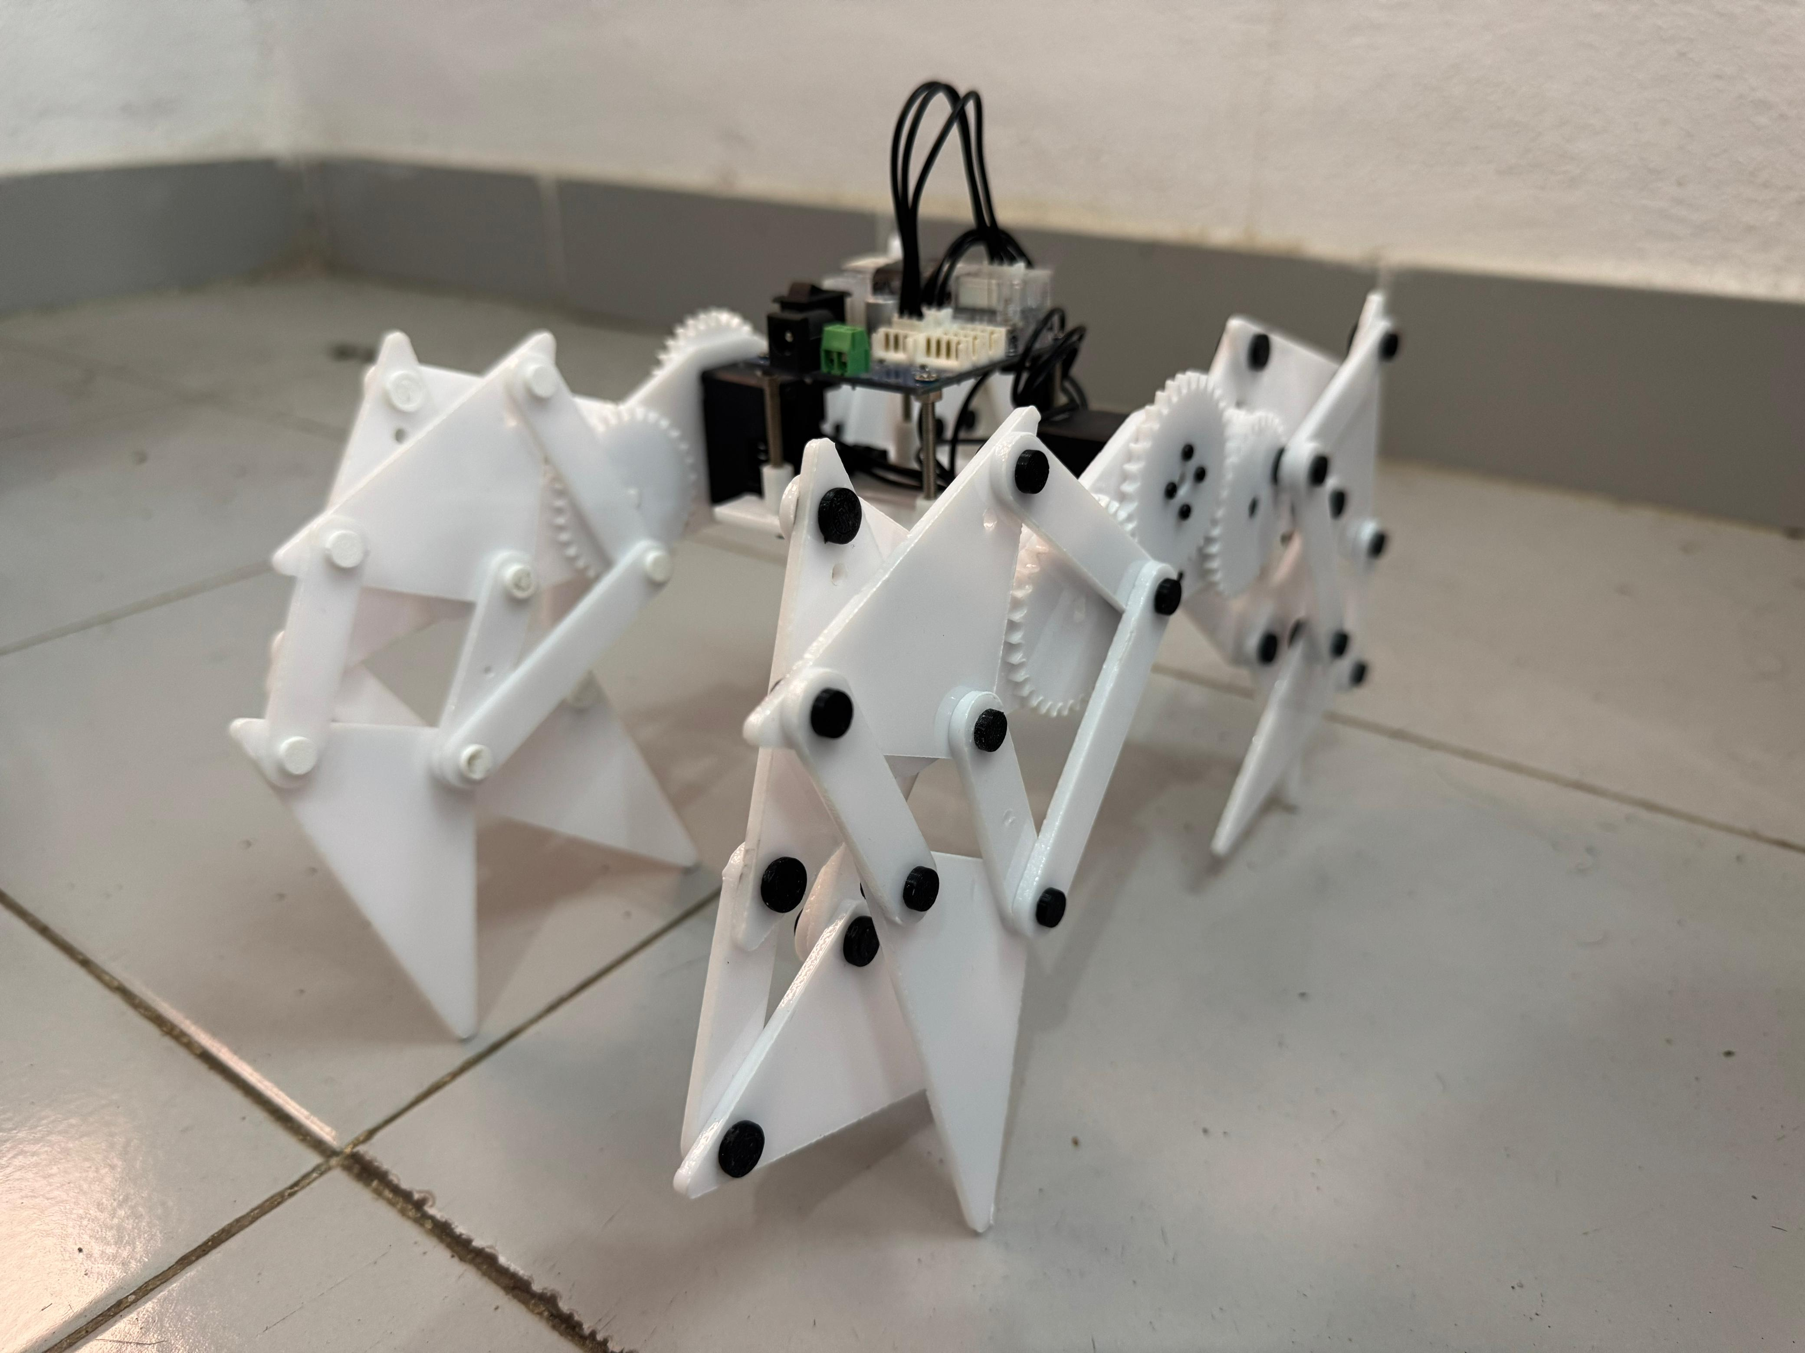
Assembly
Difficulties Faced
2. Modifications

Slide 9
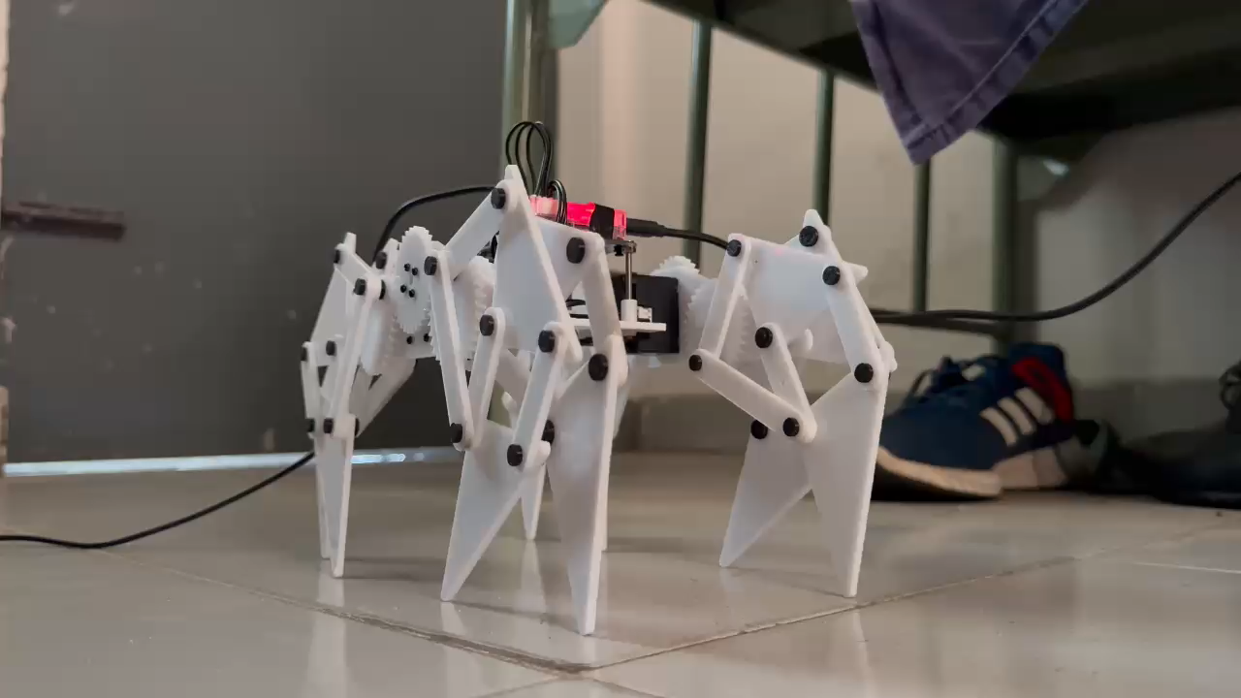
Hardware Demonstration

Slide 10
References
Jansen's Linkage
Design and Linkage Analysis of Theo Jansen Mechanism
Jansen, T. (2007). The Great Pretender. 010 Publishers.
Design of machinery: an introduction to the synthesis and analysis of mechanisms and machines. McGraw-Hill

Slide 11
Thank you!

