Slide 1


Geoservicios para Smart Cities
-
Introducción Smart -Cities
Victor Pascual Ayats
MTIG 17-18
Victor.pascual@icgc.cat

Slide 2
Introducción Smart cities
A smart city is an urban area that uses different types of electronic data collection sensors to supply information used to manage assets and resources efficiently. This includes data collected from citizens, devices, and assets that is processed and analyzed to monitor and manage traffic and transportation systems, power plants, water supply networks, waste management, law enforcement, information systems, schools, libraries, hospitals, and other community services
Fuente: https://en.wikipedia.org/wiki/Smart_city

Slide 3
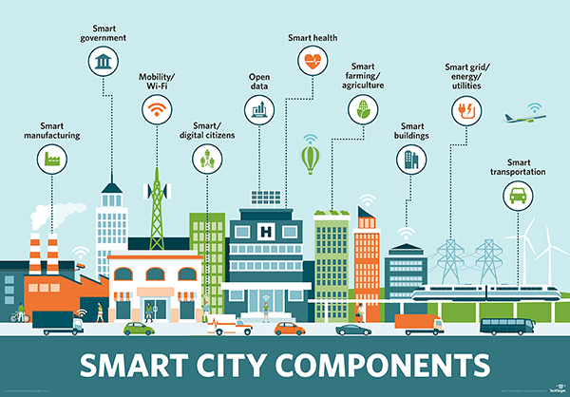
Introducción Smart cities
Smart cities es tecnología de la información

Slide 4
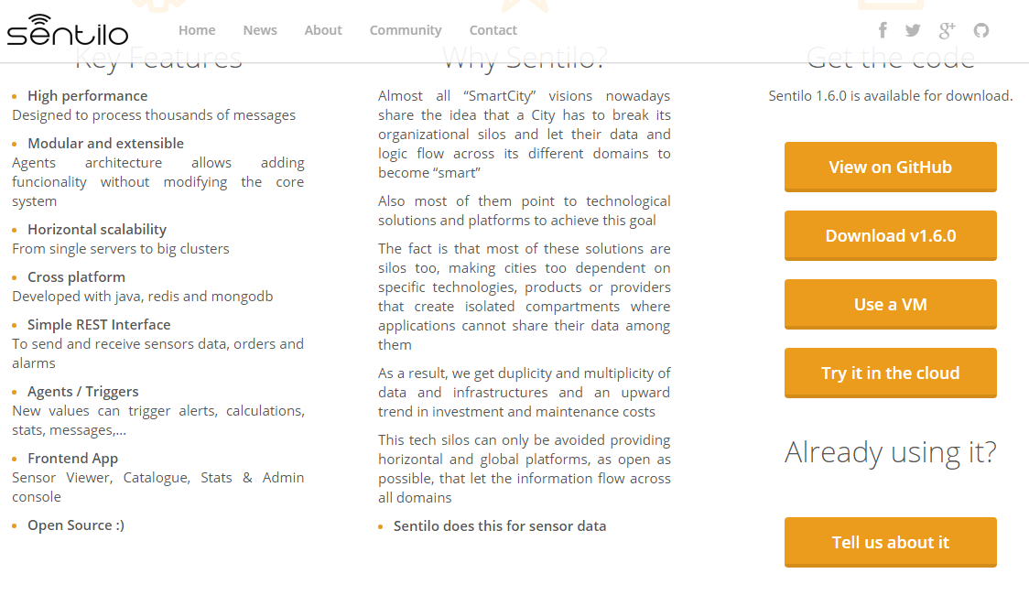
Introducción Smart cities
Smart cities ejemplo Barcelona
http://www.sentilo.io/wordpress/

Slide 5
Introducción Smart cities
Smart cities ejemplo Barcelona
Barcelona has established a number of projects that can be considered 'smart city' applications within its "CityOS" strategy. For example, sensor technology has been implemented in the irrigation system in Parc del Centre de Poblenou, where real time data is transmitted to gardening crews about the level of water required for the plants. Barcelona has also designed a new bus network based on data analysis of the most common traffic flows in Barcelona, utilising primarily vertical, horizontal and diagonal routes with a number of interchanges. Integration of multiple smart city technologies can be seen through the implementation of smart traffic lights as buses run on routes designed to optimise the number of green lights. In addition, where an emergency is reported in Barcelona, the approximate route of the emergency vehicle is entered into the traffic light system, setting all the lights to green as the vehicle approaches through a mix of GPS and traffic management software, allowing emergency services to reach the incident without delay. Much of this data is managed by the Sentilo Platform (http://www.sentilo.io/wordpress/)

Slide 6
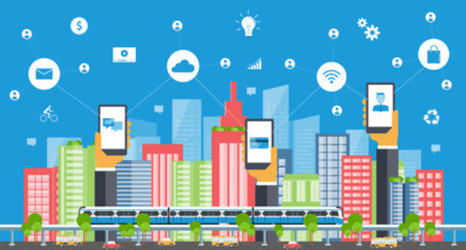
Introducción Smart cities
Smart cities también es comportamiento humano

Slide 7
Introducción Smart cities
Tecnológicamente una Smart city se basa en servicios especializados
Si estos servicios contienen una componente geográfica, hablaremos de :
GeoServicios

Slide 8
Conceptos Geoservicios
¿Qué es un GeoServicio y para qué sirve?

Slide 9
Conceptos Geoservicios
API- Application Programming Interface
In computer programming, an application programming interface (API) is a set of subroutine definitions, protocols, and tools for building application software. ( ….)
An API may be for a web-based system, operating system, database system, computer hardware, or software library. An API specification can take many forms, but often includes specifications for routines, data structures, object classes, variables, or remote calls.
Documentation for the API is usually provided to facilitate usage
Fuente: https://en.wikipedia.org/wiki/Application_programming_interface

Slide 10
Conceptos Geoservicios
API- Application Programming Interface
In computer programming, an application programming interface (API) is a set of subroutine definitions, protocols, and tools for building application software. ( ….)
An API may be for a web-based system, operating system, database system, computer hardware, or software library. An API specification can take many forms, but often includes specifications for routines, data structures, object classes, variables, or remote calls.
Documentation for the API is usually provided to facilitate usage
Direcciones web HTTP
HTTP GET / POST
Entorno WEB o APP Híbridas
Browser
HTML
JavaScript
CSS
API Doc Reference
Documentación de
Request
Response

Slide 11
Conceptos Geoservicios
El protocolo HTTP tiene diferentes metodos de interrogación / inserción
GET
POST
UPDATE
DELETE
INSERT
HTTP – GET es el más utilizado en APIs web

Slide 12
Conceptos Geoservicios
Tipos de Peticiones HTTP- GET
KvP : (Key value Pair) Después ? Pasamos parámetro = valor y concatenamos con &
http://midominio.com/servidor/enpoint?parametro1=valor1&parametro2=valor=2
RESTful : La URL define el recurso, dentro de una arquitectura REST
http://midominio.com/servidor/recurso.json
RESTful and KvP : La URL define el recurso, pero podemos filtrar recurso con parámetros
http://midominio.com/servidor/recurso.json?parametro1=valor1
Utilizada en APIs Opendata

Slide 13
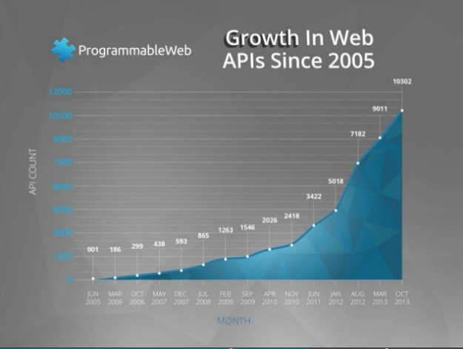
Conceptos Geoservicios
Visitamos
https://www.programmableweb.com

Slide 14
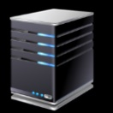

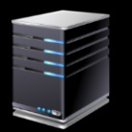


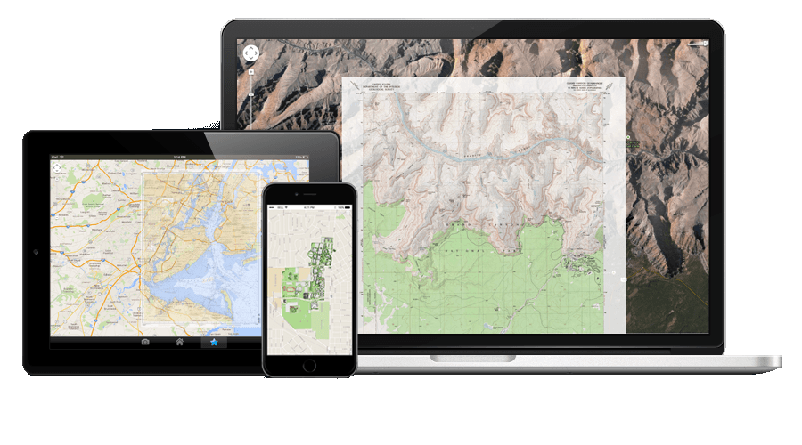


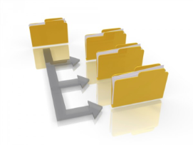

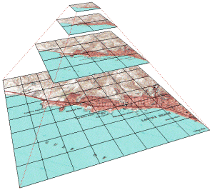
Geoservicios arquitectura
Entorno cliente
Entorno Servidor
http://
Python
Java
JavaScript(Node)
SQL
PHP
ASPX
……
JavaScript
CSS
HTML

