Slide 1

Aya, Aya
Bolor Amgalan

Slide 2
Design process
Human cognitive prosthesis
Research through making

Slide 3
Clarifai API
Node.js
Express a web framework for Node.js
Multer handles file uploads for Express web servers
Pug a template engine for Node.js

Slide 4
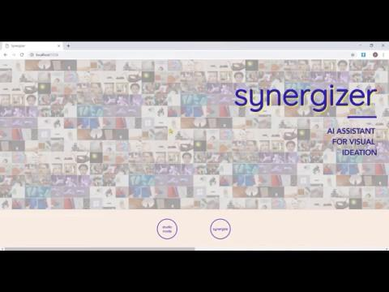

Slide 5
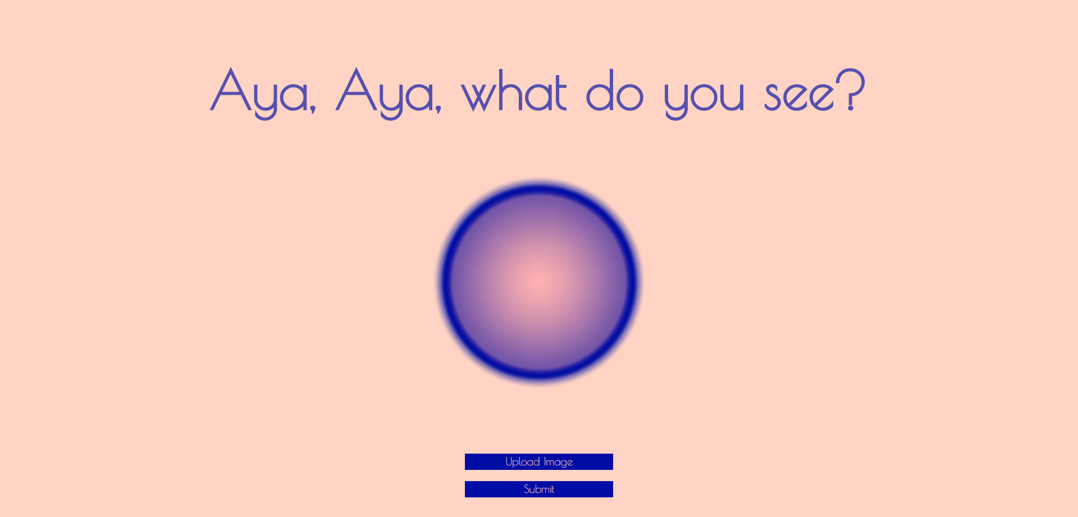

Slide 6
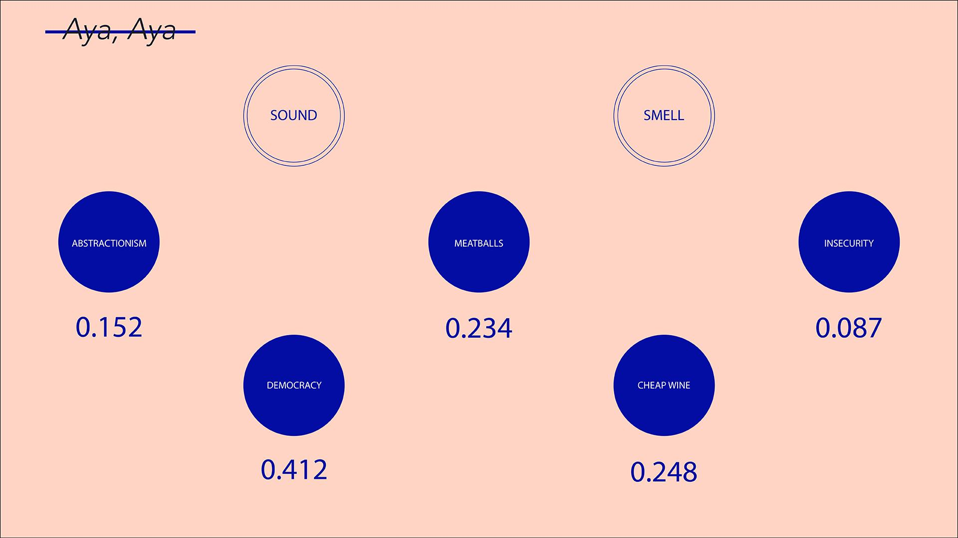

Slide 7
