Slide 1
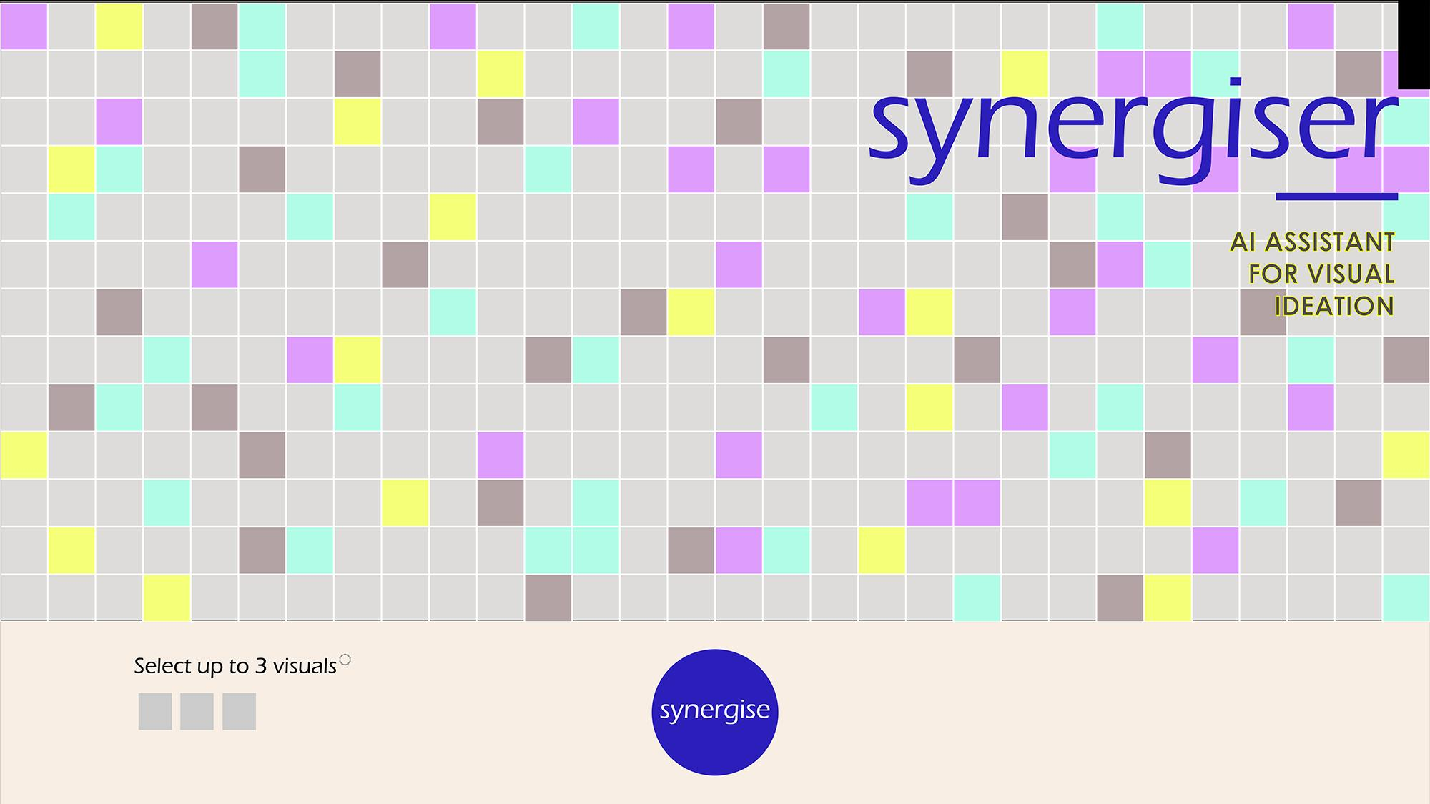
by BOLOR AMGALAN | N00666699 | amgab699
https://github.com/boloramg/WebAdvanced_Spring2019_amgab699/tree/master/Midterm/Code

Slide 2
CONCEPT
With the advent of more robust machine learning algorithms, future creative tasks will be increasingly performed by machines of all forms and capability. The question we might want to ask ourselves, then, is what happens to traditional craft skills when we no longer use them? What happens to human talent when we no longer cherish and develop them?
SYNERGIZE is an AI powered visual ideation tool that will allow designers to augment, not replace, their talent by finding/identifying a point of synergy in a collection of visual references. The typical workflow for a designer would be to upload pictures of their past projects, as well as additional visual references they find inspirational, and then, from the resulting collection of images, select an X number of random images for the AI to analyze.
The SYNERGIZE AI will then analyze these images and display information on what kinds of objects and references it is able to detect in all selected images. By identifying the similarity of the selected images using the machine vision, the designer will be able to find previously unknown synergy between the images.
The output is currently envisaged as text (keywords), which will act as inspiration, or reference points, for the designer. But moving forward, various other machine learning techniques could be implemented where the AI identifies visually similar features in the images, combines them, or processes them in some other way, and then displays the final end-result as a new machine generated image or series of images.
The premise for this project is that machine learning models often identify things/objects/features in images that humans sometimes overlook or just do not see in them. Sometimes it is a mistake by the machine that results from poor training data, but sometimes the output is highly accurate, detecting a pattern the human eyes did not notice before.

Slide 3
CHALLENGES
For my midterm, I developed the initial mockup of this app using a JSON file of images and jQuery. Getting the images to appear inside a grid was quite challenging. But getting this part to work was also one of the most rewarding moments of the first half of the semester for me! I created a grid template from the JS file and created a class and a unique id inside each grid cell. Then I extracted the file directory for each image from the JSON file and used it to create <img> divs for every id.
My initial plan to also incorporate a machine learning feature extraction library using p5.js (model built with MobileNet) did not succeed as the complexity of the p5.js related code kept breaking my other code that was functioning okay. But I would like to continue working on this over the break and get it to work as it would be really interesting to see how the machine learning feature extractor affects my own creative thought process and what it reveals to me about the images I select that I did not see previously (test the effectiveness of this tool, essentially).

Slide 4
IMPROVEMENT
The ideal scenario would be to test this tool with creative people (designers, makers, engineers etc.) and get their feedback on how effective they felt they could ideate when their design process was augmented by the tool and identify improvements based on their feedback.
On a more technical note, I think the JSON file could be created using a more automated method. Perhaps a separate JS file could act as an interface to select images to be added to the database and automatically obtain their file names to add to the JSON file. This would allow me to continue naming my files using the name/description of the project, as I am doing now, but avoid the step of having to physically type in the names for every file. Ideally I want to keep the file names as project name/description instead of 0001, 0002, 0003 (numbers, which can be done automatically). This is so that I can later use the file names as strings either embedded in the Synergize interface somehow, or informing the machine learning process as keywords that can be analyzed.

Slide 5
CONTEXT
SYNERGIZE is envisaged as a design ideation tool that will coexist alongside sketchbooks and digital rapid prototyping tools . It is a practical tool augmenting the design process, but never to the extent that it would replace the human designer/maker.

Slide 6
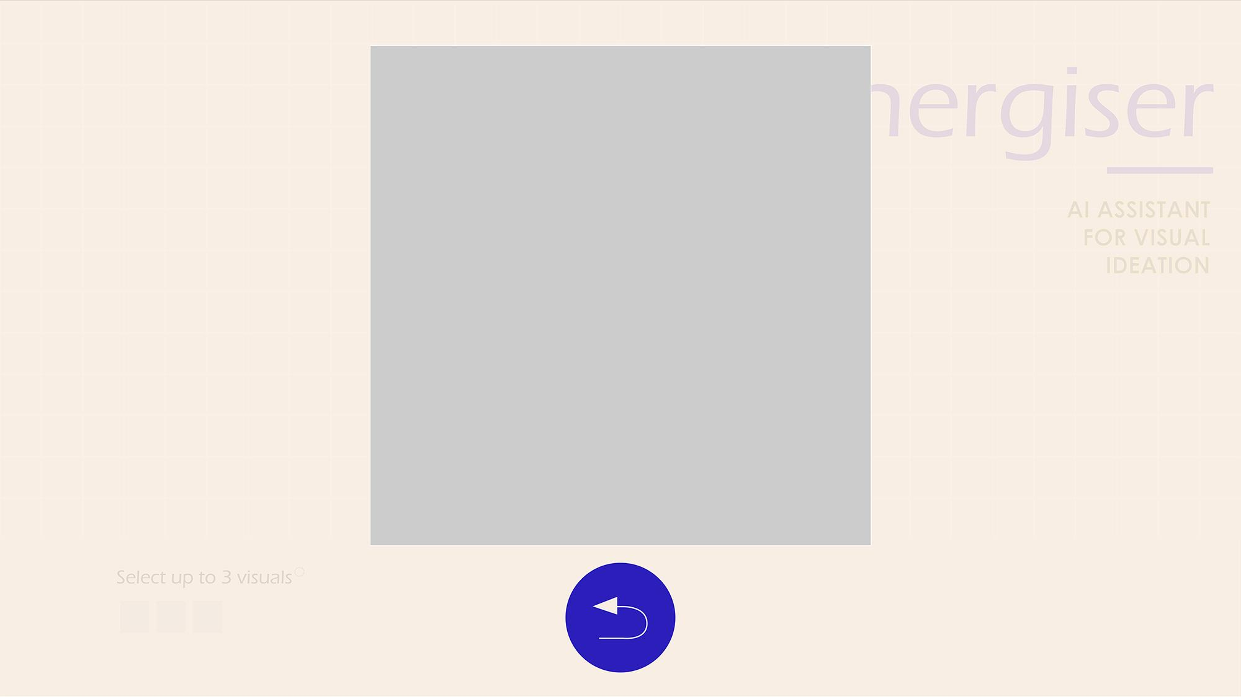
Home screen of SYNERGIZER
Output screen as an overlay on top of the home screen

Slide 7
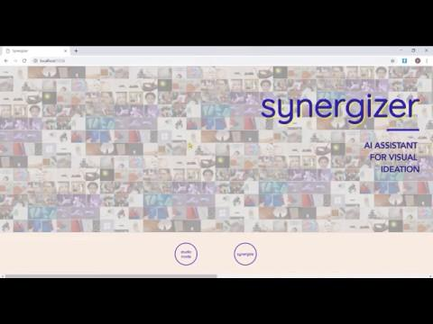
Screen recording showing JS implemented, first SYNERGIZER prototype
If the video says access not granted, please go here:
https://github.com/boloramg/WebAdvanced_Spring2019_amgab699/blob/master/Midterm/Code/Midterm_Demo_Video.mp4

Slide 8
GITHUB
Please view all code, assets and process documentation files at the below repository. https://github.com/boloramg/WebAdvanced_Spring2019_amgab699/tree/master/Midterm/Code

