Slide 1


Slide 2


Slide 3
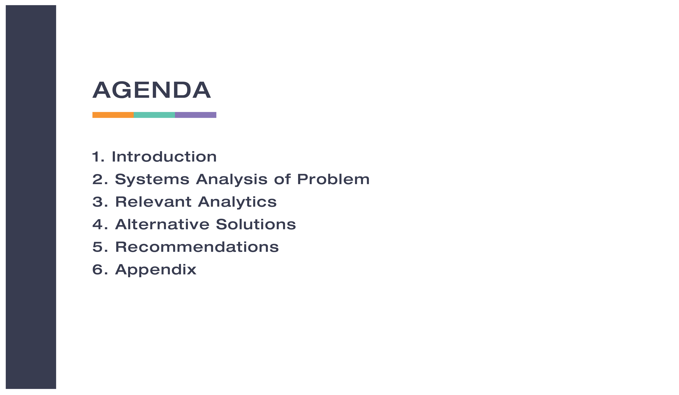

Slide 4
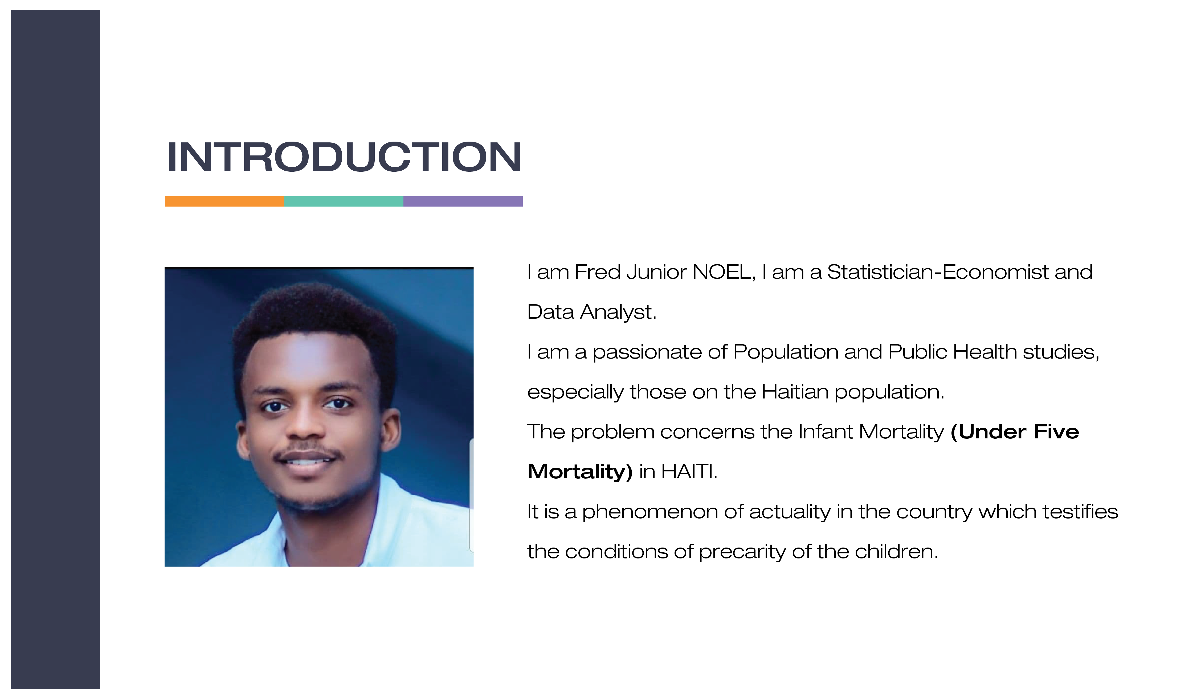

Slide 5
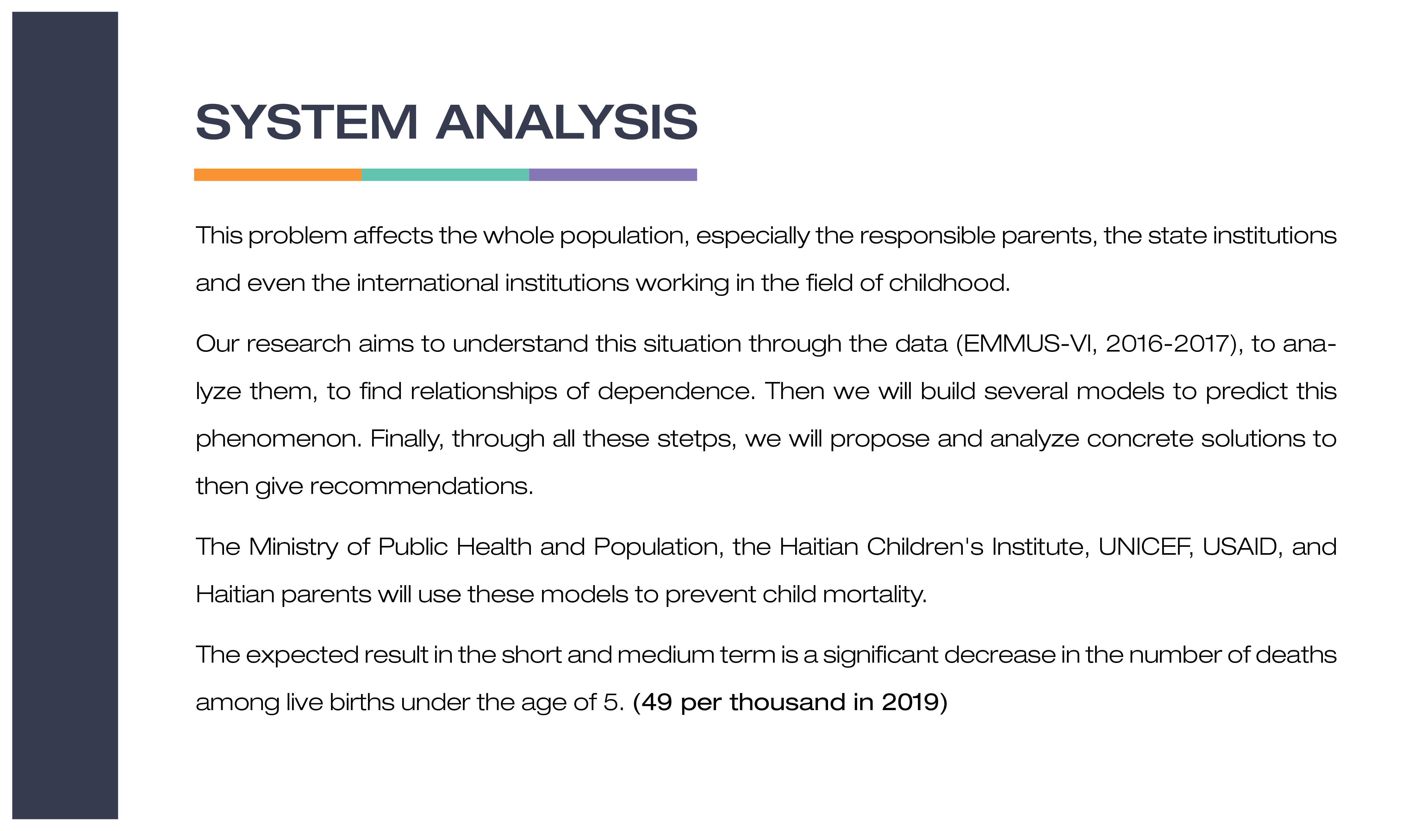

Slide 6

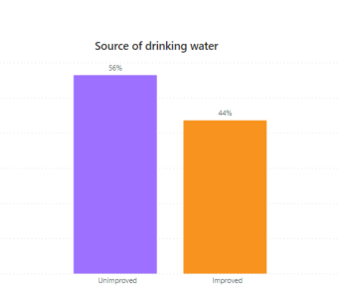
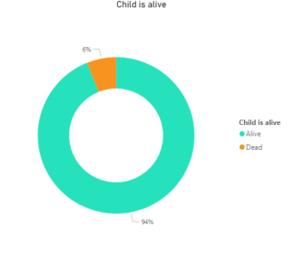
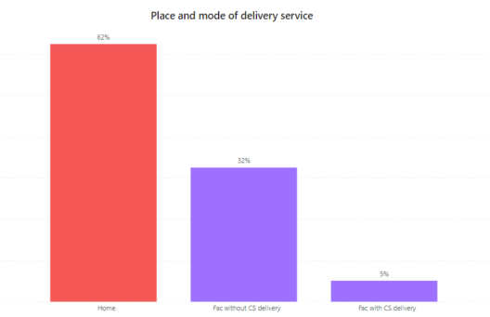
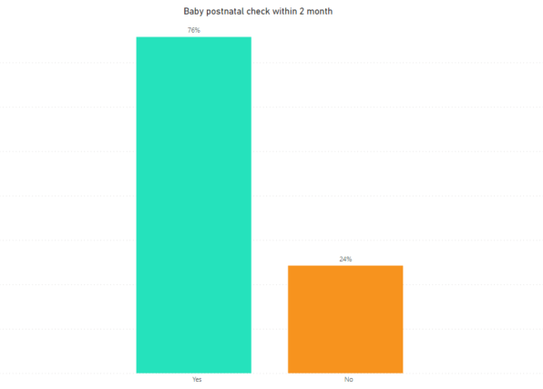
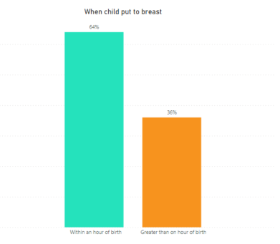
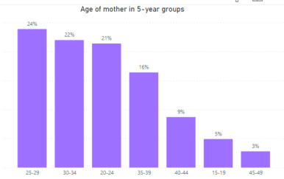

Slide 7

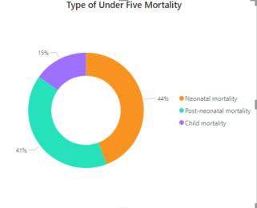
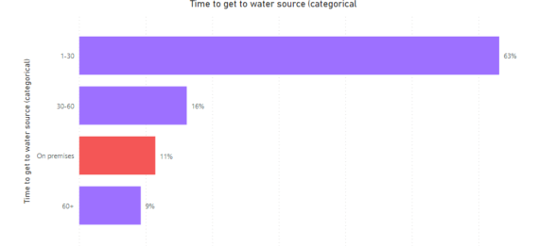
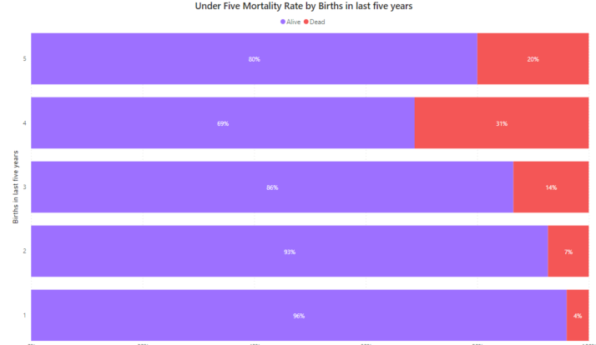
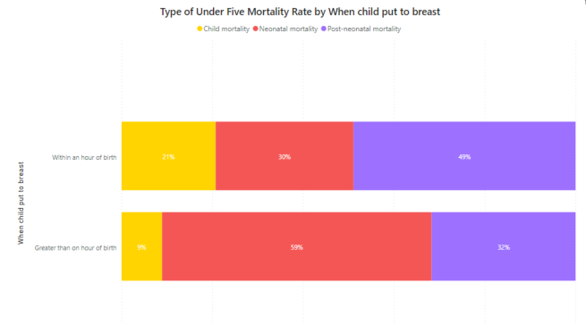

Slide 8
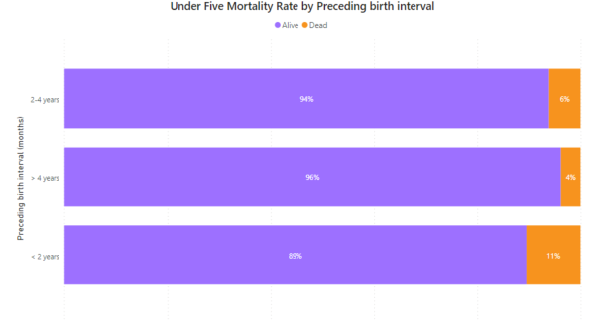
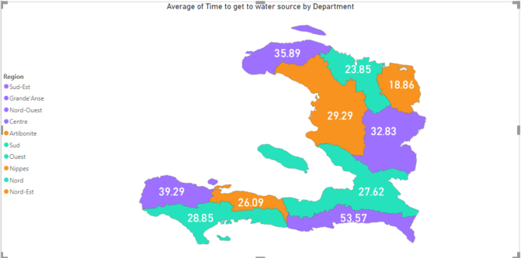
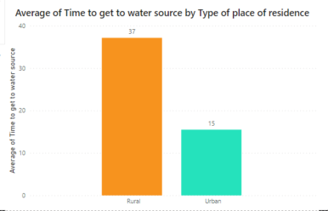

Slide 9
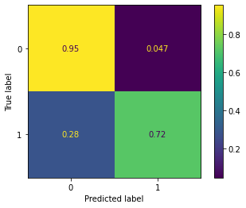
Prediction Models
Supervised Learning: Classification
Among the 10 classification models that we built, we retain the best: MLPClassifier (Deep Learning)
MLPClassifier relies on an underlying Neural Network to perform the task of classification.
Accuracy : 0.9
Precision: Dead (0.81) , Alive (0.92)
Recall: Dead (0.72) , Alive (0.95)
F1-score: Dead (0.76) , Alive (0.94)

Slide 10
Potential Solutions
Under Five Mortality is a big deal, here are some solutions and/or recommendations that the MSPP, Institut Haitien de l'Enfance can follow:
Skilled attendants for antenatal, birth, and postnatal care
Family knowledge of danger signs in a child’s health
- Improved access to water, sanitation, and hygiene
- Immunizations

Slide 11
Recommendations
Access to nutrition and micronutrients
Immediate and exclusive breastfeeding
- Immunizations

Slide 12
Appendix
EMMUS VI (2016-2017)
- The Demographic and Health Surveys (DHS) Program:
https://dhsprogram.com/
For more details on my project visit my Github account:
https://github.com/bolossi509/Capstone-Project.git

