Slide 1
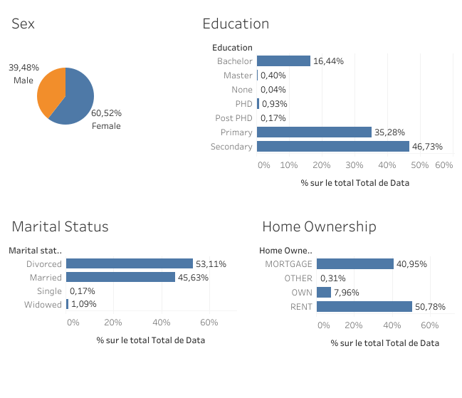
The majority of clients are women: 61% against 31 for men.
For education, the secondary level has the highest percentage, 47%. It is followed by the Primary level which is 35%.
More than half of the clients (53%) are divorced, while 46% are married.
More than half of the clients (51%) are in a rental situation. 41% have a mortgage and only 8% own their home.

Slide 2
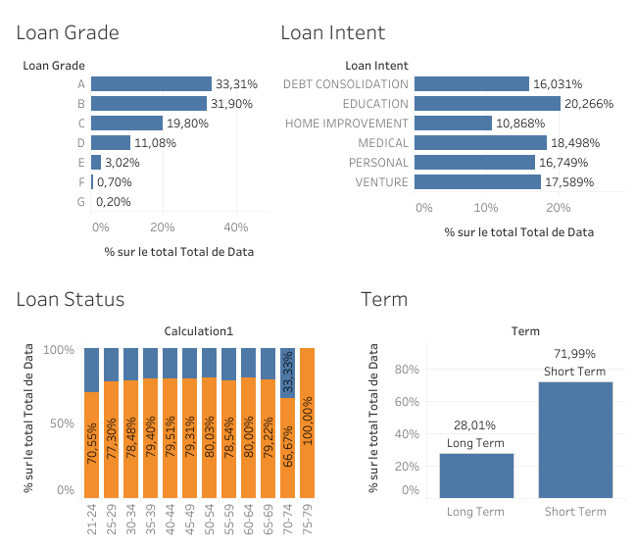
There are fewer and fewer high-risk clients.
Most loans are for education (20%), medical care (18%) and 18% for business...
80% of loans are for short term.

Slide 3
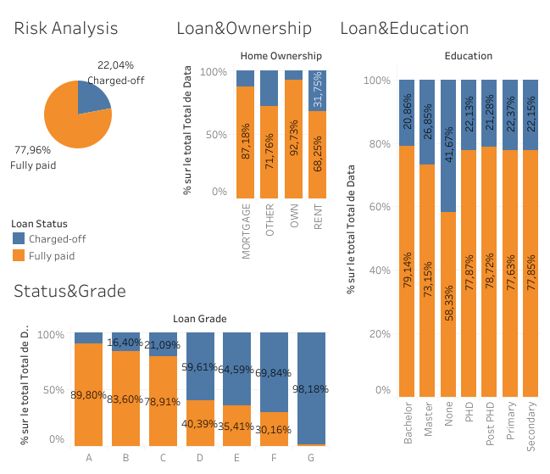
78% of loans are repaid versus 22% that are charged off
Homeowners are more likely to pay off their loans (93%), followed by those who have already taken out a mortgage (87%)
The riskier the loan, the more likely it is to be charged-off, and therefore the less likely it is to be fully paid: 90% of low-risk loans are fully paid while 98% of high-risk loans are charged-off.
Bachelors have the highest fully paid rate (79%)

Slide 4
Based on our analysis of the data, we can make the following recommendations:
G-risk clients should not be eligible to receive a loan. Only 2% of these clients are able to pay their loans in full.
Clients with their own homes are more likely to guarantee a full repayment of the loan. It is wise to look into this type of case further. Although clients who already have a mortgage on their home have a fairly favorable repayment rate.
Clients who do not declare an adequate level of education are more likely to not be fully paid, and therefore less likely to be charged off. This is a case that needs to be looked at more closely before a loan can be arranged for them.
Translated with www.DeepL.com/Translator (free version)

