Slide 1
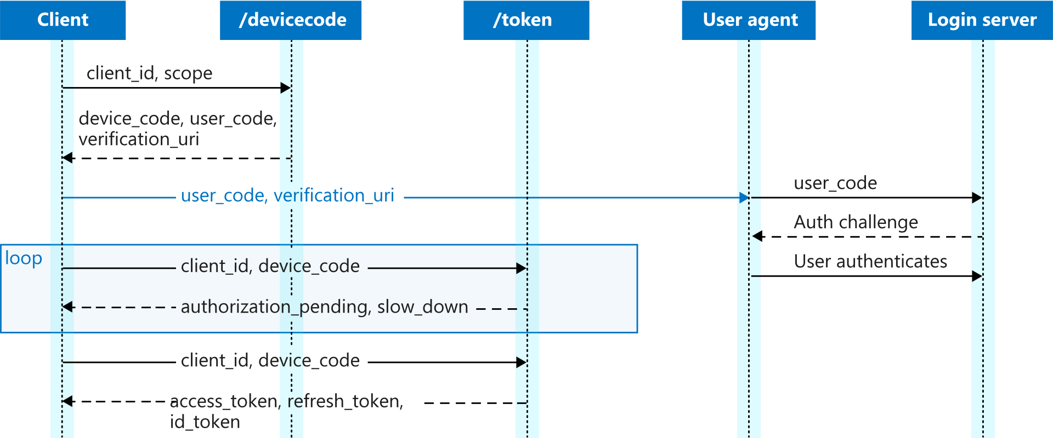
Middleware database
Persist the user_code and device_code
Check for access token (with device_code)
Write access token (with user_code)
middleware
Device
/devicecode
/token
/verification_uri
Browser
Azure AD B2C

