Slide 1
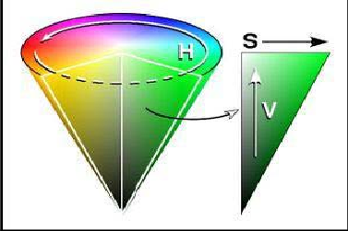
HSV color space

Slide 2
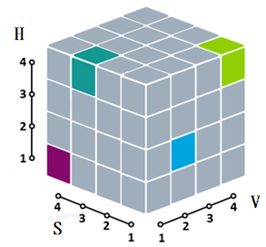
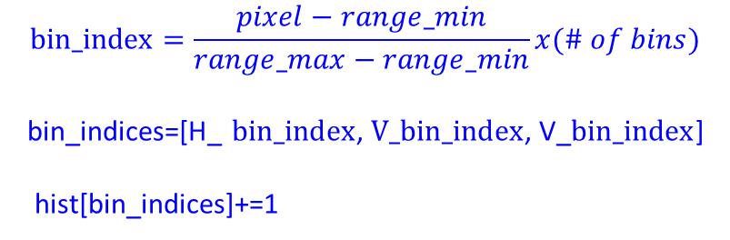
hist = np.array(
[
[ [1, 2, 3] ,
[4, 5, 6]] ,
[ [7, 8, 9],
[10, 11, 12] ]
])
bins=(2, 2, 3)
# Initialize the histogram array
hist = np.zeros(bins, dtype=np.float32)
# Define the number of channels
num_channels = len(channels)
ranges=(0, 256, 0, 256, 0, 256)
bin_ranges = [(ranges[2 * i], ranges[2 * i + 1]) for i in range(num_channels)]
$$bin_index=\frac{pixel−range_min}{range_max−range_min}x(\# of bins)$$
bin_indices=[H_ $bin_index$, $V_bin_index$, V_$bin_index$]
hist[bin_indices]+=1

Slide 3
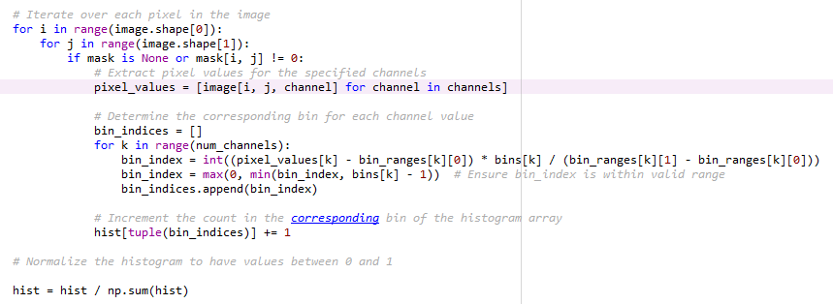

Slide 4
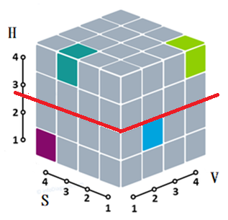
HSV histogram
The shape of HSV histogram is (2,2,3)
hist = np.array(
[
[ [1, 2, 3] ,
[4, 5, 6]] ,
[ [7, 8, 9],
[10, 11, 12] ]
])
只分彩度
hist.sum(axis=(1,2))=(21,57)
H
hist[0,:,:]➔[[1, 2, 3], [4, 5, 6]]
hist[1,:,:] ➔[[7, 8, 9], [10, 11, 12] ]
S
hist[:,0,:] ➔ [[1, 2, 3] , [7, 8, 9]]
hist[:,1,:] ➔ [[4, 5, 6], [10, 11, 12]]
V
hist[:,:,0] ➔ [[1, 4] , [7,10]]
hist[:,:,1] ➔ [[2, 5] , [8,11]]
hist[:,:,2] ➔ [[3, 6] , [9,12]]
只分飽和度
hist.sum(axis=(0,2))=(30,48)
hist.sum(axis=(0,1))=(22,26,30)

