Slide 1
Development of atomic physics
Observation of atoms and molecules
Emergence of quantum physics
Invention of lasers
Spectroscopy of atomic structure
Manipulation of atoms and molecules
Control of internal states (e.g. optical pumping)
Control of external states (e.g. cooling atoms)
Creating new forms of matter
Coherent control of atoms and molecules
Quantum metrology
Quantum information science
Quantum Simulation

Slide 2
1980-1990 Development of various laser cooling technique
Beam Slowing (1982)
Optical Molasses (1985)
Magnetic Trap (1985)
Optical Trap (1986)
Sub-Doppler Cooling (1988)
Sub-recoil Cooling (1988)
For Na atoms
T_{D} = 240 μK (30cm/s)
T_{r} = 2.3 μK (3cm/s)

Slide 3
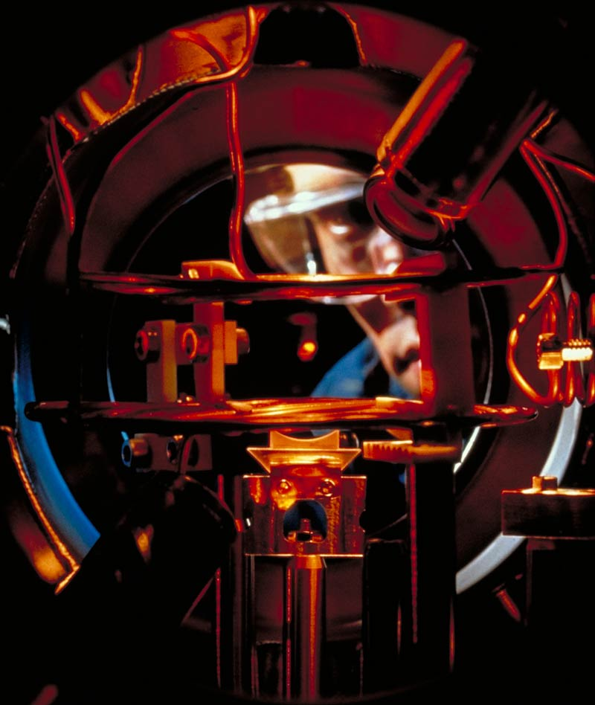

Slide 4
Lecture 1: Laser cooling
Structure of alkali atoms
Brief review of two-level system
Photon scattering force
Optical molasses (Doppler cooling)
Sisyphus cooling (sub-Doppler Cooling)
Fundamental limits of laser cooling
References
Laser Cooling and Trapping : Metcalf & van der Straten
Atom-Photon Interactions : Cohen-Tannoudji et al.
Laser Manipulation of Atoms and Ions:
Proceedings of the international school of physics “Enrico Fermi” Course CXVIII
Atomic Physics : Foot

Slide 5
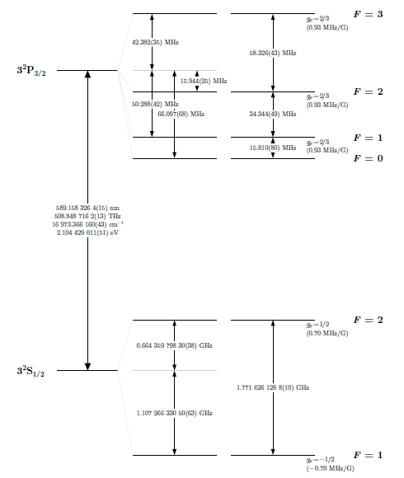
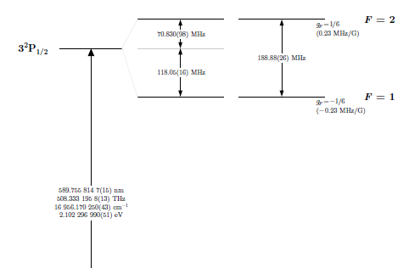
Energy levels of sodium atom
Atom | Wavelength (nm)
⁷Li ²³Na ⁴¹K ⁸⁷Rb ¹³³Cs | 670 589 766 780 852

Slide 6
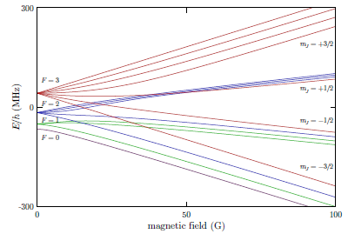
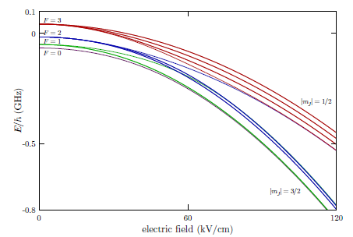
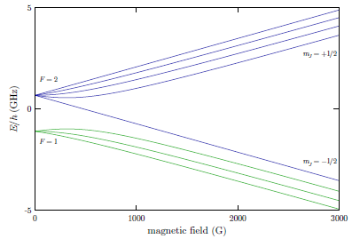
Hyperfine structure in a static field
3²P_{3/2}
3²S_{1/2}

Slide 7
Two-level system
Rabi frequency
Need to include the decay term due to spontaneous emission
➔ Master equation / Optical Bloch equation
Occupation probability of the excited state
Detuning of driving frequency

Slide 8
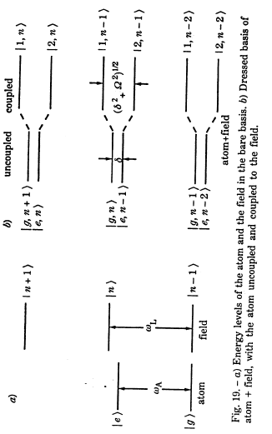
Energy level shift
Dressed atom picture

Slide 9
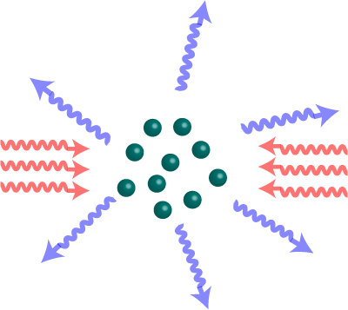
Photon scattering force
Ex) for Na,
10⁵ times of g !!!
T=900K, v=1km/s
Stopping distance 1.1m
Photon recoil momentum
Scattering force
Scattering rate

Slide 10
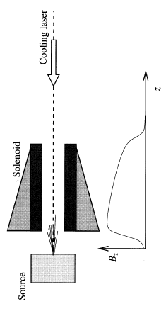
Zeeman slowing
Doppler shift effect is compensated by Zeeman effect.
With constant deceleration

Slide 11
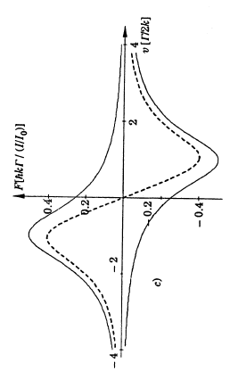
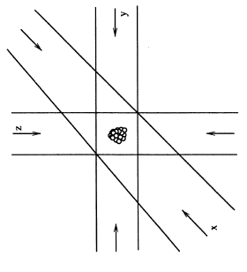
Optical molasses
➔ Dragging force

Slide 12
Doppler cooling limit
0
Dragging force
➔Cooling
Random momentum kick
➔Heating
Equilibrium temperature
Doppler cooling limit

Slide 13
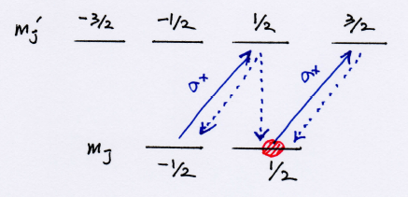
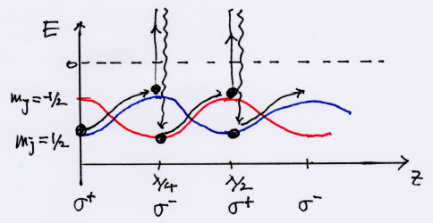
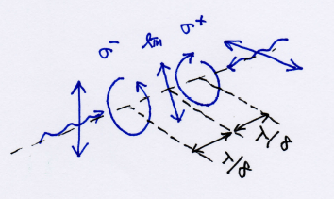
Sub-doppler cooling
Using multi-level structure of atoms
σ+ : pumping to m_{j}=1/2
σ- : pumping to m_{j}=-1/2
lin⊥lin-configration
Always uphill movement
➔ “Sisyphus cooling”

Slide 14
Fundamental limits of laser cooling
Doppler cooling limit
Recoil momentum limit
Sub-recoil cooling
(!!!???)

