Slide 1
Lecture 2: Trapping and Evaporative Cooling

Slide 2
Forces for atoms
Scattering force
Optical dipole force
Magnetic/Electric force
Photon absorption
AC Stark effect (level shifting)
Dipole moment in a field

Slide 3
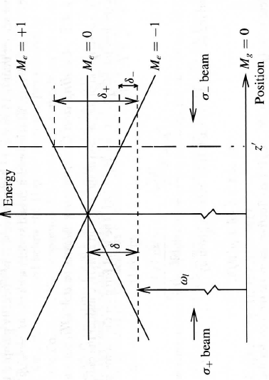
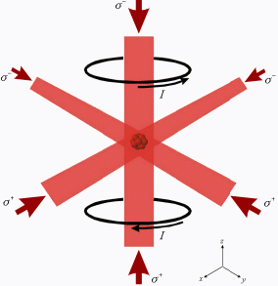
Magneto-Optical Trap (MOT)
Ex) B’=10G/cm,
Oscillation freq ~ few kHz
Damping freq ~ 100kHz
Damping
Trapping

Slide 4
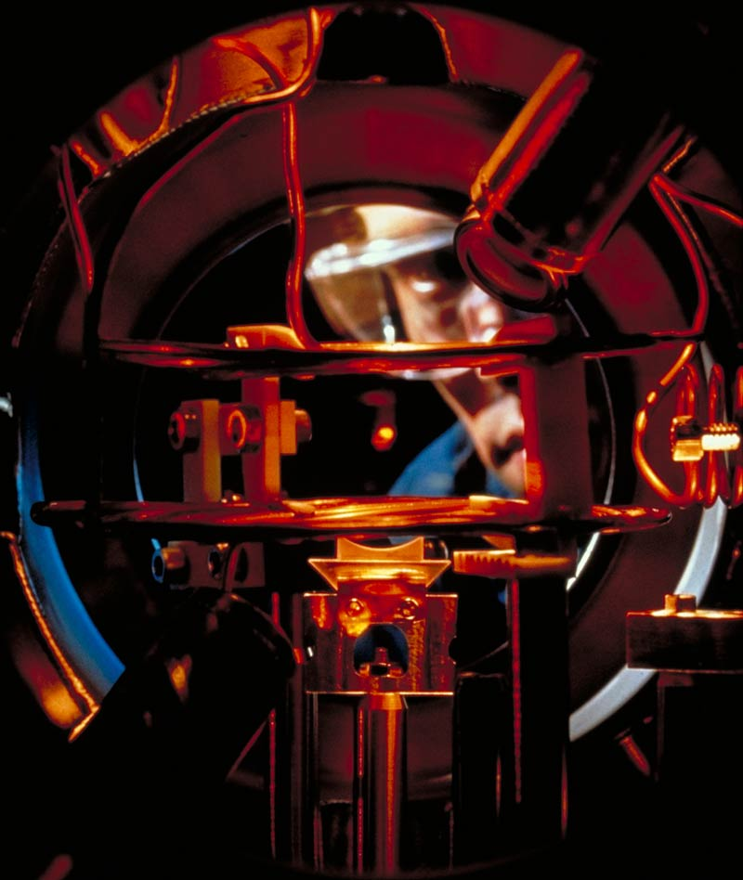
MOT dynamics
Loading from background vapor or atomic beam
Many loss mechanism:
Background collision
Inelastic collision
Radiative Escape
Radiative pressure
Modified techniques:
CMOT
Dark-spot MOT
Cloud diameter | 0.1~10 mm
Temperature | ~100 uK
# of atoms | 10⁴~10¹⁰
Atom number density | 10⁸ to 10¹¹ cm⁻³
Phase space density | ~10⁻⁶

Slide 5

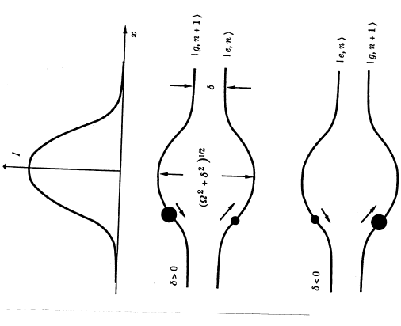
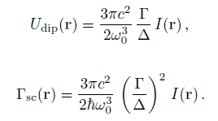
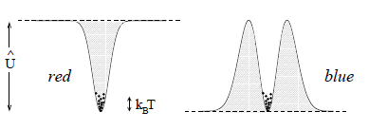
Optical dipole trap
Complex polarizability
Far detuning limit (Δ << Γ)
R. Grimm, et al, Adv. At., Mol., Opt. Phys. 42, 95 (2000)

Slide 6
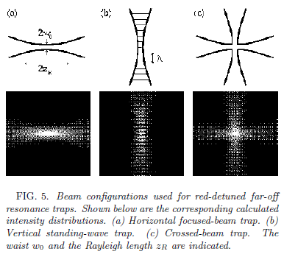
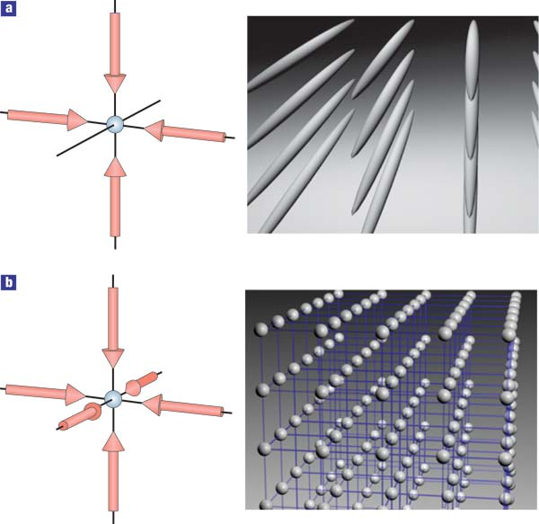


Various optical traps
Single, focused beam trap
Optical Lattices
Ex) for Na, 1064nm, 1W, w₀=10um
U_{dipole}=260uK, R_{scatt}=2s⁻¹

Slide 7
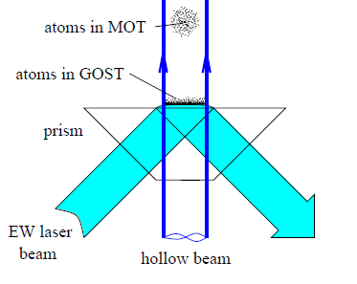
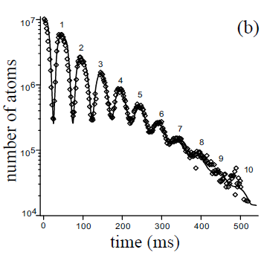
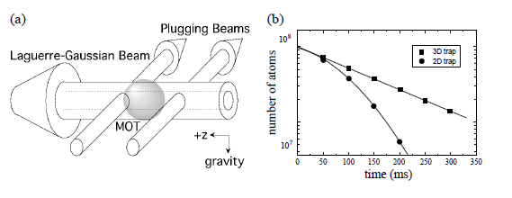
Various optical traps
Gravito-Optical Surface Trap
Hollow-beam Trap

Slide 8
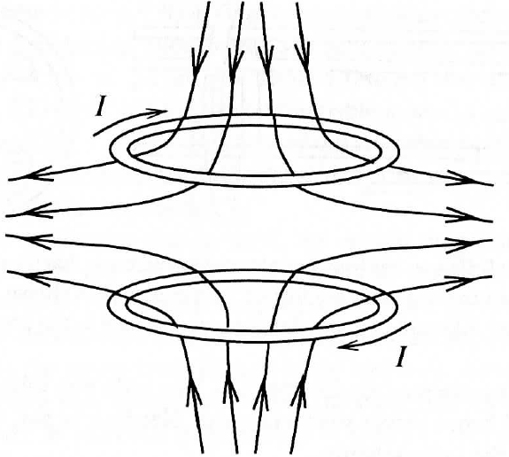
Magnetic traps
Magnetic potential
No field maximum theorem
: In the region free of charges and currents |E| and |B| cannot have a local maximum.
➔ Only weak-field seeking states can be trapped in a local minimum.
μ is anti-parallel to B
ex) Quadrupole trap

Slide 9
Stability of magnetic trap
Only stable if the atom’s magnetic moment adiabatically follows the direction of the magnetic field
In regions of very small magnetic field, a moving particle will make a Majorana spin flip to untrapable states. ➔ Atom loss
Plug trap
= Quadrupole trap
+ Optical plug at center
Used for first BEC at MIT (1995)

Slide 10
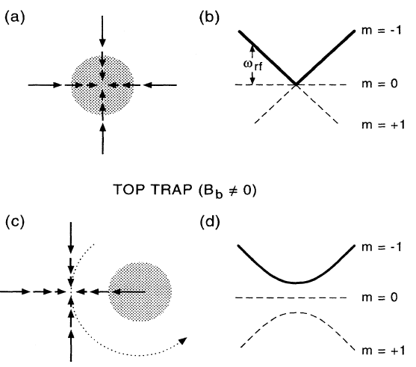
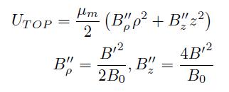
Time-averaged Orbiting Potential (TOP) trap
Used for first BEC at JILA (1995)

Slide 11
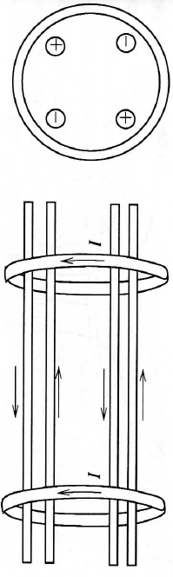
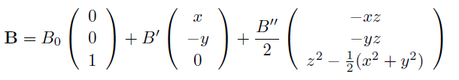
Ioffe-Pritchard Trap
Forming a static local minimum

Slide 12
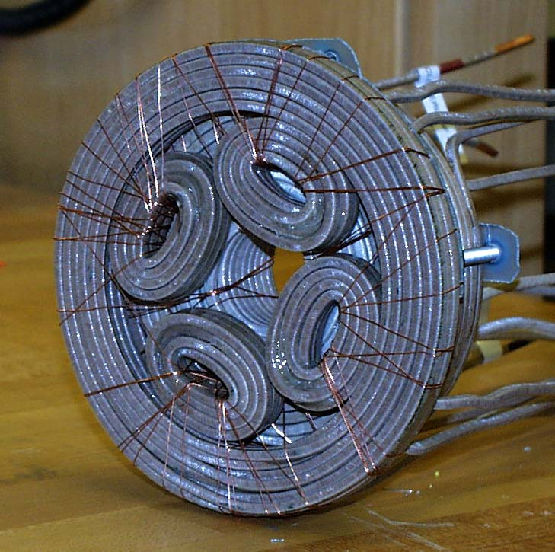
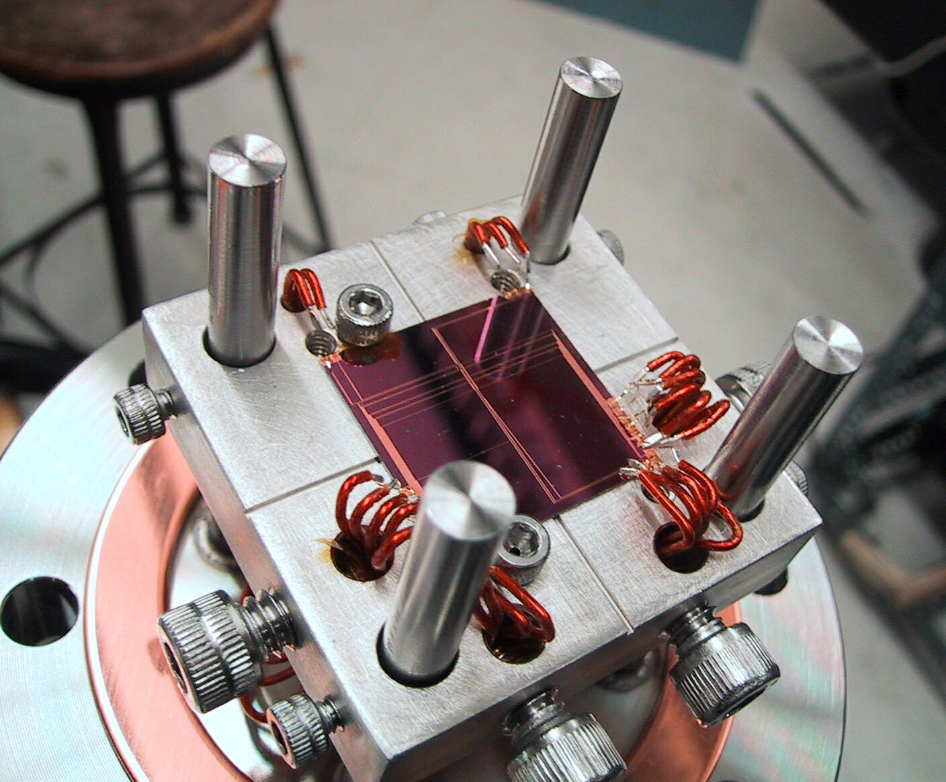
Miniaturizing Magnetic Traps
Tighter confinement.
Less power consumption.
Greater flexibility in fabrication.
14 cm
2.5 cm
3 mm X 3 mm wires
50 μm X 10 μm wires

Slide 13
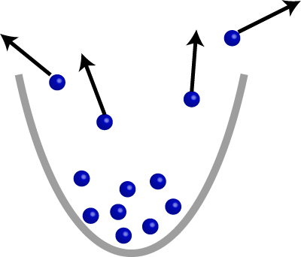
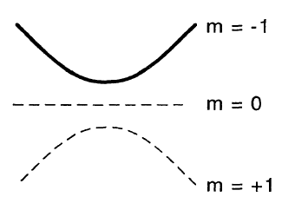
Evaporative Cooling
Removing the tail of thermal distribution leads to lower average energy, i.e., cooling the sample.
Method 1: RF transitions to untrapable states
ω_{RF}
Method 2: Reducing the trap depth
Run-away evaporation:
with a net increases in density and collision rate despite of the loss of atoms

Slide 14
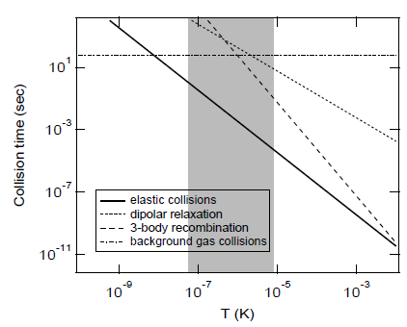
Cooling limit of Evaporation
Elastic collisions
➔ Good collision for re-thermalization
Inelastic collisions
➔ Bad collisions to heat up the sample
BEC window

