Slide 1
Lecture 3: Making and Observing BECs

Slide 2
Bose-Einstein Condensation
Notion of Bose statistics: to derive the black-body radiation (S. Bose, 1924)
Extended to include systems with conserved particle number (A. Einstein, 1925)
: pointing a peculiar feature of the distribution: at low temperature it saturates.
Example) N-particles in a two-level system
Classical counting
Quantum counting
due to the indistinguishability of particles
E
2^{N}
N+1
In a thermodynamic limit N→∞,
the occupation number of the excited state is saturated

Slide 3
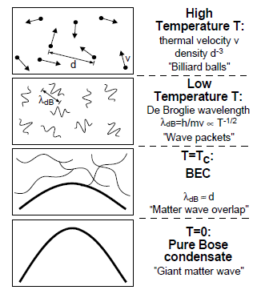


Bose-Einstein Condensation of an ideal Bose gas
BE-statistics

Slide 4
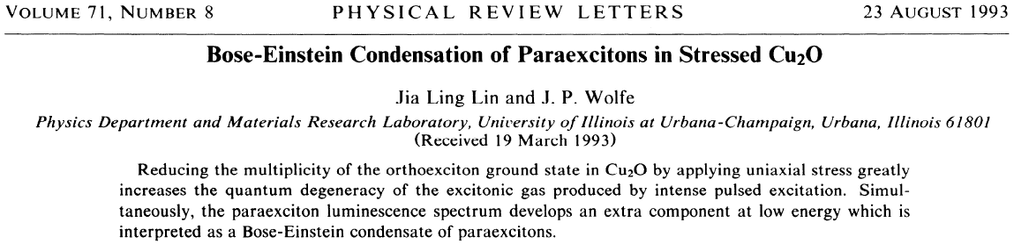
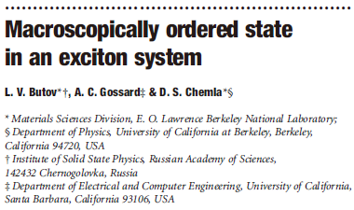
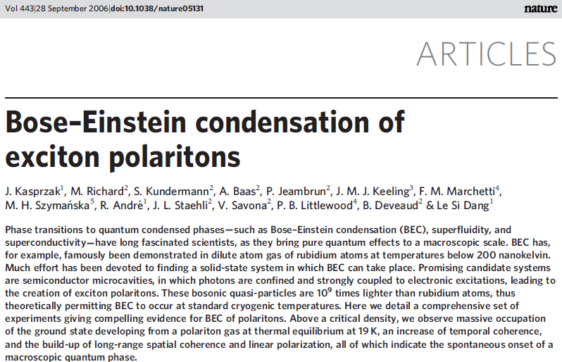
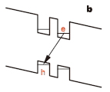
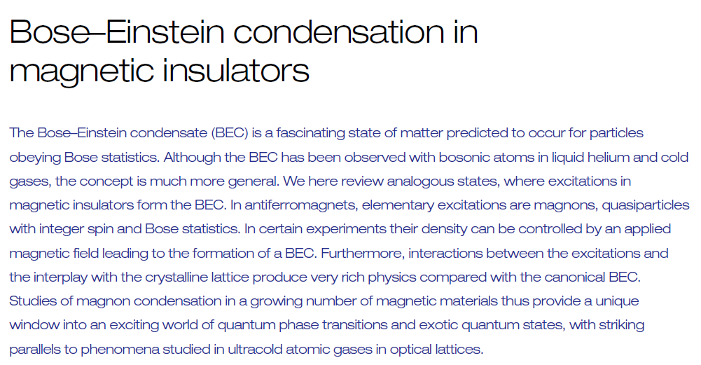
BEC systems
Superfluid Helium
Lasers and Masers (macroscopic occupation in the same state)
Superconductiviy
Excitons in cuprous oxide

Slide 5
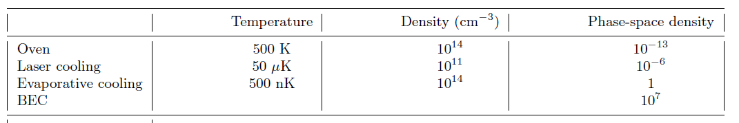
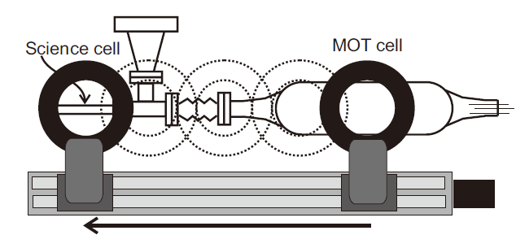
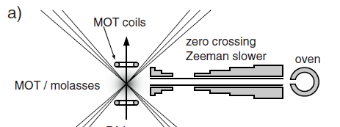
Making a BEC in a dilute gas
Atom source: atomic beam from oven / vapor cell
Pre-cooling with laser: Zeeman slowing / Double MOT configuration
Loading in a magnetic/ optical trap
Evaporative cooling

Slide 6
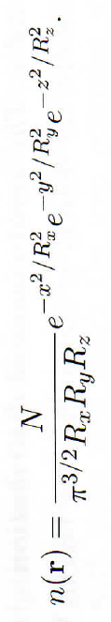

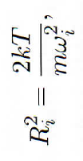
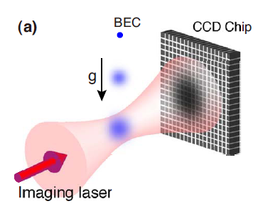



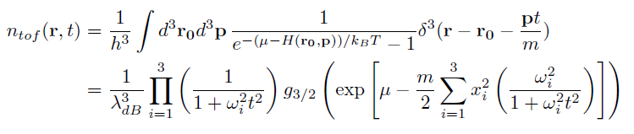

Time-of-flight Imaging

Slide 7
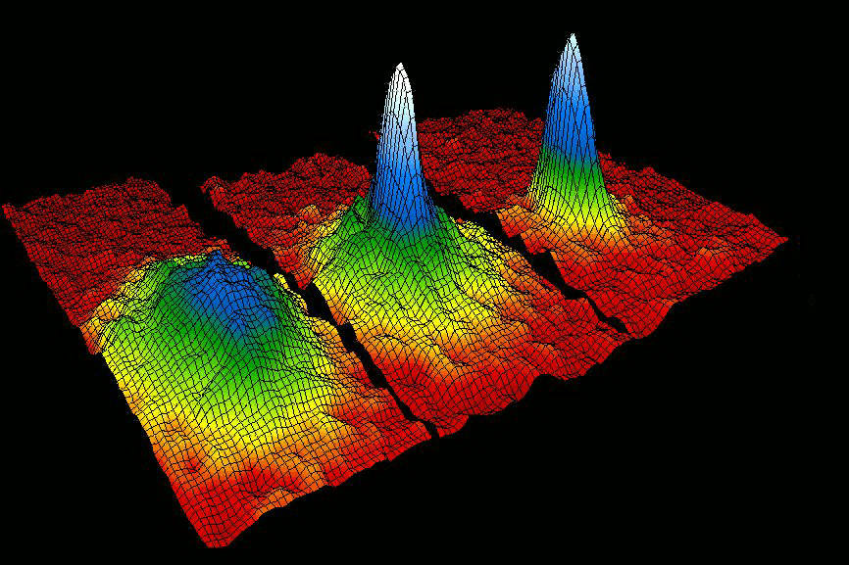
Bose-Einstein condensation in a dilute gas
BEC @ JILA, 1995
(2001 Nobel prize)

Slide 8
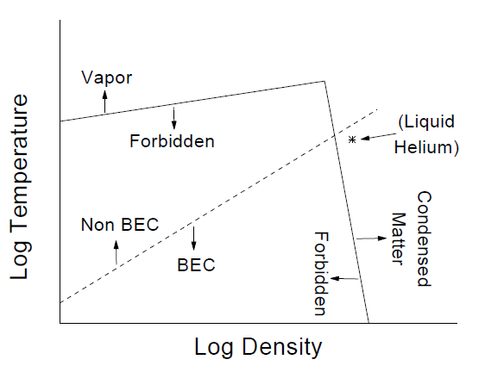
Why it was hard to make a BEC in atomic gases
Gaseous BEC: Metastable state
Requiring low density to avoid to relax to the ultimately stable solid-state condition.
Asking for a lower temperature
Evaporation cooling
➔ Initial atom number and long lifetime are critical.

