Slide 1
Lecture 4: Description of BEC

Slide 2
Many-body Hamiltonian in cold atom gases
s-wave scattering length

Slide 3
Scattering problem
For a given Interparticle potential
: Scattering amplitude
Partial wave description
Phase shift

Slide 4
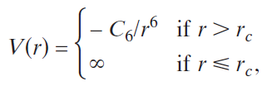
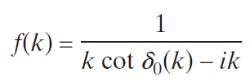

Cold atom collisions
V(r)
van der Waals attraction
r_{c}
a_{c}
r
Characteristic length
For non-zero l,
Centrifugal barrier
For gases in the sub-milikelvin regime, only s-wave collisions are relevant.
Scattering length
Effective range

Slide 5
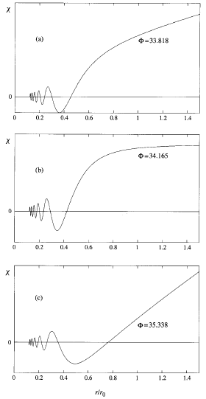
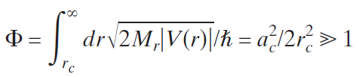
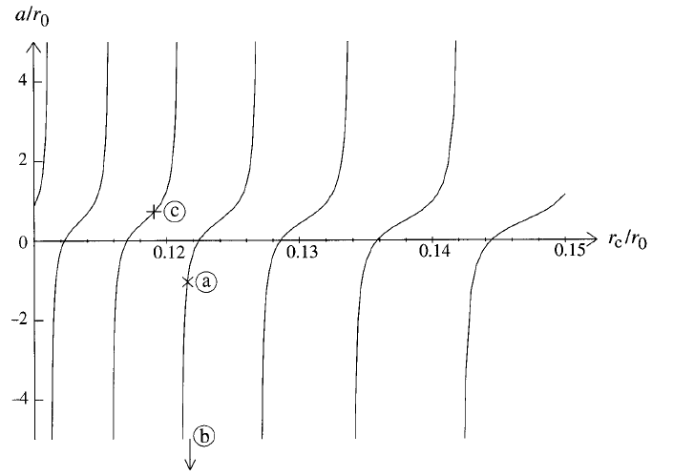
Scattering length
V(r)
r_{c}
a_{c}
r
WKB phase

Slide 6
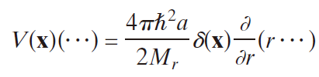

Effective potential
In the regime of ultracold collision, ka_{c}<<1
The two-body collision is completely specified by a single parameter, a
Effective pseudopotential
Realizing the toy-model Hamiltonian,

Slide 7
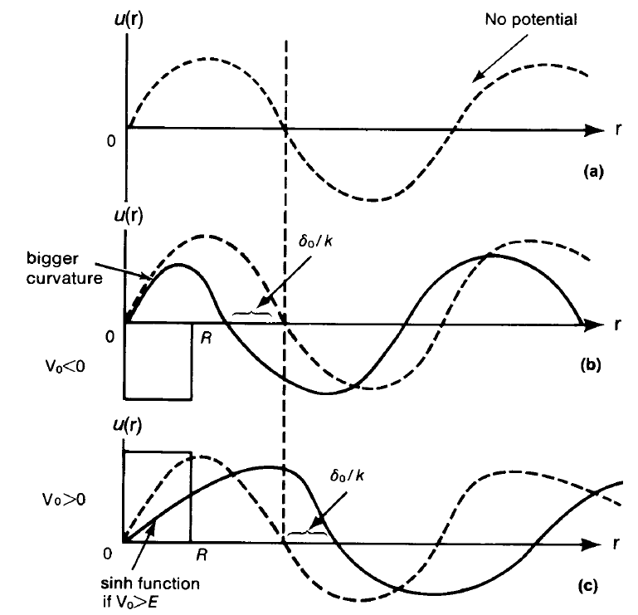
Sign of scattering length and energy shift
Attractive potential
pulling in the wavefunction
Repulsive potential
pushing out the wavefunction
Corresponding energy shift?

Slide 8





Criterion of Bose-Einstein condensation
: density matrix of a given many-body state of N-bosons
: single-particle density matrix
: corresponding eigenfunctions and values
Macroscopic occupation of a single quantum state
: wavefunction of a condensate
Penrose & Onsager (1956)
Yang (1962): off-diagonal long-range order (ODLRO)

Slide 9
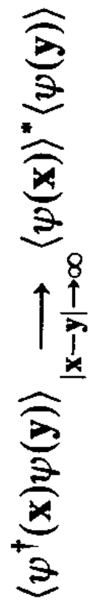

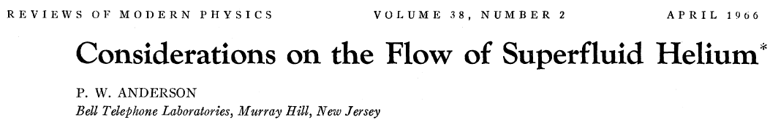

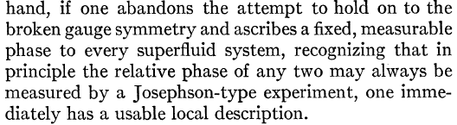
Order Parameter for BEC
Order parameter : necessary to describe the dynamics of a new phase, which vanishes in one phase and becomes non-zero in the other phase.
ODLRO: not determined by local dynamical variables
not applicable to a finite-size sample
Superfluid density, condensate wavefunction, etc..
Spontaneous symmetry breaking
Discovery of Josephson effect ➔ Existence of a definable phase in every part of system
U(1) gauge symmetry is broken !!

Slide 10
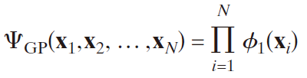
Mean-field description of a dilute Bose gas
Bogoliubov (1947)
Complex number
Gross-Pitaevskii (GP) equation
A simplest approximation for many-body states
➔ a product of a single-particle wavefunction:

Slide 11
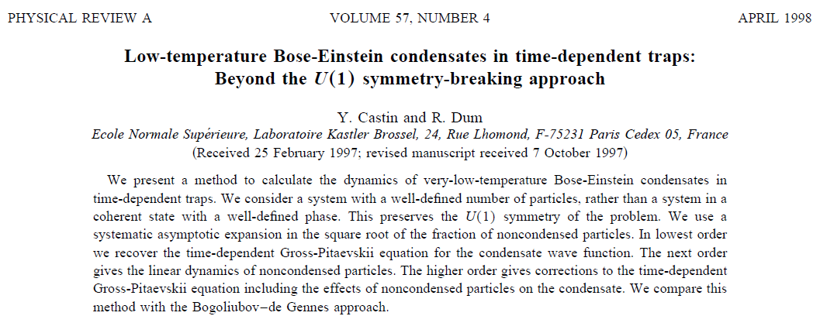
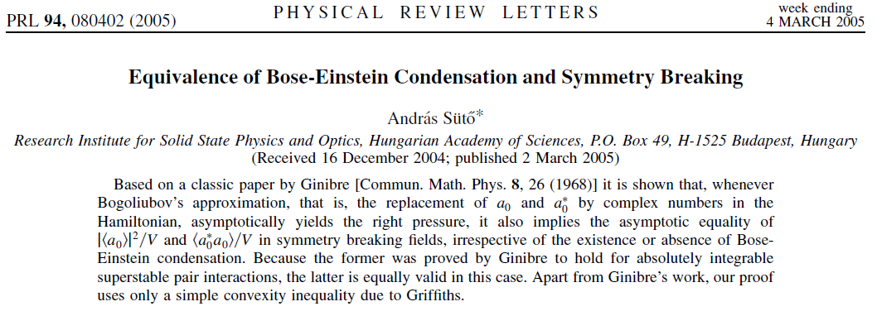
Is it necessary to break the gauge symmetry?
Violating the super-selection rule !!
Optical coherence: a convenient fiction. K. Molmer, PRA 55, 3195 (1997)
There is no way to measure the absolute phase.
Only relative phases are experimentally observable.

Slide 12
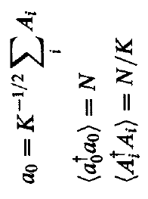

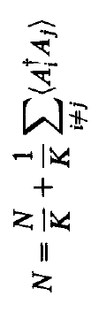
Phase coherence of BEC
i-1 i i+1 …
a₀
Phase coherence of BEC

