Slide 1
Lecture 5: Description of BEC in a trap

Slide 2
BEC in a harmonic trap
N bosonic particles in a trap with trapping potential
GP equation
Stationary solution,
Chemical potential μ is determined by number condition,
Non-interacting case

Slide 3
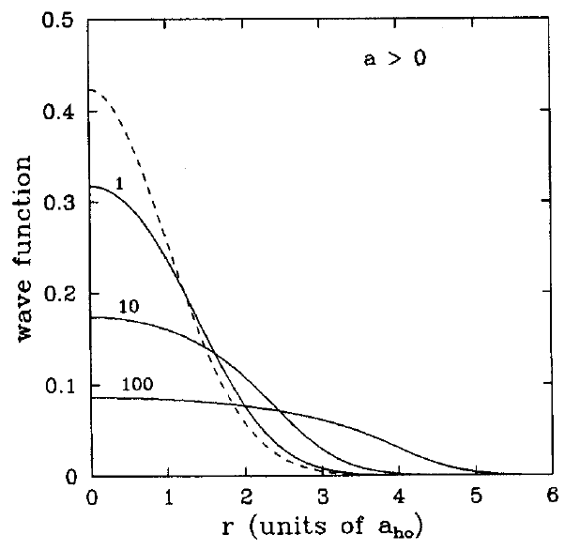
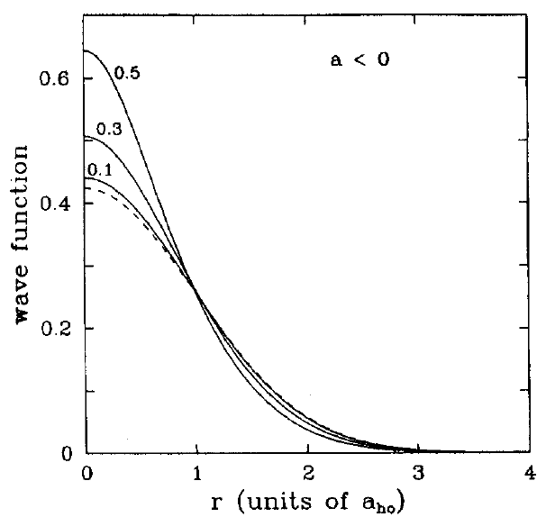
BEC in a harmonic trap
Interparticle interactions deform the condensate wavefunction
Interaction-dominated regime
N ~ 10⁵~10⁶
a ~ 100 a₀ ~ nm
a_{ho} ~ um
Collapse at

Slide 4
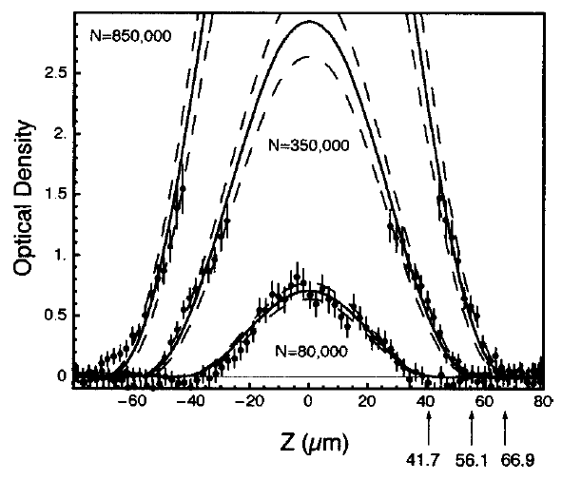
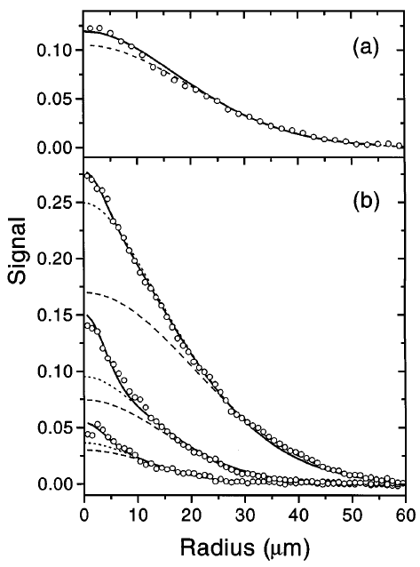
In-situ density profiles of trapped BECs
Bradley et al., PRL 78 (1997)
Observation of BEC of ⁷Li
with attractive interactions
Hau et al., PRA 58 (1998)
Using near-resonant imaging techniques

Slide 5
Thomas-Fermi (TF) approximation with large N
In the limit of
Neglect the quantum pressure term w.r.t. interaction energy.
Local chemical potential
Local density
?? Local density approximation (LDA)
Approximate the exchange-correlation energy functional in density functional theory (DFT) as a functional depends solely upon the value of the electronic density at each point in space.

Slide 6
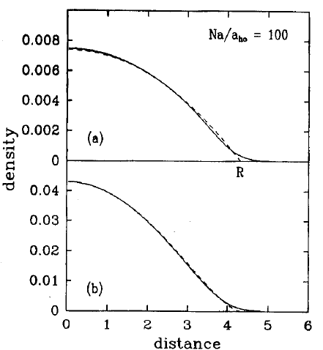
Validity of TF approximation
R : TF radius, s.t.
Near r ~ R, TF approx. is not valid.
Violating surface thickness ~ d

Slide 7
Healing length
ξ
Healing length ~ ξ

Slide 8
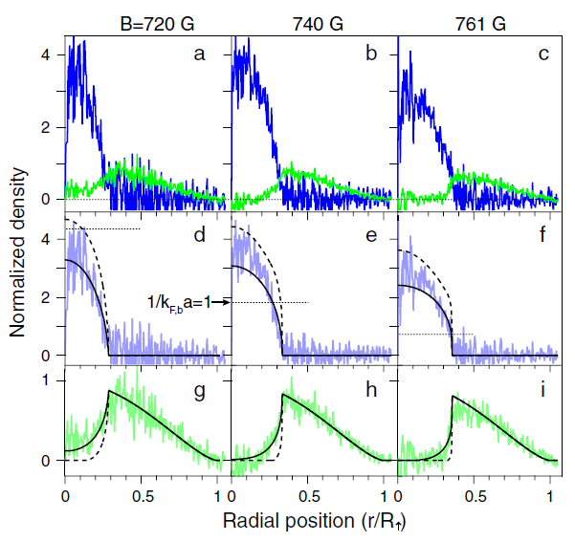
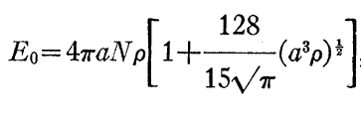
What we can learn from density profiles
In the thermodynamic limit, i.e. N→∞, ω→0, the local density approximation is valid.
If we measure the density profile of a given sample in a given potential with great precision, we can firmly determine the density of states of the system.
Ex) Beyond mean-field correction
for Bose gases
Lee-Huang-Yang correction
Physical Review 106, 1135 (1957)
Y. Shin et al., PRL 101 (2008)

Slide 9
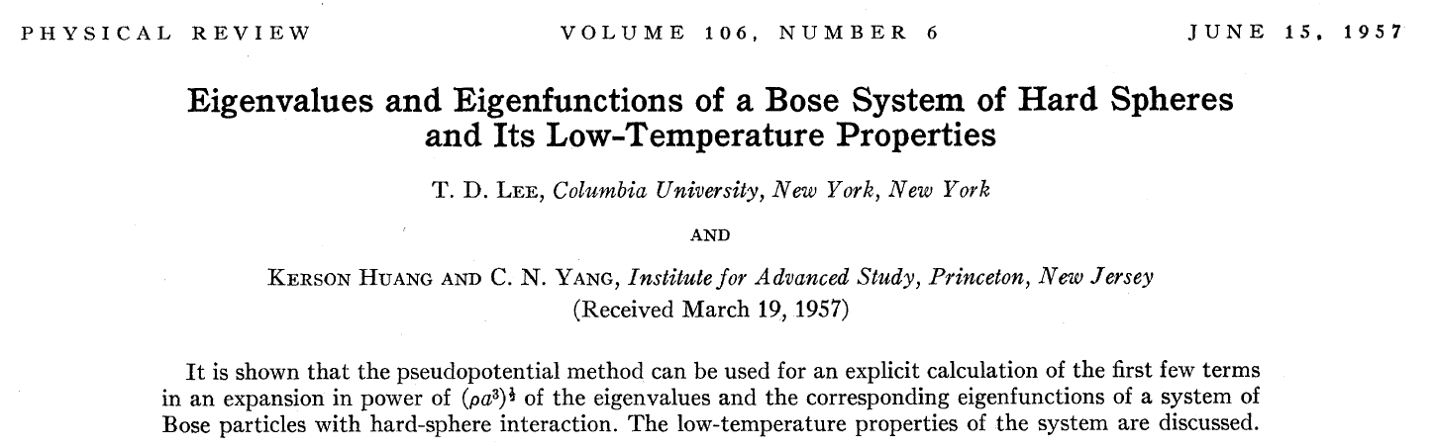
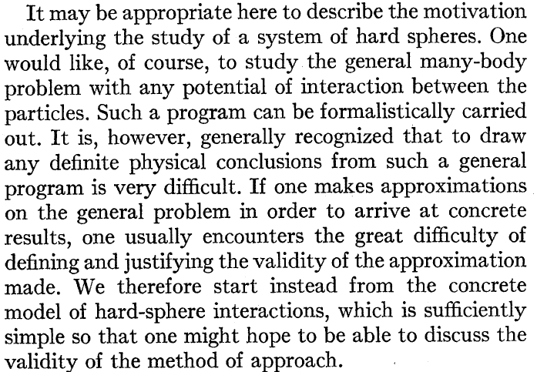
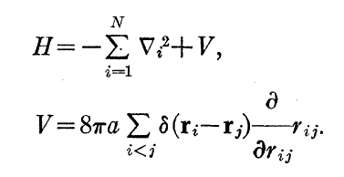

Slide 10
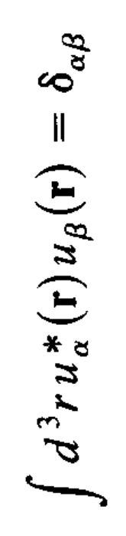
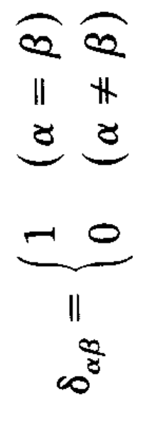
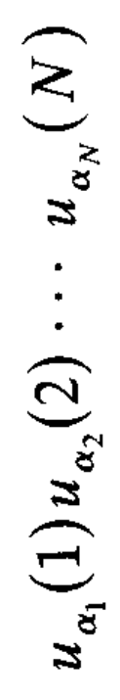
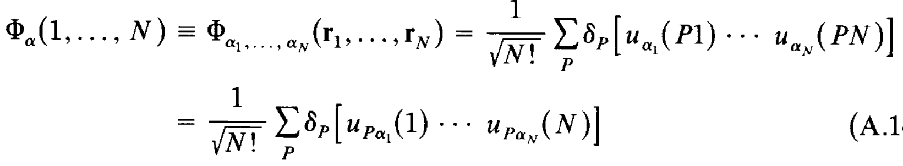
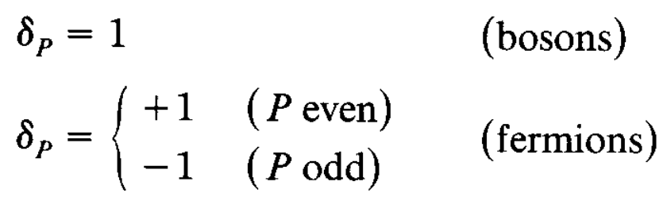
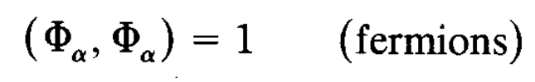
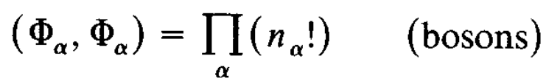
Many-body wavefunction

Slide 11
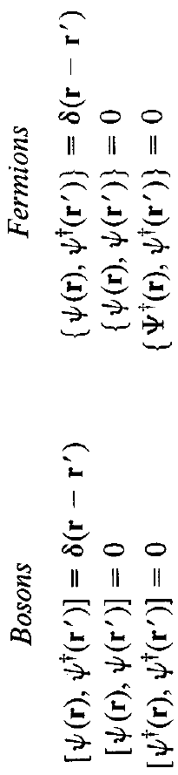
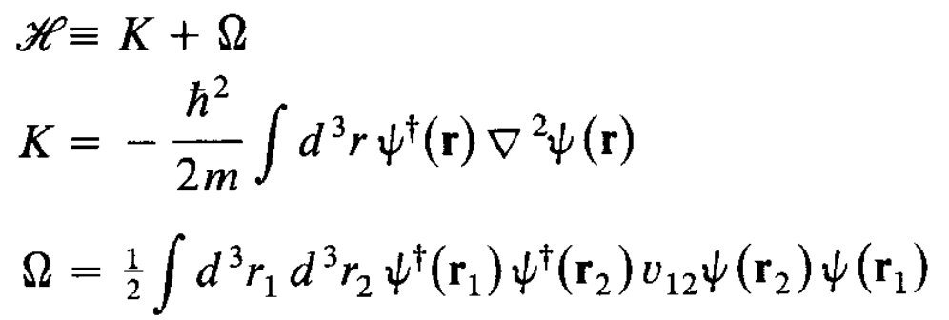
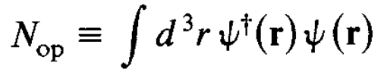

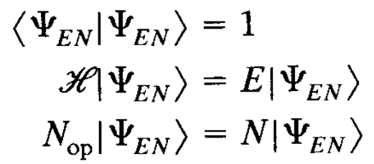
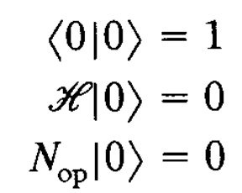
Quantized fields

Slide 12
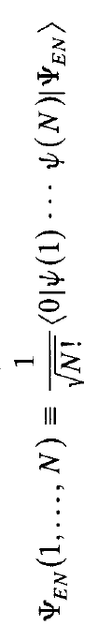
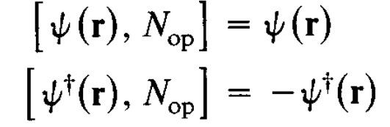
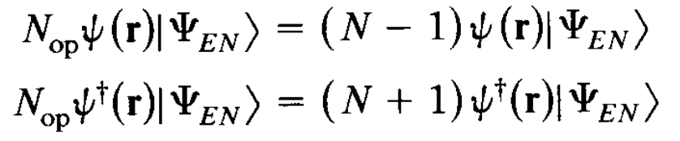

Quantized fileds
Creation/ Annihilation operator

Slide 13
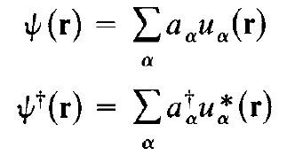

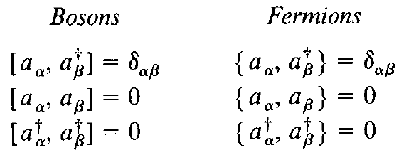
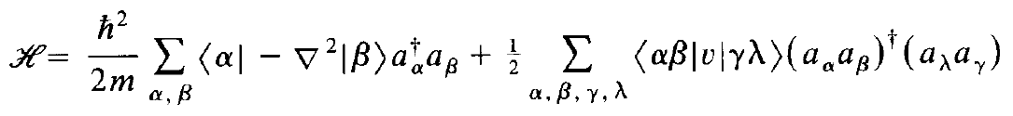

Quantized fields

Slide 14
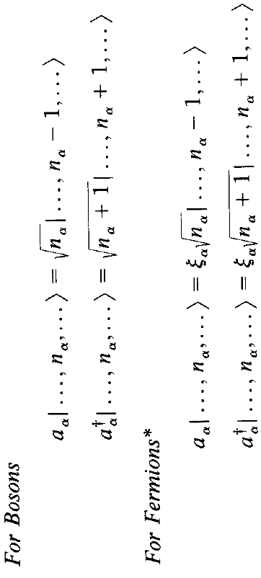
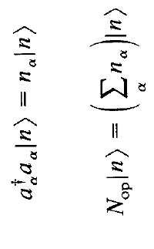
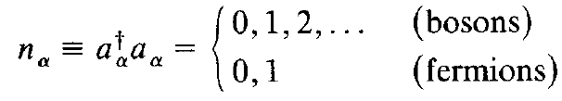
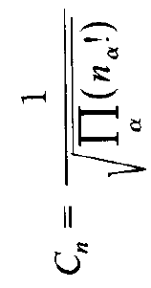
Quantized fields

