Slide 1
Lecture 6: Phase coherence of BEC

Slide 2
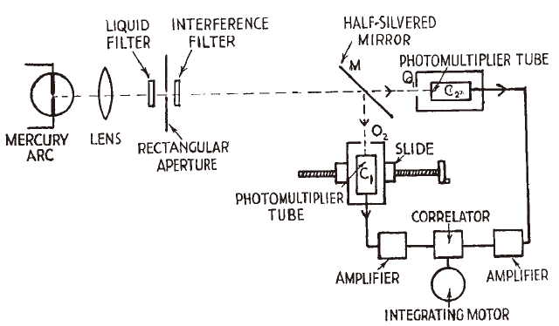
Hanbury Brown – Twiss Effect
Hanbury Brown & Twiss, Nature 177 (1956)
Photon bunching in light emitted by a chaotic source
Highlight the importance of two-photon correlations
Modern quantum optics

Slide 3


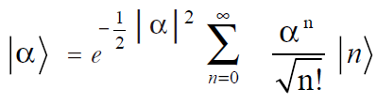
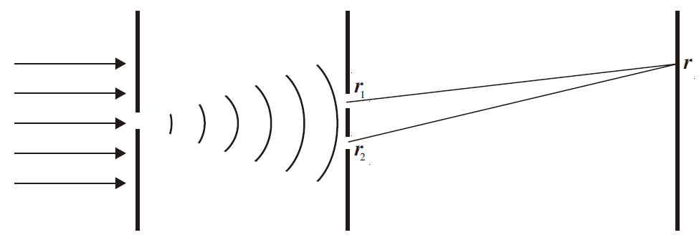
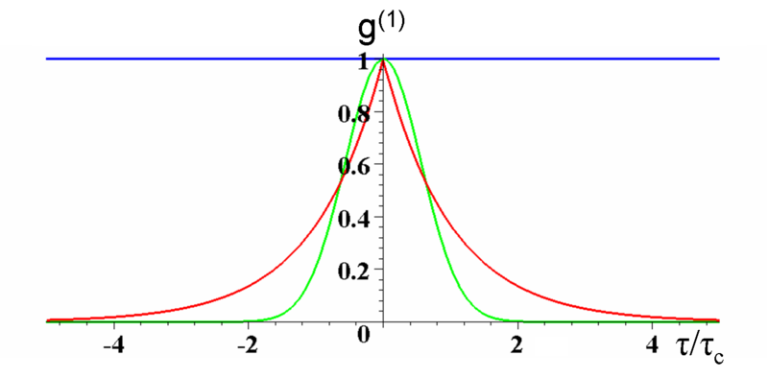
Quantum theory of optical coherence
How to describe the state of light
Glauber, PRL 10 (1963)
a
a⁺
First-order coherence function
Laser light
Chaotic light

Slide 4
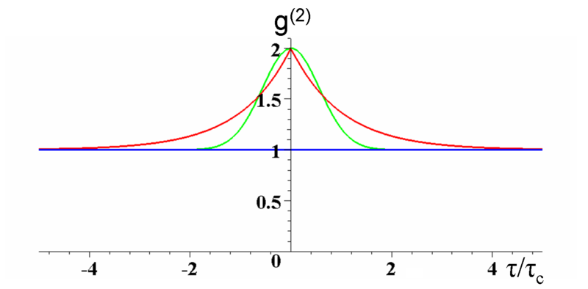
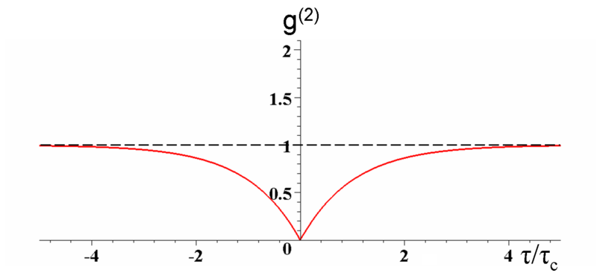
Quantum theory of optical coherence
How to describe the state of light
Glauber, PRL 10 (1963)
Second-order coherence function
Chaotic light
Fluorescence
From a single atom
Laser light

Slide 5
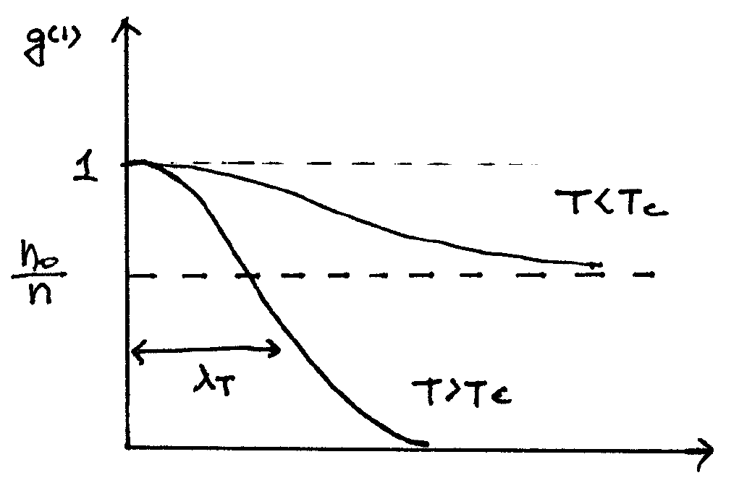
Correlations in many-body systems
First-order coherence function
one-particle density matrix
: condensate fraction
Normalized first-order coherence function
For a translational invariant system
For a classical gas
At T~T_{c}
With a BEC
r

Slide 6
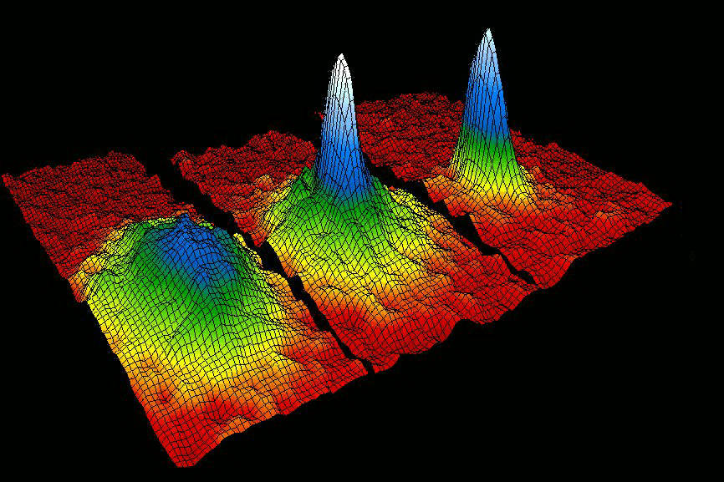
Why this is BEC?
After ballistic expansion for time t,
Here,
The one-particle density matrix of the in-trap state at t=0
The sharp central peak signals the condensation in momentum space.

Slide 7
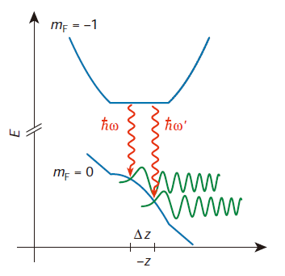
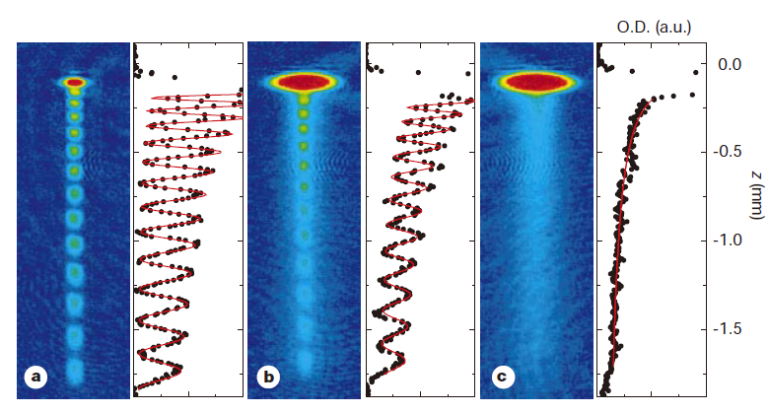
Spatial coherence of a trapped Bose gas
Bloch et al., Nature 403 (2000)
T<<T_{c}
T~T_{c}
T>>T_{c}
Two-slit experiment to measure spatial coherence
Using two rf waves, outcouple two atomic beams in different positions
Visibility of the interference pattern indicates spatial coherence

Slide 8
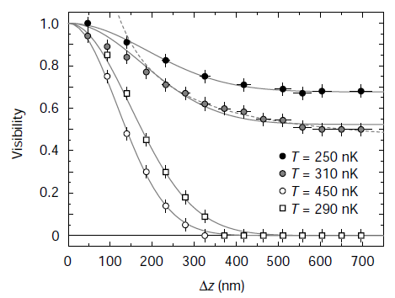
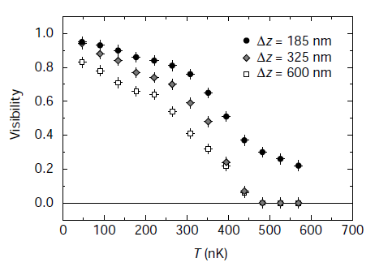
Spatial coherence of a trapped Bose gas
Bloch et al., Nature 403 (2000)

Slide 9
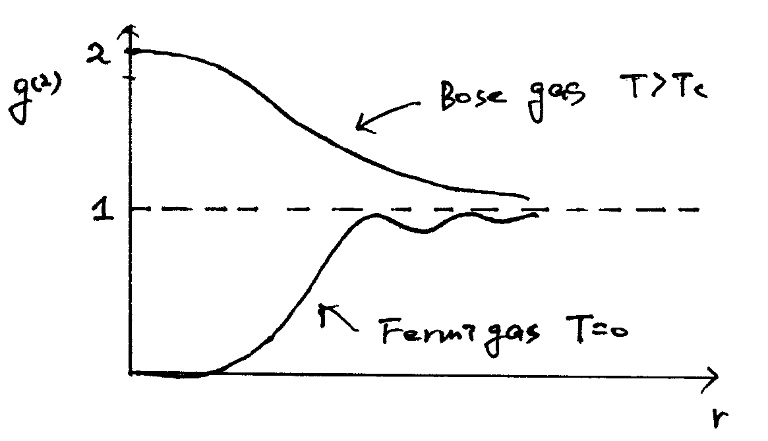
Correlations in many-body systems
Second-order coherence function
Density-density correlation function
Normalized second-order coherence function
Prob. To have another particle in a shell [r, r+dr]

Slide 10
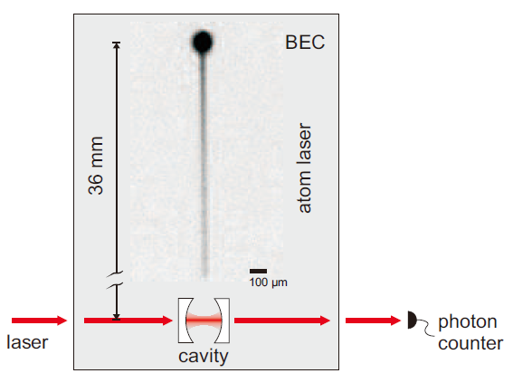
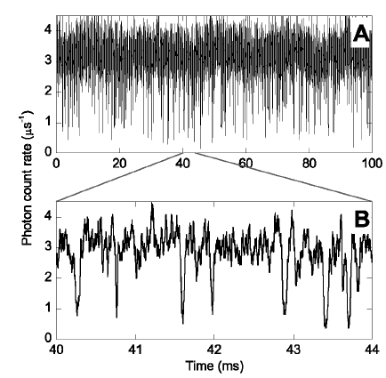
Higher order phase coherence
Ottl et al., PRL 95 (2005)

Slide 11
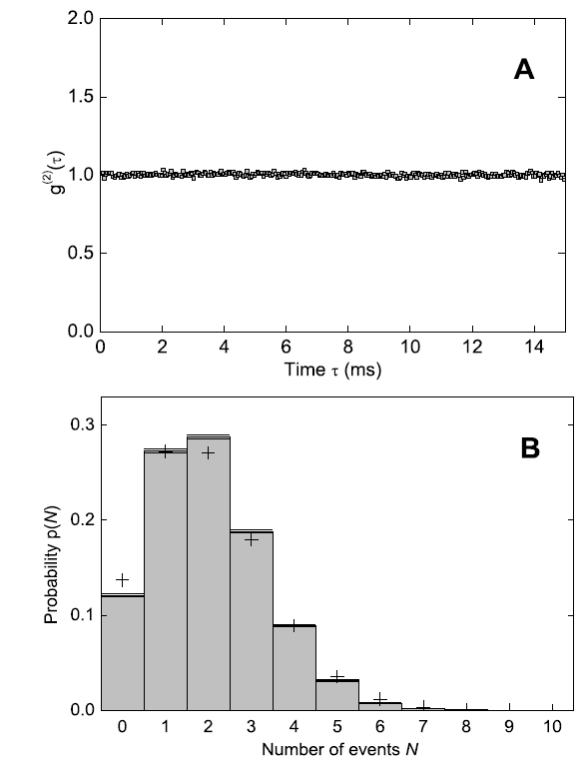
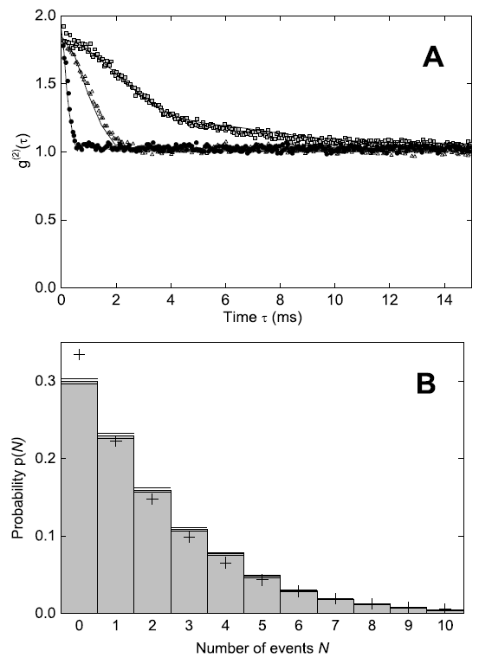
Higher order phase coherence
Ottl et al., PRL 95 (2005)
Coherent outcoupling
Incoherent outcoupling

Slide 12
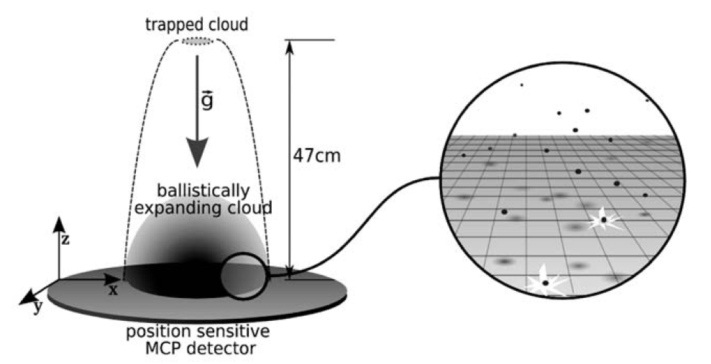
HBT effect with bosons and fermions
Schellekens et al., Science 310 (2005)
Using ³He* (boson) and ⁴He* (fermion)
Jeltes et al., Nature 445 (2007)

Slide 13
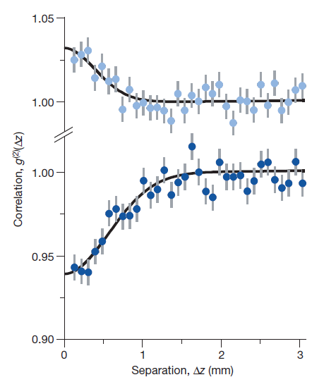
HBT effect with bosons and fermions
Schellekens et al., Science 310 (2005)
Using ³He* (boson) and ⁴He* (fermion)
Jeltes et al., Nature 445 (2007)

Slide 14
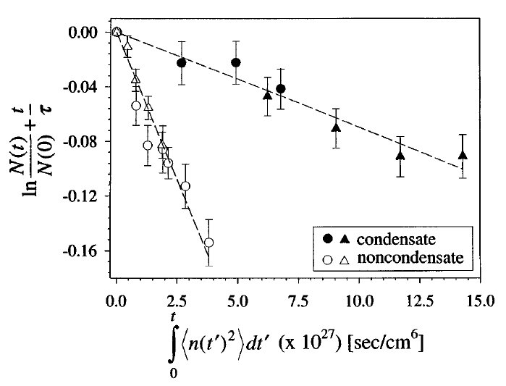
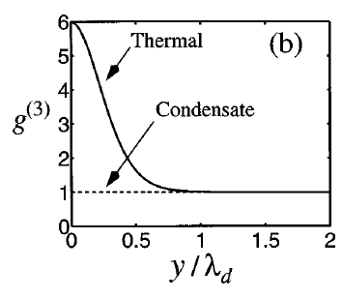
Higher order phase coherence
Thermal atoms bunch two times stronger than condensates.
➔ Mean-field interaction energy is larger for thermal atoms at a same density.
Three-body decay rate is six-times smaller for condensates.
Burt et al., PRL 79 (1997)

