Slide 1
Atomic and Molecular Physics Lecture 16
Prof. Kyungwon An
Department of Physics and Astronomy
Seoul National University

Slide 2
Terms from a Configuration of n Electrons
For nonequivalent electrons, angular momenta can be coupled sequentially.
The result should be the same regardless of the order in which the electrons are coupled.
For equivalent electrons, the Pauli principle forbids certain terms from appearing.
A simple bookkeeping scheme can be used to tell which terms are forbidden.

Slide 3
Example 4
Consider a nonequivalent configuration, spd.
We first couple s & p, and then couple the result and d.
sp(¹P)d=²P, ²D, ²F,
sp(³P)d=²P, ²D, ²F , ⁴P, ⁴D, ⁴F.
We can couple s & d, and then couple the result and p.
sd(¹D)p=²P, ²D, ²F,
sd(³D)p=²P, ²D, ²F , ⁴P, ⁴D, ⁴F,
or couple p and d first and then s.
pd(¹P)s=²P,
pd(³P)s=²P, ⁴P,
pd(¹D)s=²D,
pd(³D)s=²D, ⁴D,
pd(¹F)s=²F.
pd(³F)s=²F , ⁴F.

Slide 4
Exercise 8
Find all possible terms for .
Answer) ²S, ²P, ²D, ²F, ⁴S, ⁴P, ⁴D, ⁴F.

Slide 5
Example 5
Consider three equivalent electrons, np³. Each electron can have There are six possible combinations. Let us use a shorthand notation,
etc. Note that the highest M_{L} state is 2 since the Pauli principle forces us to have two electrons with m_{l}=1 with opposite spins and the other then with m_{l} =0. We can associate the states of three electrons with (M_{L}, M_{S}) values in the following way.

Slide 6
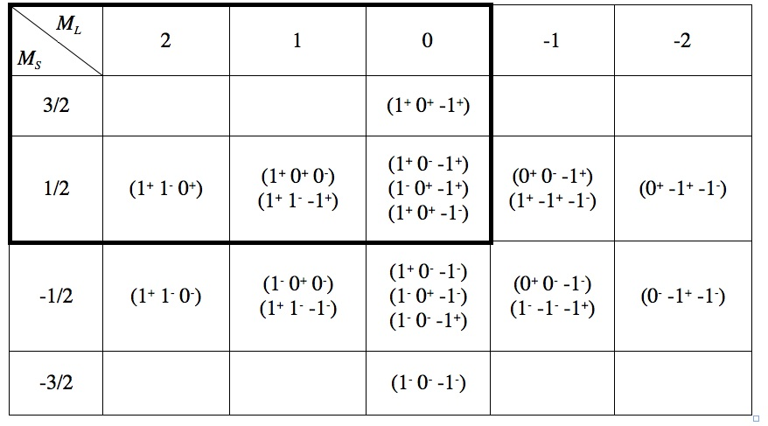
For example, consider . There are two possible distributions, resulting in 2 different linear combinations (so 2 different terms) of those two distributions.

Slide 7
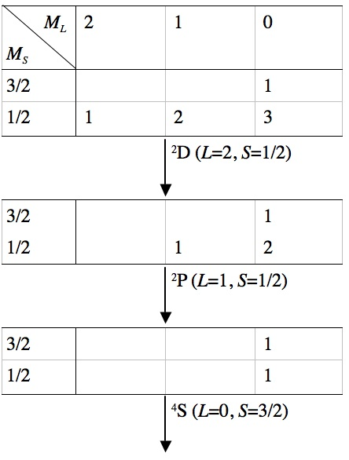
The states must belong to a ²D term, which also includes One then removes the entries belonging to ²D as in the tabulation shown below, where we concentrate on the part in a rectangle in the above table.
Now we consider the L=1 case. We have corresponding to ²P, which also has . The remaining entries are
, which should belong to ⁴S. Therefore, the possible terms for np³ are ²D, ²P and ⁴S only.

Slide 8
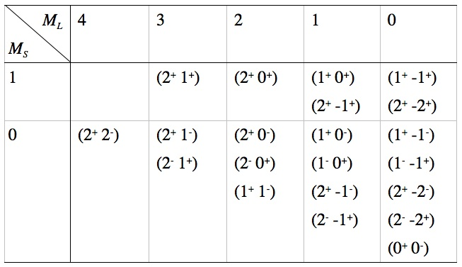
Exercise 9
Find all possible terms for nd², for which the orbital distributions are shown below.
Ans) ¹G → ³F → ¹D → ³P → ¹S

Slide 9
Exercise 10
Find all possible terms for nd³. First, find the orbital distributions.
Ans) ²P, ²D, ²D, ²F, ²G, ²H, ⁴P, ⁴F (Note ²D appearing twice. They have different seniority numbers. See below).

Slide 10
For a completely filled shell, there is only one distribution of electrons: M_{L}=M_{S}=0, and thus ¹S.
The parity of a term is given by .
The highest M_{S} state is possible when the shell is half-full (or half-empty): each spatial orbital is singly occupied, so M_{L}=0 and thus L=0. In this case, M_{S}=(2l+1)x1/2=l+1/2=S, and thus the corresponding term is ^{2l+2}S. This term is spherically symmetric and is said to have the highest multiplicity (i.e., the largest 2S+1).
Hund’s Rule: In LS coupling the term of highest multiplicity is usually the ground term.

Slide 11
Example 6
Senioriy Number: It is defined for d^{n} and f^{n} configurations. For d^{n}, each multiplet which occurs first for d^{n-2} is assigned a seniority number v=n-2; each multiplet which occurs first for d^{n-4} is assigned a seniority number v=n-4. All other muliplets have seniority numbers equal to n.
d² has the multiplets ¹S, ³P, ¹D, ³F, ¹G (see Exercise 9); the multiplet ¹S can be regarded as having occurred in d⁰ (nothing in d orbitals). Therefore, ¹S has a seniority number of 0 with the notation . The others have v=2.

Slide 12
Exercise 11
Consider d³. Assign seniority numbers to the all possible multiplets.
Answer)

Slide 13
jj Coupling
One electron states are designated by l_{j}. Examples are s_{1/2}, p_{1/2}, p_{3/2}, etc.
Two-electron states are designated by .
Example 7
For the pd configuation, the possible jj coupling states are
For p², one can think of
However, due to the Pauli principle, only the following states are possible.

Slide 14
In general, when j₁=j₂, the allowed values of J in jj coupling are given by J=2j-1, 2j-3,…
There are many situations for which neither LS nor jj coupling are valid approximations: in such cases it is necessary to diagonalize the Coulomb repulsion and the spin-orbit interaction for each value of J. The coupling is then said to be intermediate.

Slide 15
Table 1
Terms arising from l^{n} configurations.

