Slide 1
Atomic and Molecular Physics Lecture 20
Prof. Kyungwon An
Department of Physics and Astronomy
Seoul National University

Slide 2
Electric Quadrupole Interaction
For the symmetric operator ,
and
Note that rr is a tensor. Consider a diagonal element
Therefore, we replace rr with an irreducible tensor of rank 2,

Slide 3
The matrix elements corresponding to the quadrupole interaction are
and
For N electrons, we use
in the place of r, m and Q.

Slide 4
Relative transition strengths of E1, M1 and E2
Relative strengths of the matrix elements are
Since the transition rate is proportional to the absolute square of the matrix element, the relative strengths of the transition rates are
For the visible range (λ~600 nm)

Slide 5
3.3 Selection Rules
Wigner-Eckart Theorem Consideratin
For E1 and M1, the transition matrix elements are involved with irreducible tensors of rank 1 (vectors, r and L+2S, respectively): . Nonvanishing matrix elements are obtained if
The situation is not allowed when , but this situation is automatically excluded by the last condition
.
For E2, the operator is an irreducible tensor of rank 2,
, so that

Slide 6
Parity Consideration
The parity associated with the electric dipole is –1 whereas the parities for the magnetic dipole and the electric quadrupole are both . Due to the parity conservation, we should have . Therefore,

Slide 7
Spin Consideration
For LS coupling, the orbital and spin angular momenta are independent.
Since E1 and E2 are independent of spin, we must have ΔS=0 for these transitions, and thus for E1 and for E2.
In the exact LS coupling, M1 cannot occur. Consider the matrix element for M1,
Since L and S does not change L and S values in , . However, in the LS coupling scheme, the states with the same L and S are degenerate. Therefore, the transition photon should have a zero energy, meaning that the matrix element should vanish.

Slide 8
If we include the spin-orbit interaction, the energy of a state depends on J, so the above matrix element does not vanish. In this case the matrix element for M1 is given by
and the selection rule becomes . ΔJ=0 is not allowed since the same-J states are degenerate.

Slide 9
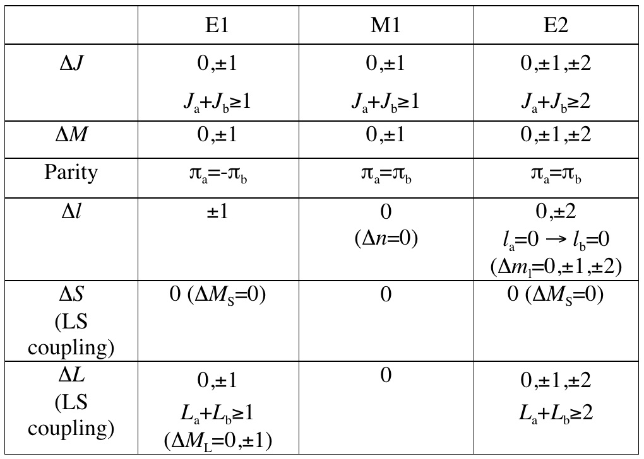
Table 1. Selection rules for radiative transitions from an initial state a to a final state b. For exact LS coupling there are no M1 transitions. Δl referes to one electron transitions. In this case parity requirement restricts Δl values.

