Slide 1
Atomic and Molecular Physics Lecture 21
Prof. Kyungwon An
Department of Physics and Astronomy
Seoul National University

Slide 2
3.5 Transition Probabilities
Consider an atom interacting with a radiation field of frequency . Assume that only a transition between particular two states (let us call them level a and level b) is resonant with the radiation field. Let the transition frequency be . The approximation that we can neglect the other levels is called two-level approximation and the atom in this case is called a two level system.
The transition probability from an initial state to a final state can be calculated from the Fermi Golden Rule:

Slide 3
For E1 absorption process in which the two-level atom interacts with a field mode kl,
When we have a distribution of modes instead of the infinitely-narrow-frequency mode, the above expression should be multiplied by the number of modes in a frequency interval in vacuum and integrated over all frequencies.
The number of modes in a frequency interval per polarization direction is

Slide 4
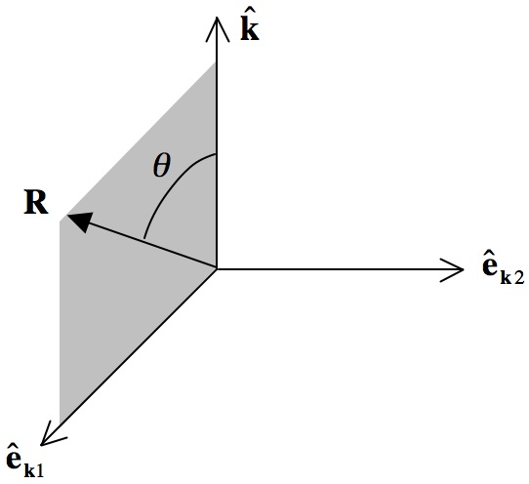
and thus
which then needs be integrated over all angles accounting for two possible polarization directions. We choose the polarization directions as shown in Fig. 1.

Slide 5
Then,
For E1 emission process, the procedure proceeds in the same way except that the result is proportional to n+1.
Emission can occur even in the absence of photons in the mode. Such emission is called the spontaneous emission whereas the part proportional to n is called the stimulated emission. The absorption with its rate proportional to n is by definition a stimulated process.

Slide 6
The spontaneous emission rate
is also known as the Einstein A coefficient. The inverse of this rate is called the radiative lifetime of the excited state.
As clearly demonstrated so far, the spontaneous emission is a true quantum mechanical effect, not explainable in the classical electromagnetism.
It is remarkable that Einstein introduced the concept of spontaneous emission in his consideration of the black body radiation, solely based on the thermodynamic detailed balance argument.

Slide 7
Extension to Multilevels
Suppose that the level a consists of degenerate sublevels with degeneracy . Likewise, the level b consists of degenerate sublevels with degeneracy . When the sublevels of level a are equally populated initially, the absorption rate becomes
Similarly, the emission rate becomes
if the sublevels of level b are equally populated initially.

Slide 8
3.6 Oscillator Strength and Sum Rules
For two states, level a and level b, with , the oscillator strength for emission b→a is defined by
Oscillator strength for emission is negative ( ) whereas for absorption it is positive.
It satisfies the following identity.
The oscillator strength is related to the emission rate as

Slide 9
Exercise 5
Derive the radiative damping rate in the classical electrodynamics
for a charge under harmonic oscillations. Use the Larmor fomula for calculating the radiative power loss of the accelerating charge.

Slide 10
The oscillator strength is dimensionless and of order of unity. Classically it is the number of electrons in an atom that are associated with electron harmonic oscillators with a particular resonance frequency among the total of Z (valence) electrons. Therefore, the sum of all oscillator strengths equals to Z.
Quantum mechanically, we have a similar sum rule. Consider the commutation relation for N electrons.
Recalling the relation which was derived in Sec. 3.2,

Slide 11
we get
Including the level degeneracy,
We get the sum rule for the oscillator strength:

Slide 12
Note that the summation is over all final states, which can be the states with both lower and higher energies. Therefore, the oscillator strength entering in the sum rule can have both positive and negative signs (see Fig. 2).
Fig. 2. Sum rule states that , where the first three have a positive sign (absorption) and the fourth has a negative sign (emission).

Slide 13
Real World Examples – Rubidium and Barium
Energy-levels and transition diagrams have been indispensable in atomic physics researches. The pioneering work by Grotrian has made his name associated with pictorial representations of electronic transitions. Here we have two real-world examples, rubidium (Fig. 3) and barium (Fig. 4). Both atoms have been widely used in atomic physic and quantum optics researches because of their simple energy level structures, strong transitions in the visible range and the absence of hyperfine structures for the most abundant isotopes (for barium). The reader may be surprised by the fact that we still do not know the oscillator strengths (or transition rate) of most of the transition lines of these popular atoms.
W. Grotrian, “Graphische Darstellung der Spektren”, J. Springer (Berlin 1928).

Slide 14
Example 1
Rubidium (Z=37) is alkali metal, having one valence electron in the 5s shell. The ground state configuration is 1s²2s²2p⁶3s²3p⁶3d¹⁰4s²4p⁶5s. Its term is ²S_{1/2} (L=0, S=1/2, J=1/2) and thus the absorption from the ground state takes place to ²P_{1/2} and ²P_{3/2} (D2 and D1 lines). The sum of all oscillator strengths amounts to
The transition at 780 nm is one of the most explored lines along with sodium’s 590 nm doublet lines ( ) in atomic physics.

Slide 15
Example 2
Barium (Z=56) is alkaline earth metal, having two valence electrons in the 6s shell. The ground state configuration is 1s²2s²2p⁶3s²3p⁶3d¹⁰4s²4p⁶4d¹⁰5s²5p⁶5d¹⁰6s². Its term is ¹S₀ (closed shell, L=0, S=0, J=0). The spin orbit interaction allows transitions between different S values. E1 transitions can occur from ¹S₀ to ¹P₁ and ³P₁. The E1 Selection rule forbids transitions to ³P₀, ³P₂, ¹D and ³D (by parity) states. The largest oscillator strength from the ground state is 1.6, which is associated with the transition to ¹P₁ (configuration 6s6p, 556 nm). The sum rule for the transitions from the ground state is

Slide 16
Fig. 3. Grotrian diagram for rubidium. Each line is shown with its transition wavelength in Angstrom and oscillator strength in ( ). Excerpted from A. A. Radzig and B. M. Smirnov, “Reference data on atoms, molecules, and ions” (Springer-Verlag, Berlin, 1986).

