Slide 1
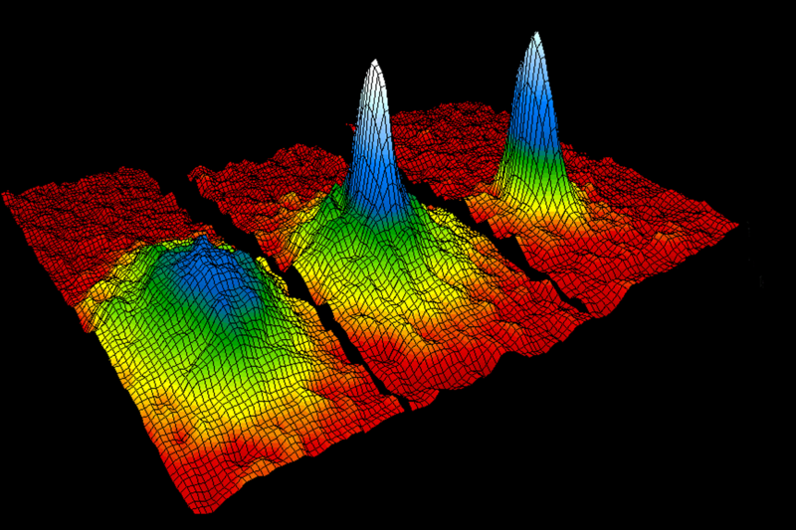
SNU BEC Project (Type 2)
Yong-il Shin (Invited Scholar)
Hyunseok Jeong
Kyungwon An (PI)
2001 Nobel Prize (Cornell, Kitterle, Wienman)

Slide 2
Members
PI: K. An
Foreign Scholar:
Y. Shin
Supporting Staff: E. Noh
Domestric Scholar: H. Jeong
Research Assistant: J. Choi
Research Assistant: H. Hong
S. Kang
Y. Song
Research Assistant: K. Park
C. Lee

Slide 3
Research Goal
To realize Bose-Einstein condensates by laser trapping and cooling of neutral atoms
To understand many-body physics in strongly interacting fermion/boson systems
To realize macroscopic superposition and entanglement with BEC for quantum infromation
To realize matter-wave scar modes of ultracold ataoms for quantum chaos studies

Slide 4
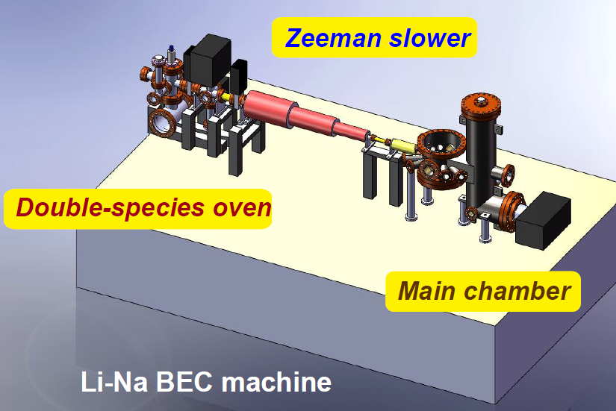
Production of Quantum Gas
Na-23: bosonic atom, by BEC technique (evaporative cooling w/ optical plug)
Li-6: fermionic atom, by sympathetic cooling with Na-23
Optically-plugged linear trap
Quadruple magnetic trap
Green optical plug beam

Slide 5
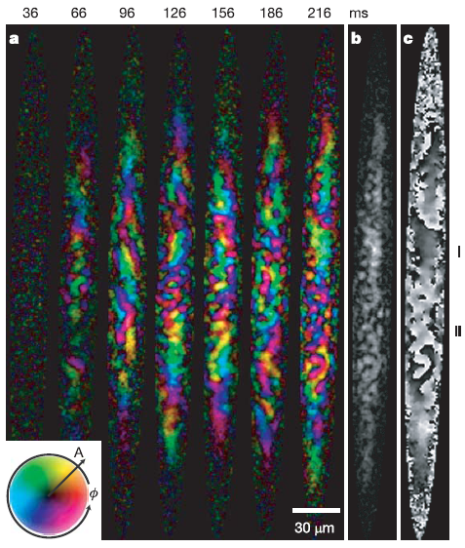
antiferromagnetic condensate
ferromagnetic spinor condensate, Rb-87, F=1
antiferromagnetic spinor condensate, Na-23, F=1
Recent prediction of spin-domain formation and phase separation will be tested.
Spontaneous symmetry breaking in a quenched ferromagnetic spinor Bose-Einstein condensate: L.E. Sadler et al., Nature 443 (2006)

Slide 6
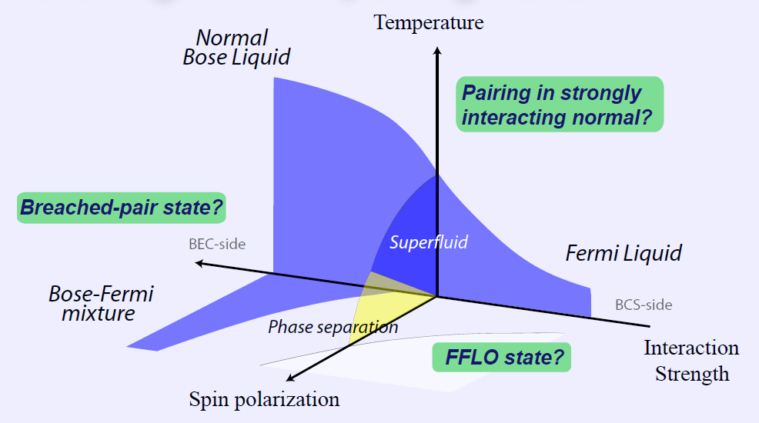
BEC-BCS Phase Transition
Ultracold Li-6 atoms near Feshbach resonances
System parameters are tunable: new pairing states may be realized.

Slide 7
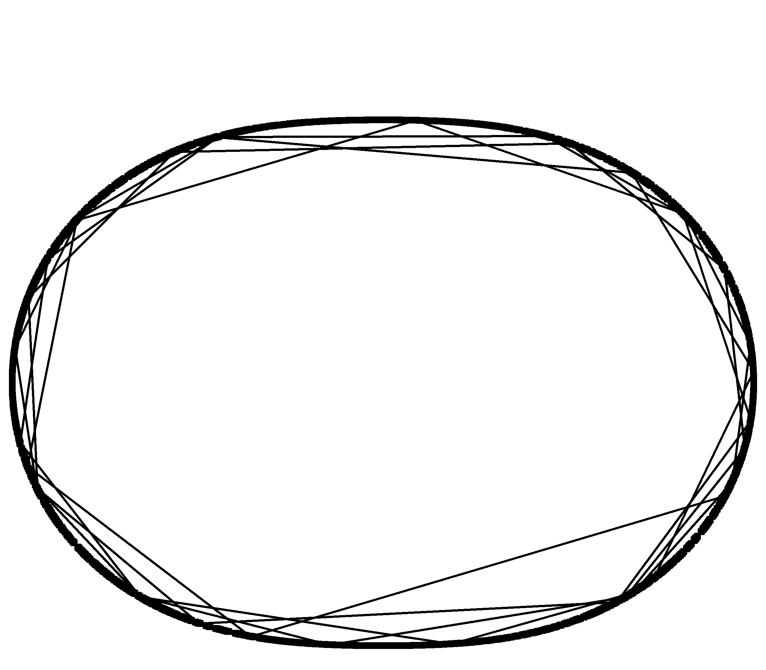
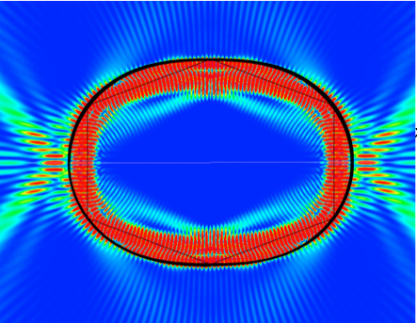
Quantum Chaos with a BEC
Chaotic trajectory of a particle vs. quasi-eigenmodes of a matter wave
Matter wave (BEC) enclosed in a potential well by light force
Efficient cavity for an atom laser
chaotic trajectory
existence of scar modes

Slide 8
Quantum Information with a BEC
To place a BEC in a high-Q microcavity and create BEC-cavity entanglement
To use a BEC as a Bragg mirror and create BEC-photon entanglement and a Schroedinger cat state

