Slide 1
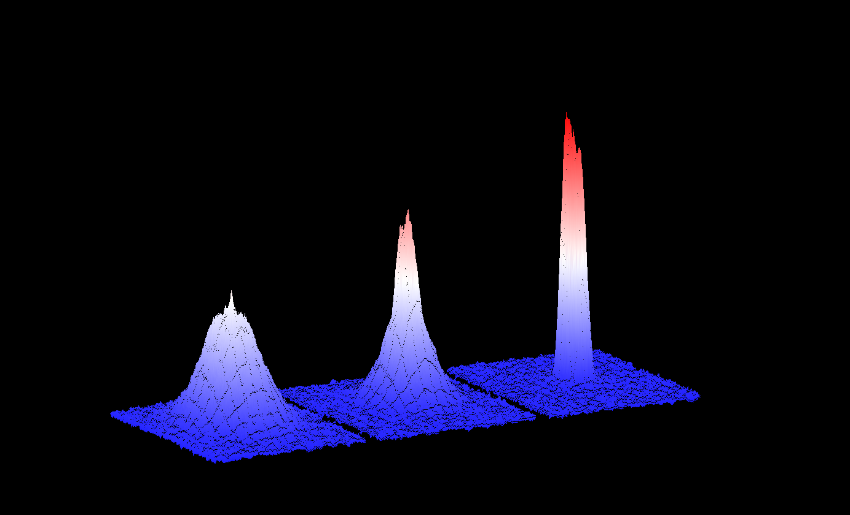
SNU BEC 사업단 (Type 2)
The first BEC in Korea by SNU BEC group

Slide 2






Members
PI: K. An
56-324 (room no.)
Oversea Scholar:
Y. Shin
Supporting Staff:
E. Noh
National Scholar:
H. Jeong
56-410
56-319
56-424
Research Assistant:
Master degree students (2)
Research Assistant: Ph.D and Master degree students (17)
Research Assistant:
Ph.D and Master degree students (7)

Slide 3
Project Goals
To realize Bose-Einstein condensates by laser trapping and cooling of neutral atoms (Primary goal of the first phase)
To investigate strongly interacting fermion/boson systems with BECs
To study quantum chaos with ultracold atoms from a BEC
To realize macroscopic superposition and entanglement with BEC for advanced quantum information
To train graduate students for Ph.D and master degrees in the field of BEC, quantum chaos and quantum information

Slide 4
Results of the First Phase
Production of Bose-Einstein condensate (Primary goal)
Study of open quantum systems (exceptional points)
Progress in quantum chaos with a microcavity
Progresses in quantum optics & information with single atoms and single photons

Slide 5
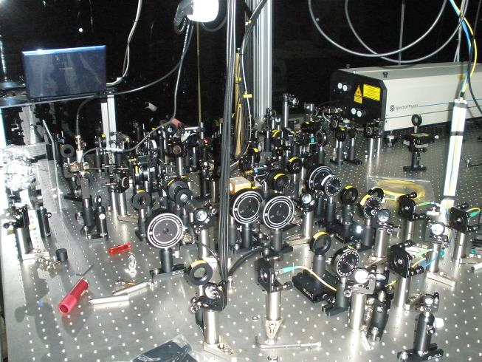
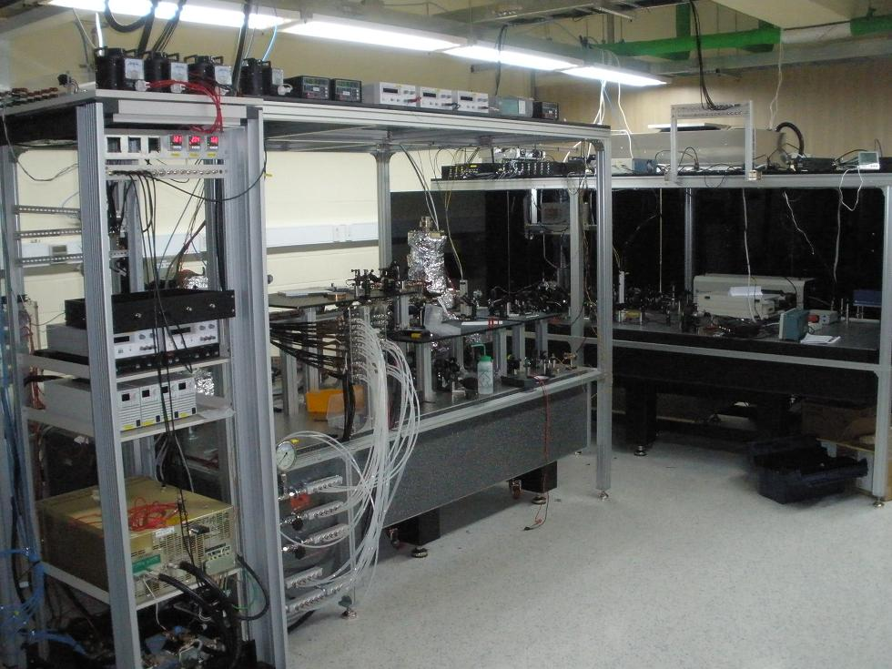
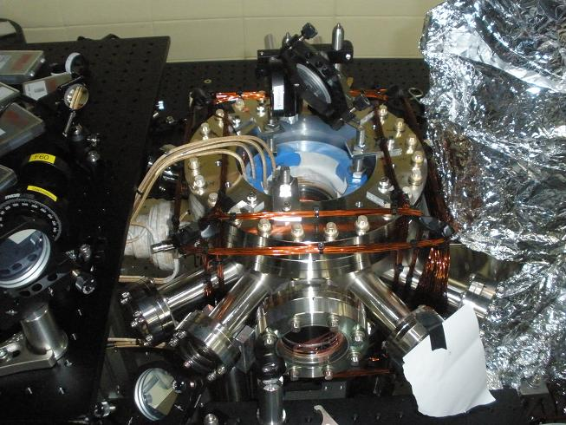
Newly Built Quantum Gas Lab
Laser System
Quantum Gas Laboratory, SNU 23-104
Vacuum System
Notes:
In this phase 1, quantum gas laboratory has been constructed in supervision of our foreign scholar, Yong-il Shin, which is located at Bldg23 Room 104. The main lab equipments in the lab includes laser system and ultra high vacuum system.

Slide 6
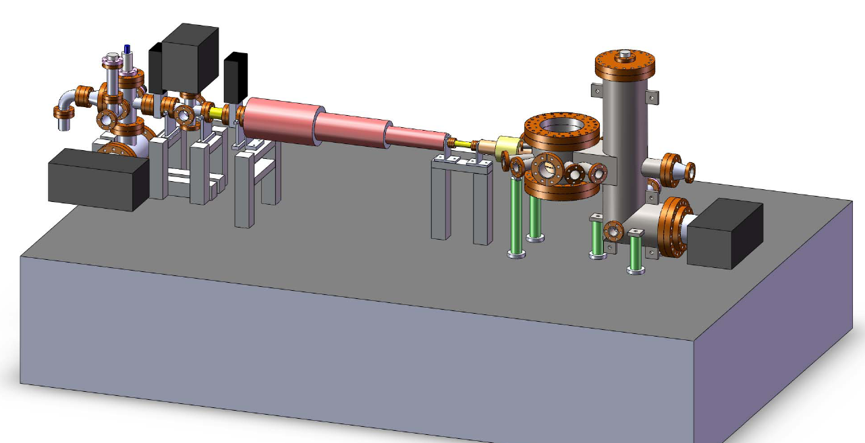
Na oven
P~ 8⋅10⁻⁹ torr
320˚C
Main chamber
P < 10⁻¹¹ torr
Zeeman slower
10¹¹ atoms/s
300 m/s ➔ 30 m/s
1.2 m
Design of BEC machine

Slide 7
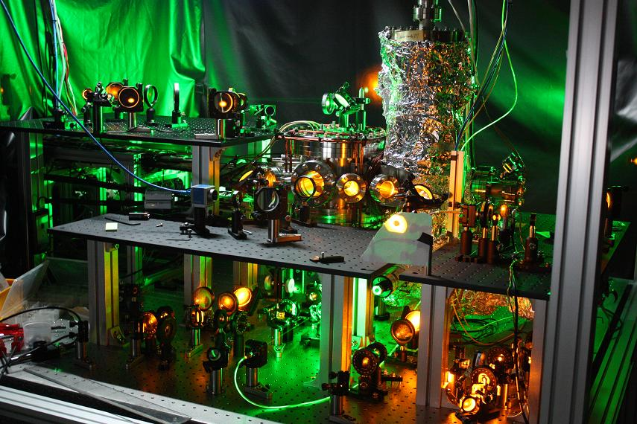
Machine Photo w/ Lasers on

Slide 8
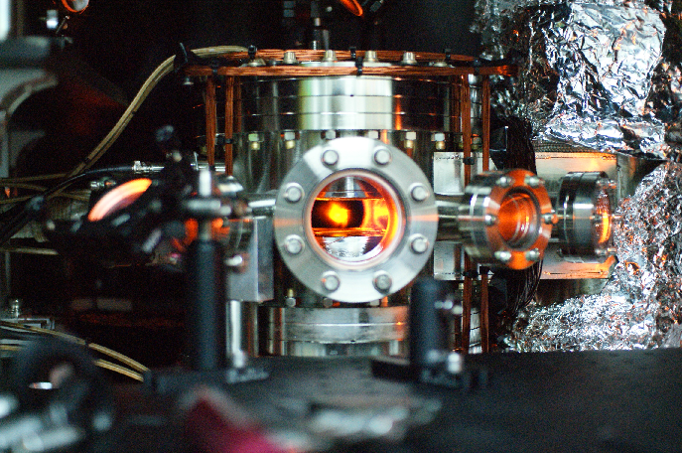
➊Laser cooling from room temperature to 100 μK, ➋Evaporation cooling to 100 nK ⇒ BEC

Slide 9
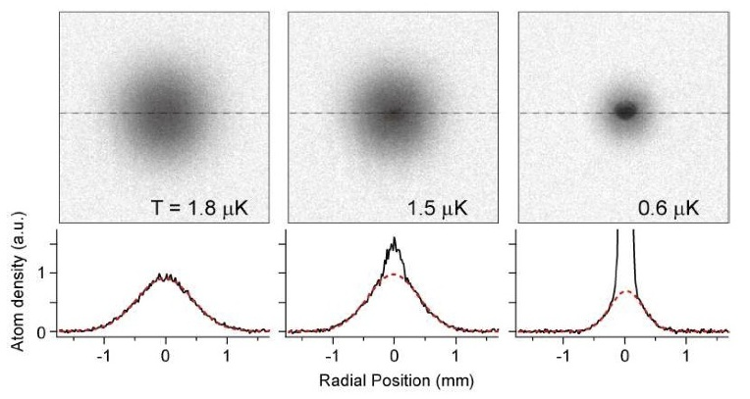
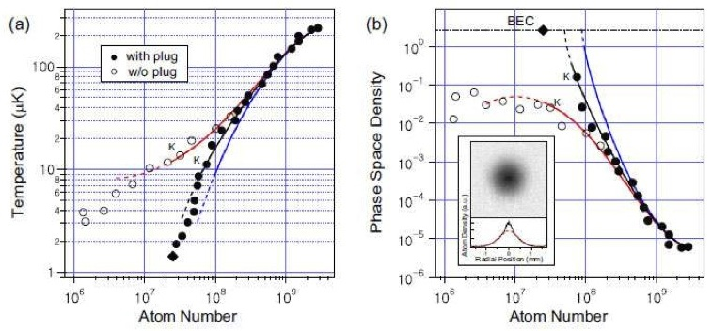
The first BEC in Korea
Produced a pure condensate of 1⋅10⁷ atoms in 14s evaporation (30 times better than the conventional BECs)
This achievement fully accomplishes the primary goal of the first phase (2008 - 2010), providing a solid platform for launching the second-phase program for various BEC applications
Myoung-Sun Heo, Jaeyoon Choi, and Yong-il Shin, “Fast production of large 23Na BECs in an optically plugged magnetic quadrupole trap”, arXiv: 1011.1078 (2010).
Notes:
Last June, we have succeeded in observing Bose-Einstein condensation in an atomic sodium gases. This is the first BEC in korea, even though 15 years after the world-first BEC production. In our experiments, furthermore, we could produce BECs of more than 10^7 atoms in 14 s. Considering that typically people produce a condensate of less than 10^6 within 30s, our result is superior.

Slide 10
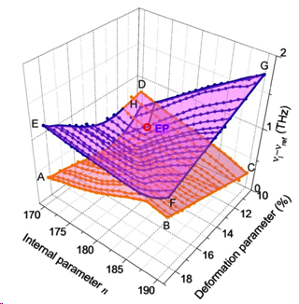
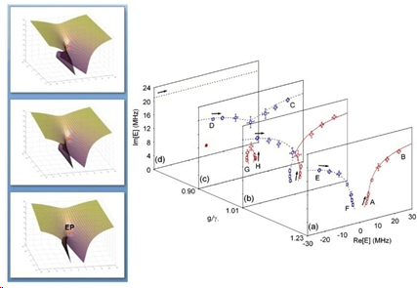
Study of open quantum systems
Exceptional points have been observed in a deformed microcavity, simulating open quantum systems [S. Lee et al, Phys. Rev. Lett. 103, 134101 (2009)].
Exceptional points have also been observed in a true quantum system, an atom-cavity coupled system in our study [Y. Choi et al., Phys. Rev. Lett. 104, 153601 (2010)].
Exceptional point observed in a deformed microcavity laser
Eigenstates coalescence at the exceptional point in the atom-cavity quantum composite

Slide 11
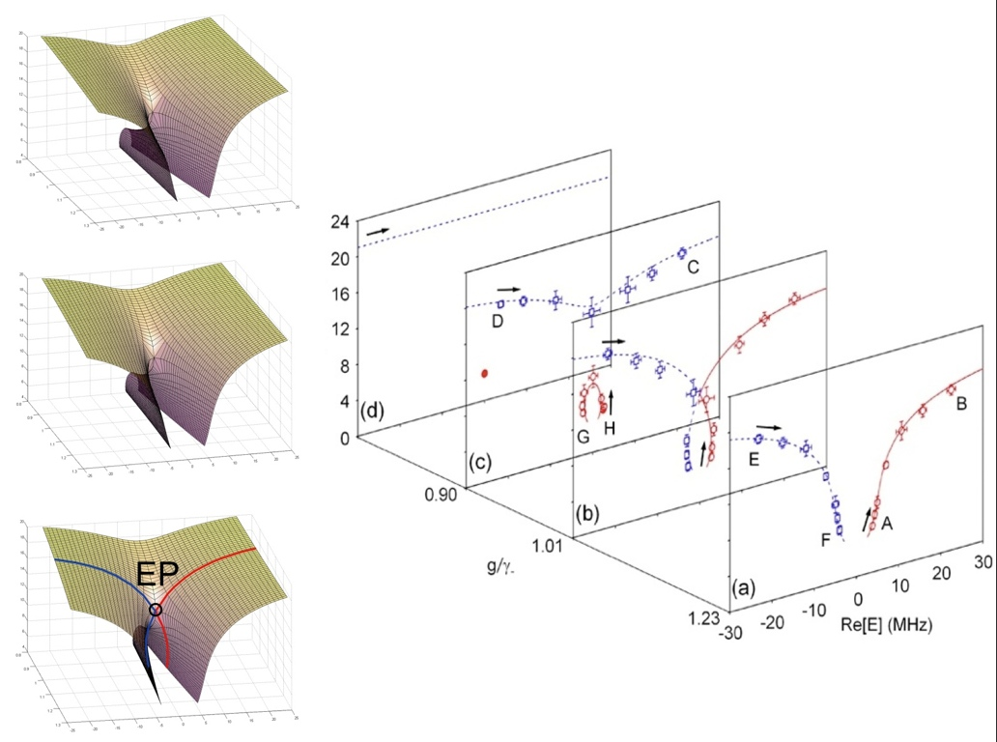
Im[E] (MHz)
11

Slide 12
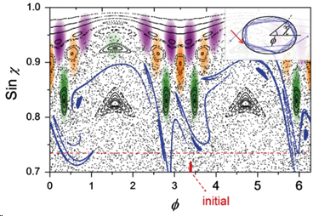
Quantum Chaos in Microcavities
Dynamical tunneling has been observed in a deformed microcavity laser for the first time [J. Yang et al., Physical Review Letters 104, 243601 (2010)].
Important since dynamical tunneling will also play an important role in matter wave tunneling and its applications with a BEC.
Dynamical tunneling from chaotic modes to a regular mode in a deformed microcavity laser, represented in the phase space.

Slide 13
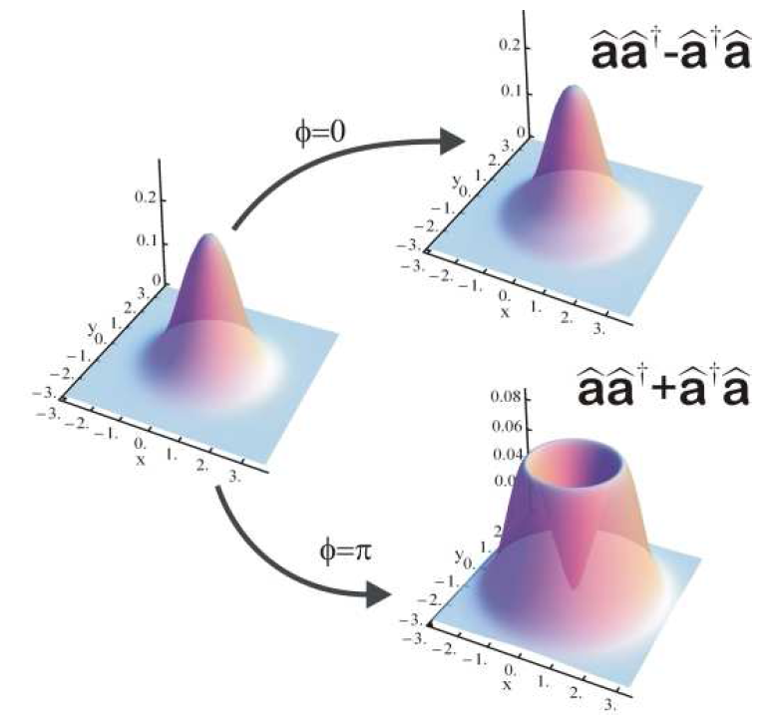
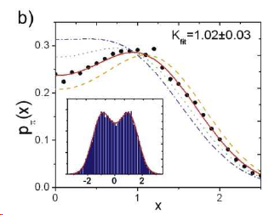
Observation of bosonic commutation relation
Using a new macroscopic-entanglement generation scheme [Phys. Rev. Lett. 102, 060403 (2009)], we could demonstrat the bosonic commutation relation, aa⁺-a⁺a=1, for the first time [Phys. Rev. Lett. 103, 140406 (2009)]
Would also be crucial for later photon-BEC entanglement.
a)
Demonstration of the bosonic commutation relation
Notes:
최초로 보존 교환관계를 실험적으로 입증함. 입력한 양자 상태(열상태)가 두 가지 다른 오퍼레이터들의 중첩에 따라 어떻게 다르게 변하는지를 보여줌. 오퍼레이터들의 양자 중첩을 구현할 수 있어 다양한 양자 제어에 응용할 수 있을 것으로 기대.

Slide 14
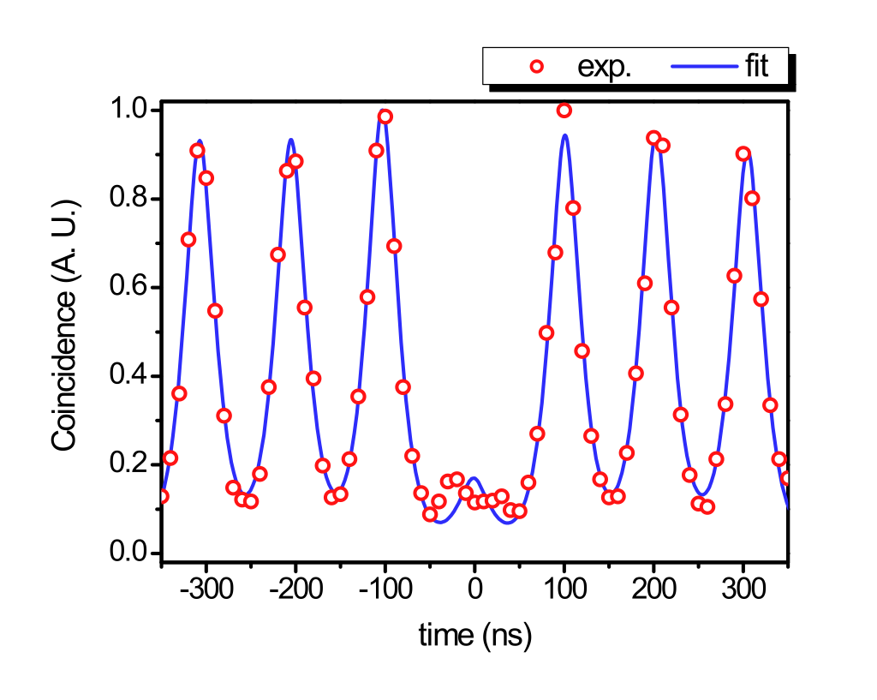
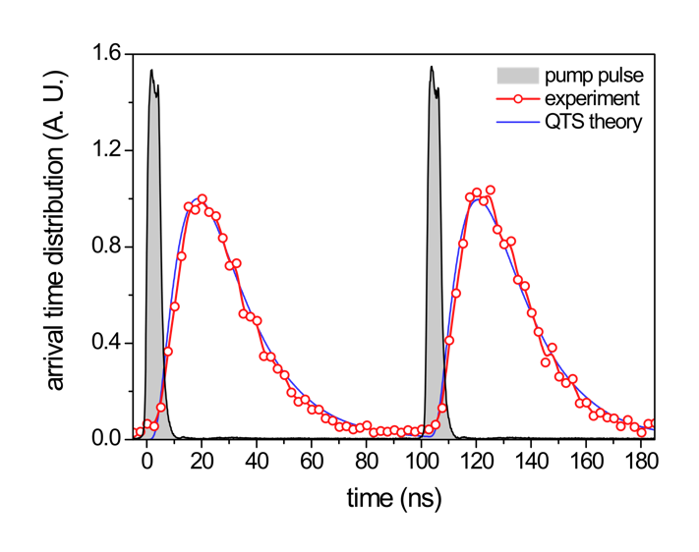
Generation of flying qubits on demand
Using a single atom coupled to a high-Q cavity, we could generate single photons on demand at a rapid rate and high efficiency, so the figure of merit was 10 MHz x 20%, which is the highest so far in the atom-cavity system.
A BEC will be used instead for advanced qubit generation.
single-photon pulse profile
Two-photon coincidence measurement showing negligible multi-photon events

Slide 15
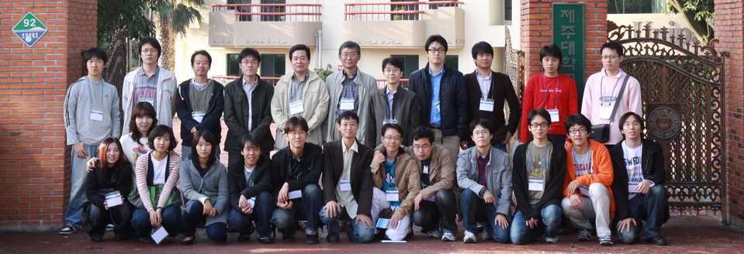
Education
Two classes (AMP, Sp. Seminar on BEC) taught by Y. Shin (foreign scholar) in English in 2009 and 2010.
Six classes (AMP, Physics 1(x2), QM 1(x2), 2) were taught by the two Korean scholars in the first phase.
Three OCW’s (AMP, QM, BEC) have been developed and registered.
Total of 26 graduate students (mostly Ph.D students) have been trained.
Three Ph.D’s have been produced in the first phase (W. Choi, C.-W. Lee, J. Yang).
Y. Shin
K. An
H. Jeong
Notes:
The participating foreign scholar, Yong-il Shin gave two lectures and is advising two graduate students. They have made excellent performance in research and awarded many presentation prizes.

Slide 16
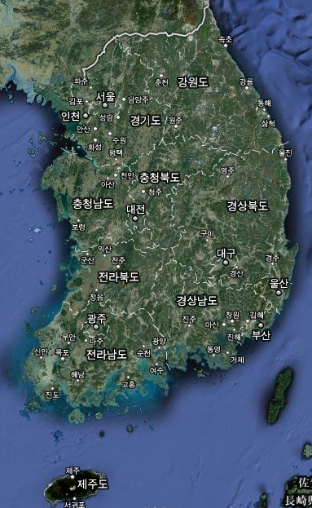
Talks by Oversea Scholar
Invited Conference Presentations
Ultracold atom gases: Bose vs Fermi, The Optical Society of Korea Meeting, Busan, Korea (6/15/2010).
Bose-Einstein condensation of sodium atoms, the Atomic Molecular Physics Workshop, Muju resort, Mooan, Korea (6/25/2010)
Strongly interacting Fermi gas, The APCTP-KIAS workshop on Quantum entanglement and dynamics in correlated many-body system, Pohang, Korea (5/20/2010).
Determination of the fermion pair size and the superfluid gap in a unitary Fermi gas, The 16th International Symposium on Laser Spectroscopy, Korea Atomic Energy Research Institute, Daejeon, Korea (11/12/2009).
RF spectroscopy of a polarized Fermi gas, The Optical Society of Korea 20th Anniversary Special Meeting, Gwangju, Korea (10/20/2009).
Invited Colloquiums, Lectures and Seminars
Supercold Atomic Gases: a New Quantum System, WCU-Distinguished Lecture Series, Seoul National University, Seoul, Korea (10/20/2010).
Polarized Fermi Gas and 2D Bose Gas, SCES, Seoul National University, Seoul, Korea (10/8/2010).
Fast production of BECs in a plugged quadrupole magnetic trap, KRISS, Deajeon, Korea (6/26/2010).
Strongly Interacting Fermi Gases, KIAS, Seoul, Korea (6/15/2010).
Strongly Interacting Fermi Gases, Physics Colloquium, Sogang University, Seoul, Korea (5/25/2010).
Bose-Einstein condensation, KIAS-SNU winter camp, KIAS, Seoul (2/5,6/2010).
Nanokelvin BEC bouncing off a room-temperature solid wall, Physics Colloquium, Konkuk University, Seoul, Korea (12/2/2009).
Nanokelvin BEC bouncing off a room-temperature solid wall, Mechanical Engineering Department, KAIST, Daejeon, Korea (11/19/2009).
Controlling and measuring the relative phase of two spatially separate BECs, Physics seminar, Pusan National University, Pusan, Korea (8/21/2009).
16
Notes:
This is the list of numerous academic activities of Yong-il Shin.

Slide 17
Plan for the Second Phase
Generation of Fermi gases
Study of strongly correlated systems
Application of BEC to quantum chaos
Application of BEC to quantum information

Slide 18
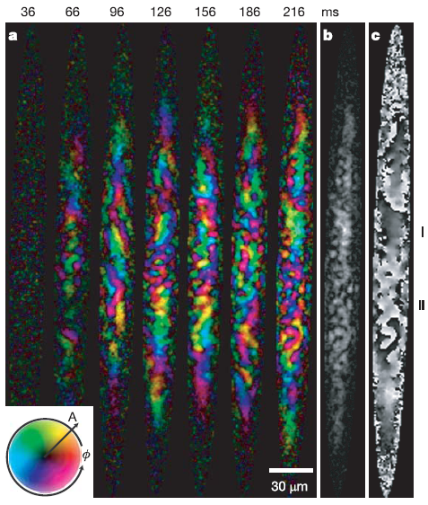
Antiferromagnetic Condensate
Ferromagnetic spinor condensate, Rb-87, F=1, so far
We will make Antiferromagnetic spinor condensate, Na-23, F=1.
With the Na-23 condensate we should be able to study new spinor physics such as magnetic monopole, polar state, half quantum vortex state, etc.
Spontaneous symmetry breaking in a quenched ferromagnetic spinor Bose-Einstein condensate: L.E. Sadler et al., Nature 443 (2006)
Notes:
In the following program phase, we will investigate spinor physics with sodium condensates. In past decades, most of spinor physics has studied with rubidium condensates, where people observe, for example, the spontaneous magnetic domain formation and so on. Sodium condensates have different spin-exchange properties than rubidium condensates, so we expect to explore the other side of spinor physics with our BEC machine. The major topics include magnetic monopole, polar state, half quantum vortex state and so on.

Slide 19
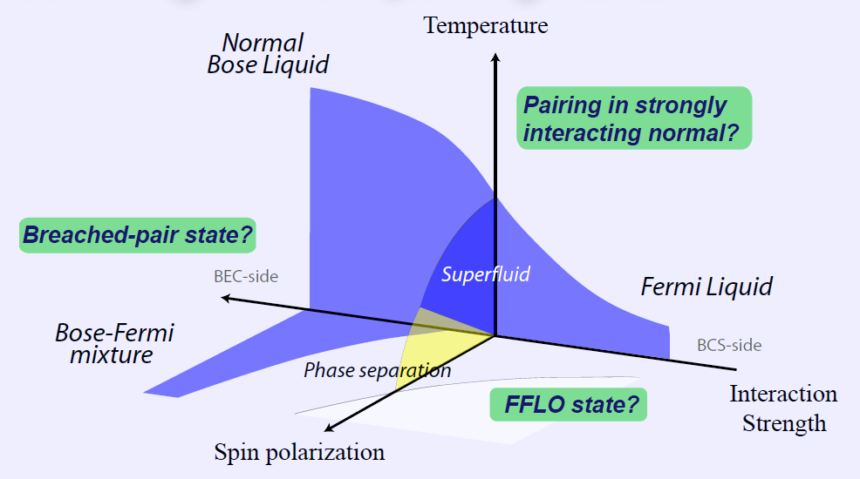
BEC-BCS Phase Transition
Ultracold Li-6 atoms near Feshbach resonances
System parameters are tunable, so thus BEC-BCS crossover and new quantum pairing states may be realized.
New insights on fermionic superfluidity and high-Tc superconductivity
Notes:
Another main agenda in the second phase is the study of superfluidity in strongly-interacting Fermi gases. Our apparatus will be upgraded to produce quantum degenerate gases of Li-6 atoms together with Na condensates. Using magnetically tunable Feshbach scattering resonances, one can prepare maximally interacting Fermi gases. We will explore new exotic quantum phases, for example, the FFLO state and the breached-pair state, which have been theoretically predicted to exist in this system. Ultimately, the precise quantitative understanding of this strongly interacting Fermi system will provide new insights on fermionic superfluidity, including high-Tc superconductors.

Slide 20
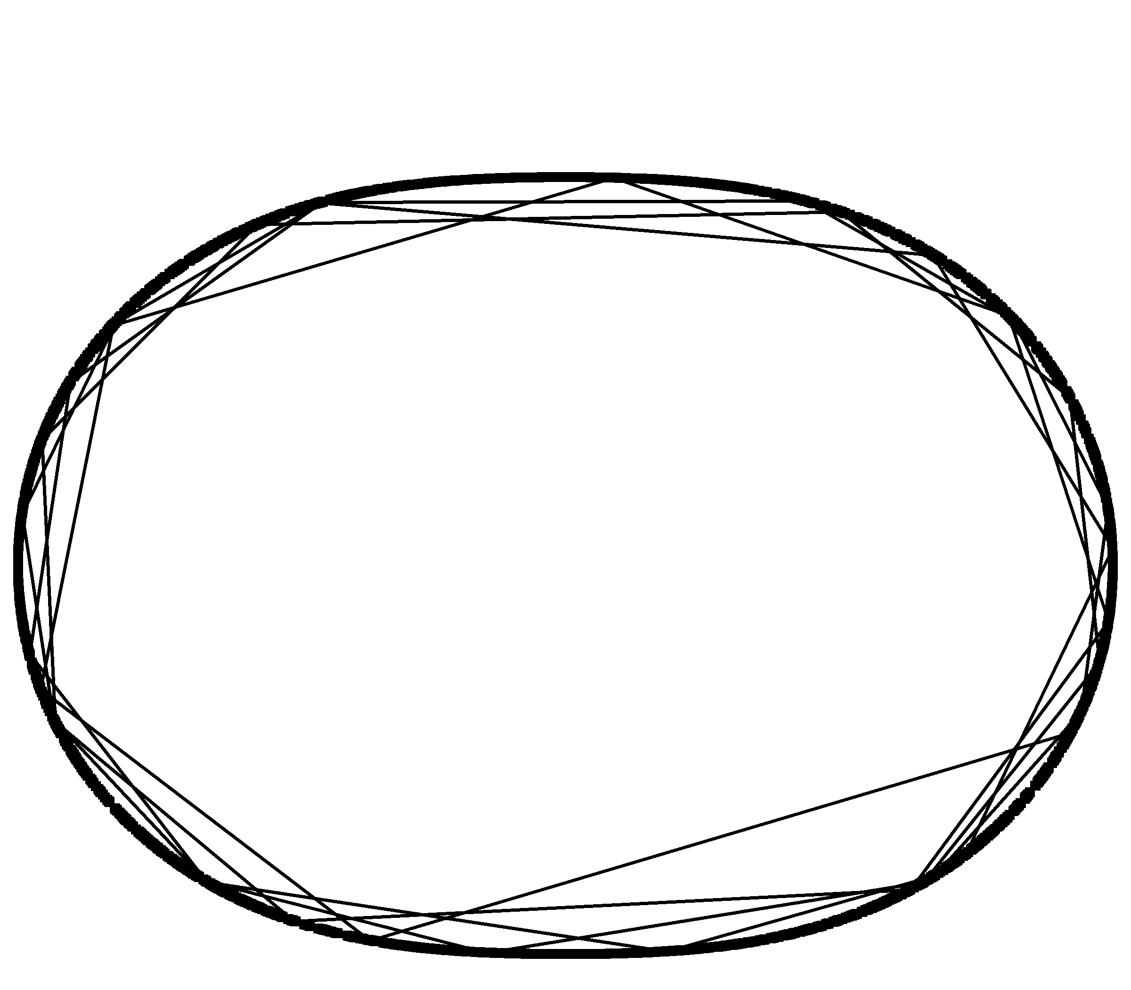
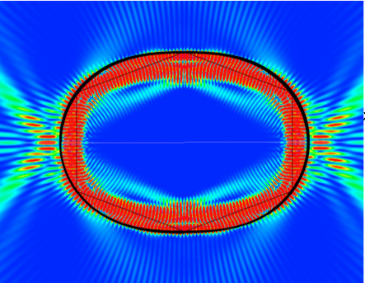
Quantum Chaos with a BEC
Big question: How is chaotic trajectory of a particle related to quasi-eigenmodes of a matter wave?
Setting: Matter wave (BEC) enclosed in a potential well by light force
Mode pattern can be easily imaged, facilitating quantum chaos studies greatly.
chaotic trajectory
existence of scar modes

Slide 21
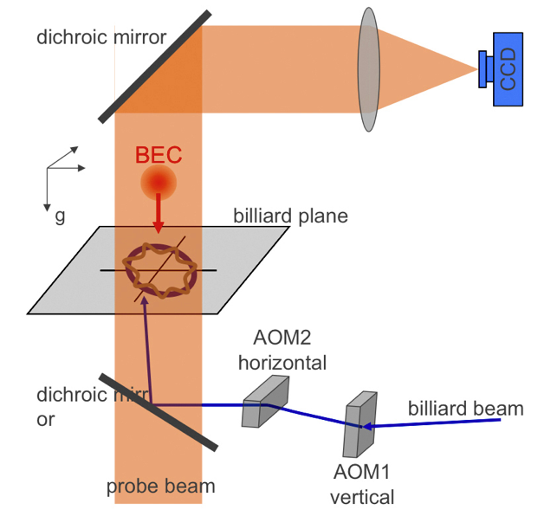
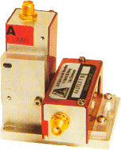
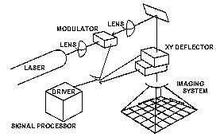
Atomic Whispering Gallery
Ultracold atoms, bounced off a circular potential well, will form a whispering-gallery-mode pattern in a steady state.
Ideal quantum billiard (particle vs. wave) for quantum chaos studies
Enables the study of open quantum system due to matter-wave tunneling

Slide 22
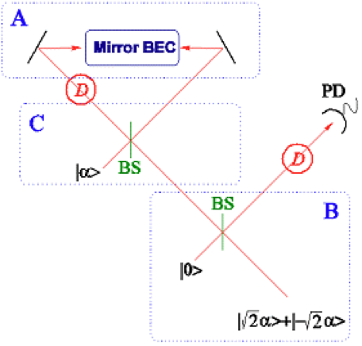
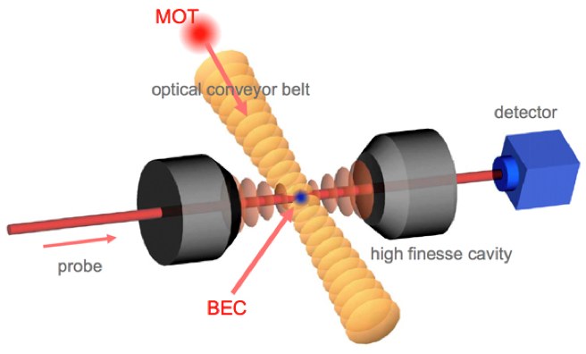
Quantum Information with a BEC
To place a BEC in a high-Q microcavity and create BEC-cavity entanglement
Advanced flying qubit generation
To use a BEC as a Bragg mirror and create BEC-photon entanglement and a Schrödinger cat state

