Slide 1
Measurement and Decoherence Theory
January 5-6, 2009
Hyunseok Jeong
Department of Physics and Astronomy
Seoul National University

Slide 2
Outline
Logical review of quantum mechanics
Paradoxical aspects of quantum mechanics: two big problems
Measurement, reality, EPR paradox, and Bell’s inequality
Quantum world, classical world, Schrödinger’s cat paradox, and decoherence
Some recent (and some old) research highlights related to the subject
Project

Slide 3
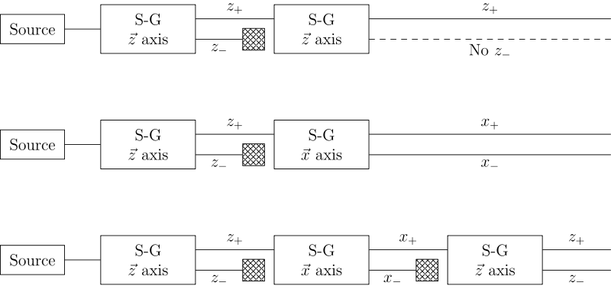
Stern-Gerlach experiment

Slide 4
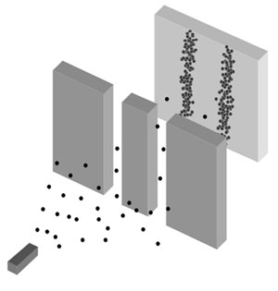

Double slit experiment

Slide 7
Classical gun

Slide 8
Not a simple statistical mixture of the two previous cases!

Slide 9
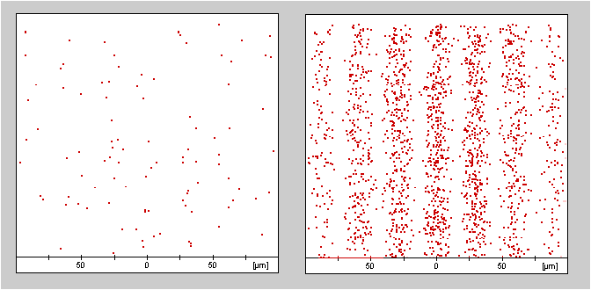
Interference patterns with electrons
Researchers led by Pier Giorgio Merli, the University of Milan (1974).
Tonomura et al., Hitachi in Japan (1989).

Slide 10
The postulates of quantum mechanics
Object at time t
Observer
Results
Equation of motion
Measurement
Object at time t’
Physical quantities (position, momentum, spin …)

Slide 11
Postulate 1: quantum state
[Postulate 1] A state of a physical system at a fixed time t₀ can be described by a state vector |ψ(t₀)> belonging to a Hilbert space H.
Let us suppose N-dimensional Hilbert space H_{N} spanned by an orthonormal basis {|φ₁> , |φ₂> … |φ_{N}> } (<φ_{n}|φ_{m}> =δ_{nm})
Basis: An arbitrary state |ψ(t)> in H_{N} can be represented by |ψ(t)> =∑_{n}c_{n}|φ_{n}> where c_{n} is complex.
The superposition principle: Any two states can be superposed to define a new state as |ψ’’’> =c₁|ψ’> +c₂|ψ’’>

Slide 12
Postulate 2: dynamics
[Postulate 2] The time evolution of the state vector |ψ(t)> is governed by the Schrödinger equation:
where H is the Hamiltonian operator.

Slide 13
Postulates 3 & 4: observable and measurement
[Postulate 3] Every measurable physical quantity A is described by an operator Â acting in H; this operator is an observable.
[Postulate 4] The only possible result of the measurement of a physical quantity A is one of the eigenvalues of the corresponding observable Â.
Eigenequation: Â|φ_{n}>= a_{n}|φ_{n}>
n=1,2,…N and a_{n}’s are eigenvalues

Slide 14
Postulate 5: probabilities for measurements
[Postulate 4: for the case of a discrete non-degenerate system] When the physical quantity A is measured on a system in the normalized state |ψ>, the probability P(a_{n}) of obtaining the eigenvalue a_{n} is P(a_{n})=|<φ_{n}|ψ>|² where |φ_{n}> is the eigenstate corresponding to the eigenvalue a_{n}.
The case for a continuous variable system:
dP(α)=|<φ_{α}|ψ>|²dα.

Slide 15
Postulate 6: reduction of state vector
[Postulate 5] If the measurement of the physical quantity A on the system in the state |ψ > gives the result a_{n}, the state of the system immediately after the measurement is the normalized projection, |ψ ’>, of |ψ > onto the eigensubspace
Projector: P_{n}=∑ _{i}|φ_{n}^{i}> <φ_{n}^{i}| for all eigenvalues corresponding the eigenvalue a_{n}. (P_{n}=|φ_{n}> <φ_{n}| for a non-degenerate system. )

Slide 16
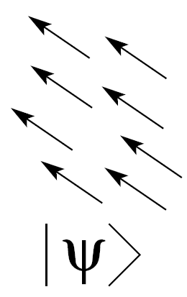
Pure and mixed systems

Slide 17
Pure and mixed states
A pure state is a state that can be represented by a state vector:
A mixed state cannot be represented by a state vector but a density operator:

Slide 18
Statistical mixture and quantum superposition

Slide 19
Statistical mixture and quantum superposition
Population
Coherence
Population
Coherence

Slide 20

Degree of mixedness

Slide 21
Entanglement
A quantum state is entangled when it cannot be represented as a direct product of two arbitrary states as
Example: entangled photons

Slide 22
Entanglement and classical correlation
Entanglement
Classical correlation

Slide 23
Partial trace
When we are interested in only the subsystem 1 of the total state :
is called “partial density matrix” or “marginal density matrix”.

Slide 24
Degree of entanglement (for pure states)
Von Neumann entropy of the partial density operator

Slide 25
Proper and improper mixtures (termed by d'Espagnat)
Proper mixture: A single system is in one of the pure states, but we do not know which (“ignorance” mixture).
Improper mixture: The result of a trace reduction of a composite system (E.g. a subensemble of an entangled state).

Slide 26

Commutation relations
Non-commuting observables cannot have simultaneous eigenvectors.

Slide 27
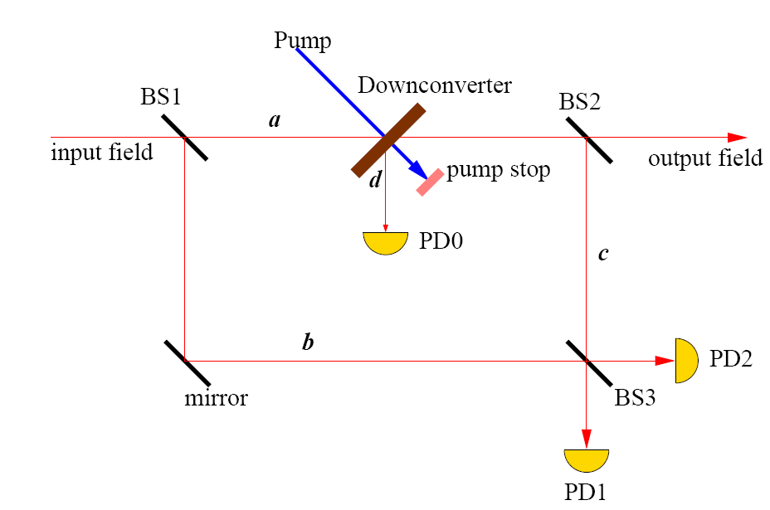
Modern quantum optics version
Adding
BS1
mirror
silent
silent
mirror
silent
silent

Slide 28
Modern quantum optics version
Adding
BS1
mirror
silent
mirror
BS2
silent

Slide 29
Interaction free measurement
Adding
BS1
mirror
?
silent
mirror
BS2
silent

Slide 30
Delayed-choice experiment (Wheeler): quantum optics version
Adding
BS1
mirror
silent
mirror
silent

Slide 31
Delayed-choice experiment (Wheeler): quantum optics version
Adding
BS1
mirror
silent
mirror
BS2
silent

Slide 32
Two BIG problems of quantum mechanics

Slide 33
These problems are characterized in the double slit experiment.

Slide 34
Problem 1
Where was each electron? Has it occupied a definite position at all time??

Slide 35
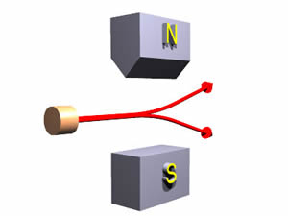
Stern-Gerlach experiment
State vector의 붕괴는 어느 시점에?
Where was each spin-1/2 particle?

Slide 36
How can we understand this?
Measurement is the process of estimating the value of a physical quantity.
Can we still say that the value of the physical quantity already pre-determined before the measurement?
If not, do we have to conclude that the reality of the physical quantity comes into being only by the measurement?

Slide 37
꽃
김춘수
내가 그의 이름을 불러 주기 전에는
그는 다만
하나의 몸짓에 지나지 않았다.
내가 그의 이름을 불러 주었을 때,
그는 나에게로 와서
꽃이 되었다.
내가 그의 이름을 불러준 것처럼
나의 이 빛깔과 향기에 알맞은
누가 나의 이름을 불러다오
그에게로 가서 나도
그의 꽃이 되고 싶다
우리들은 모두
무엇이 되고 싶다.
너는 나에게 나는 너에게
잊혀지지 않는 하나의 눈짓이 되고 싶다.

Slide 38
Possible choices?

Slide 39
Choice 1 To remain as a “classical realist”
The electron was either here or there!
Hidden variable models
Bell’s argument excludes every local hidden variable model.
De Broglie-Bohm interpretation

Slide 40
Choice 2 To abandon realism
The electron was neither here nor there before the measurement event.
The measurement determines the position of the electron.
The wave function (state vector) describes our state of knowledge.
Copenhagen interpretation (Bohr and his friends), “standard” interpretation, statistical interpretation …
The “abrupt” reduction of the wave function is required as a key assumption.

Slide 41
Choice 3 To be a “quantum realist”
The wave function describes (or corresponds to) reality.
“I believe in reality. … To me it seems more economical to assume that the wave function describes reality, unless and until you can dissuade me.” [J. Preskill, Lecture note, 1998].
Many world interpretation (Everett)
One can remove the assumption of the wave function reduction. The “wave function of the universe” evolves unitarily.

Slide 42
Choice 4
“Shut up and calculate” interpretation (R. Feynman, “quoted” by D. Mermin)

Slide 43

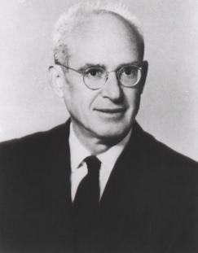
The Einstein-Podolsky-Rosen paradox
[Einstein, Podolsky and Rosen, Physical Review (1935)]

Slide 44
The Einstein-Podolsky-Rosen paradox
Is quantum mechanics a complete physical theory?
Complete physical theory: one in which there is an element corresponding to every element of reality.
Real World
Element of reality 1
Element of reality 2
Element of reality 3
…
…

Slide 45
The Einstein-Podolsky-Rosen paradox
Is quantum mechanics a complete physical theory?
Complete physical theory: one in which there is an element corresponding to every element of reality.
Real World
Complete theory
Element of reality 1
Element of reality 2
Element of reality 3
…
…
Element of the theory 1
Element of the theory 2
Element of the theory 3
…
…

Slide 46
The Einstein-Podolsky-Rosen paradox
Is quantum mechanics a complete physical theory?
Complete physical theory: one in which there is an element corresponding to every element of reality.
Real World
Complete theory
Element of reality 1
Element of reality 2
Element of reality 3
…
…
Element of the theory 1
Element of the theory 2
Element of the theory 3
…
…

Slide 47
The Einstein-Podolsky-Rosen paradox
Is quantum mechanics a complete physical theory?
Complete physical theory: one in which there is an element corresponding to every element of reality.
Real World
Incomplete theory!
Element of reality 1
Element of reality 2
Element of reality 3
…
…
Element of the theory 1
Element of the theory 2
…
…
Missing!

Slide 48
The Einstein-Podolsky-Rosen paradox
Element of Reality: If, without in any way disturbing a system, we can predict with certainty (i.e., with probability unity) the value of a physical quantity, then there exist an element of physical reality corresponding to this physical quantity.
Einstein’s locality: Physical processes occurring at one place should have no immediate effect on the elements of reality at another location.

Slide 49
The Einstein-Podolsky-Rosen paradox
1
2

Slide 50
The Einstein-Podolsky-Rosen paradox
measure x₁
1
2
One can predict x₂ with certainty:
x₂ is an element of reality.

Slide 51
The Einstein-Podolsky-Rosen paradox
measure p₁
1
2
One can predict p₂ with certainty:
p₂ is an element of reality.

Slide 52
The Einstein-Podolsky-Rosen paradox
1
2
x₂ and p₂ cannot be simultaneously described by QM.

Slide 53
The Einstein-Podolsky-Rosen paradox
Is quantum mechanics a complete physical theory?
Complete physical theory: one in which there is an element corresponding to every element of reality.
Real World
Quantum mechanics
Element of reality x
Element of reality p
…
…
Element of the theory x
…
…
Missing!

Slide 54
The Einstein-Podolsky-Rosen paradox
Is quantum mechanics a complete physical theory?
Complete physical theory: one in which there is an element corresponding to every element of reality.
Real World
Quantum mechanics
Element of reality x
Element of reality p
…
…
Missing!
…
…
Element of the theory p

Slide 55
The Einstein-Podolsky-Rosen paradox
Quantum mechanics is an incomplete theory!

Slide 56
Quantum mechanics vs local realism
Einstein-Podolsky-Rosen (EPR) paradox (1935): Is quantum mechanics a complete physical theory?
[A. Einstein, B. Podolsky, and N. Rosen, Phys. Rev. 47, 777 (1935).]
Local realism: locality + realism
- Locality: “Distant objects cannot have direct influence on one another.”
- Realism: “The results of observations are a consequence of properties carried by physical systems, i.e., an external reality exists independent of observation.”: measurement results can only reveal pre-determined values.

Slide 57
Bell’s inequality (Bell, 1964)
EPR-Bohm state
Average of the product of the spin measurements, for a given set of detector orientations
The results of the measurements with hidden variable λ.
Realism (Determinism)
Locality

Slide 58
What makes quantum theory quantum?
Uncertainty relation:
Complementarity:
“Two observables are complementary if precise knowledge of one of them implies that all possible outcomes of measuring the other one are equally probable.” (Scully et al.)
“No matter how the system is prepared, there is always a measurement whose outcome is utterly unpredictable.” (Scully et al.)
Commutation relation:

Slide 59
Experimental proof of the commutation relation using quantum measurements? (Kim, Jeong, Zavatta, Parigi, Bellini, Phys. Rev. Lett. 2008)
List for optical implementation
Implementation of the photon annihilation and creation operators
Consecutive applications of the operators
Coherent superposition of the operators

Slide 60
Two BIG problems of quantum mechanics
The first problem is related to the question of “what reality is”. This makes us to consider the relation between the measurement and reality.
The second problem is related to the reconciliation between the descriptions of the microscopic and macroscopic worlds. This will lead us to the decoherence theory.

Slide 61
This was the case with electrons…

Slide 62

Problem 2
How does a classical world appear from the laws of quantum physics?

Slide 63
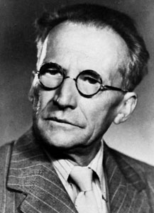

E. Schrödinger
What about a cat??
?

Slide 64
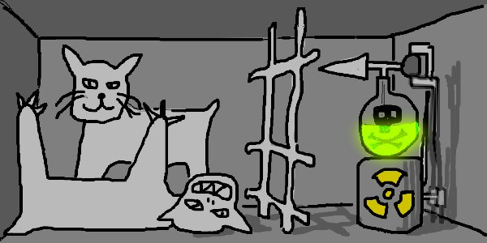
Schrödinger’s cat paradox
E. Schrödinger, Naturwissenschaftern. 23 (1935)
The Brussels Journal (29/10/2007)
By measuring the microscopic part on the superposed basis
Quantum superposition and entanglement involving macroscopic systems

Slide 65
Double slit experiment

Slide 66
Classical gun
Why do we not observe interference with bullets?

Slide 67

Feynman’s argument
Very good magnifier

Slide 68
This is only a part of the story….
Certain physical systems allow for exotic measurements with quite large systems.
It is still extremely difficult to observe macroscopic quantum interference.

Slide 69
“The idea that the “openness” of quantum systems might have anything to do with the transition from quantum to classical was ignored for a very long time, probably because in classical physics problems of fundamental importance were always settled in isolated systems.” (Zurek)

Slide 70

Environment
Very good magnifier

Slide 71
Basic idea
If the measurement result is “recorded” in the environment, |E₁> and |E₂> will be orthogonal.
After the interaction with the environment and tracing over the environment degree of freedom, one can find that the system is decohered.

Slide 72
Basic idea

Slide 73
Decoherence
Interactions with the environment typically causes a rapid vanishing of the diagonal terms in the density matrix of a physical system.

Slide 74
It is difficult to isolate macroscopic objects from their environment.
Macroscopic quantum states decohere much faster than microscopic states.

Slide 75
Some examples with microscopic and macroscopic systems (Tegmark, 1993)

Slide 76
Measurement problem (summarized by Schlosshauer)
The problem of outcomes: Why do measurements have outcomes at all, and what selects a particular outcome among the different possibilities described by the quantum probability distributions.
The problem of nonobservability of interference: Why is it so difficult to observe quantum interference effects, especially on macroscopic scale?
The problem of preferred basis: What singles out the preferred physical quantities in nature? For example, why are physical systems usually observed to be in definite positions rather than in superpositions of positions?

Slide 77
Measurement and decoherence
Consider the measuring device as a “quantum” system.
Reduction is no longer needed.
Von Neumann chain

Slide 78
Does the decohrence program resolve the measurement problem?
“A “collapse” in the traditional sense is no longer necessary. … The emergence of “objective existence” [from decoherence] … significantly reduces and perhaps even eliminates the role of the “collapse” of the state vector.” (Zurek)
“decoherence is able to solve practically all the problems of Measurement which have been discussed in the previous chapters.” (Auletta, “Foundations and Interpretation of Quantum Mechanics in the Light of a Critical-Historical Analysis of the Problems and of a Synthesis of the Results” 2000)

Slide 79
Does the decohrence program resolve the measurement problem?
“Does decoherence solve the measurement problem? Clearly not. What decoherence tells us, is that certain objects appear classical when they are observed. But what is an observation? At some stage, we still have to apply the usual probability rules of quantum theory.” (Joos)
“Decoherence by itself does not yet solve the measurement problem. … This argument is nonetheless found wide-spread in the literature. … It does seem that the measurement problem can only be resolved if the Schrödinger dynamics is supplemented by a nonunitary collapse.” (Zeh)

