Slide 1
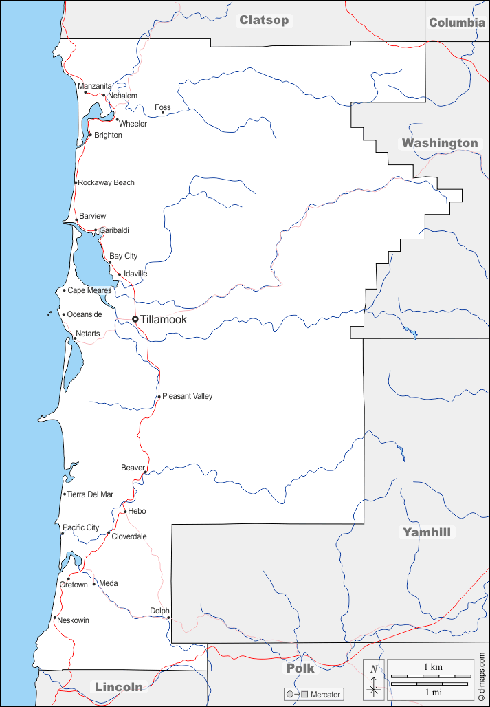
Model Representation - TWLs
Required Inputs
Coverage | Notes
Dune Points | DuneLine.shp – contains representation of shoreline points describing beach, dune characteristics | 10m
TWL Transects | Transect_lookup_1km.csv | 1km
Beach Profiles (bathymetry) | Profile_lookup.csv

Slide 2
BchT_UNDEFINED = 0,
BchT_SANDY_DUNE_BACKED = 1,
BchT_SANDY_BLUFF_BACKED,
BchT_RIPRAP_BACKED,
BchT_SEAWALL_BACKED,
BchT_DUNE_BLUFF_BACKED,
BchT_CLIFF_BACKED,
BchT_WOODY_DEBRIS_BACKED,
BchT_WOODY_BLUFF_BACKED,
BchT_BAY,
BchT_RIVER,
BchT_ROCKY_HEADLAND
Dune Crest
Backshore Beach slope (defined between MHW and dune toe)
Shoreface slope (calculated between MHW and 25 m contour line using cross-shore profiles)
Dune Toe
MHW
25m Depth

Slide 3
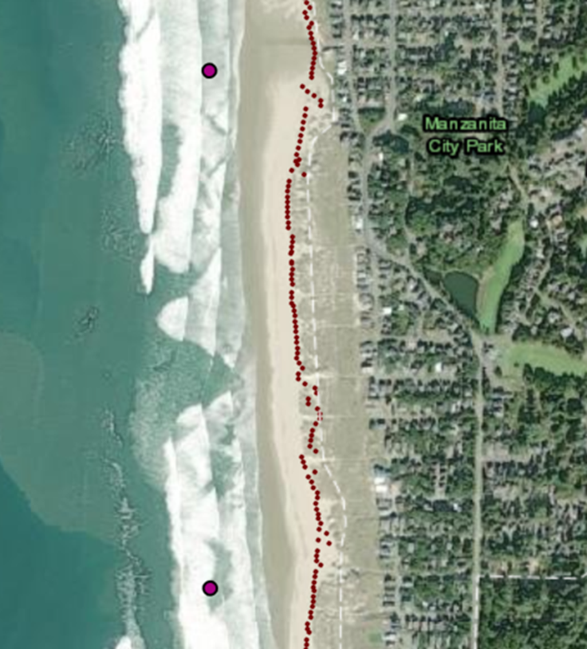
Offshore Bouy
Stillwater Level (NAVD88)
TWL Transect Points (1km)
Shoreline Points (10m)

Slide 4
Harvest
Feed Input
Harvest
Fish
Plants
Excretion
Recirculation
(F)
Uptake
N₁
N₂
Recirculation
(F)
Mortality
F₁
S₂
S_{in}
Growth
B₁
B₂
S_{in}
Algae
Flow Out
f, Algae
Uptake
Flow In
f, S_{in}
Nutrient
Uptake
Flow Out
f, N
Recirculation

