Slide 1
Content Security Policy
Defending Web applications from Cross site Scripting

Slide 2
About the speaker
Bryce Jech
Web Developer at the Oklahoma State University Foundation
Developing web and network applications for ~4 years
Previously worked for a WISP as a web and network programmer (Python)
Slack display name: @pyguy
Github: https://github.com/brycejech
LinkedIn: https://www.linkedin.com/in/brycejech/
Hobbies: Foosball, longboarding, gardening, all things web related

Slide 3
What is content security policy
From MDN:
“Content Security Policy (CSP) is an added layer of security that helps to detect and mitigate certain types of attacks, including Cross Site Scripting (XSS) and data injection attacks. These attacks are used for everything from data theft to site defacement or distribution of malware.”
- CSP on MDN

Slide 4
What does a content security policy do?
A content security policy allows us to instruct the browser on the origins from which scripts, styles, images, frames, and other web resources are allowed to be loaded and executed for any given web page.
A CSP should not be your only layer of defense against XSS attacks. User input still should never be trusted and always be properly sanitized. However, when leveraged correctly, a robust content security policy can be an extremely versatile addition to your defense in depth strategy.

Slide 5
What is Cross Site Scripting (XSS)?
From MDN:
“Cross-site scripting (XSS) is a security exploit which allows an attacker to inject malicious client-side code into a website. This code is executed by the victim's browser and lets the attackers bypass access controls and impersonate users.
According to the Open Web Application Security Project (OWASP), XSS was the third most common Web app vulnerability in 2013.”
XSS on MDN
XSS on OWASP

Slide 6
What are http headers?
HTTP headers are part of an HTTP request or response, they convey additional information about the request/response. A header consists of it's case insensitive name followed by a colon, then it's value (without line breaks). Leading white space before the value is ignored.

Slide 7
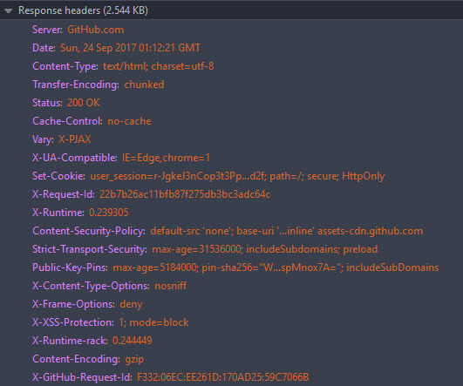
http Response Header examples

Slide 8
Using the content-security-policy header
Currently, the most widely supported version of CSP is version 2. All of the keywords and directives mentioned here are supported in this CSP version.
*Browser support is sometimes limited, more on that later.
To use a CSP, we must configure our server to return the `Content-Security-Policy` HTTP header:
Content-Security-Policy: <policy>

Slide 9
Setting the content-security-policy in header in popular web servers
Nginx
In the server{ } block in the nginx.conf file, add the following
add_header Content-Security-Policy “<your policy>”;
Apache
In the httpd.conf file for the host or in an .htaccess file, add:
Header set Content-Security-Policy “<your policy>”
IIS
In the web.config file, in the <system.webServer> node, in the <httpProtocol> node, in the <customHeader> node, add the following:
<add name=“Content-Security-Policy” value=“<your policy>”

Slide 10
Other methods
Popular web frameworks also provide interfaces through which you can set custom headers. However, if you plan to have a singular policy for your site, the recommended approach would be to add the CSP header directly via the web server.
If you do not have access to set HTTP response headers on your server, a CSP can also be specified with an HTML <meta> tag inside the document <head>:
<meta http-equiv="Content-Security-Policy" content="<your policy>" />

Slide 11
Example usage
Before we look at a comprehensive list of CSP keywords and directives, let's look at a few examples.
Content-Security-Policy: default-src 'self';
This policy would restrict all resources to the site’s origin (excluding subdomains)

Slide 12
Example usage
Content-Security-Policy: default-src 'self'; script-src https: 'self' 'unsafe-inline'; style-src https: 'self' 'unsafe-inline';
This policy would:
Restrict JavaScript to be loaded via https: from the current origin, allow inline script (unsafe)
Restrict CSS to load via https: from the current origin, allow inline styles (unsafe)
Restrict all other content to be loaded from the current origin

Slide 13
A more restrictive example
Content-Security-Policy: default-src 'none'; script-src 'self'; style-src 'self'; img-src 'self'
This would allow scripts, styles, and images to load from the current origin, and block everything else

Slide 14
Why is the use of inline JavaScript and CSS considered unsafe?
Browsers do not have any way to tell trusted from untrusted inline code; they cannot see the difference between your inline code and unsafe code from an attacker that may have been rendered into the page without being properly sanitized.

Slide 15
What makes styles or scripts 'inline'
Scripts are considered inline if they are a part of a <script> tag that is not loaded via the src attribute. onclick, onhover, onload, onerror and other similar HTML attributes that can contain JavaScript code are also considered inline.
HTML style attributes as well as <style> elements are considered inline style.
When a CSP is enabled and the “script-src 'unsafe-inline‘;” or “style-src 'unsafe-inline‘;” directives are not specified, inline JavaScript and CSS evaluation are blocked. However, an inline script tag may also be evaluated if it has a valid nonce- attribute value, or if it matches an already specified sha256- hash.

Slide 16
What about unsafe eval?
The script-src 'unsave-eval' directive allows the use of text to JavaScript functions such as eval(string), setTimeout(string), and new Function(). They are also considered unsafe because untrusted user input could make it's way into them. They are blocked unless the 'unsafe-eval' value is set.
eval(), setTimeout(string), and new Function() are blocked because strings can be passed to these functions and evaluated as JavaScript code. When using setTimeout(), only the string evaluation is blocked, if you pass setTimeout() an inline function, it will still work as expected

Slide 17
Keywords
Keyword | Meaning
‘none’ | Matches nothing, blocks use of the specified source
‘self’ | Refers to the current origin (excluding subdomains)
‘unsafe-inline’ | Allows inline JS and CSS (unsafe)
'unsafe-eval' | Allows text to be evaluated as JS (unsafe)
https: | Restrict resources to https:
nonce- | script or style tags can be evaluated if their nonce attribute matches the header value <script nonce="f8uz0jlZq41ljc">alert('Hello World!')</script>
sha256- | Allow a script or style to execute if it matches the specified sha256 hash.
data: | Allows loading resources via the data scheme such as a base 64 image src

Slide 18
Directives
Directive | Meaning
default-src | Used as a fallback for unspecified directives
script-src | Restricts origins from which scripts can be loaded
style-src | Restricts origins from which stylesheets may be loaded
img-src | Restricts origins from which images can be loaded
connect-src | Restricts origins to which you can connect via XMLHTTPRequests (XHR), WebSockets, and EventSource
font-src | Restricts origins from which fonts may be loaded
form-action | Restricts endpoints for form submissions
frame-ancestors | Restricts origins from which the current page may be loaded in a frame element. Applies to <frame>, <iframe>, <embed>, and <applet>. Setting this to 'none' is roughly equivalent to X-Frame-Options: DENY
media-src | Restricts origins from which <video> and <audio> can be loaded

Slide 19
Directives Continued
Directive | Meaning
object-src | Allows control of Flash and other plugins
frame-src | DEPRECATED, use child-src
child-src | Restricts URLs for workers and frames. child-src: https://youtube.com would allow frames to be loaded from youtube.com, but not from any other origins.
base-uri | Restricts URLs that can appear in the <base> element
plugin-types | Limits the types of plugins a page may invoke
report-uri | URL to which the browser will POST policy violations
upgrade-insecure-requests | Instructs browsers to re-write URLs from http to https (useful for legacy sites with a lot of URLs that need to be re-written)

Slide 20
What does a production csp look like?
Let’s have a look at GitHub’s CSP
Content-Security-Policy: default-src 'none';
base-uri 'self';
child-src render.githubusercontent.com;
connect-src 'self' uploads.github.com status.github.com collector.githubapp.com api.github.com www.google-analytics.com github-cloud.s3.amazonaws.com github-production-repository-file-5c1aeb.s3.amazonaws.com github-production-upload-manifest-file-7fdce7.s3.amazonaws.com github-production-user-asset-6210df.s3.amazonaws.com wss://live.github.com;
font-src assets-cdn.github.com;
form-action 'self' github.com gist.github.com;
frame-ancestors 'none';
img-src 'self' data: assets-cdn.github.com identicons.github.com collector.githubapp.com github-cloud.s3.amazonaws.com *.githubusercontent.com;
media-src 'none';
script-src assets-cdn.github.com;
style-src 'unsafe-inline' assets-cdn.github.com

Slide 21
Testing a policy with report-only mode
You may also supply a “Content-Security-Policy-Report-Only: <policy>” header, which will cause the browser to report on policy violations via the console as well as POST report violations to a report-uri (if specified) without blocking resources from loading or executing.
This feature can be used to help you fine-tune your policy. It can be used to test out new directives without making them part of the enforced policy, giving you time to address issues without breaking site functionality.

Slide 22
Using the report-uri directive to collect policy violations
The report-uri directive is extremely useful for collecting information on report violations. There may be resources that we missed or an attacker actively trying to exploit an XSS attack vector. Aside from logged violations in the console, without policy violation reporting, we are left in the dark as to which directives may be being violated.
The report-uri directive is used to specify a URL to which the browser should POST a JSON formatted violation report in the event that it acts on the CSP.

Slide 23
Consider the following policy:
Content-Security-Policy: default-src https: 'self'; report-uri https://cspreport.mydomain.com;
Let's say that on a page at https://mydomain.com/index.html that is subject to this policy we have the following img tag: <img src="http://mydomain.com/favicon.ico" />.
Upon detecting that this resource is in violation of the policy, the browser will POST a JSON formatted report similar to this:
{
"csp-report": {
"document-uri": "https://mydomain.com/index.html",
"referrer": "",
"blocked-uri": "http://mydomain.com/favicon.ico",
"violated-directive": "default-src https: 'self'",
"original-policy": "default-src https: 'self'; report-uri https://cspreport.mydomain.com;"
}
}

Slide 24
The endpoint at https://cspreport.mydomain.com should capture this data and log it for later use. You can then use the data to identify the pages and resources which are most frequently violating the policies (high traffic) and address them first, then move on to violations that are seeing less traffic.

Slide 25
Browser Support
Header | Firefox | Chrome | Safari | IE | Edge
Content-Security-Policy v2 | 31+ | 40+ | 10+ | - | 15 build 15002+
Content-Security-Policy v1 | 23+ | 25+ | 7+ | - | 12 build 10240+
X-Content-Security-Policy deprecated | 4+ | - | - | 10+ limited | 12+ limited
X-Webkit-CSP deprecated | - | 14+ | 6+ | - | -

Slide 26
Summary
A Content Security Policy is an extremely flexible defense mechanism for defending against XSS attacks
CSPs allow us to instruct browsers on which web resources are trusted, allowing them to block other (potentially unsafe) resources
CSPs can be defined in an HTTP response header or in a <meta> tag in the document head
Inline JS and CSS are considered unsafe
Use of eval(), new Function(string), setTimeout(string), and similar methods are also unsafe
CSPs have keywords, such as ‘self’, that give us a shorter syntax and allow us to more safely include inline code with the use of hashes and/or nonces
The Content-Security-Policy-Report-Only header allows us to report on CSP violations without actually blocking content
The report-uri directive is extremely useful for aggregating policy violations and allowing us to address the highest traffic issues first

Slide 27
Questions?

Slide 28
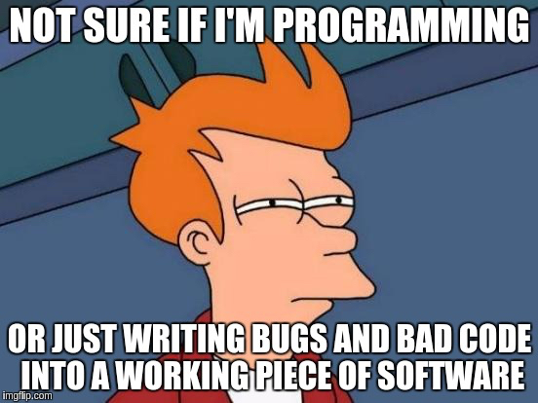
Thank you! Enjoy a meme!

Slide 29
Information available as a markdown document at
https://github.com/brycejech/Content-Security-Policy/blob/master/README.md

