Slide 1
Point of Sale System
Navjot Bhatti, Hardeep Sandhu, Jonathan Fitz, Chaitanya (LastName)

Slide 2
Definition
Point of Sales (POS) describes the moment when a merchant accepts payment in exchange for goods
POS system handles this transaction
Ex. Customer pays cashier for goods
Ex. You make an online order from Amazon

Slide 3
Our System
Created a general POS system used in a store where barcodes are not used
Instead, cashier takes order by selecting item from list
Ex. Tim Hortons, Food Court

Slide 4
Users
Cashier
Manager
Starts a new transaction
Adds/removes items from customer’s “virtual cart”
Accepts payment to finish transaction
Adds/removes cashiers that can login
Change list of goods offered by store
…
Supervises?

Slide 5
User’s Perspective
Show Login screen
Show post-login screen

Slide 6
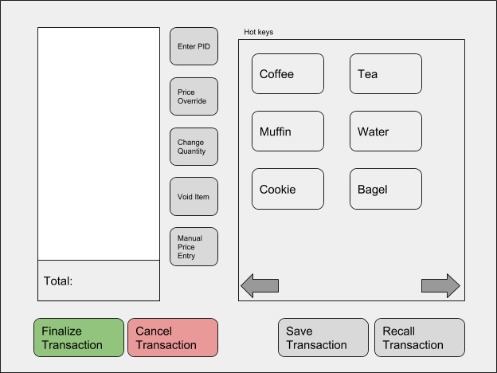
User’s Perspective Cont.
Some of what cashier can do…
Add item by selecting category
Remove item
Override price of good
Save transaction so it can be continued later (ie. customer forgets wallet)
Finalize transaction by taking payment

Slide 7
But wait, there’s more!
Key info is stored in a Database
Employee info (Name, credentials, etc.)
List of goods sold by store
Saved Transactions
Only Managers allowed to access employee info

Slide 8


The Database, Exposed
Suppose manager wants to confirm their salary is greater than cashier’s
Manager requests to see list of cashiers and their salaries
Requests transformed into MySQL Query
Database handles Query and returns with answer
User Makes Reqest
Happy User*
Turned into MySQL
[Not sure what to put here]
Database find answer…
…and returns it
*Results may vary

Slide 9
Conclusion
What did we learn?
Communication is key
Work smarter, not harder
…But still work hard
Notes:
Communication: Maybe most important attribute a team can have is good communication. If people don’t know what is going on, morale decreases and mistakes are made. Documentation and modelling can help with this, which leads to…
Work smart, not hard: Creating requirements, building models, etc. may initially feel like wasted time, but except for with the smallest projects, this does actually save you time
Work hard: Have a good attitude, and pull your weight.

