Slide 1
Point of Sale System
Navjot Bhatti, Hardeep Sandhu, Jonathan Fitz

Slide 2
Overview

Slide 3
Definition
Point of Sales (POS) describes the moment when a merchant accepts payment in exchange for goods
POS system handles this transaction
Ex. Customer pays cashier for goods
Ex. You make an online order from Amazon

Slide 4
Our System
Created a general POS system for businesses that do not use barcodes
Instead, cashier takes order by selecting item from list
Ex. Coffee Shop, Movie Theaters
Notes:
Fill this out

Slide 5
Users
Cashier
Manager
Starts a new transaction
Adds/removes items from customer’s “virtual cart”
Accepts payment to finish transaction
Adds/removes cashiers that can login
Change list of goods offered by store
…
Supervises?

Slide 6
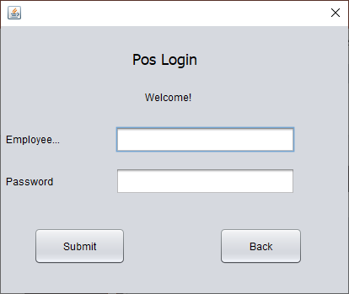
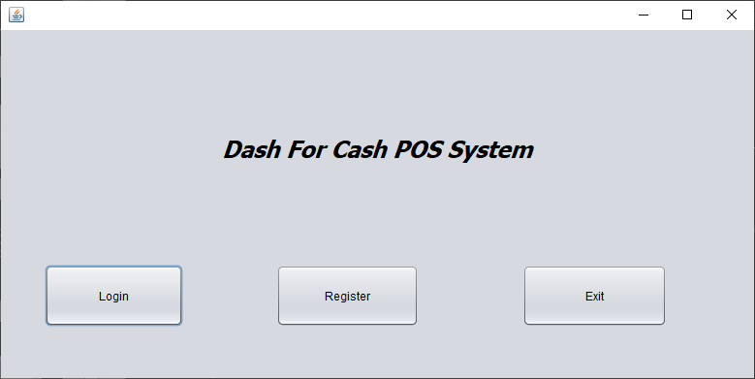
User’s Perspective
First Screen Seen By User
Employee Logs In

Slide 7
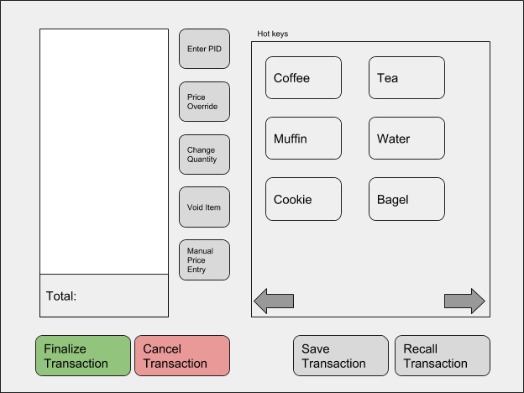
User’s Perspective Cont.
Some of what cashier can do…
Add item by selecting category
Remove item
Override price of good
Save transaction so it can be continued later (ie. customer forgets wallet)
Finalize transaction by taking payment
Notes:
Alter Screen

Slide 8
But wait, there’s more!
Key info is stored in a Database
Employee info (Name, credentials, etc.)
List of goods sold by store
Saved Transactions
Only Managers allowed to access employee info
Notes:
Anything else? What about sales?

Slide 9


The Database, Exposed
Suppose manager wants to confirm they make more money than cashiers do
Manager requests to see cashier data
Request transformed into MySQL Query and sent to Database
Database handles Query and returns with answer
User Makes Request
Happy User*
Turned into MySQL
Database find answer…
…and returns it
Displayed to user
*Results may vary

Slide 10
Development Process

Slide 11
Development Model
Used techniques from both Waterfall and Agile model
From Waterfall:
Requirements first
Then modelling
Development
And Testing
These were followed generally
From Agile:
More communication, less documentation
Team members given more autonomy

Slide 12
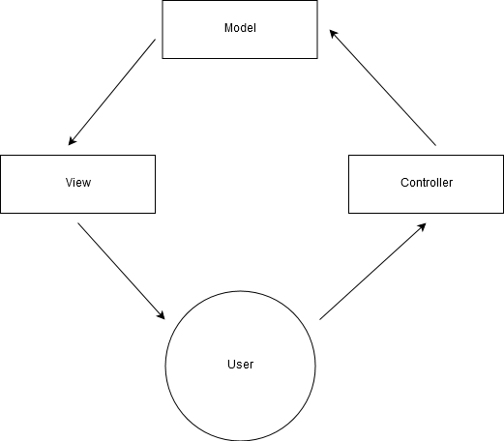
Architectural Design
Used Model-View-Controller architectural pattern
User makes request
Controller translates this request for Model
Model manipulates and returns appropriate data
View displays data to User

Slide 13
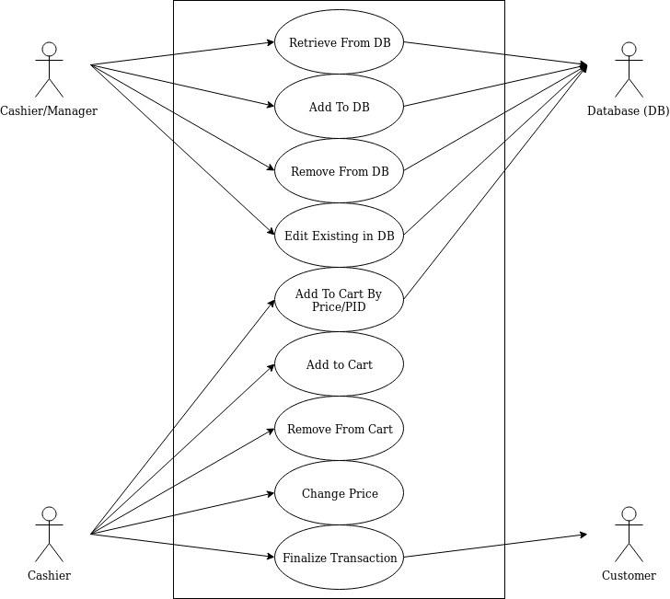
Interaction Models
Use Case Models
Sequence Diagrams

Slide 14
Programming
Mostly used Java
MySQL used to create structure of database

Slide 15
Testing
Still underway!
Done Manually
Most unit testing replaced by careful examination of code
Focus on Component Testing
Check common workflows
Then get more creative!

Slide 16
Work To Be Done
Most documentation is finished
Programming will focus on UI and fixing bugs
Test cases will be executed

Slide 17
Problems We Overcame
Slow Start
Conflicting Work Styles
Different Strengths and Skills

Slide 18
What We Learned
Communication is key
Work smarter, not harder
…But still work hard
Notes:
Communication: Maybe most important attribute a team can have is good communication. If people don’t know what is going on, morale decreases and mistakes are made. Documentation and modelling can help with this, which leads to…
Work smart, not hard: Creating requirements, building models, etc. may initially feel like wasted time, but except for with the smallest projects, this does actually save you time
Work hard: Have a good attitude, and pull your weight.

Slide 19
Any Questions?

