Slide 1
Point of Sale System
Navjot Bhatti, Hardeep Sandhu, Jonathan Fitz, Chaitanya (LastName)

Slide 2
Overview

Slide 3
Definition
Point of Sales (POS) describes the moment when a merchant accepts payment in exchange for goods
POS system handles this transaction
Ex. Customer pays cashier for goods
Ex. You make an online order from Amazon

Slide 4
Our System
Created a general POS system used in a store where barcodes are not used
Instead, cashier takes order by selecting item from list
Ex. Tim Hortons, Movie Theaters
Notes:
General since this stores can input their own items they sell into the system

Slide 5
Users
Cashier
Manager
Starts a new transaction
Adds/removes items from customer’s “virtual cart”
Accepts payment to finish transaction
Adds/removes cashiers that can login
Change list of goods offered by store
…
Supervises?

Slide 6
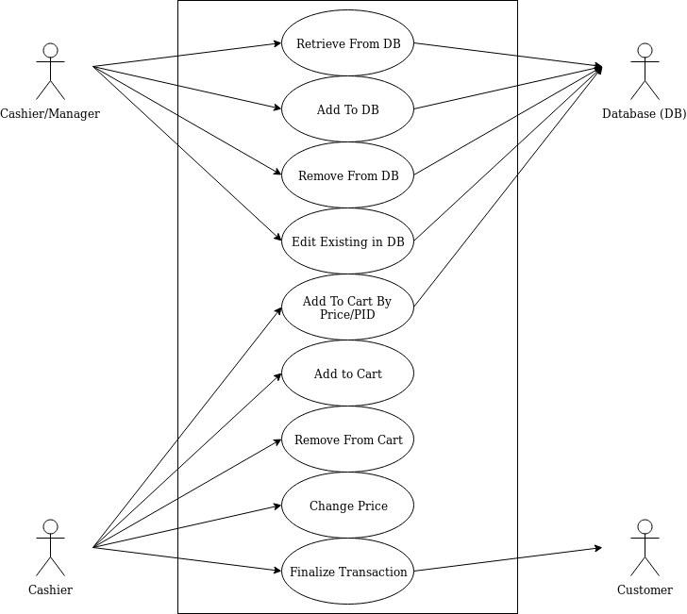
Use Case Diagram
Shows essential use cases for cashier and manager

Slide 7
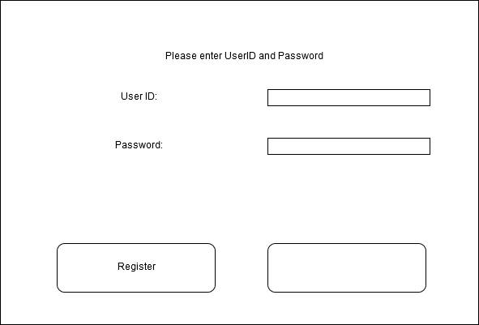
User’s Perspective
Show Login screen
User provides their ID and password and selects Login
Manager selects
Only users with the correct credentials are allowed past this screen

Slide 8
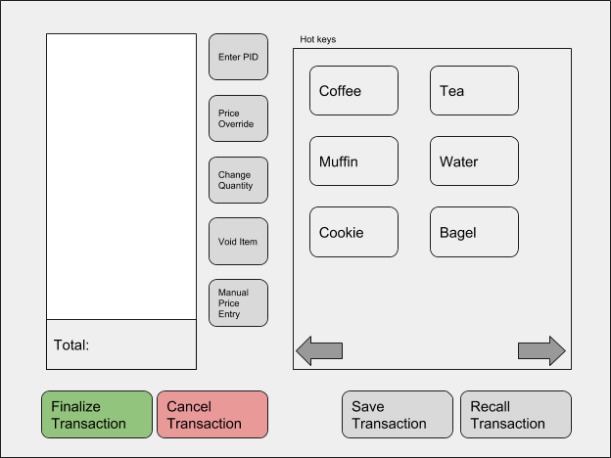
User’s Perspective Cont.
Some of what cashier can do…
Add item by selecting category
Remove item
Override price of good
Save transaction so it can be continued later (ie. customer forgets wallet)
Finalize transaction by taking payment

Slide 9
But wait, there’s more!
Key info is stored in a Database
Employee info (Name, credentials, etc.)
List of goods sold by store
Saved Transactions
Only Managers allowed to access employee info

Slide 10


The Database, Exposed
Suppose manager wants to confirm their salary is greater than cashiers
Manager requests to see list of cashiers and their salaries
Requests transformed into MySQL Query
Database handles Query and returns with answer
User Makes Request
Happy User*
Turned into MySQL
[Not sure what to put here]
Database find answer…
…and returns it
*Results may vary

Slide 11
Specific Use Case
Cashier Login
Cashier provides ID and Password to interface
Info is sent to Database
Database handles request
Result is sent back

Slide 12
Development Process

Slide 13
Development Model
Used techniques from both Waterfall and Agile processes
Followed Waterfall method generally:
Requirements first
Then modelling
Development
And Testing
From Agile
Wasn’t strict about keeping linear progression
Sometimes processes were intermingled

Slide 14
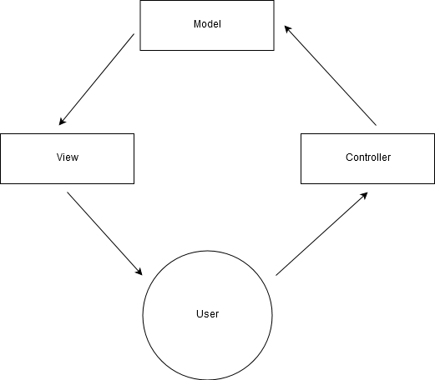
Architectural Design
Used Model-View-Controller architectural pattern
Controller does..
Model does …
View does …

Slide 15
Conclusion
What did we learn?
Communication is key
Work smarter, not harder
…But still work hard
Notes:
Communication: Maybe most important attribute a team can have is good communication. If people don’t know what is going on, morale decreases and mistakes are made. Documentation and modelling can help with this, which leads to…
Work smart, not hard: Creating requirements, building models, etc. may initially feel like wasted time, but except for with the smallest projects, this does actually save you time
Work hard: Have a good attitude, and pull your weight.

