Slide 1
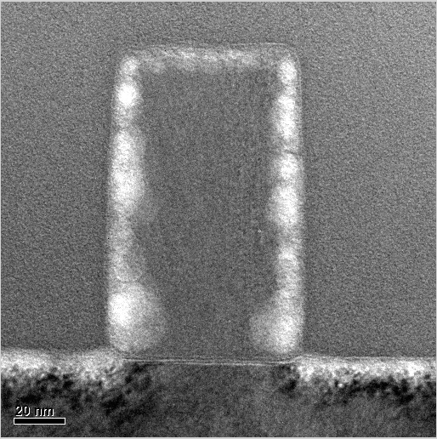
Top CD
Poly
Height
Middle CD
(a) Before Alignment
(b) After Alignment
Sidewall
Angle
Bottom CD

Slide 2
Gate Etch Plan
Alignment
Raw PLS Prediction/ Simplified PLS prediciton
MW PLS
MW-TPLS
GSMMS PLS
Case Study Comparison

Slide 3
Metal Etch Plan
Data Set Description
Narrow down variable selection
Relevant Variable Identification and Contribution Study
Final Prediction Results

Slide 4
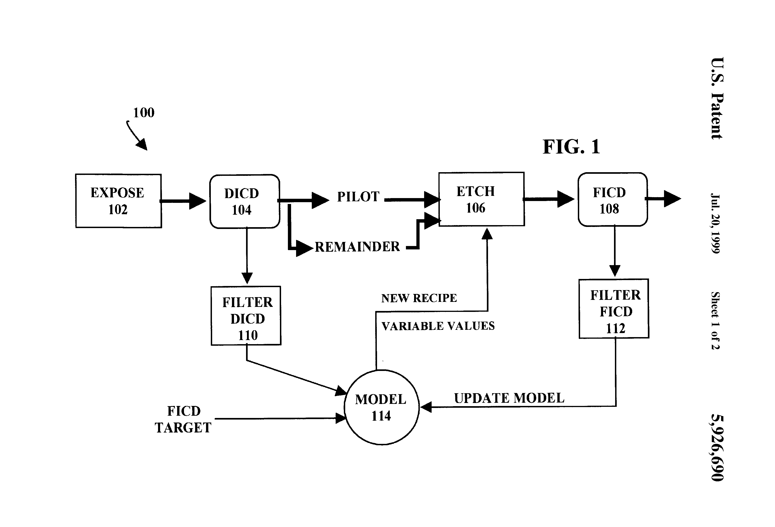

Slide 8
Controller Performance Assessment
Simulate a EWMA process first
Simulate a case with gain drift in addition to process drift..
Simulate a case with process drifts
200 samples normal with drifts
200 samples with process gain mismatch
200 samples return to normal

Slide 9
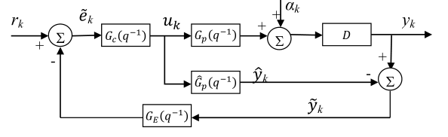
R2R control diagram
Set-point
Control law
Real Process
Time delay
Model
Model-Plant Error
G_{d}(q⁻¹)
∑
G_{c}(q⁻¹)
G_{p}(q⁻¹)
∑
D
G_{m}(q⁻¹)
∑
G_{e}(q⁻¹)

Slide 10
R2R control application
Review existing methods
Show VM assisted strategy
Model mismatch index, residual autocorrelation index
Plots:
Simulated cases, 1, mismatch, 2, bad tuning, 3. lots of delays
Contour plots (axis: 1, plant model, 2. tuning factor, values: output variance, performance index)

