Slide 1
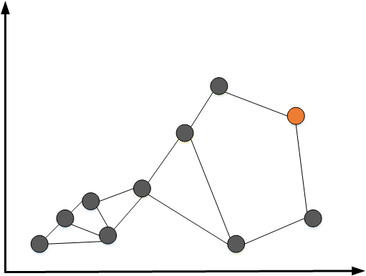
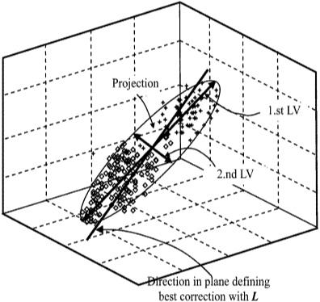
Clustering, Density Estimation, Validity Function, etc.
Training Data
Local Modeling
Model 1
Model 2
….
Model N
N is fixed after training
3
1
Input space coordinate 2
4
7
6
9
5
2
8
10
Input space coordinate 1

Slide 2
Feature Input
GSOM
Layer
Find Best Neighborhood
Update
GSOM
Or
Local Models
PLS 1
PLS 2
PLS 2
PLS M
…
Combining Prediction
Predicted Output

Slide 3
Dis=1
m
Initialize GSOM
Input space coordinate 2
Dis=2
Find best matching units (BMUs)
Dis=4
Dis=3
Dis=5
Dis=1
I. Train local models and calculate fitting error
Dis=4
Dis=6
Dis=2
II. Update GSOM network
Input space coordinate 1
III. Evaluate global error and adjust GSOM net size
Repeat Until Convergence

Slide 4
data belonging
to m’
Node m
Node m’
Primary neighbor

Slide 5
(1)
(2)
(3)
Node p Node q New node New connection

Slide 6
Process
−
+
Decisions
GSOM Model
Region, neighborhood, …
Process
GSOM

Slide 7
New process data pair(X,y)
Convert incoming data into GSOM features
Find best matching units (BMUs) and make prediction
Check for node growth criteria
Perform RPLS or RPCA on BMU node
Update EWMA filtered node error
If
BMUs change
Update node location
<Complete>

Slide 8
Is the BMU node alarming?
Yes
No
Is the BMU node a normal node?
Any neighbor not alarming?
Normal
Faulty
Yes
No
Is there any neighbor not alarming
Is there any neighbor not alarming?
Is that node faulty or normal?
Yes
Is neighbor a normal node?
No
Is neighbor a faulty node?
No
Normal
Faulty
Yes
No
No
Yes
<Normal>
<Fault>
<Fault>
<Normal>
<Fault>
<Fault>
<Inconclusive>
<Normal>
<Normal>

