Slide 1

Reactive Neutral Species
(Isotropic)
Ionic Species
+
Charging
+ + + +
+
+
Mask Erosion
Mask
Chemical
Etching
Film
Undercutting
Side-wall Inhibition
Trenching
Ion-Enhanced Etching
Physical Etching

Slide 2
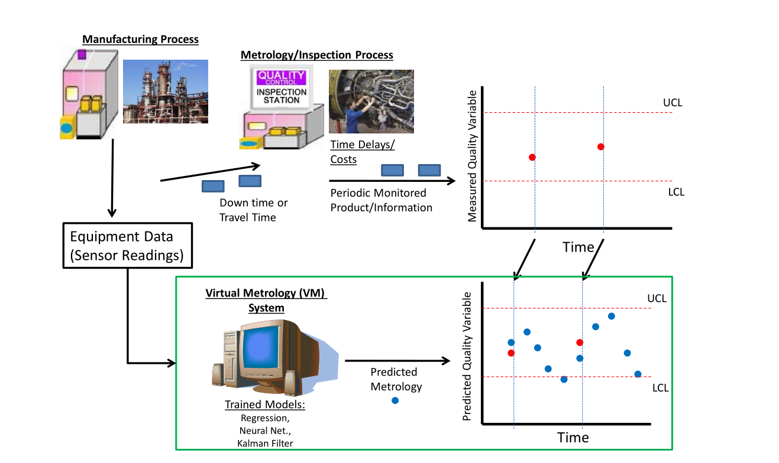

Slide 3
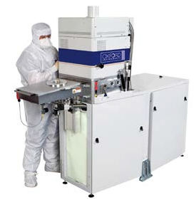
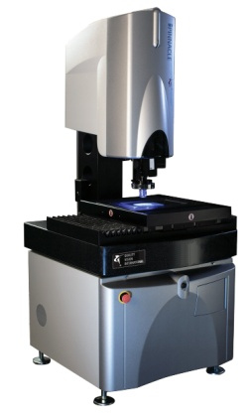


Batch Process
Quality Measurement / Inspection
Measurement
delay & costs
Quality
Sampled or
Periodic monitor
Samples
Virtual Metrology
Equipment Data
Sensor Reading
MLR
PLS regression
Neural networks
SVM or GSMMS
Quality
Instantaneous
Samples

Slide 4

RF power input
Electrode
Matching Network
Plasma
Plasma
sheaths
RF Generator
Electrode
Gas Inlet
(Ar, CF₄, O₂)
Ground
Gas Outlet
Pump

Slide 5
C
P
E
X
K
P
P
=
+
G
J
B
N
M
N
I
A
M
N
M

Slide 6
Offline
Process scope definition and data extraction
Trajectory alignment, time synchronization
Variable selection, feature selection, summary statistics
Model parameter estimation
No
Good model?
Process knowledge
Yes
Online
Validation and deployment
Predictor quality monitoring and maintenance

