Slide 1
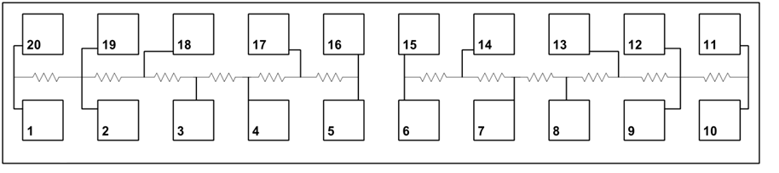
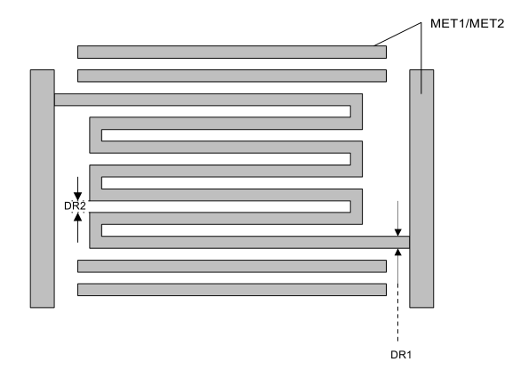

Slide 2
I. Manual screening
Engineering judgment
Process Knowledge
If unsatisfactory
II. Unsupervised screening
Trajectory similarity
Clustering
III. Modeling and statistical analysis
Based on output correlation
IV. Model refinement and validation
Refine model and isolate variable

Slide 4
IV. 2nd stage PLS model
Results
The wafer to wafer variations are not very well captured
but lot-to-lot variations are being predicted

Slide 7
Model Refinement: Dynamic PLS model
Results
Includes lagged values of y_{k-1}, y_{k-2} into the X matrix
Blue line – prediction
Circles – measurements
Colored by lot ID
R²_{corr} = 0.9258
Normalized R_{s}
R²_{test} = 0.9020
Normalized R_{s}
Wafer Samples

Slide 8
Model Refinement – Time Series Residual
Results
an ARMA(1,1) time series model was found to be sufficient
R²_{train} = 0.9136
Normalized R_{s}
Blue line – prediction
Circles – measurements
Colored by lot ID
Normalized R_{s}
R²_{test} = 0.8370
Wafer Samples

Slide 9
Score plot of the reduced model
Results
The testing data (shaded squares) are within the valid operating regime
Colored by device ID

Slide 10
Relevant samples from batch trajectory
Results
Notes:
Most of the signals do not show significant variation during the time range of interest
Summarize by mean, then successively add other statistical moments to see if they improve the model performance

Slide 11
Models using summary data
Results
 | Number of Parameters | Model Description | R² training | R² testing
1 | 36 | Raw trace + lagged y | 0.9258 | 0.9020
2 | 8 | Mean | 0.6737 | 0.6903
3 | 16 | Mean + std | 0.7202 | -0.5774
4 | 16 | Mean + max | 0.6841 | 0.6801
5 | 16 | Mean + sum (integral) | 0.6737 | 0.6903
6 | 16 | Mean + derivative | 0.6882 | 0. 5880
7 | 10 | Mean + lagged y | 0.9231 | 0.9138
Blue line – prediction
Circles – measurements
Colored by lot ID

Slide 12
Appendices
This list of variables are manually screened from a list of 100 signals in FabGuard. Subsequent screening of variables are based on data based methods
Ar Flow (sccm) | ChuckESCCurrentMonitor2Reading (uAmp) | N2 Flow (sccm)
BiasMatchSeriesCapPositionAIReading (count) | ChuckESCTotalVoltageReading (V) | OESB1Value
BiasMatchShuntCapPositionAIReading (count) | ChuckHeBacksidePressureReading (torr) | PreviousStepElapsedProcessTime (s)
BiasRFCurrentProbeAIReading (amp) | ChuckRFVoltageProbeAIReading (V) | ProcessManometerAdjustedPressure
BiasRFGenForwardPowerAIReading (watt) | Cl2 Flow (sccm) | TCPMatchC1CapPositionAIReading (count)
BiasRFGenReflectedPowerAIReading (watt) | CurrentStepNumber | TCPMatchC3CapPositionAIReading (count)
BiasRFVoltageProbeAIReading (V) | ForelinePressureManometer | TCPRFGenReflectedPowerAIReading (watt)
ChuckESCBiasVoltageReading (V) | HeInnerZoneBacksideFlow | TemperatureControlESCTargetFlowSensorReading (GPM)
ChuckESCCurrentMonitor1Reading (uAmp) | Manometer | ThrottleValvePosition

Slide 13
Appendix: Variables that are not relevant to the process
Appendices
Ar Flow (sccm); SVID21800731'
BiasMatchSeriesCapPositionAIReading (count); SVID21800070'
BiasRFCurrentProbeAIReading (amp); SVID21800678'
BiasRFGenForwardPowerAIReading (watt); SVID21800092'
BiasRFGenReflectedPowerAIReading (watt); SVID21800097'
BiasRFVoltageProbeAIReading (V); SVID21800679'
ChuckESCTotalVoltageReading (V); SVID21800229'
ChuckHeBacksidePressureReading (torr); SVID21800237'
ChuckRFVoltageProbeAIReading (V); SVID21800961'
Cl2 Flow (sccm); SVID21800701'
CurrentStepNumber; SVID21800003 [Tool''s Step]'
ForelinePressureManometer; SVID21800883'
HeInnerZoneBacksideFlow; SVID21800236'
Manometer; SVID21800873'
PreviousStepElapsedProcessTime (s); SVID21802475'
ProcessManometerAdjustedPressure; SVID21800870'
TCPMatchC1CapPositionAIReading (count); SVID21800186'
TCPMatchC3CapPositionAIReading (count); SVID21800197'
TCPRFGenReflectedPowerAIReading (watt); SVID21800217'
TemperatureControlESCTargetFlowSensorReading (GPM); SVID21800894'
ThrottleValvePosition; SVID21800437'

Slide 14
Appendix: Variables removed due to poor excitation (no variation)
Appendices
37 – Bias ESC capacitance
35 – Nitrogen purge flow
52 – Dry Pump Temperature
53 – Dry Pump motor temperature
54 – Dry Pump oil status
55 – Dry Pump Phase Current
56 – Dry Pump Power
66 – Inverter Current
63 – Hours on Process
68 – Inverter speed
69 – Inverter Torque
71 – Booster Pump Motor Temp
73 – Booster Pump Phase Current
74 – Booster Pump Power ( meaningless oscillations)
80 – Cycles
82 – Pump system cycles
86 - Tool: TCPRFGenForwardPowerAIReading (watt); SVID21800212
88 - TemperatureControlChamberAverageTemperatureReading
89 - TemperatureControlESCTargetCurrentSetpoint
91 - TemperatureControlESCTargetTemperatureSensorReading

Slide 15
Appendix: traces removed due to lack of data (incomplete or over 50% missing)
Appendices
Shaft-seals Purge Pressure (kPa)
Mechanical Booster Pump Oil Status
Latch: N2 Setpoint; SVID21800820
Sig: N2 Flow Deviation
Sig: Previous Step Number
Sig: Run Time
Sig: TCP Power Deviation
Sig: TCP Reflected Power Ratio
Tool Bin Data Age
Tool Bin Polling Latency
Tool: Active Gauge Pressure (Pa); EdwardsD372:7,53
Tool: Analog Water Flow (ml/s); EdwardsD372:7,52
Tool: Electrical Supply Voltage (V); EdwardsD372:7,2
Tool: Exhaust Temperature (K); EdwardsD372:7,56
Tool: Final Stage Purge Nitrogen Flow (ml/s); EdwardsD372:7,32
Tool: Imbalance in Dry Pump Phase Current (%); EdwardsD372:7,6
Tool: Imbalance in Mechanical Booster Pump Phase Current (%); EdwardsD372:7,10
Tool: Inverter Power (kW); EdwardsD372:7,173

