Slide 1

Safe Use of Opioids - Concurrent Prescribing
Bolu Oluwalade

Slide 2
Background
Synthetic Opioid overdose is the leading cause of Drug-involved Overdose death in the USA. (CDC, 2023)
Prescription of multiple and concurrent unique opioids or an opioid and benzodiazepine are medically necessary.
CMS eCQM (Electronic Quality Improvement Measure) Safe Use of Opioids - Concurrent Prescribing, monitors the proportion of inpatient hospitalizations for patients 18 years of age and older prescribed, or continued on, two or more opioids or an opioid and benzodiazepine concurrently at discharge.
Notes:
References:
Centers for Disease Control and Prevention. (2023, May 8). Understanding drug overdoses and deaths. Centers for Disease Control and Prevention. https://www.cdc.gov/drugoverdose/epidemic/index.html#:~:text=The%20drug%20overdose%20epidemic%20continues,of%20overdose%20deaths%20involve%20opioids.

Slide 3
Quality Measures and Control Charts
Quality measures are tools that can help us measure or quantify healthcare processes, outcomes, patient satisfactions.
The control chart is used to study how a process changes over time. Data are plotted in time order. A control chart always has a central line for the average, an upper line for the upper control limit, and a lower line for the lower control limit.
In Healthcare, Control charts are used to gain critical insight into opportunities, understand the efficacy of initiatives, and sustain improved processes over time.
Control Charts are leveraged in Plan-Do-Study-Act Cycles

Slide 4
Data Source and Cohort
Inpatient hospitalizations less than or equal to 120 days at the end of the measurement period
The patient is 18 years of age and older at the start of the encounter
Prescribed one or more new or continuing opioids or benzodiazepines at discharge
Admitted between the Years 2112 and 2132
Exclude patients who expire during the hospital stay
MIMIC-III is a large, freely-available database
Deidentified health-related data
Over forty thousand Critical Care Units Patients at Beth Israel Deaconess Medical Center between 2001 and 2012.
Available on Google Cloud Platform (GCP) and Amazon Web Services (AWS)
Notes:
References:
Johnson, A., Pollard, T., & Mark, R. (2016). MIMIC-III Clinical Database (version 1.4). PhysioNet. https://doi.org/10.13026/C2XW26.

Slide 5


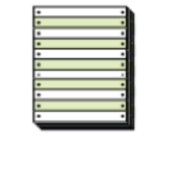

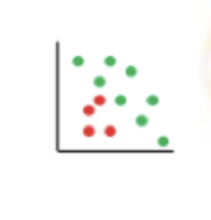

Analytic Process
Transform Data and Cohort Development
(SQL, DBT)
Analyze
the
Data
(R)
Develop and Deploy
Dashboard
(Shiny, shiny.io)
Identify Clinical
Problem
Identify
Data
Source
Clean the
Data
(SQL)
Preprocessing
Analysis
Post Processing

Slide 6
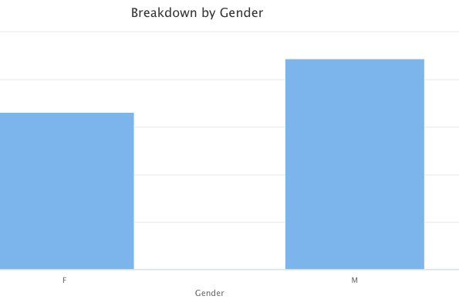
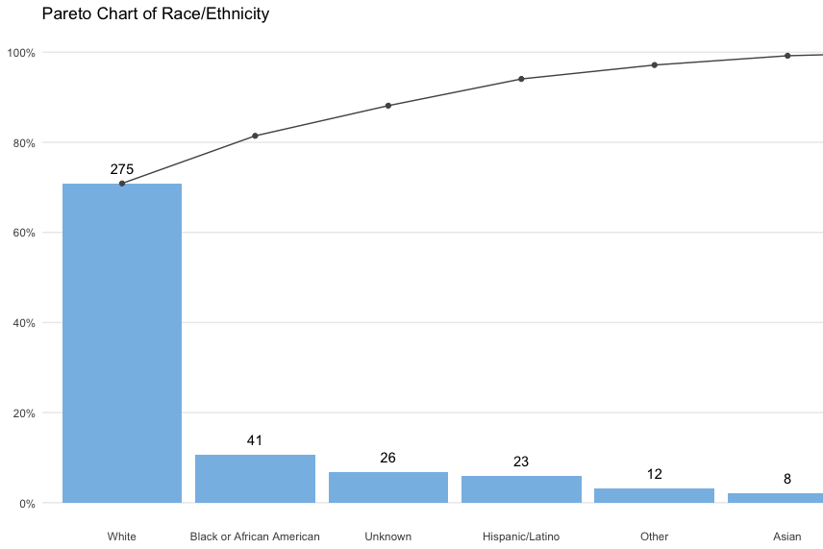
Demographics

Slide 7
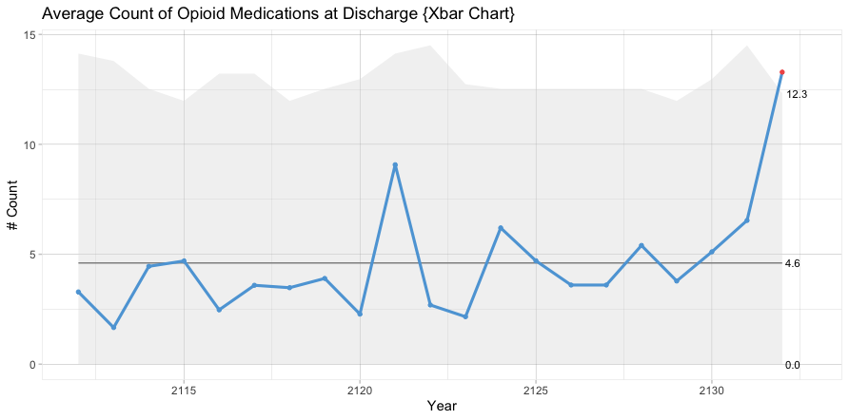
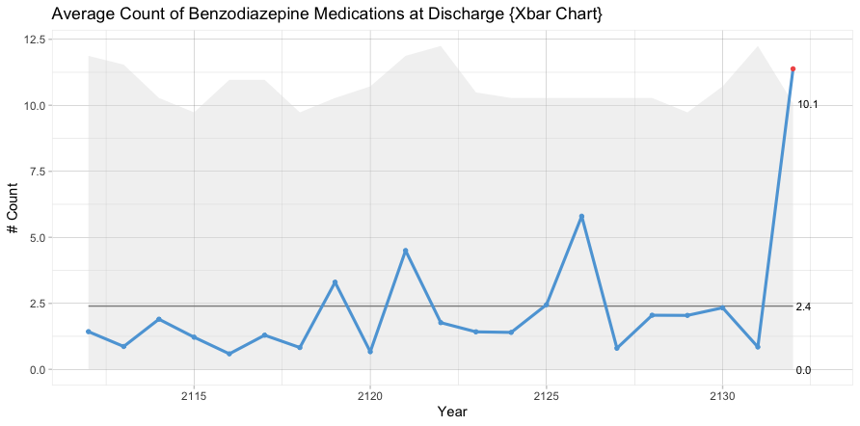
Process Measures
X bar chart: The average yearly change in the number of opioids and benzodiazepines at discharge. The control limits on the X bar chart are the sample’s mean and standard Deviation
P chart: control chart for proportions. It is used to analyze the proportions of patients who were discharged with two or more opioids or an opioid and benzodiazepine concurrently

Slide 8
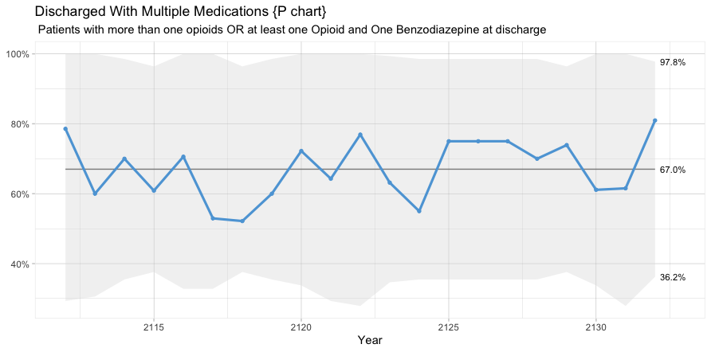

Slide 9
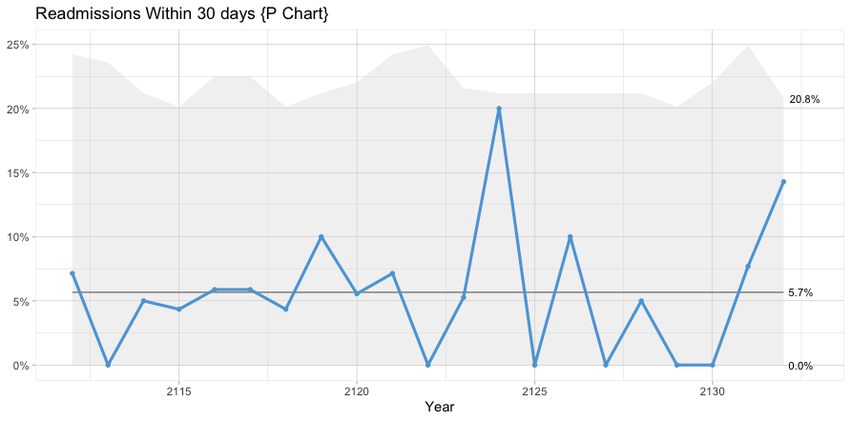
Outcome Measures

Slide 10
Conclusion
eCQMs are used to monitor clinical processes and outcomes
67 percent of patients in the cohort were discharged with multiple opioids OR an opioid and benzodiazepine.
A Quality Improvement project can be initiated to reduce the rate of Opioid and benzodiazepine at discharge.

