Slide 1

IMPLEMENTING IOE
Week 10
Assist. Prof. Rassim Suliyev - SDU 2017

Slide 2
Ethernet and Networking
Share your sensor data
Take control of your Arduino’s actions
Communicate with a broader world over Ethernet and wireless
Use Arduino with the Internet
Build and use web clients and servers
Use the most common Internet communication protocols

Slide 3
Ethernet and Networking
Internet allows a client (e.g. your web browser) request information from a server
Arduino can be
  Internet client
    retrieves information from a service
  Internet server
    provides information to clients using Internet protocols
  Can act as a web server
    creates pages for viewing in web browsers

Slide 4
Some of the key concepts
  Ethernet - Low-level signaling layer
  TCP and IP - core Internet protocols built above Ethernet
Local IP addresses
Ethernet
  Low-level signaling layer
    provide basic physical message-passing capability
  Source and destination addresses for messages are identified by a Media Access Control (MAC) address
  Arduino sketch must define unique MAC address value

Slide 5
TCP and IP
Transmission Control Protocol (TCP) Internet Protocol (IP)
provide a message-passing capability that operates over the global Internet
TCP/IP messages are delivered through unique IP addresses for the sender and receiver
a server on the Internet must be uniquely identified
server has an address which consists of four bytes usually represented with dots separating the bytes
  (e.g., 64.233.187.64 is an IP address used by Google).

Slide 6
Local IP addresses
if more than one device connected to the Internet
use a broadband router or gateway
each device uses a local IP address
provided by router
the local address is created using a Dynamic Host Configuration Protocol (DHCP) service in router
the Arduino Ethernet library includes a DHCP service

Slide 7
Web requests
web browser and the resultant responses use Hypertext Transfer Protocol (HTTP) messages
Web pages are usually formatted using Hypertext Markup Language (HTML)
it’s not essential to use HTML if you are making an Arduino web server
but the web pages you serve can use this capability
extracting data from a web page is a hard work
stream parsing functionality simplifies this work

Slide 8
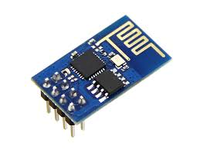
ESP8266 WiFi Module
Low cost WiFi module $2-$5
Can be controlled via serial port
Can act as a standalone device
Features:
  802.11 b/g/n protocol
  Wi-Fi Direct (P2P), soft-AP
  Integrated TCP/IP protocol stack

Slide 9
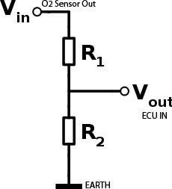
Hardware Connections
ESP8266 requires 3.3V power
  do not power it with 5 volts!
Needs to communicate via serial at 3.3V
  does not have 5V tolerant inputs
Need level conversion to communicate with a 5V microcontroller
If Vin = 5V, R1=1K, R2=2K
Vout = (2K/(2K+1K))*5V = 3.3V

Slide 10
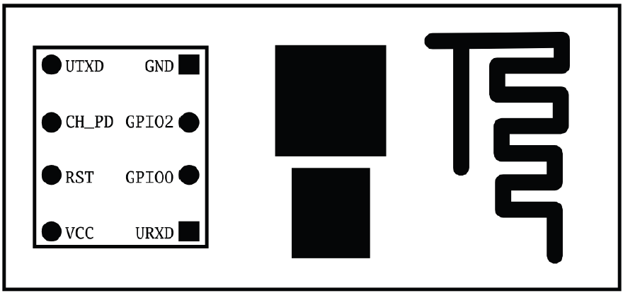
Hardware Connections
UTXD – Data Transmit line
URXD – Data Receive line
CH_PD – Chip Enable (1-ON, 0-OFF)
RST – Reset (1-Stable, 0-Reset)
GPIO – General purpose input/output pins

Slide 11
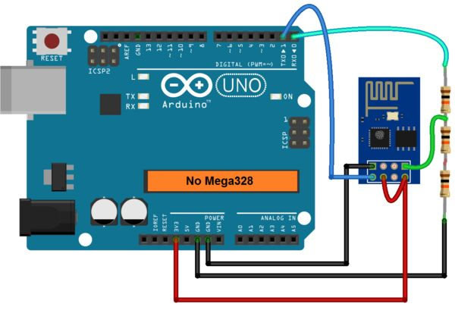

Hardware Connections

Slide 12
Using Arduino IDE Serial Monitor
Plug in the WiFi module
Choose the correct serial port
Open the Serial Monitor
Ensure that Both NL & CR is selected in the line ending pop-up menu at the bottom of the serial monitor
For the default firmware version, ensure the communication speed is set to 115200 baud
For later versions or if it has been modified baud may be different

Slide 13
First Commands
Send “AT” command, you will receive “OK”
  If you don’t get this response check:
    Connections. Try swapping RX & TX (blue LED should flash)
  Correct baudrate – should be 115200 (by default)
  Correct line endings–should be NL & CR
Ensure the module is in a known state by issuing “AT+RST” command
Check the firmware version by “AT+GMR”
Change baud rate by “AT+CIOBAUD=9600”
  Supported: 9600, 19200, 38400, 74880, 115200, 230400, 460800, 921600

Slide 14
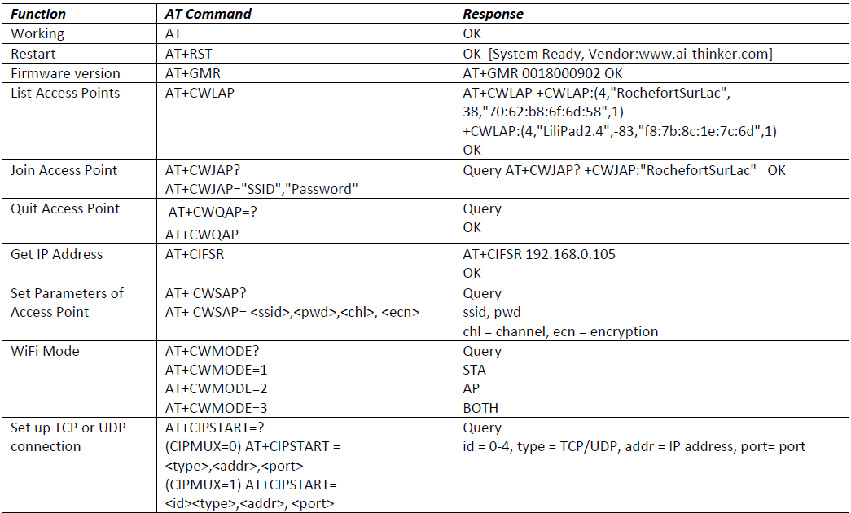
AT commands

Slide 15
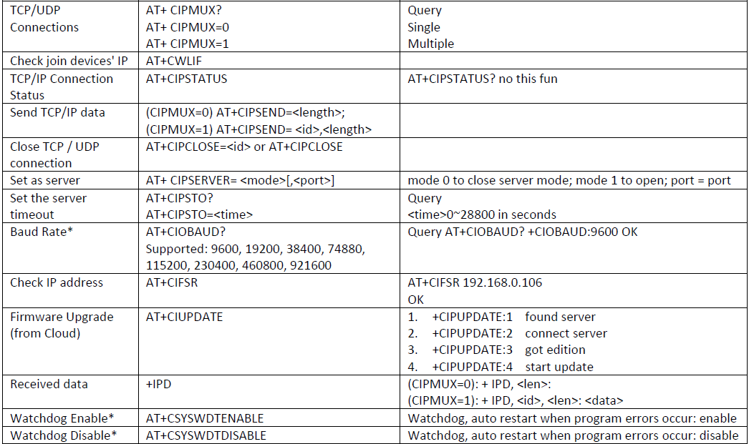
AT commands

Slide 16
WIFI modes
AT+CWMODE? - Show current mode
AT+CWMODE=1 – switch to station mode (STA)
AT+CWMODE=2 – switch to access point mode (AP)
AT+CWMODE=3 – switch to both STA+AP
Station mode – device works as a slave, connects to access points
Access point mode – device works as master and serves station devices connected to it

Slide 17
Configuring STA mode
AT+RST #reset device
AT+CWMODE=1 #set to STA mode
AT+CWLAP #list visible APs
AT+CWJAP=”SSID", ”PASS" #connect to AP
AT+CIFSR #get current IP address
AT+CWQAP #quit AP
AT+CIPSTAMAC? #get mac address of STA
AT+CIPSTA? #get ip address of STA
AT+CIPSTA=“IP”,”GW”,”MSK” #set ip of STA
AT+CWDHCP=mode,en #enable or disable DHCP

Slide 18
Configuring AP mode
AT+RST #reset device
AT+CWMODE=2 #set to AP mode
AT+CWLIF #list connected clients
AT+CWSAP? #get configuration of AP
AT+CWSAP=“ssid”,”pwd”,ch,enc #set configuration of AP
AT+CWDHCP=mode,en #enable or disable DHCP
AT+CIPSTAMAC? #get mac address of STA
AT+CIPSTA? #get IP address of STA
AT+CIPSTA=“IP”,”GW”,”MSK” #set IP address of STA

Slide 19
TCP/UDP connections
------------TCP CLIENT------------
AT+RST
AT+CWMODE=1
AT+CWDHCP=1,1
AT+CWJAP="->RASMUS<-",""
AT+CIFSR
AT+CIPMUX=0
AT+CIPSTART="TCP","192.168.43.1",2222
AT+CIPSEND=7
hello
AT+CIPCLOSE
---------------------------------------------------------
AT+CIPSTART="TCP","instructor.sdu.edu.kz",80
AT+CIPSEND=79
GET /~rasmus/ HTTP/1.1
Host: instructor.sdu.edu.kz
Connection: Keep-Alive
AT+CIPCLOSE
------------TCP SERVER------------
AT+RST
AT+CWMODE=1
AT+CWDHCP=1,1
AT+CWJAP="->RASMUS<-",""
AT+CIPMUX=1
AT+CIPSERVER=1,2222
AT+CIPSEND=0,7
hello
AT+CIPCLOSE=0
------------UDP CONNECTION------------
AT+RST
AT+CWMODE=1
AT+CWDHCP=1,1
AT+CWJAP="->RASMUS<-",""
AT+CIFSR
AT+CIPMUX=0
AT+CIPSTART="UDP","192.168.43.1",8080,8080
AT+CIPSEND=7
hello
AT+CIPCLOSE

Slide 20
Wifi Talk
#include <SoftwareSerial.h>
SoftwareSerial wifiSerial(10, 9); // TX, RX
void setup(){
Serial.begin(9600);
wifiSerial.begin(9600); //can't be faster than 115200
wifiSerial.setTimeout(5000);
}
void loop(){
while(Serial.available()){
wifiSerial.print((char)Serial.read());
}
while(wifiSerial.available()){
Serial.print((char)wifiSerial.read());
}
}

Slide 21
Software Serial
Arduino hardware has built-in support for serial communication on pins 0 and 1
SoftwareSerial library allow serial communication on other digital pins of the Arduino
Speed up to 115200 bps
SoftwareSerial(rxPin, txPin) – constructor
available() – returns true if bytes received
begin(baud) – set communication speed to baud
read() – returns received byte
print(data), println(data) – send the data in ascii form
write(data) - send data as raw bytes

Slide 22
Connecting to web Server
#include <SoftwareSerial.h>
String SSID = "->RASMUS<-";
String PASS = "";
String DST_IP = "instructor.sdu.edu.kz";
SoftwareSerial wifiSerial(10, 9); // RX, TX
void setup()
{
// Open serial communications and wait for port to open:
Serial.begin(9600);
Serial.println("ESP8266 Demo");
wifiSerial.begin(9600);
wifiSerial.setTimeout(5000);
delay(1000);
//test if the module is ready
wifiSerial.println("AT+RST");
String responce = "";
for(int i=0; i<100; i++){
while(wifiSerial.available())
responce += (char)wifiSerial.read();
delay(10);
}
if(responce.indexOf("ready")>=0){
Serial.println("Module is Ready!");
}else{
Serial.println("Module have no response.");
while (1);
}
delay(1000);
//connect to the wifi
boolean connected = false;
for (int i = 0; i < 5; i++){
if (connectWiFi()){
connected = true;
break;
}
}
if (!connected) {
Serial.println("Error connecting to WIFI!");
while (1);
}
delay(3000);
wifiSerial.println("AT+CWDHCP=1,1");
delay(2000);
wifiSerial.println("AT+CIFSR");
delay(1000);
//print the ip addr
Serial.println("ip address:");
for(int i=0; i < 100; i++){
while (wifiSerial.available())
Serial.write(wifiSerial.read());
delay(10);
}
//set the single connection mode
wifiSerial.println("AT+CIPMUX=0");
delay(1000);
}
void loop(){
String cmd = "AT+CIPSTART=\"TCP\",\"";
cmd += DST_IP;
cmd += "\",80";
wifiSerial.println(cmd);
Serial.println(cmd);
if (wifiSerial.find("Error")) return;
cmd = "GET /~rasmus/ HTTP/1.1\r\nHost: "+DST_IP+"\r\nConnection: Close\r\n\r\n";
wifiSerial.print("AT+CIPSEND=");
wifiSerial.println(cmd.length());
delay(5000);
if (wifiSerial.find(">")) {
Serial.print(">");
} else{
wifiSerial.println("AT+CIPCLOSE");
Serial.println("connect timeout");
delay(1000);
return;
}
Serial.print(cmd);
wifiSerial.print(cmd);
for(int i=0; i<100; i++){
while (wifiSerial.available()){
char c = wifiSerial.read();
Serial.write(c);
if (c == '\r') Serial.print('\n');
}
delay(50);
}
Serial.println("====REPEAT AFTER 10 SECONDS====");
delay(10000);
}
boolean connectWiFi(){
wifiSerial.println("AT+CWMODE=1");
delay(100);
String cmd = "AT+CWJAP=\"";
cmd += SSID;
cmd += "\",\"";
cmd += PASS;
cmd += "\"";
Serial.println(cmd);
wifiSerial.println(cmd);
delay(3000);
if (wifiSerial.find("OK")){
Serial.println("OK, Connected to WiFi.");
return true;
} else{
Serial.println("Can not connect to the WiFi.");
return false;
}
}

Slide 23
Creating a web Server
#include<SoftwareSerial.h>
#define DEBUG true
SoftwareSerial esp8266(10, 9);
void setup()
{
Serial.begin(9600); ///////For Serial monitor
esp8266.begin(9600); ///////ESP Baud rate
pinMode(11,OUTPUT); /////used if connecting a LED to pin 11
digitalWrite(11,LOW);
sendData("AT+RST\r\n",2000,DEBUG); // reset module
sendData("AT+CWMODE=2\r\n",1000,DEBUG); // configure as access point
sendData("AT+CIFSR\r\n",1000,DEBUG); // get ip address
sendData("AT+CIPMUX=1\r\n",1000,DEBUG); // configure for multiple connections
sendData("AT+CIPSERVER=1,80\r\n",1000,DEBUG); // turn on server on port 80
}
float sensetemp() ///////function to sense temperature.
{
int val = analogRead(A0);
float mv = ( val/1024.0)*5000;
float celcius = mv/10;
return(celcius);
}
int connectionId;
void loop()
{
if(esp8266.available())
{
/////////////////////Recieving from web browser to toggle led
if(esp8266.find("+IPD,"))
{
delay(300);
connectionId = esp8266.read()-48;
if(esp8266.find("pin="))
{
Serial.println("recieving data from web browser");
int pinNumber = (esp8266.read()-48)*10;
pinNumber += (esp8266.read()-48);
digitalWrite(pinNumber, !digitalRead(pinNumber));
}
/////////////////////Sending data to browser
else
{
String webpage = "<h1>Hello World</h1>";
espsend(webpage);
}
if(sensetemp() != 0)
{
String add1="<h4>Temperature=</h4>";
String two = String(sensetemp(), 3);
add1+= two;
add1+="&#x2103"; //////////Hex code for degree celcius
espsend(add1);
}
else
{
String c="sensor is not conneted";
espsend(c);
}
String closeCommand = "AT+CIPCLOSE="; ////////////////close the socket connection////esp command
closeCommand+=connectionId; // append connection id
closeCommand+="\r\n";
sendData(closeCommand,3000,DEBUG);
}
}
}
//////////////////////////////sends data from ESP to webpage///////////////////////////
void espsend(String d)
{
String cipSend = " AT+CIPSEND=";
cipSend += connectionId;
cipSend += ",";
cipSend +=d.length();
cipSend +="\r\n";
sendData(cipSend,1000,DEBUG);
sendData(d,1000,DEBUG);
}
//////////////gets the data from esp and displays in serial monitor///////////////////////
String sendData(String command, const int timeout, boolean debug)
{
String response = "";
esp8266.print(command);
long int time = millis();
while( (time+timeout) > millis())
{
while(esp8266.available())
{
char c = esp8266.read(); // read the next character.
response+=c;
}
}
if(debug)
{
Serial.print(response); //displays the esp response messages in arduino Serial monitor
}
return response;
}

