Slide 1

IMPLEMENTING IOE
Week 12
Assist. Prof. Rassim Suliyev - SDU 2017

Slide 2
Audio Output
Produce sound through an output device such as a speaker
Sound is produced by vibrating air
A sound has a distinctive pitch if the vibration
repeats regularly
The Arduino can create sound by driving a loudspeaker or Piezo device
Converts electronic vibrations into speaker pulses that vibrate the air

Slide 3
Sound Characteristics
The pitch (frequency) of the sound is determined by the time it takes to pulse the speaker in and out
The shorter the amount of time, the higher the frequency
The unit of frequency is measured in hertz
Number of times the signal goes through its repeating cycle in one second
The range of human hearing is from around 20 hertz (Hz) up to 20,000 hertz

Slide 4
Producing Sound
Arduino software includes a tone function which uses
hardware timers
Arduino UNO board can produce only one tone at a time
Tone uses timer2 which is also used by analogWrite on pins 9 and 10
Simultaneous use of both is impossible
The sound that can be produced by pulsing a speaker is limited and does not sound very musical

Slide 5
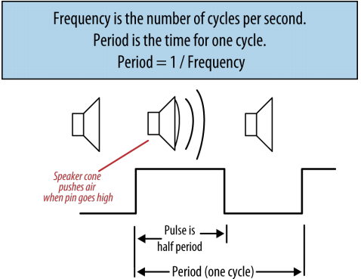
Producing Sound
The output is a square wave
Sounds harsh and more like an antique computer
It’s difficult for Arduino to produce more musically complex sounds without external hardware
  shield that play back audio files from a memory card
  send Musical Instrument Digital Interface (MIDI) messages to a MIDI device

Slide 6
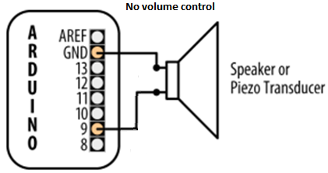
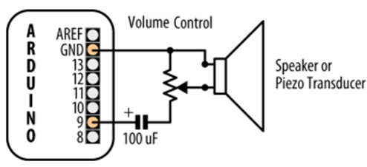
Connecting Small speaker or Piezo
Volume control - variable resistor (200 ~ 500 ohms)
Capacitor - 100 microfarad electrolyte
Speake is not polarized but Piezo is
Alternatively, you can connect the output to an external audio amplifier

Slide 7
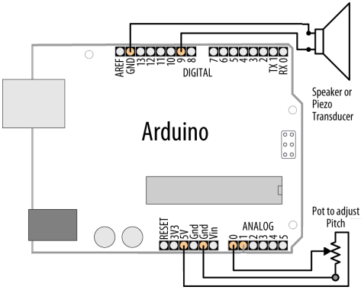
Playing Tones
tone(pin, freq[, dur])
pin: where to generate the tone
freq: frequency of the tone in HZ
dur: the duration of the tone in milliseconds
const int speakerPin = 9;
const int pitchPin = 0;
void setup(){
}
void loop(){
//read the sensor
int sensorReading = analogRead(pitchPin);
// convert the value to frequency 100Hz to 5kHz
int frequency = map(sensorReading, 0, 1023, 100,5000);
int duration = 250; // how long the tone lasts
tone(speakerPin, frequency, duration); // play the tone
}

Slide 8
Playing a Simple Melody
const int speakerPin = 9; // connect speaker to pin 9
char noteNames[] = {'C','D','E','F','G','a','b'};
unsigned int frequencies[] = {262,294,330,349,392,440,494};
const byte noteCount = sizeof(noteNames); // number of notes (7 here)
char score[] = "CCGGaaGFFEEDDC GGFFEEDGGFFEED CCGGaaGFFEEDDC "; //space is a rest
byte beats[] = {1,1,1,1,1,1,2,1,1,1,1,1,1,1,1, 1,1,1,1,1,1,2,1,1,1,1,1,1,1,1,
1,1,1,1,1,1,2,1,1,1,1,1,1,1,1};
const byte scoreLen = sizeof(score)-1; // the number of notes in the score
void setup(){}
void loop(){
for (int i = 0; i < scoreLen; i++){
int duration = 333; // each note lasts for a third of a second
playNote(score[i], duration*beats[i]); // play the note
}
delay(2000); // wait two seconds before repeating the song
}
void playNote(char note, int duration){ //play the tone corresponding to the note
for (int i = 0; i < noteCount; i++){
// try and find a match for the noteName to get the index to the note
if (noteNames[i] == note) // find a matching note name in the array
tone(speakerPin, frequencies[i], duration); // play the note
}
delay(duration); // if there is no match then the note is a rest, so just delay
}

Slide 9

Playing PCM Audio

Slide 10
Using Time and Dates
delay(duration) - pauses the execution of your sketch for the duration
delayMicroseconds() to delay short periods
millis() can be used if need to perform other tasks within the delay period
if (millis() - previousMillis > interval){
// save the last time you blinked the LED
previousMillis = millis();
// if the LED is off turn it on and vice versa:
if (ledState == LOW) ledState = HIGH;
else ledState = LOW;
// set the LED with the ledState of the variable:
digitalWrite(ledPin, ledState);
}

Slide 11
Time.h library
#include <Time.h>
Time library enables you to keep track of the date and time
It allows a sketch to get the time and date as
  second, minute, hour, day, month and year
Arduino boards use a quartz crystal for timing
  accurate to a couple of seconds per day
  it does not have a battery to remember the time
  time will restart from 0 each time a sketch starts

Slide 12
<Time.h> Functional Overview
hour(); - returns the system hour now (0-23)
minute(); - returns the minute now (0-59)
second(); - returns the second now (0-59)
day(); - returns the day now (1-31)
weekday(); - returns the weekday now (1-7)
  Sunday is day 1
month(); - returns the month now (1-12)
year(); - returns the year now (ex:2009)
All functions can take an optional parameter for the time, Ex:
  hour(t); - returns the hour for the given time t
  year(t); - returns the year for the given time t

Slide 13
<Time.h> Functional Overview
hourFormat12(); - returns the hour now in 12 hour format
isAM(); - returns true if time now is AM
isPM(); - returns true if time now is PM
now(); - returns the current time as seconds since Jan 1 1970
time_t t = now(); - store the current time in time variable t
setTime(hr,min,sec,day,mnth,yr); - set the system time
  yr is 2 or 4 digit (ex: 2010 or 10 sets year to 2010)
setTime(t); - set the system time to the give time t

Slide 14
Using Arduino as a Clock
#include <Time.h>
void setup(){
Serial.begin(9600);
setTime(15,30,0,26,04,17);
}
void loop(){
digitalClockDisplay();
delay(1000);
}
void digitalClockDisplay(){
printDigits(hour());
Serial.print(":");
printDigits(minute());
Serial.print(":");
printDigits(second());
Serial.print(" ");
printDigits(day());
Serial.print(".");
printDigits(month());
Serial.print(".");
printDigits(year());
Serial.println();
}
void printDigits(int digits){
// prints leading 0
if(digits < 10) Serial.print('0');
Serial.print(digits);
}

Slide 15
TimeAlarms Library
Is a companion to the Time library
Makes it easy to perform tasks at specific times or after specific intervals
Tasks scheduled at a particular time of day are called Alarms
Tasks scheduled after an interval of time has elapsed are called Timers
These tasks can be created to continuously repeat or to occur once only

Slide 16
Creating Alarms
Call a function every day at a particular time
  Alarm.alarmRepeat(hours, minutes, seconds, function);
Call a function every week on a specific day at a particular time
  Alarm.alarmRepeat(dayofweek, hours, minutes, seconds, function);
Call a function once at a particular time
  Alarm.alarmOnce(hours, minutes, seconds, function);
Call a function once, at specific day and time
  Alarm.alarmOnce(dayofweek, hours, minutes, seconds, function);
* dayofweek can be: dowSunday, dowMonday, dowTuesday, dowWednesday, dowThursday, dowFriday, dowSaturday.

Slide 17
Creating Timers
Call function repeatedly at an interval of … seconds
  Alarm.timerRepeat(seconds, function);
Call a function once in … seconds
  Alarm.timerOnce(seconds, function);
Each constructor returns an id for created object
Alarm.disable(id) / Alarm.enable(id) – disable / enable object by its id.
Alarm.free(id) – delete object and recycle its memory

Slide 18
Normal Running Usage
Alarms and Timers are only checks
Their functions called whith Alarm.delay()
Pass 0 argument for minimal delay
Call the Alarm.delay() function instead of the normal delay() function when using the Alarms library
Intervals range from one second to several years
Tasks are scheduled for specific times
If you change the system time the trigger times will not be adjusted

Slide 19
Periodically Call a Function
#include <Time.h>
#include <TimeAlarms.h>
AlarmId id;
void setup() {
Serial.begin(9600);
setTime(15,30,0,26,04,17);
// create the alarms, to trigger at specific times
Alarm.alarmRepeat(15,31,0, DailyAlarm); // 15:30am every day
Alarm.alarmRepeat(dowWednesday,15,30,30,WeeklyAlarm); // 15:30:30 every Wednesday
// create timers, to trigger relative to when they're created
Alarm.timerRepeat(15, Timer1); // timer for every 15 seconds
id = Alarm.timerRepeat(2, Timer2); // timer for every 2 seconds
Alarm.timerOnce(10, OnceOnly); // called once after 10 seconds
}
void loop() {
digitalClockDisplay();
Alarm.delay(1000); // wait one second between clock display
}
// functions to be called when an alarm triggers:
void DailyAlarm() {
Serial.println("Daily Alarm: - Check the mail please!");
}
void WeeklyAlarm() {
Serial.println("Weekly Alarm: - It's IOT lesson today");
}
void Timer1() {
Serial.println("15 second timer");
}
void Timer2() {
Serial.println("2 second timer");
}
void OnceOnly() {
Serial.println("This timer only triggers once, it stops the 2 second timer");
//disable a timer and recycle its memory.
Alarm.free(id);
}
void digitalClockDisplay() {
printDigits(hour());
Serial.print(":");
printDigits(minute());
Serial.print(":");
printDigits(second());
Serial.println();
}
void printDigits(int digits) {
if (digits < 10) Serial.print('0');
Serial.print(digits);
}

Slide 20
I2C and SPI
I2C (Inter-Integrated Circuit) and SPI (Serial Peripheral Interface)
  provide simple ways for digital information to be transferred between sensors and microcontrollers
Choice between I2C and SPI is usually determined by the devices you want to connect
I2C advantage: it only needs two signal connections
I2C disadvantages:
  data rate is slower than SPI
  data can only be traveling in one direction at a time

Slide 21
I2C and SPI
SPI advantages:
  runs at a higher data rate
  has separate input and output connections
  thus, can send and receive at the same time
SPI disadvantage: uses one additional line per device to select the active device
SPI generally used for high data rate applications such as Ethernet and memory cards
I2C is more typically used with sensors that don’t need to send a lot of data

Slide 22
I2C
I2C bus uses two connections called SCL and SDA
  SCL – on analog pin 5 (provides a clock signal)
  SDA – on analog pin 4 (used for transfer of data)
One device on the bus is considered the master
  coordinate the transfer of information between the other attached devices (slaves)
  there must be only one master
  in most cases the Arduino is the master
  controls other chips attached to it

Slide 23
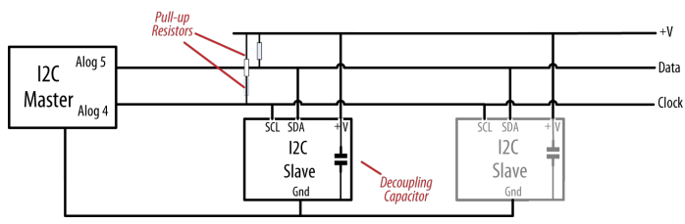
I2C
Devices need a common ground to communicate
Slave devices are identified by their address number
Each slave must have a unique address

Slide 24
I2C
Some I2C devices have a fixed address
Others are configured by setting pins high or low or by sending initialization commands
Arduino uses 7-bit values to specify I2C addresses
  If device uses 8-bit address divide that value by 2 to
  get the correct 7-bit value
I2C and SPI only define how communication takes place between devices
  controlling messages depend on each individual device
  consult the data sheet to determine required commands

Slide 25
Wire.h library for I2C connection
Wire.begin([addr]) - Initiate and join the I2C bus as a master(no addr) or slave(with addr)
Wire.requestFrom(a,n) - Used by the master to request n bytes from a slave device
Wire.beginTransmission(a) - Begin a transmission to the I2C slave device with the given address
Wire.endTransmission() - transmits the bytes that were queued by write()
Wire.available() - Returns the number of bytes available for retrieval with read()

Slide 26
Wire.h library for I2C connection
Wire.write(d) - Writes data from a slave device in response to a request from a master, or queues bytes for transmission from a master
Wire.read() - Reads a transmitted byte
Wire.SetClock(clk) - modifies the clock frequency
Wire.onReceive(f) - Calls function f when a slave device receives message from master
Wire.onRequest(f) – Calls function f when a master requests data from the slave device

Slide 27
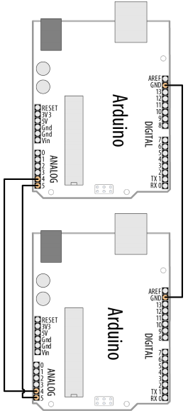
Communicating Using I2C
// I2C MASTER
#include <Wire.h>
void setup(){
Wire.begin();
Serial.begin(9600);
}
void loop() {
while(Serial.available() > 0){
char c = Serial.read();
Wire.beginTransmission(8); // transmit to device #8
Wire.write((char)c); // sends one byte
Wire.endTransmission(); // stop transmitting
}
}
// I2C SLAVE
#include <Wire.h>
void setup() {
Wire.begin(8); // join i2c bus with address #8
Wire.onReceive(receiveEvent); // register event
Serial.begin(9600); // start serial for output
}
void loop(){}
void receiveEvent(int howMany){
while (Wire.available() > 0){
char c = Wire.read(); // receive byte as a character
Serial.print(c);
}
}

Slide 28
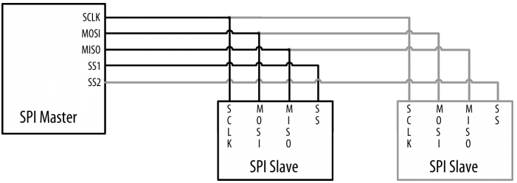
SPI
SPI has three lines connected to the respective lines
on one or more slaves:
  MOSI - separate input (pin 11 on Uno)
  MISO - separate output (pin 12 on Uno)
  SCLK - clock line (pin 13 on Uno)
Slaves identified by SS - Slave Select line (pin10)

Slide 29
SPI configuration
When a device's Slave Select pin is:
  LOW - it communicates with the master
  HIGH - it ignores the master
To communicate SPI device note a few things
  What is the maximum SPI speed your device can use?
  Is data shifted in Most Significant Bit (MSB) or Least Significant Bit (LSB) first?
  Is the data clock idle when high or low?
  Are samples on the rising or falling edge of clock pulses?

Slide 30
SPI configuration
Each device implements SPI a little differently
  Pay special attention to the device's datasheet
There are four modes of transmission
These modes and other configurations are controlled by three parameters in SPISettings
Mode | Clock Polarity (CPOL) | Clock Phase (CPHA) | Output Edge | Data Capture
SPI_MODE0 | 0 | 0 | Falling | Rising
SPI_MODE1 | 0 | 1 | Rising | Falling
SPI_MODE2 | 1 | 0 | Rising | Falling
SPI_MODE3 | 1 | 1 | Falling | Rising

Slide 31
SPISettings
The SPISettings object is used to configure the SPI port for your SPI device
SPISettings(spdMax, dataOrder, dataMode)
  spMax: maximum speed of communication
  dataOrder: MSBFIRST or LSBFIRST
  dataMode : SPI_MODE0, SPI_MODE1, SPI_MODE2, or SPI_MODE3
Example of usage:
SPI.beginTransaction(SPISettings(14000000, MSBFIRST, SPI_MODE0))

Slide 32
SPI library
SPI.begin() - Initializes the SPI bus
    setting SCK, MOSI, and SS to outputs, pulling SCK and MOSI low, and SS high
SPI.end() - Disables the SPI bus (leaving pin modes unchanged)
SPI.beginTransaction(mySettings) - Initializes the SPI bus using the defined SPISettings
SPI.endTransaction() - Stop using the SPI bus
SPI.transfer(val) - based on a simultaneous send and receive
    the received data is returned by the function
In case of buffer transfers like SPI.transfer(buffer, size)
  the received data is stored in the buffer in-place the old data is replaced with the data received

Slide 33
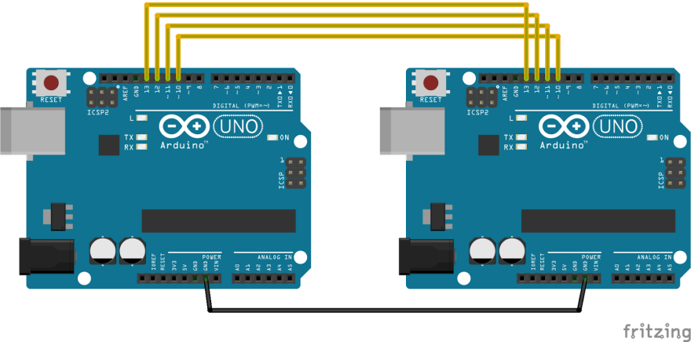
SPI communication
// SPI MASTER
#include <SPI.h>
void setup() {
SPI.begin();
Serial.begin(9600);
}
void loop() {
while(Serial.available() > 0){
char c = Serial.read();
//select the chip:
digitalWrite(SS, LOW);
//send in the char:
SPI.transfer(c);
//de-select the chip:
digitalWrite(SS, HIGH);
delay(20); // wait for Slave
}
}
// SPI SLAVE
#include <SPI.h>
void SlaveInit(void) { // Initialize SPI pins.
pinMode(SCK, INPUT);
pinMode(MOSI, INPUT);
pinMode(MISO, OUTPUT);
pinMode(SS, INPUT);
SPCR = (1 << SPE); // Enable SPI as slave.
}
// Function for transfering data as a Slave
byte SPItransfer(byte value) {
SPDR = value;
while(!(SPSR & (1<<SPIF)));
delay(10);
return SPDR;
}
void setup() {
SPI.begin();
SlaveInit();
Serial.begin(9600);
}
void loop() {
if (digitalRead(SS) == LOW) {
char rx = SPItransfer(255);
Serial.print(rx);
}
}

