Slide 1

IMPLEMENTING IOE
Week 4
Assist. Prof. Rassim Suliyev - SDU 2017

Slide 2
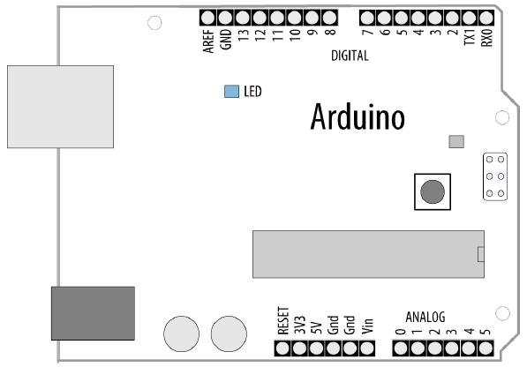
Simple Digital and Analog Inputs
The Arduino’s ability to sense digital and analog inputs allows it to respond to you and to the world around you
Digital input pins sense the presence and absence of voltage on a pin
Analog input pins measure a range of voltages on a pin

Slide 3
Simple Digital and Analog Inputs
digitalRead(pin) - tells your sketch if a voltage on a pin is HIGH (5 volts) or LOW (0 volts)
pinMode(pin, INPUT) – configure pin as an INPUT
14 digital pins (numbered 0 to 13)
Pins 0 and 1 (marked RX and TX) are used for the USB serial connection
Need more?
Analog pins 0 through 5 can be used as digital pins 14 through 19

Slide 4
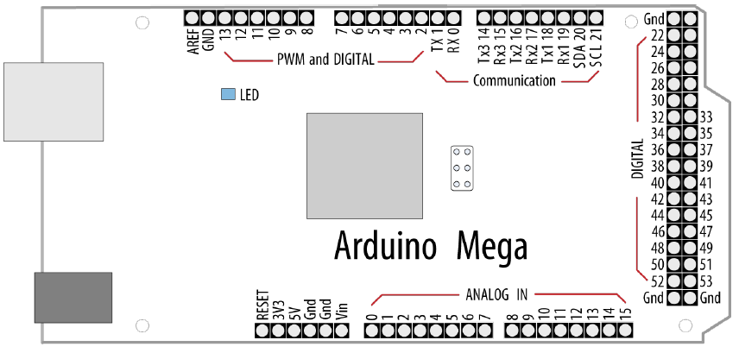
Simple Digital and Analog Inputs
Still need more?
Analog pins 0 through 15 are digital pin numbers 54 through 69

Slide 5
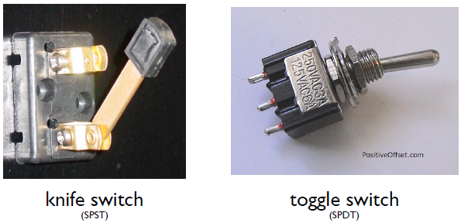
Sensors & Inputs
Many sensors are variations on switches
Switches make or break a connection
Single pole = only one circuit is being controlled
Double pole = two circuits are being controlled at once
Single throw = only one path for circuit
Double throw = two potential paths for circuit

Slide 6
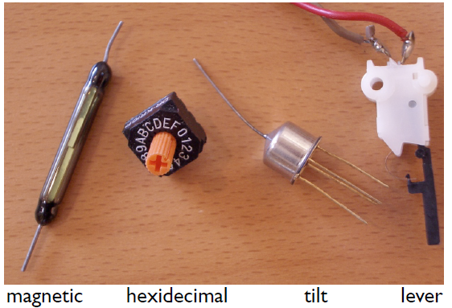
Many Kinds of Switches
Tilt sensor has a little ball inside
Magnetic switches are delicate
The hex switch is actually many switches in one, and outputs 4 signals

Slide 7

Digital Input
Switches make or break a connection
But Arduino wants to see a voltage
Specifically, a “HIGH” (5 volts) or a “LOW” (0 volts)
How do you go from make/break to HIGH/LOW?

Slide 8
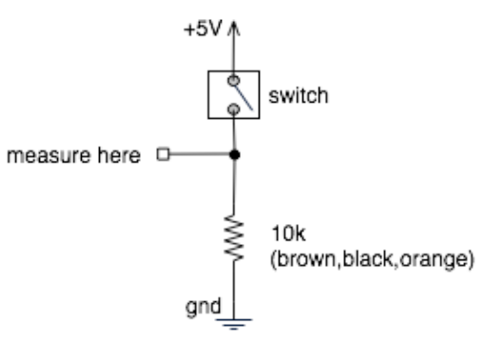
From Switch to HIGH / LOW
With no connection, digital inputs “float” between 0 & 5 volts (LOW & HIGH)
Resistor “pulls” input to ground (0 volts)
Pressing switch “pushes” input to 5 volts
Press is HIGH
Not pressed is LOW
Pull-down resistor

Slide 9
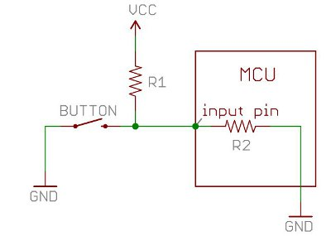
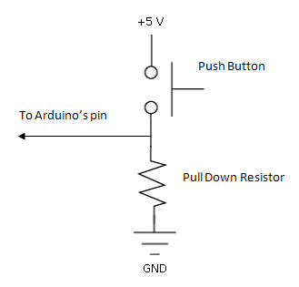
Pull-up and Pull-down
pull-up resistors – pull the voltage up to the 5V line that the resistor is connected to
pull-down resistors – pull the voltage down to 0 volts
Although 10K ohms is a commonly used value, anything between 4.7K and 20K or more will work

Slide 10
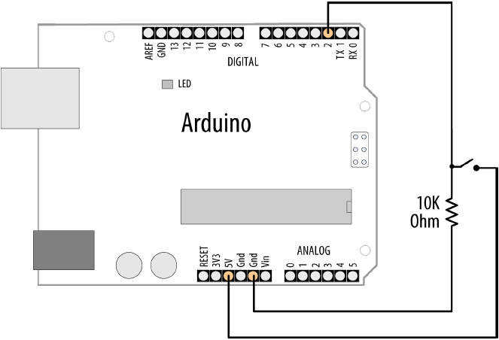
Control the Blinking
Connect a button to pin 2 with a pull-down resistor
Turn on LED if button pressed and OFF if released

Slide 11
Control the Blinking
// Pushbutton sketch a switch connected to pin 2 lights the LED on pin 13
const int ledPin = 13; // choose the pin for the LED
const int inputPin = 2; // choose the input pin (for a pushbutton)
void setup() {
pinMode(ledPin, OUTPUT); // declare LED as output
pinMode(inputPin, INPUT); // declare pushbutton as input
}
void loop(){
int val = digitalRead(inputPin); // read input value
If (val == HIGH) { // check if the input is HIGH
digitalWrite(ledPin, HIGH); // turn LED on if switch is pressed
} else {
digitalWrite(ledPin, LOW); // turn LED off
}
}

Slide 12
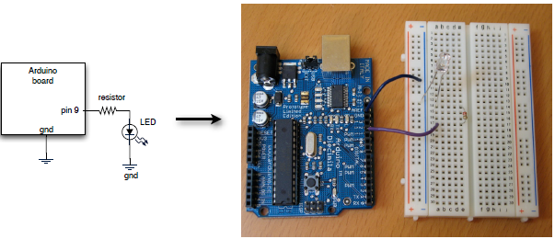
Let’s Wire It Up
Going from schematic to physical circuit.

Slide 13
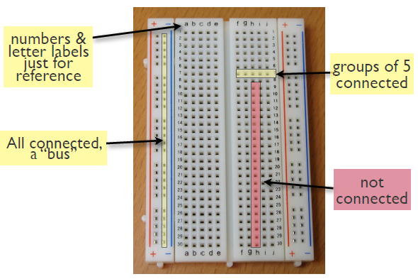
Solderless Breadboards

Slide 14
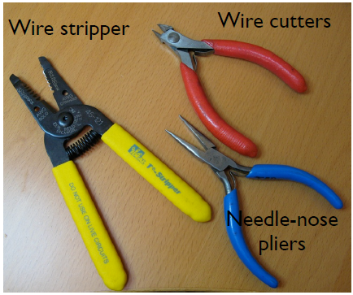
Useful Tools

Slide 15
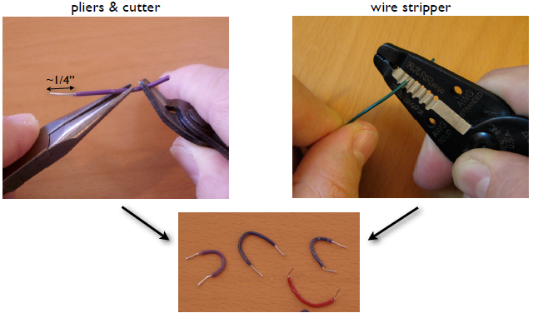
Making Jumper Wires

Slide 16
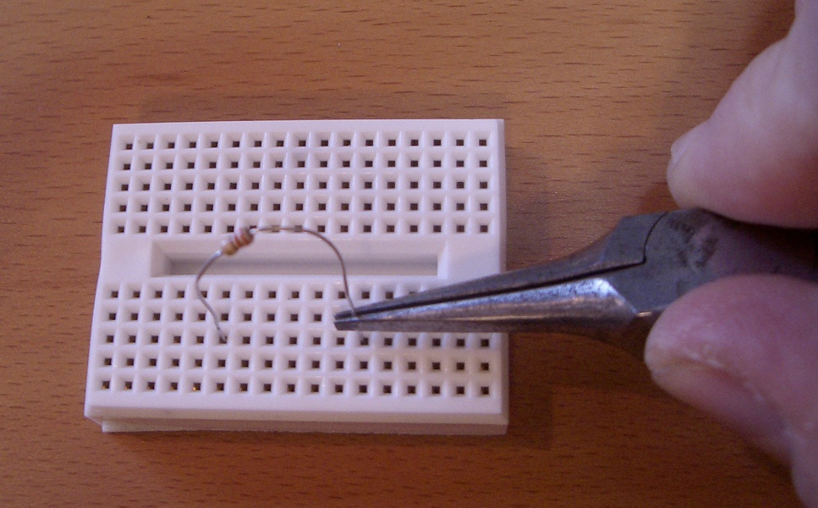
Using Solderless Breadboards
Using needle nose pliers can help push wires & components into holes

Slide 17
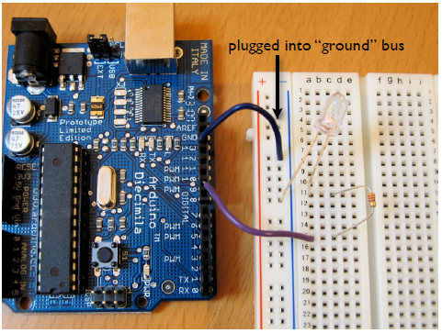
All Wired Up

Slide 18
Using Switches to Make Decisions
Often you’ll want to choose between actions, based on a data obtained from switch-like sensor
  E.g. “If motion is detected, turn on the lights”
  E.g. “If flower pot soil is dry, turn on sprinklers”
Define actions, choose them from sensor inputs
Let’s try that with the actions we currently know
  E.g.: If button is pressed send “Hello!” to serial port, and if released send “Goodbye!”

Slide 19
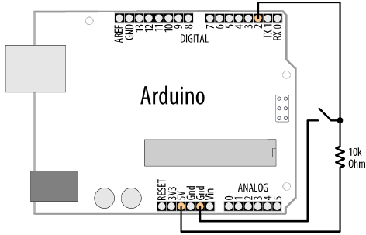
Control the Blinking (pull-up)

Slide 20
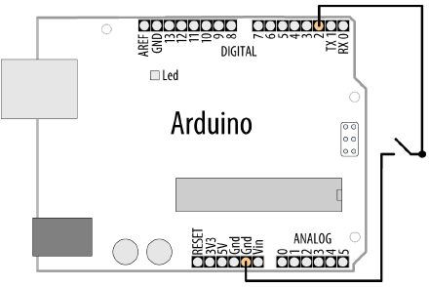
Switch Without External Resistors
Arduino has internal pull-up resistors that can be enabled by writing a HIGH value to a pin that is in INPUT mode
const int ledPin = 13;
const int inputPin = 2;
void setup() {
pinMode(ledPin, OUTPUT);
pinMode(inputPin, INPUT);
digitalWrite(inputPin,HIGH);
// turn on internal pull-up
}
void loop(){
int val = digitalRead(inputPin);
if (val == HIGH) {
digitalWrite(ledPin, HIGH);
} else {
digitalWrite(ledPin, LOW);
}
}

Slide 21
Reliably Detecting the Switch State
contact bounce produces spurious signals at the moment the switch contacts close or open
avoid false readings due to contact bounce - debouncing
boolean debounce(int pin) {
boolean state;
boolean previousState;
previousState = digitalRead(pin); // store switch state
for(int cnt=0; cnt < debounceDelay; cnt++) {
delay(1); // wait for 1 millisecond
state = digitalRead(pin); // read the pin
if( state != previousState) {
cnt = 0; // reset the counter if the state changes
previousState = state; // and save the current state
}
}
return state;
}

Slide 22
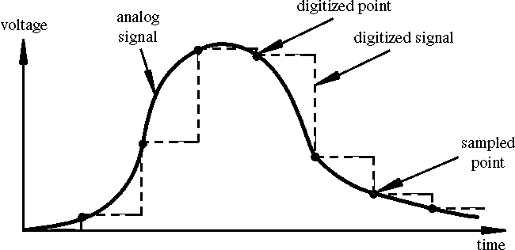
Analog Input
To computers, analog is chunky

Slide 23
Analog Input
Many states, not just two (HIGH/LOW)
Number of states (or values, or “bins”) is resolution
Common computer resolutions:
  8-bit = 256 values
  16-bit = 65,536 values
  32-bit = 4,294,967,296 values

Slide 24
Analog Input
Arduino (ATmega168) has six ADC inputs
(ADC = Analog to Digital Converter)
Reads voltage between 0 to 5 volts
Resolution is 10-bit (1024 values)
In other words, 5/1024 = 4.8 mV smallest voltage change you can measure

Slide 25
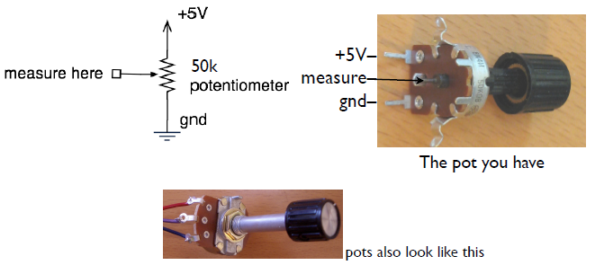
Analog Input
Sure sure, but how to make a varying voltage?
With a potentiometer. (pot)

Slide 26
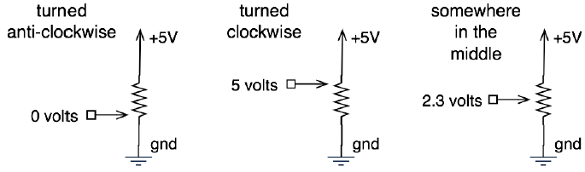
Potentiometers
Moving the knob is like moving where the arrow taps the voltage on the resistor
When a resistor goes across a voltage difference, like +5V to Gnd, the voltage measured at any point along a resistor’s length is proportional to the distance from one side.

Slide 27
What good are pots at?
Anytime you need a ranged input
Measure rotational position
steering wheel, robotic joint, etc.
But more importantly for us, potentiometers are a good example of a resistive sensor

Slide 28
Arduino Analog Input
Plug pot directly into breadboard
Two “legs” plug into +5V & Gnd (red + & blue -) buses
Middle “post” plugs into a row (row 7 here)
Run a wire from that row to Analog In 2

Slide 29
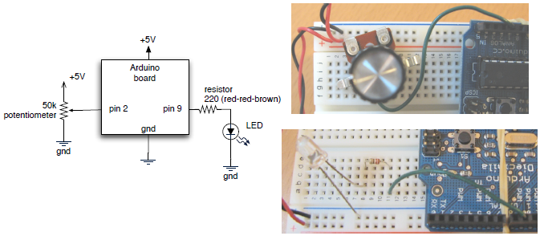
Pot & LED Circuit

Slide 30
Pot Blink Rate
/*
Pot sketch
blink an LED at a rate set by the position of a potentiometer
*/
const int potPin = 0; // select the input pin for the potentiometer
const int ledPin = 13; // select the pin for the LED
int val = 0; // variable to store the value coming from the sensor
void setup(){
pinMode(ledPin, OUTPUT); // declare the ledPin as an OUTPUT
}
void loop() {
val = analogRead(potPin); // read the voltage on the pot
digitalWrite(ledPin, HIGH); // turn the ledPin on
delay(val); // blink rate set by pot value (in milliseconds)
digitalWrite(ledPin, LOW); // turn the ledPin off
delay(val); // turn led off for same period as it was turned on
}

